Slide 1
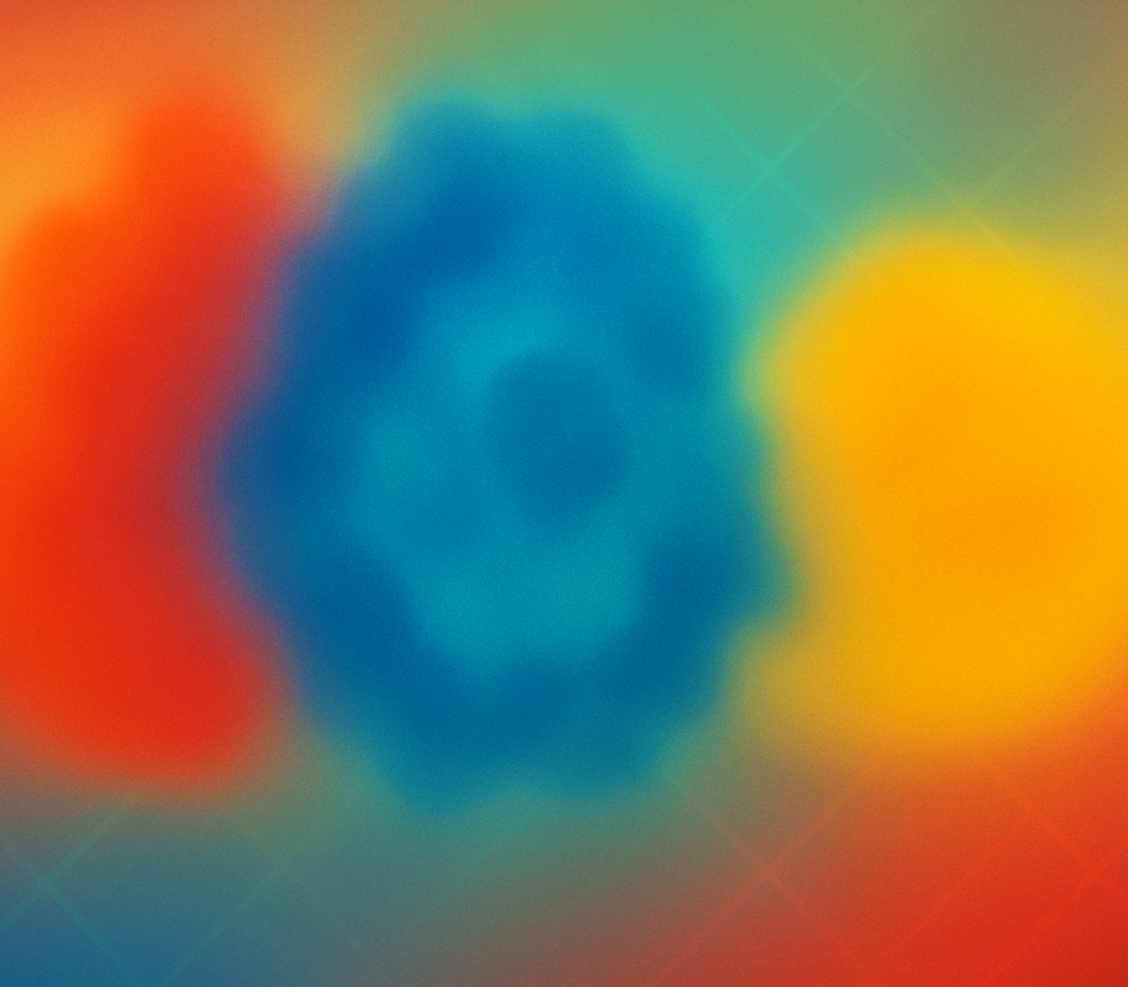
Threshold‑Based Tumor Segmentation Analysis of Threshold Percentage vs Dice Coefficient
August 20, 2025

Slide 2
Outline
Introduction to threshold segmentation
Methodology & synthetic data generation
Results: Dice vs threshold
ROI‑guided vs global threshold
Conclusions & reporting recommendations

Slide 3
Introduction
Threshold segmentation Positron Emission Tomography (PET) images quantify radiotracer uptake. A simple yet popular way to delineate tumors is to threshold voxels by a fraction of the maximum intensity. Let Imax denote the highest intensity within the image. A global threshold p ∈ [0,1] scales this value so that all voxels with I(x) ≥ p·Imax are considered tumour. The code defines Imax and computes a binary mask at p = 0.42 in the example scripts. Segmentation quality is commonly assessed by the Dice coefficient: 2|A ∩ B| / (|A|+|B|). A value of 1 indicates perfect overlap, and lower values indicate under‑ or over‑segmentation.
[1] [2]

Slide 4
Methodology
Synthetic data generation
A 100×100×100 volume with a spherical tumour (radius = 20 voxels).
Intensities follow a Gaussian decay from the tumour centre plus small noise.
Thresholds p ∈ {0.10, 0.15, …, 0.90} scale the global maximum intensity.
For each p, voxels with I ≥ p·Imax form a binary prediction. The largest connected component is optionally retained to suppress noise.
Dice coefficients are calculated between predictions and the ground truth sphere.
[3]

Slide 5
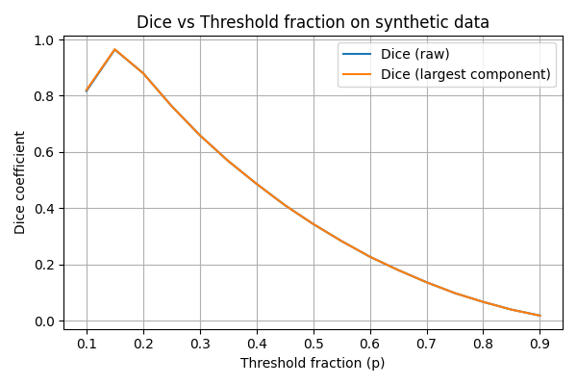
Results
p | Dice (raw) | Dice (largest)
0.10 | 0.82 | 0.82
0.15 | 0.96 | 0.96
0.20 | 0.88 | 0.88
0.25 | 0.77 | 0.77
0.30 | 0.66 | 0.66
Key observations
The Dice coefficient peaks around p = 0.15, indicating an optimal trade‑off.
Very low thresholds (p ≤ 0.1) over‑segment, whereas high thresholds under‑segment.
Retaining only the largest component has little effect because the synthetic data contains a single tumour.

Slide 6
ROI‑Guided vs Global
Global thresholding
Computes Imax over the entire image and applies a fixed fraction p.
ROI‑guided thresholding
Restricts analysis to a manually drawn region and computes Imax only inside this ROI.
Uses a separate parameter p_roi (0.30 in P20, 0.20 in P21) to scale the local maximum.
Keeps only the connected component containing the hottest voxel to avoid spurious clusters.
[4] [5]

Slide 7
Conclusions & Reporting
Key takeaways
The optimal threshold varies by dataset; exploring p across a range is essential.
Dice vs threshold curves reveal trade‑offs between sensitivity and specificity.
Largest‑component filtering mitigates noise; ROI‑guided thresholds further localise segmentation but require manual input.
Reporting recommendations
Describe acquisition parameters and pre‑processing (registration, resampling).
Specify the threshold formula (p·Imax), chosen p values, and any ROI definitions.
Report quantitative metrics: volumes, Dice scores, and segmentation examples.
Include Dice vs threshold plots to justify parameter selection.
[1] [2] [4]

