Slide 1
Knowledge of Image Processing and Computer Vision(OpenCV)

Slide 2
Changing To Grayscale Image
Before processing other image processing operations, we need to change other color spaces of images (such as BGR in OpenCV or RGB) to grayscale.
It is because image processing algorithms better handle grayscale image than BGR or RGB images.
In OpenCV, changing to grayscale image can be achived by the method:
cvtColor(src, bwsrc, CV_RGB2GRAY);

Slide 3
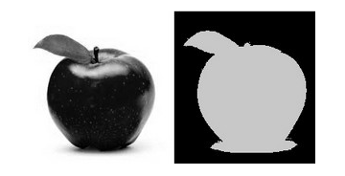

What is Thresholding?
The simplest segmentation method
Application example: Separate out regions of an image corresponding to objects which we want to analyze. This separation is based on the variation of intensity between the object pixels and the background pixels.
The binary thresholding operation can be expressed as:
Thresholding plays a key and fundamental role in image processing and it is required for other advanced processing such as edge detection and blob detection.

Slide 4

Smoothing Images
Smoothing, also called blurring, is a simple and frequently used image processing operation.
The most common type of filters are linear, in which an output pixel’s value (i.e. ) is determined as a weighted sum of input pixel values (i.e.
) :
is called the kernel.
There are other filtering methods such as Guassian Filter and Median Filter
Smoothing images is also used for reducing noise.

Slide 5


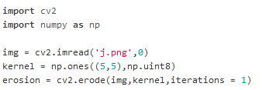
Erosion
Erosion: The kernel (a small window) slides through the image (as in 2D convolution). A pixel in the original image (either 1 or 0) will be considered 1 only if all the pixels under the kernel is 1, otherwise it is eroded (made to zero).
So the thickness or size of the foreground object decreases or simply white region decreases in the image.
It is useful for removing small white noises. Example python code is given:

Slide 6


Dilation
It is just opposite of erosion.
Normally, in cases like noise removal, erosion is followed by dilation. Because, erosion removes white noises, but it also shrinks our object. So we dilate it.
Example python code is given as follows:

Slide 7
Canny Edge Detector
Steps for Canny Edge Detector are:
1. Filter out any noise. The Gaussian filter is used for this purpose.
2. Find the intensity gradient of the image.
3. Non-maximum suppression is applied. This removes pixels that are not considered to be part of an edge. Hence, only thin lines (candidate edges) will remain.
4. Hysteresis: The final step. Canny does use two thresholds (upper and lower):
a. If a pixel gradient is higher than the upper threshold, the pixel is accepted as an edge
b. If a pixel gradient value is below the lower threshold, then it is rejected.
c. If the pixel gradient is between the two thresholds, then it will be accepted only if it is connected to a pixel that is above the upper threshold.

Slide 8
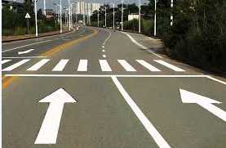
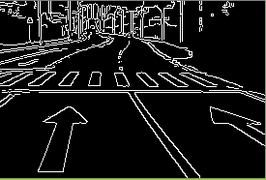
Canny Edge Detector
Example OpenCV code in C++ API for Canny Edge Detector:
// Reduce noise with a kernel 3x3
blur( src_gray, detected_edges, Size(3,3) );
// Canny detector
Canny( detected_edges, detected_edges, lowThreshold, lowThreshold*ratio, kernel_size );

Slide 9
Hough Line Transform
The Hough Line Transform is a transform used to detect straight lines.
To apply the Transform, first an edge detection (such as canny edge detection) pre-processing is desirable.
Note: Theory of Hough Line Transform is too long to be explained in this brief presentation. So, it is omitted.
OpenCV implements two kind of Hough Line Transforms:
a. The Standard Hough Transform
C++: void HoughLinesP(InputArray image, OutputArray lines, double rho, double theta, int threshold, double minLineLength, double maxLineGap)
b. The Probabilistic Hough Line Transform
C++: void HoughLinesP(InputArray image, OutputArray lines, double rho, double theta, int threshold, double minLineLength, double maxLineGap)

Slide 10
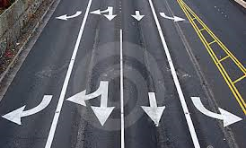
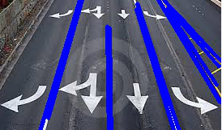
Can Detect Traffic Line by Hough Line Transform
By giving suitable parameters to HougLinesP method, traffic lines can be detected.

Slide 11
Object Detection with OpenCV
Object detection usually consists of two steps: feature detection and classification.
In the feature detection step, the relevant features of the object to be detected are gathered.
These features are input to the second step, classification.
First, a classifier (namely a cascade of boosted classifiers working with haar-like features) is trained with a few hundred sample views of a particular object (i.e., a face or a car), called positive examples, that are scaled to the same size (say, 20x20), and negative examples - arbitrary images of the same size.

Slide 12
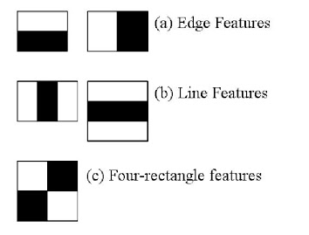
Cascade Classifier
Initially, the algorithm needs a lot of positive images (images of faces) and negative images (images without faces) to train the classifier.
Each feature is a single value obtained by subtracting sum of pixels under white rectangle from sum of pixels under black rectangle.

Slide 13
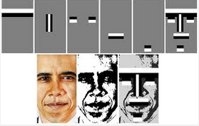
Cascade Classifier
If we want to train our own classifier for any object like car, planes etc. we can use OpenCV to create one.
There are utility applications for training OpenCV:
opencv_traincascade and opencv_createsamples

Slide 14
Detection of Any Kinds of Objects by OpenCV
We can detect any kinds of objects by using OpenCV by training cascade classifiers for the types of objects we want to detect.
Note: Training cascade classifiers need a large numbers of positive images and negative images (a few hundreds of images or thousands of images).
The more exact results we want, the more images we need to train cascade.
Loads a classifier from a file.
C++: bool CascadeClassifier::load(const string& filename)
Detects objects of different sizes in the input image. The detected objects are returned as a list of rectangles.
C++: void CascadeClassifier::detectMultiScale(const Mat& image, vector<Rect>& objects, double scaleFactor=1.1, int minNeighbors=3, int flags=0, Size minSize=Size(), Size maxSize=Size())

Slide 15
Other Ways of Detection
With the findContours function, we can find all closed contours in the binary, including the ones formed by holes in the components.
C++: cv::findContours(image, contours, // a vector of contours CV_RETR_LIST, // retrieve all contours CV_CHAIN_APPROX_NONE); // all pixels of each contours

Slide 16
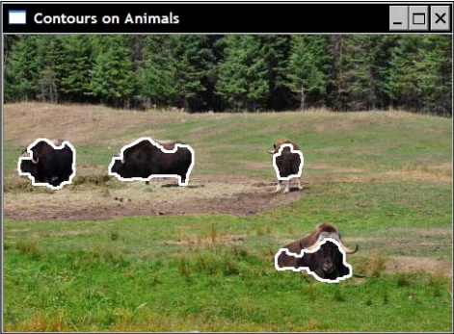
Other Ways of Detection
By finding contours, we can find certain kinds of objects in an image region.

Slide 17
What Do We Need? (Conclusion)
For most general problems and applications, OpenCV includes enough implemented algorithms (and API) for image processing and computer vision.
We only need to be able to use those OpenCV API.
If we are going to more advanced computer vision and machine learning operations, we need a lot of knowledge of theories on AI, computer vision and certain mathematical knowledge (such as Linear Algebra and Analytics Geometry) as well as C++ language competence and OpenCV Data Structures.
In conclusion, by having the above knowledge, we can build certain kinds of computer vision software.

Slide 18
References and Sources
http://docs.opencv.org
http://opencv-python-tutroals.readthedocs.io
http://opencv-java-tutorials.readthedocs.io/
Learning OpenCV by Adrian Kaehler and Gary Rost Bradski
Computer Vision: Algorithms and Applications by Richard Szeliski

