Slide 1

Red Hat Enterprise Linux System Administration
Notes:
Note from Chuck. If you are using these materials, you can remove the UM logo and replace it with your own, but please retain the CC-BY logo on the first page as well as the acknowledgement page(s) at the end.

Slide 2
Why do we need Red Hat Linux
Red Hat Enterprise Linux gives you the stability and consistency that you need for development, and can run on any infrastructure and any cloud securely.
Notes:
Note from Chuck. If you are using these materials, you can remove the UM logo and replace it with your own, but please retain the CC-BY logo on the first page as well as the acknowledgement page(s) at the end.

Slide 3
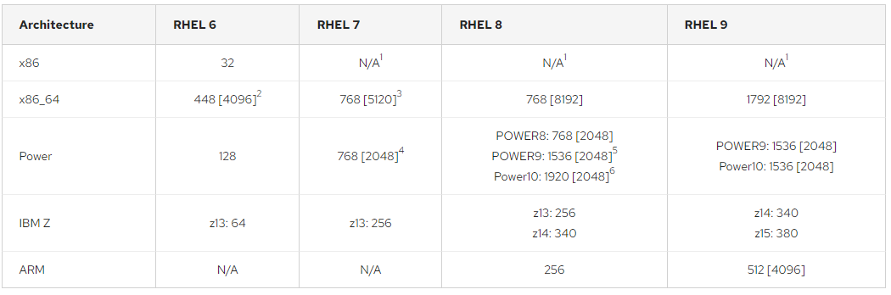
System Requirement
CPU

Slide 4
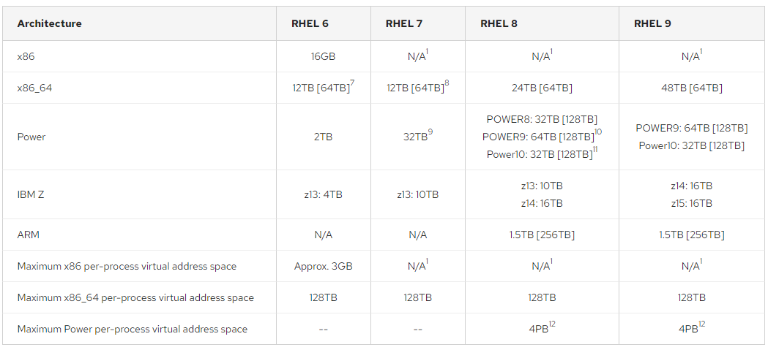
System Requirement
Maximum Requirement of Memory

Slide 5
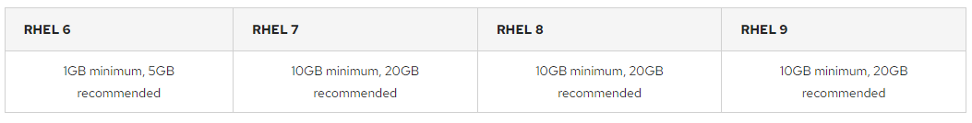
System Requirement
Disk

Slide 6
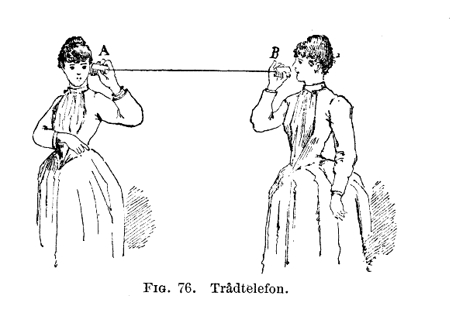
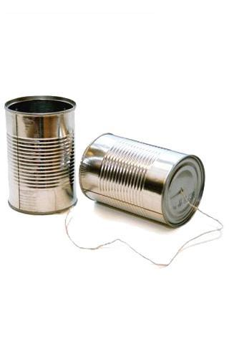
http://en.wikipedia.org/wiki/Tin_can_telephone
http://www.flickr.com/photos/kitcowan/2103850699/

Slide 7

TCP Connections / Sockets
“In computer networking, an Internet socket or network socket is an endpoint of a bidirectional inter-process communication flow across an Internet Protocol-based computer network, such as the Internet.”
Process
Process
Internet
http://en.wikipedia.org/wiki/Internet_socket

Slide 8
TCP Port Numbers
A port is an application-specific or process-specific software communications endpoint
It allows multiple networked applications to coexist on the same server
There is a list of well-known TCP port numbers
http://en.wikipedia.org/wiki/TCP_and_UDP_port

Slide 9


www.umich.edu
Incoming
E-Mail
25
blah blah blah blah
Login
23
74.208.28.177
80
Web Server
443
Personal
Mail Box
109
110
Clipart: http://www.clker.com/search/networksym/1

Slide 10
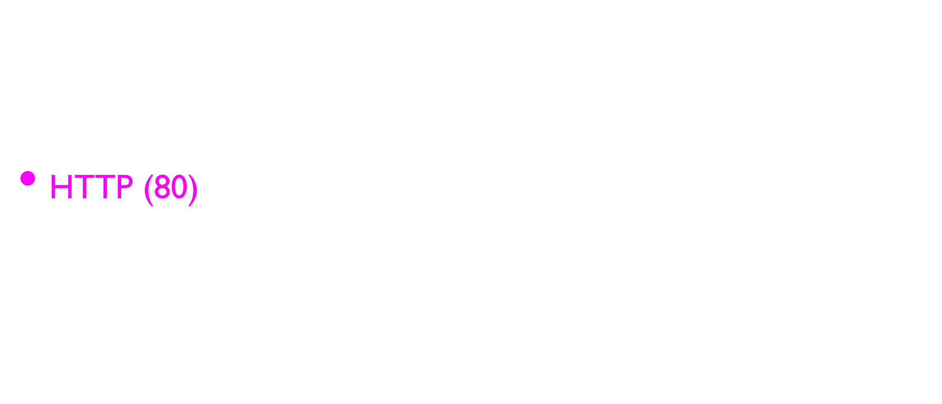
Common TCP Ports
http://en.wikipedia.org/wiki/List_of_TCP_and_UDP_port_numbers

Slide 11
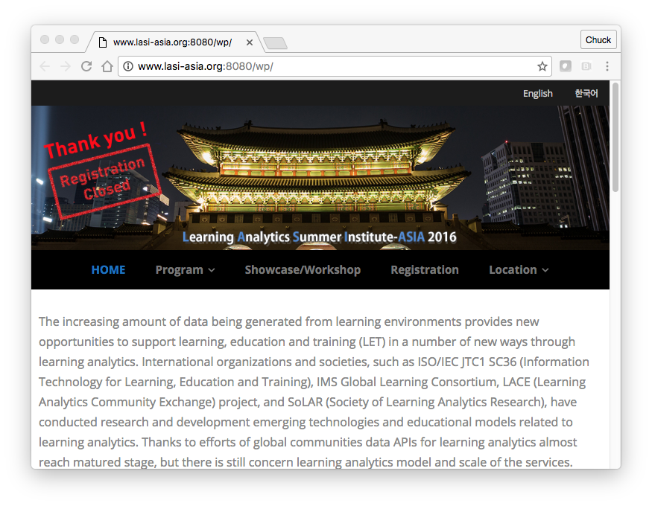
Sometimes we see the port number in the URL if the web server is running on a “non-standard” port.

Slide 12
Sockets in Python
Python has built-in support for TCP Sockets
import socket
mysock = socket.socket(socket.AF_INET, socket.SOCK_STREAM)
mysock.connect( ('data.pr4e.org', 80) )
Host
Port
http://docs.python.org/library/socket.html

Slide 13
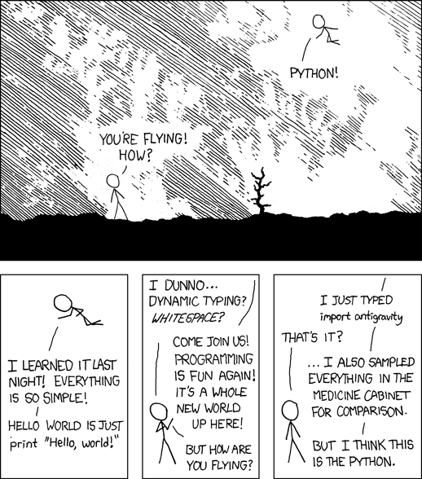
http://xkcd.com/353/

Slide 14
Application Protocols

Slide 15
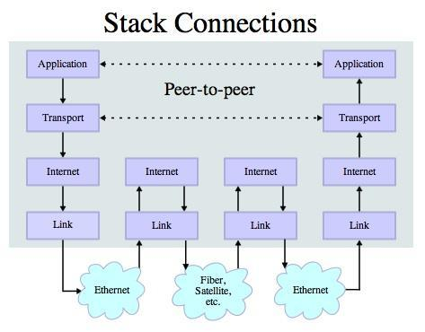
Application Protocol
Since TCP (and Python) gives us a reliable socket, what do we want to do with the socket? What problem do we want to solve?
Application Protocols
- Mail
- World Wide Web
Source: http://en.wikipedia.org/wiki/Internet_Protocol_Suite

Slide 16
HTTP - Hypertext Transfer Protocol
The dominant Application Layer Protocol on the Internet
Invented for the Web - to Retrieve HTML, Images, Documents, etc.
Extended to be data in addition to documents - RSS, Web Services, etc. Basic Concept - Make a Connection - Request a document - Retrieve the Document - Close the Connection
http://en.wikipedia.org/wiki/Http

Slide 17
HTTP
The HyperText Transfer Protocol is the set of rules to allow browsers to retrieve web documents from servers over the Internet

Slide 18
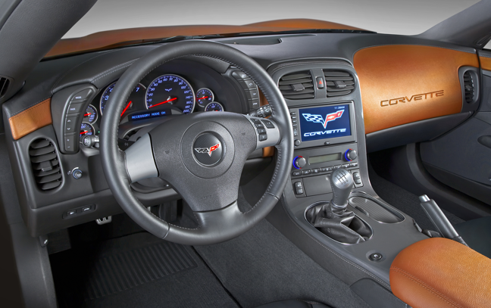
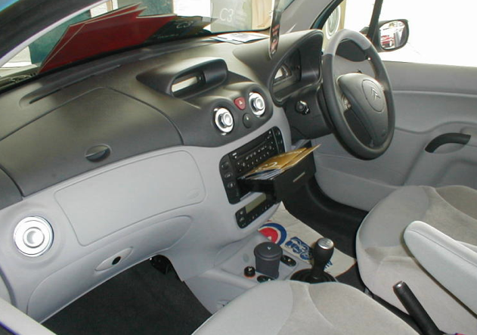
What is a Protocol?
A set of rules that all parties follow so we can predict each other’s behavior
And not bump into each other
On two-way roads in USA, drive on the right-hand side of the road
On two-way roads in the UK, drive on the left-hand side of the road

Slide 19
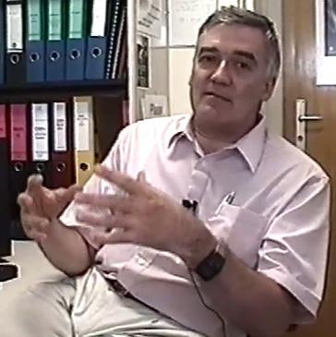
http://www.dr-chuck.com/page1.htm
protocol
host
document
http://www.youtube.com/watch?v=x2GylLq59rI
Robert Cailliau
CERN
1:17 - 2:19

Slide 20
Getting Data From The Server
Each time the user clicks on an anchor tag with an href= value to switch to a new page, the browser makes a connection to the web server and issues a “GET” request - to GET the content of the page at the specified URL
The server returns the HTML document to the browser, which formats and displays the document to the user

Slide 21

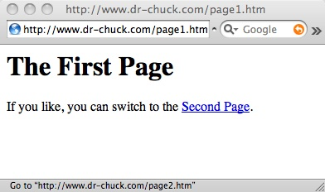
Web Server
80
Browser

Slide 22
Web Server
80
Browser
Click

Slide 23
Request
Web Server
80
GET http://www.dr-chuck.com/page2.htm
Browser
Click

Slide 24
Request
Web Server
80
GET http://www.dr-chuck.com/page2.htm
Browser
Click

Slide 25
Request
Web Server
Response
80
<h1>The Second Page</h1><p>If you like, you can switch back to the <a href="page1.htm">First Page</a>.</p>
GET http://www.dr-chuck.com/page2.htm
Browser
Click

Slide 26
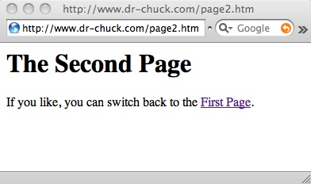
Request
Web Server
Response
80
<h1>The Second Page</h1><p>If you like, you can switch back to the <a href="page1.htm">First Page</a>.</p>
GET http://www.dr-chuck.com/page2.htm
Browser
Click
Parse/
Render

Slide 27
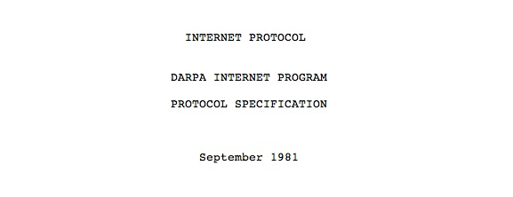
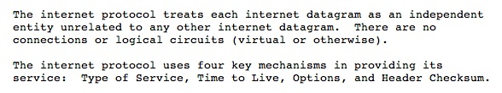
Internet Standards
The standards for all of the Internet protocols (inner workings) are developed by an organization
Internet Engineering Task Force (IETF)
www.ietf.org
Standards are called “RFCs” - “Request for Comments”
Source: http://tools.ietf.org/html/rfc791

Slide 28
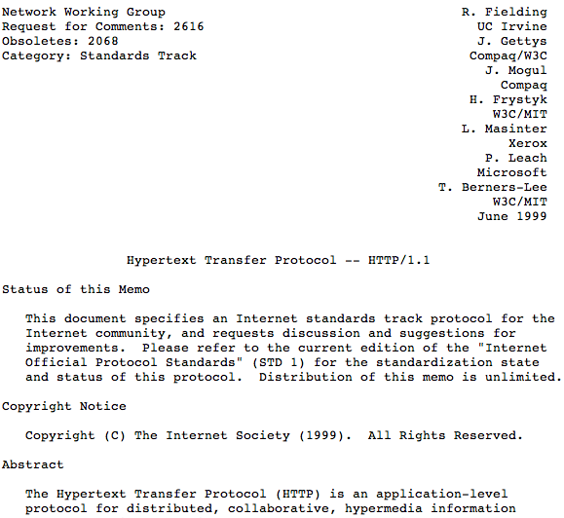
http://www.w3.org/Protocols/rfc2616/rfc2616.txt

Slide 29
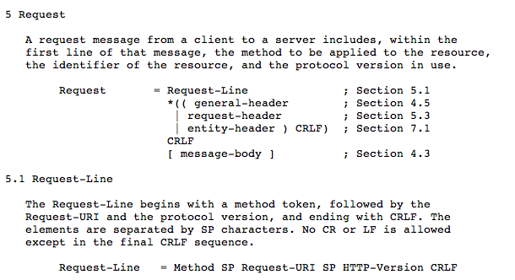

Slide 30
Making an HTTP request
Connect to the server like www.dr-chuck.com"
Request a document (or the default document)
GET http://www.dr-chuck.com/page1.htm HTTP/1.0
GET http://www.mlive.com/ann-arbor/ HTTP/1.0
GET http://www.facebook.com HTTP/1.0

Slide 31
$ telnet www.dr-chuck.com 80
Trying 74.208.28.177...
Connected to www.dr-chuck.com.Escape character is '^]'.
GET http://www.dr-chuck.com/page1.htm HTTP/1.0
HTTP/1.1 200 OK
Date: Thu, 08 Jan 2015 01:57:52 GMT
Last-Modified: Sun, 19 Jan 2014 14:25:43 GMT
Connection: close
Content-Type: text/html
<h1>The First Page</h1>
<p>If you like, you can switch to
the <a href="http://www.dr-chuck.com/page2.htm">Second Page</a>.</p>
Connection closed by foreign host.
Web Server
Browser

Slide 32

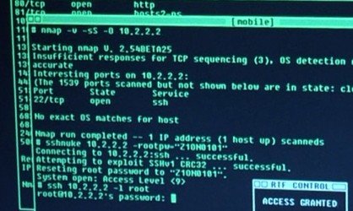
Accurate Hacking in the Movies
Matrix Reloaded
Bourne Ultimatum
Die Hard 4
...
http://nmap.org/movies.html

Slide 33
Let’s Write a Web Browser!

Slide 34
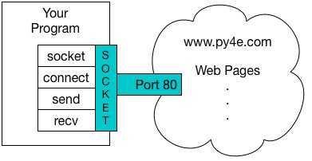
An HTTP Request in Python
import socket
mysock = socket.socket(socket.AF_INET, socket.SOCK_STREAM)
mysock.connect(('data.pr4e.org', 80))
cmd = 'GET http://data.pr4e.org/romeo.txt HTTP/1.0\r\n\r\n'.encode()
mysock.send(cmd)
while True:
data = mysock.recv(512)
if (len(data) < 1):
break
print(data.decode(),end='')
mysock.close()

Slide 35
HTTP/1.1 200 OK
Date: Sun, 14 Mar 2010 23:52:41 GMT
Server: Apache
Last-Modified: Tue, 29 Dec 2009 01:31:22 GMT
ETag: "143c1b33-a7-4b395bea"
Accept-Ranges: bytes
Content-Length: 167
Connection: close
Content-Type: text/plain
But soft what light through yonder window breaks
It is the east and Juliet is the sun
Arise fair sun and kill the envious moon
Who is already sick and pale with grief
HTTP Header
while True:
data = mysock.recv(512)
if ( len(data) < 1 ) :
break
print(data.decode())
HTTP Body

Slide 36
About Characters and Strings…

Slide 37
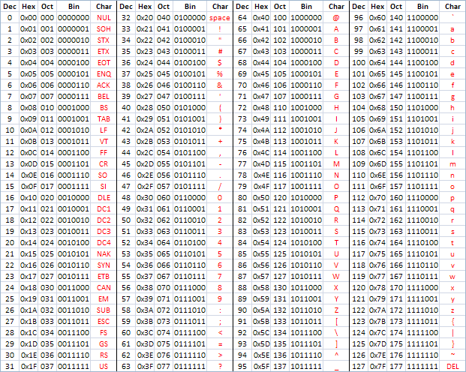
ASCII
American Standard Code for Information Interchange
https://en.wikipedia.org/wiki/ASCII
http://www.catonmat.net/download/ascii-cheat-sheet.png

Slide 38
Representing Simple Strings
Each character is represented by a number between 0 and 256 stored in 8 bits of memory
We refer to "8 bits of memory as a "byte" of memory – (i.e. my disk drive contains 3 Terabytes of memory)
The ord() function tells us the numeric value of a simple ASCII character
>>> print(ord('H'))
72
>>> print(ord('e'))
101
>>> print(ord('\n'))
10
>>>

Slide 39
ASCII
>>> print(ord('H'))
72
>>> print(ord('e'))
101
>>> print(ord('\n'))
10
>>>
In the 1960s and 1970s, we just assumed that one byte was one character

Slide 40
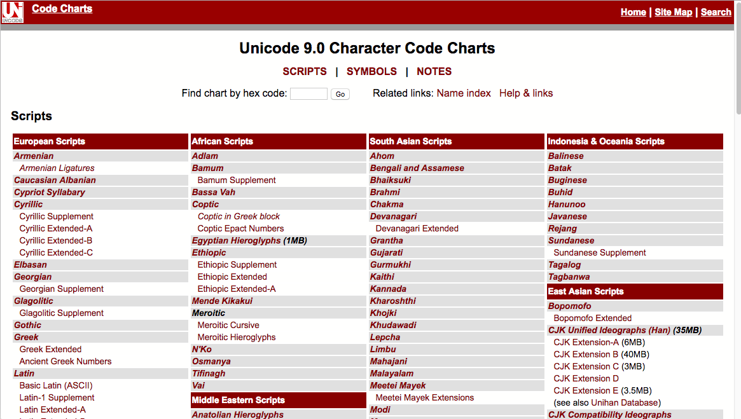
http://unicode.org/charts/

Slide 41
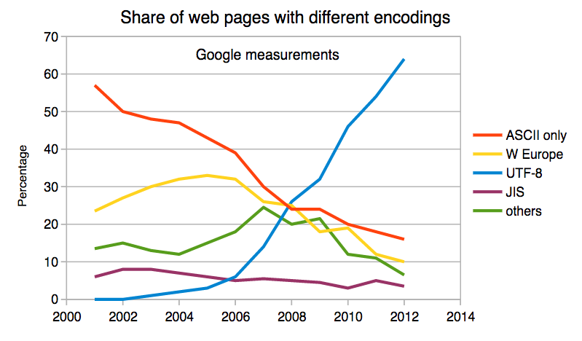
Multi-Byte Characters
To represent the wide range of characters computers must handle we represent characters with more than one byte
UTF-16 – Fixed length - Two bytes
UTF-32 – Fixed Length - Four Bytes
UTF-8 – 1-4 bytes
- Upwards compatible with ASCII
- Automatic detection between ASCII and UTF-8
- UTF-8 is recommended practice for encoding data to be exchanged between systems
https://en.wikipedia.org/wiki/UTF-8

Slide 42
Two Kinds of Strings in Python
Python 2.7.10
>>> x = '이광춘'
>>> type(x)
<type 'str'>
>>> x = u'이광춘'
>>> type(x)
<type 'unicode'>
>>>
Python 3.5.1
>>> x = '이광춘'
>>> type(x)
<class 'str'>
>>> x = u'이광춘'
>>> type(x)
<class 'str'>
>>>
In Python 3, all strings are Unicode

Slide 43
Python 2 versus Python 3
Python 2.7.10
>>> x = b'abc'
>>> type(x)
<type 'str'>
>>> x = '이광춘'
>>> type(x)
<type 'str'>
>>> x = u'이광춘'
>>> type(x)
<type 'unicode'>
Python 3.5.1
>>> x = b'abc'
>>> type(x)
<class 'bytes'>
>>> x = '이광춘'
>>> type(x)
<class 'str'>
>>> x = u'이광춘'
>>> type(x)
<class 'str'>

Slide 44
Python 3 and Unicode
In Python 3, all strings internally are UNICODE
Working with string variables in Python programs and reading data from files usually "just works"
When we talk to a network resource using sockets or talk to a database we have to encode and decode data (usually to UTF-8)
Python 3.5.1
>>> x = b'abc'
>>> type(x)
<class 'bytes'>
>>> x = '이광춘'
>>> type(x)
<class 'str'>
>>> x = u'이광춘'
>>> type(x)
<class 'str'>

Slide 45
Python Strings to Bytes
When we talk to an external resource like a network socket we send bytes, so we need to encode Python 3 strings into a given character encoding
When we read data from an external resource, we must decode it based on the character set so it is properly represented in Python 3 as a string
while True:
data = mysock.recv(512)
if ( len(data) < 1 ) :
break
mystring = data.decode()
print(mystring)

Slide 46
An HTTP Request in Python
import socket
mysock = socket.socket(socket.AF_INET, socket.SOCK_STREAM)
mysock.connect(('data.pr4e.org', 80))
cmd = 'GET http://data.pr4e.org/romeo.txt HTTP/1.0\n\n'.encode()
mysock.send(cmd)
while True:
data = mysock.recv(512)
if (len(data) < 1):
break
print(data.decode())
mysock.close()

Slide 47
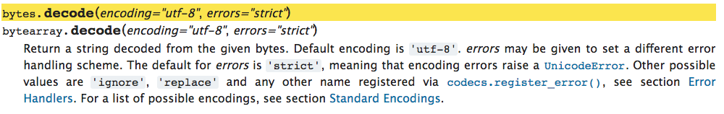
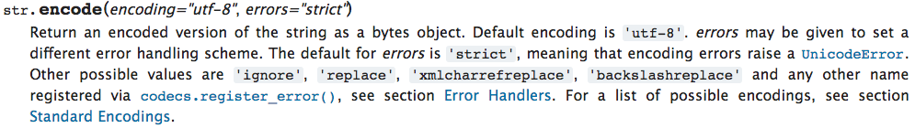
https://docs.python.org/3/library/stdtypes.html#bytes.decode
https://docs.python.org/3/library/stdtypes.html#str.encode

Slide 48
Network
decode()
Bytes
UTF-8
recv()
Socket
String
Unicode
Bytes
UTF-8
encode()
send()
import socket
mysock = socket.socket(socket.AF_INET, socket.SOCK_STREAM)
mysock.connect(('data.pr4e.org', 80))
cmd = 'GET http://data.pr4e.org/romeo.txt HTTP/1.0\n\n'.encode()
mysock.send(cmd)
while True:
data = mysock.recv(512)
if (len(data) < 1):
break
print(data.decode())
mysock.close()

Slide 49
Making HTTP Easier With urllib

Slide 50
Using urllib in Python
Since HTTP is so common, we have a library that does all the socket work for us and makes web pages look like a file
import urllib.request, urllib.parse, urllib.error
fhand = urllib.request.urlopen('http://data.pr4e.org/romeo.txt')
for line in fhand:
print(line.decode().strip())
urllib1.py

Slide 51
import urllib.request, urllib.parse, urllib.error
fhand = urllib.request.urlopen('http://data.pr4e.org/romeo.txt')
for line in fhand:
print(line.decode().strip())
But soft what light through yonder window breaks
It is the east and Juliet is the sun
Arise fair sun and kill the envious moon
Who is already sick and pale with grief
urllib1.py

Slide 52
Like a File...
import urllib.request, urllib.parse, urllib.error
fhand = urllib.request.urlopen('http://data.pr4e.org/romeo.txt')
counts = dict()
for line in fhand:
words = line.decode().split()
for word in words:
counts[word] = counts.get(word, 0) + 1
print(counts)
urlwords.py

Slide 53
Reading Web Pages
import urllib.request, urllib.parse, urllib.error
fhand = urllib.request.urlopen('http://www.dr-chuck.com/page1.htm')
for line in fhand:
print(line.decode().strip())
<h1>The First Page</h1>
<p>If you like, you can switch to the <a href="http://www.dr-chuck.com/page2.htm">Second Page</a>.
</p>
urllib2.py

Slide 54
Following Links
import urllib.request, urllib.parse, urllib.error
fhand = urllib.request.urlopen('http://www.dr-chuck.com/page1.htm')
for line in fhand:
print(line.decode().strip())
<h1>The First Page</h1>
<p>If you like, you can switch to the <a href="http://www.dr-chuck.com/page2.htm">Second Page</a>.
</p>
urllib2.py

Slide 55
The First Lines of Code @ Google?
import urllib.request, urllib.parse, urllib.error
fhand = urllib.request.urlopen('http://www.dr-chuck.com/page1.htm')
for line in fhand:
print(line.decode().strip())

Slide 56
Parsing HTML (a.k.a. Web Scraping)

Slide 57
What is Web Scraping?
When a program or script pretends to be a browser and retrieves web pages, looks at those web pages, extracts information, and then looks at more web pages
Search engines scrape web pages - we call this “spidering the web” or “web crawling”
http://en.wikipedia.org/wiki/Web_scraping
http://en.wikipedia.org/wiki/Web_crawler

Slide 58
Why Scrape?
Pull data - particularly social data - who links to who?
Get your own data back out of some system that has no “export capability”
Monitor a site for new information
Spider the web to make a database for a search engine

Slide 59
Scraping Web Pages
There is some controversy about web page scraping and some sites are a bit snippy about it.
Republishing copyrighted information is not allowed
Violating terms of service is not allowed

Slide 60
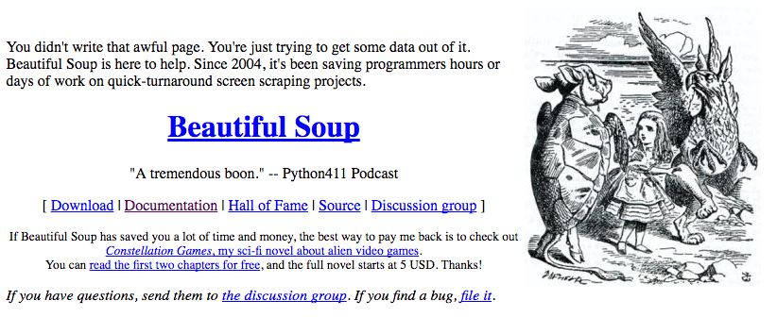
The Easy Way - Beautiful Soup
You could do string searches the hard way
Or use the free software library called BeautifulSoup from www.crummy.com
https://www.crummy.com/software/BeautifulSoup/

Slide 61
BeautifulSoup Installation
# To run this, you can install BeautifulSoup
# https://pypi.python.org/pypi/beautifulsoup4
# Or download the file
# http://www.py4e.com/code3/bs4.zip
# and unzip it in the same directory as this file
import urllib.request, urllib.parse, urllib.error
from bs4 import BeautifulSoup
...
urllinks.py

Slide 62
import urllib.request, urllib.parse, urllib.error
from bs4 import BeautifulSoup
url = input('Enter - ')
html = urllib.request.urlopen(url).read()
soup = BeautifulSoup(html, 'html.parser')
# Retrieve all of the anchor tags
tags = soup('a')
for tag in tags:
print(tag.get('href', None))
python urllinks.py
Enter - http://www.dr-chuck.com/page1.htm
http://www.dr-chuck.com/page2.htm

Slide 63
Summary
The TCP/IP gives us pipes / sockets between applications
We designed application protocols to make use of these pipes
HyperText Transfer Protocol (HTTP) is a simple yet powerful protocol
Python has good support for sockets, HTTP, and HTML parsing

Slide 64


Acknowledgements / Contributions
Thes slide are Copyright 2010- Charles R. Severance (www.dr-chuck.com) of the University of Michigan School of Information and open.umich.edu and made available under a Creative Commons Attribution 4.0 License. Please maintain this last slide in all copies of the document to comply with the attribution requirements of the license. If you make a change, feel free to add your name and organization to the list of contributors on this page as you republish the materials.
Initial Development: Charles Severance, University of Michigan School of Information
… Insert new Contributors here
...

