Slide 1
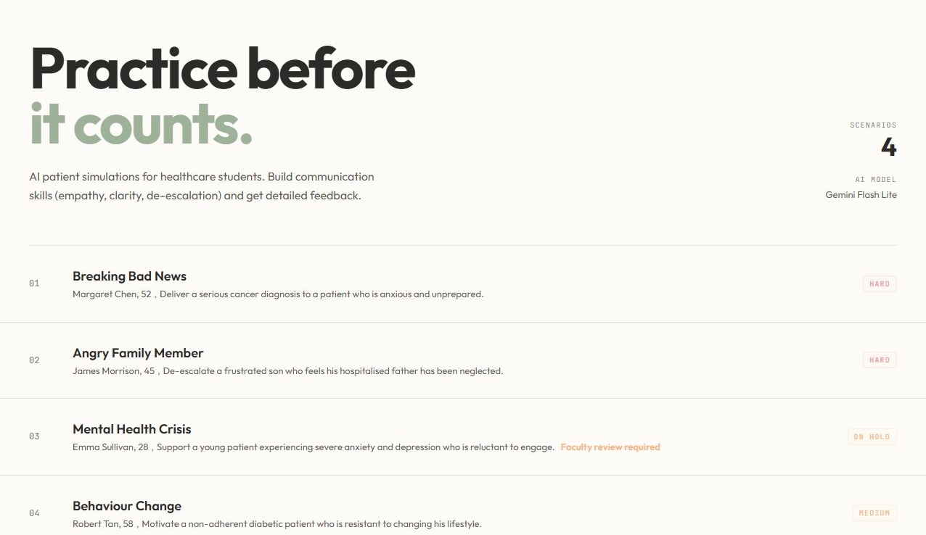
CLINICALMIRROR
01 / 02
Practice difficult conversations before they count
A scalable rehearsal layer for healthcare communication training
THE GAP
Students need repeated practice with emotionally difficult conversations, but realistic actor sessions are costly, planning-heavy and capacity-limited.
THE PROPOSAL
ClinicalMirror provides fictional AI patient role-play followed by immediate, evidence-linked formative feedback and a clear retry plan.
COMPLEMENTS—NOT REPLACES—FACULTY SIMULATION
REPEATABLE
RESPONSIVE
ACTIONABLE
Practise again without booking another session.
Patient replies adapt to learner wording.
Feedback cites exact turns and next moves.
Notes:
Start with the capacity problem. Difficult conversations—breaking bad news, distress, angry family members and behaviour change—require both compassion and clarity, yet students may get too few chances to rehearse them. Actor-based simulation remains valuable but is expensive and difficult to make continuously available. ClinicalMirror adds a browser-based rehearsal layer: a fictional AI patient reacts to what the learner says, and the review links feedback to exact learner turns. The aim is more repetition between high-fidelity sessions, not replacement of educators or simulated patients.
[Sources]
- AI Challenge 2026_Simplified Problem Description.pdf
- hackaton 1.pdf
- Current ClinicalMirror repository and live homepage screenshot, reviewed 6 Aug 2026

Slide 2
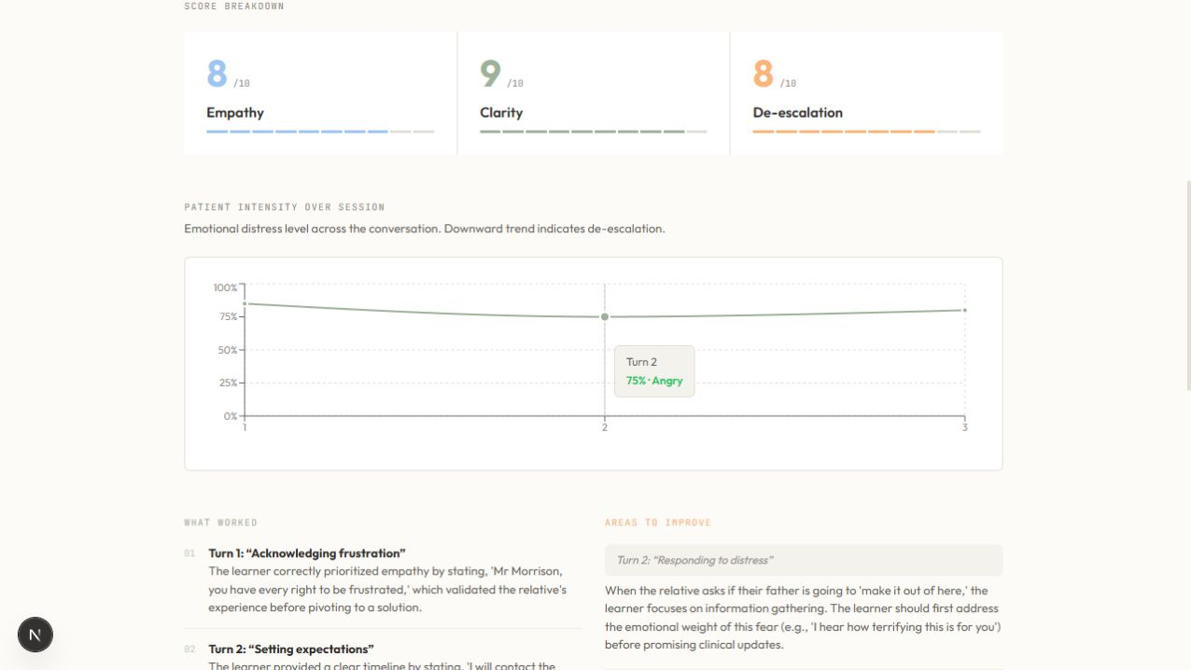
CLINICALMIRROR
02 / 02
Working prototype. Next step: validation.
Current capability, safeguards and a realistic pilot path
4
configured scenarios
3
available now; one held for faculty review
2
input modes: voice + text
0
database installs required
WORKING FLOW
Select → Brief → Practise → Review → Retry
Browser voice/text → Next.js server routes → Gemini
Attempts remain in browser session storage; no SQL is needed for the current demo.
SAFE BY DESIGN
NEXT DECISION
Fictional data • server-only key/prompts • input limits • formative-use boundaries
Approve a small, faculty-supervised learner pilot.
Pilot focus: scenario realism • psychological safety • usefulness of feedback • quality of the next attempt
Illustrative prototype output—not validated learning-impact evidence.
Notes:
Show what is genuinely working today. Four scenarios are configured; three are available, while Mental Health Crisis is held pending faculty review. Learners can speak or type, browser speech handles recognition and playback, server routes protect prompts and the Gemini key, and attempts are limited to browser session storage—so SQL, external speech services, avatar plugins and learner accounts are not required for this demo. Feedback covers empathy, clarity and de-escalation, cites exact turns, suggests improvements and produces a retry plan. The screenshot is illustrative output, not validated educational outcome evidence. The proposed next step is a limited faculty-supervised pilot to assess realism, psychological safety, feedback usefulness and whether the learner's next attempt improves. Persistent data, authentication and institutional governance should only be prioritised after that validation.
[Sources]
- Current repository README.md
- src/lib/scenario-catalog.ts
- src/app/session/[scenarioId]/page.tsx
- src/app/api/chat/route.ts
- src/app/api/feedback/route.ts
- src/lib/attempt-history.ts
- Live feedback screenshot captured 6 Aug 2026
- hackaton 1.pdf judging criteria

