Slide 1
AI CHALLENGE 2026 / TOP 8 FINALIST / TEAM 14
ClinicalMirror
CM
Practice difficult conversations
before they count.
REHEARSE
REFLECT
RETRY
Multi-avatar AI simulation for healthcare communication training
Notes:
Open with the stakes, not the technology. ClinicalMirror gives healthcare students a place to rehearse difficult conversations before those conversations carry real consequences. It is designed to complement high-fidelity simulation, not replace educators or simulated patients.
[Sources]
- AI Challenge 2026_Simplified Problem Description.pdf
- Current ClinicalMirror repository at c0932fb, reviewed 13 Aug 2026

Slide 2
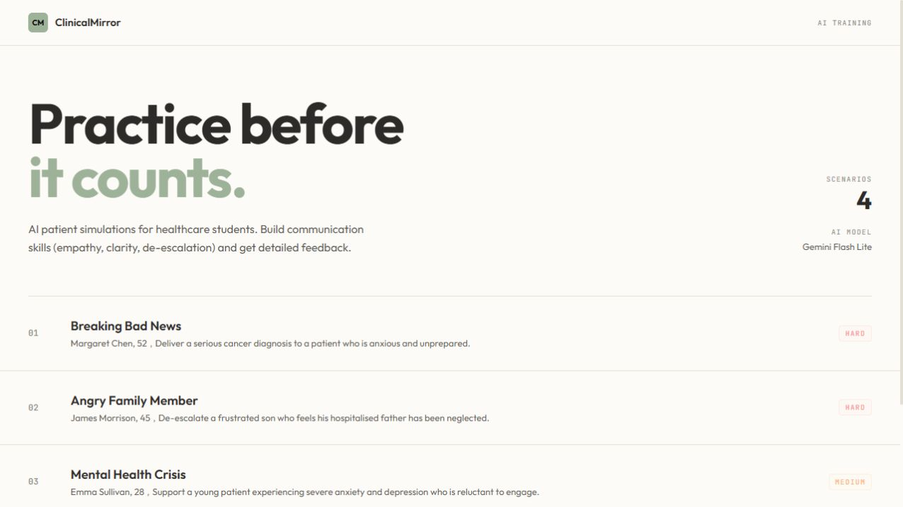
CLINICALMIRROR
02
The training gap is repetition - not awareness
Difficult conversations demand empathy under pressure. Students may know the framework, yet still get too few chances to practise it aloud.
Actor simulation remains valuable, but it is scheduled, planning-heavy and capacity-limited.
ClinicalMirror adds an on-demand rehearsal layer between high-fidelity sessions: fictional role-play, immediate feedback and another attempt.
Four difficult-conversation scenarios are available from one browser interface.
Complement simulation. Increase repetition.
Notes:
The problem is not that students do not value communication. The problem is limited repetition. Actor-based simulation is realistic, but expensive and difficult to make available on demand. ClinicalMirror adds a lower-friction practice layer so students can rehearse, receive feedback and try again between high-fidelity sessions.
[Sources]
- AI Challenge 2026_Simplified Problem Description.pdf
- Live ClinicalMirror homepage screenshot captured 13 Aug 2026
- src/app/page.tsx
- src/lib/scenario-catalog.ts

Slide 3
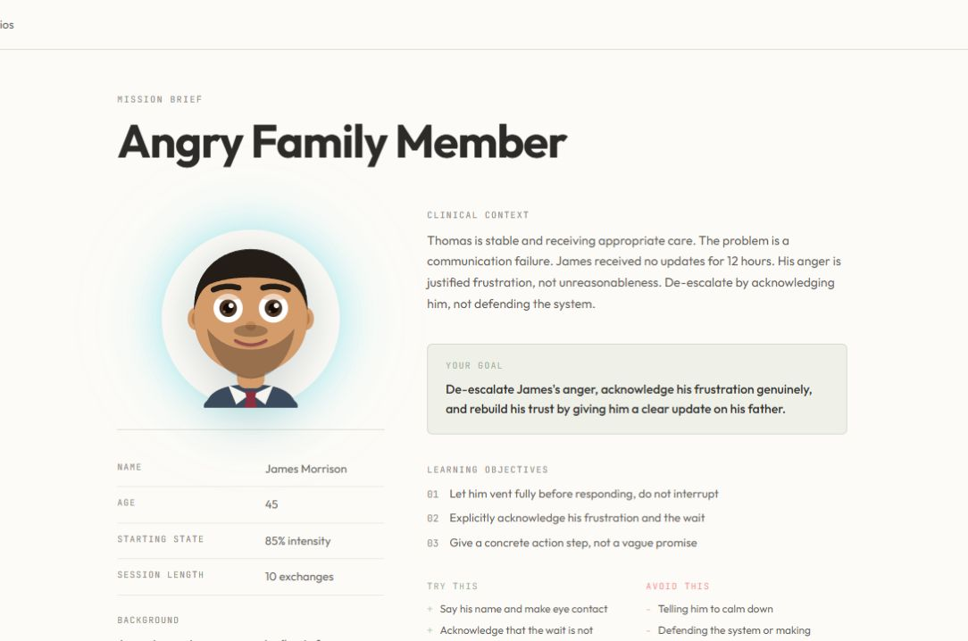
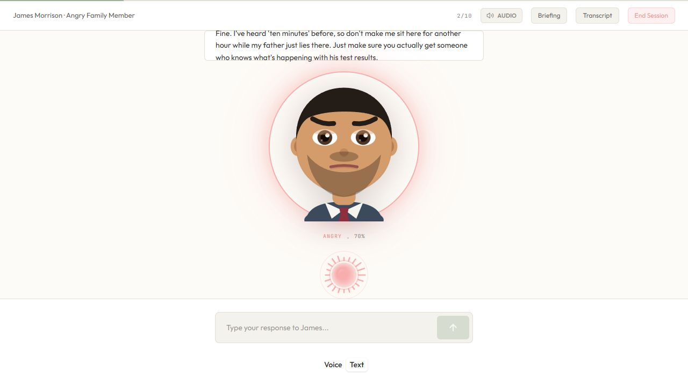
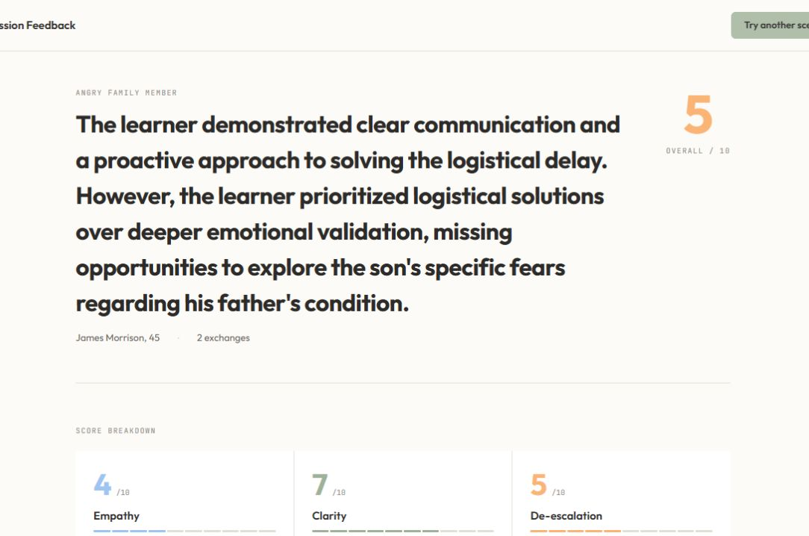
CLINICALMIRROR
03
One browser session completes the learning loop
01
Prepare
02
Practise
03
Reflect and retry
Review the fictional context, goal and privacy acknowledgement.
Speak or type while the patient responds to wording and emotional direction.
See turn-linked evidence, improvements and a concrete retry plan.
Retry history remains in the browser session - no learner account or SQL database is required for the prototype.
Notes:
Walk the judges through the full journey. The learner chooses a scenario, reviews the mission and fictional-data boundary, selects an avatar mode, completes the consultation by voice or text, receives feedback and can retry. If the live demo is working, use this slide only as framing and move directly into the product.
[Sources]
- Live ClinicalMirror screenshots captured 13 Aug 2026
- src/app/session/[scenarioId]/page.tsx
- src/app/feedback/page.tsx

Slide 4
CLINICALMIRROR
04
The patient changes with the learner - not a script
One learning loop, flexible delivery
01
Stylised avatar
Instant, expressive and available without an external avatar service.
02
Live video patient
Tavus CVI streams a photorealistic spoken patient through Daily WebRTC.
03
Adaptive patient voice
ElevenLabs adds optional emotional TTS; browser speech remains the fallback.
Voice or text input | context-aware replies | visible emotion and intensity | graceful fallback
Notes:
The interaction is generated from the learner's words and prior turns rather than played from a fixed script. In the core path, Gemini returns the patient's spoken reply plus an emotion and intensity signal. The learner can use the instant stylised avatar or a Tavus live video patient. ElevenLabs can add an adaptive patient voice, while browser speech remains the fallback. We are not presenting Wav2Lip as a finalist capability; legacy code is still present in the current commit pending the team's planned removal. The emotion signal is an interface aid, not independent evidence of learning.
[Sources]
- Live stylised-avatar session screenshot captured 13 Aug 2026
- src/app/api/chat/route.ts
- src/components/Avatar.tsx
- src/components/TavusAvatar.tsx
- src/app/api/tts/route.ts
- src/lib/tts.ts
- .env.example and src/app/api/patient-reply-video/route.ts for the legacy-code caveat

Slide 5
CLINICALMIRROR
05
A modular architecture keeps the learning loop running
Gemini 3.1 Flash Lite
Learner browser
Next.js server routes
Core role-play
Emotion classification
Structured formative feedback
Next.js / React UI
Voice or text input
Avatar, transcript and charts
/api/chat and /api/emotion
/api/feedback and /api/tts
/api/tavus/* conversation routes
Validation + secret handling
Tavus CVI + Daily WebRTC
Live spoken video patient
Room creation, streaming and transcript events
ElevenLabs voice (optional)
Emotional TTS with per-patient voices
Browser speech remains the fallback
Server-side keys and hidden prompts
Tavus returns a room URL; Daily joins the WebRTC call in the browser.
Browser session storage
Current attempt and retry comparison
No persistent database or account
Core demo needs Gemini. Tavus and voice enhancements are optional.
Notes:
Explain the system from left to right. The learner uses one browser interface. Next.js server routes validate requests, protect API keys and hidden prompts, and call the relevant service. Gemini powers the core text role-play, emotion classification and feedback. Tavus owns the live video conversation; the browser joins its Daily WebRTC room. ElevenLabs is an optional voice enhancement with browser speech fallback. Session history stays in the browser. The diagram intentionally excludes Wav2Lip because the team does not plan to use it in the finalist demo and intends to remove the remaining legacy path.
[Sources]
- package.json
- src/app/session/[scenarioId]/page.tsx
- src/app/api/chat/route.ts
- src/app/api/emotion/route.ts
- src/app/api/feedback/route.ts
- src/app/api/tts/route.ts
- src/lib/tavus.server.ts
- src/components/TavusAvatar.tsx
- src/lib/tts.ts
- src/app/feedback/page.tsx
- .env.example and src/app/api/patient-reply-video/route.ts for the legacy-code caveat

Slide 6
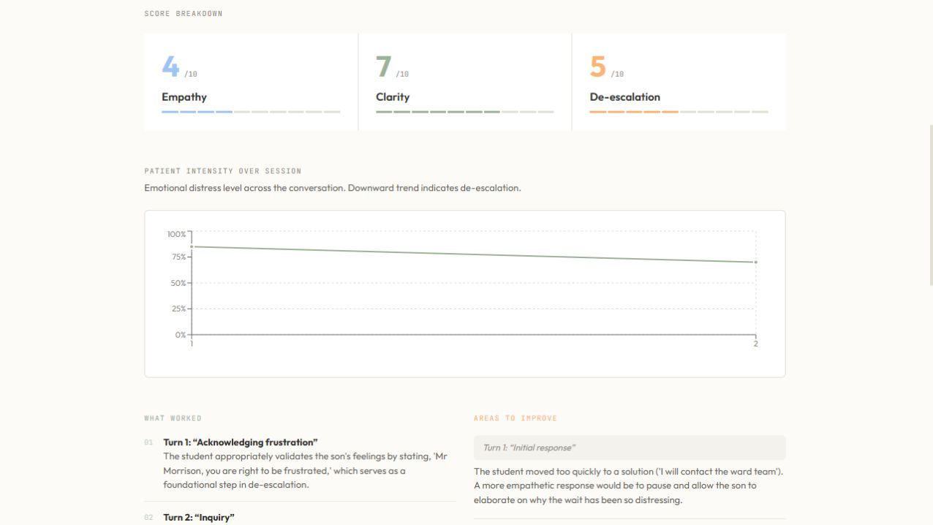
CLINICALMIRROR
06
Feedback points to the learner's exact words
01
Evidence-linked
Strengths and improvements cite the learner's numbered turn.
02
Retry-oriented
The review converts critique into specific steps for the next attempt.
03
Honest limits
Confidence and limitations remain visible; one simulation cannot establish competence.
Formative only | fictional data | server-side keys and prompts | no clinical advice or competence certification
Notes:
The review is designed for reflection, not grading. It scores empathy, clarity and de-escalation, but the important part is traceability: the model must cite the learner's exact turn, explain what worked, identify a better move and create a retry plan. The interface also shows confidence and limitations. Current safeguards include fictional-data acknowledgement, server-side keys and prompts, bounded inputs, disabled Tavus recording and clear formative-use disclaimers. The sample shown is illustrative output, not evidence of validated learning impact.
[Sources]
- Live ClinicalMirror feedback screenshot captured 13 Aug 2026
- src/app/api/feedback/route.ts
- src/lib/ai-api.server.ts
- src/app/feedback/page.tsx
- src/lib/tavus.server.ts
- src/app/session/[scenarioId]/page.tsx

Slide 7
CLINICALMIRROR
07
The next milestone is validation - not more features
The prototype is strong enough to test the educational question: does the feedback help the learner make a better next attempt?
PROVED IN THE PROTOTYPE
VALIDATE NEXT
Working end-to-end learner journey
Four difficult-conversation scenarios
Voice, text and multi-avatar delivery
Evidence-linked feedback and retry
Faculty review of realism and safeguards
Learner usability and psychological safety
Usefulness of feedback in the next attempt
Retention, consent and governance decisions
THE ASK
Approve a limited, faculty-supervised pilot focused on the quality of the next attempt.
Notes:
Close with a measured next step. We have a working prototype and enough functionality to test the educational hypothesis. We are not asking for a full institutional rollout. We are asking for a small faculty-supervised pilot that reviews scenario realism and safeguarding, observes learner usability and psychological safety, and tests whether the learner can use the feedback in a stronger retry. Data retention, accounts and wider governance should follow evidence, not precede it.
[Sources]
- Current ClinicalMirror repository at c0932fb
- README.md prototype boundaries
- AI Challenge 2026_Simplified Problem Description.pdf
- hackaton 1.pdf judging criteria

Slide 8
CLINICALMIRROR / Q&A
A1
Appendix: what requires an account, key or local service?
Component | Role | Requirement | Prototype behaviour
Gemini | Role-play, emotion, feedback | GEMINI_API_KEY | Required for the core learning loop
Tavus CVI | Live video patient | TAVUS_API_KEY; Face/PAL optional | Enabled on a configured team machine
Daily JS | Join Tavus WebRTC room | No separate key in this repo | Client dependency used by Tavus mode
ElevenLabs | Optional emotional TTS | API key + per-patient voice IDs | Optional; falls back to browser speech
Next.js / React | Browser UI and server routes | Node.js + npm dependencies | Runs locally; no SQL required
Browser APIs | Voice input and speech fallback | Compatible browser + mic permission | No external account
SQL / Auth | Persistent records and accounts | Not implemented | Not required for the prototype
Core: Gemini. Live video: Tavus + Daily. Voice: ElevenLabs or browser speech.
Notes:
Use this appendix only for technical Q&A. Gemini is the only external AI service required for the core text and stylised-avatar experience. Tavus enables the live video patient. Daily is the client library used to join the Tavus WebRTC room and does not require a separate key in this repository. ElevenLabs is optional and falls back to browser speech. The application runs on Next.js and React. There is currently no SQL database or authentication layer. Legacy Wav2Lip code is still present in the current commit, but it is excluded from the finalist architecture and scheduled for removal.
[Sources]
- .env.example
- package.json
- src/lib/tavus.server.ts
- src/components/TavusAvatar.tsx
- src/app/api/tts/route.ts
- src/lib/tts.ts
- src/app/feedback/page.tsx
- src/app/api/patient-reply-video/route.ts for the legacy-code caveat

