Slide 1
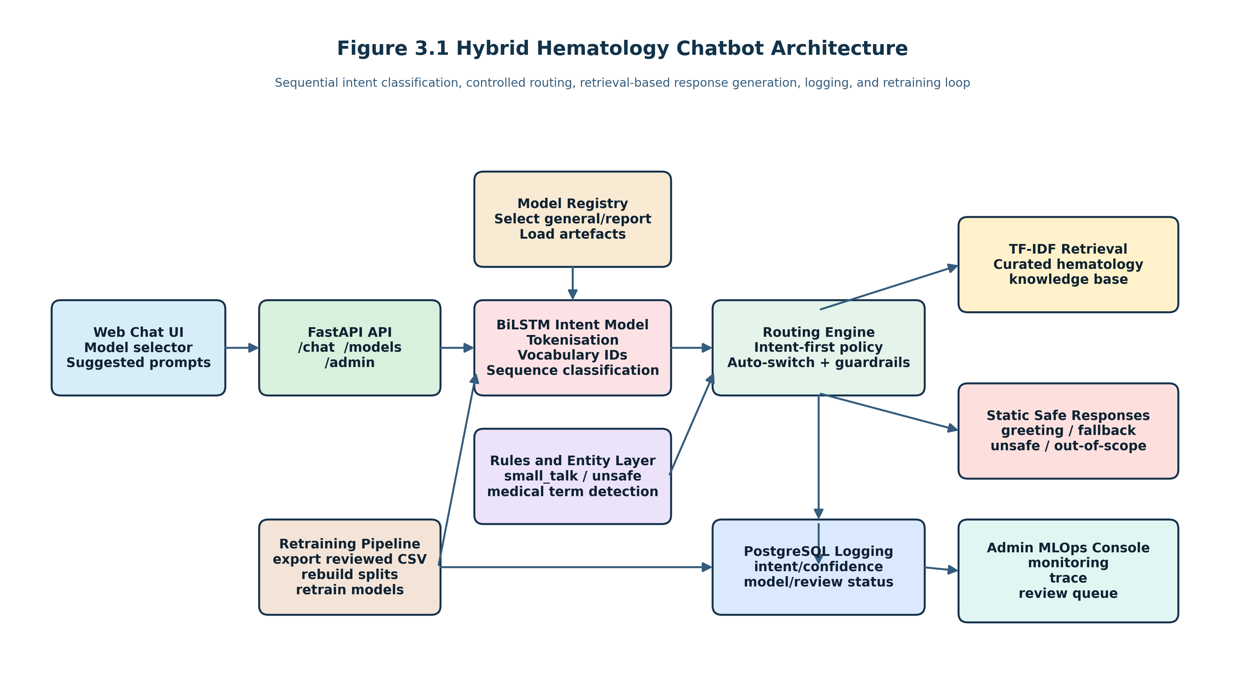
Hybrid Chatbot for Medical Haematology
Sequential models for intent classification and retrieval-based response generation
Final Year Dissertation Presentation
Student: [Insert Name] Supervisor: [Insert Name] Year: 2026

Slide 2
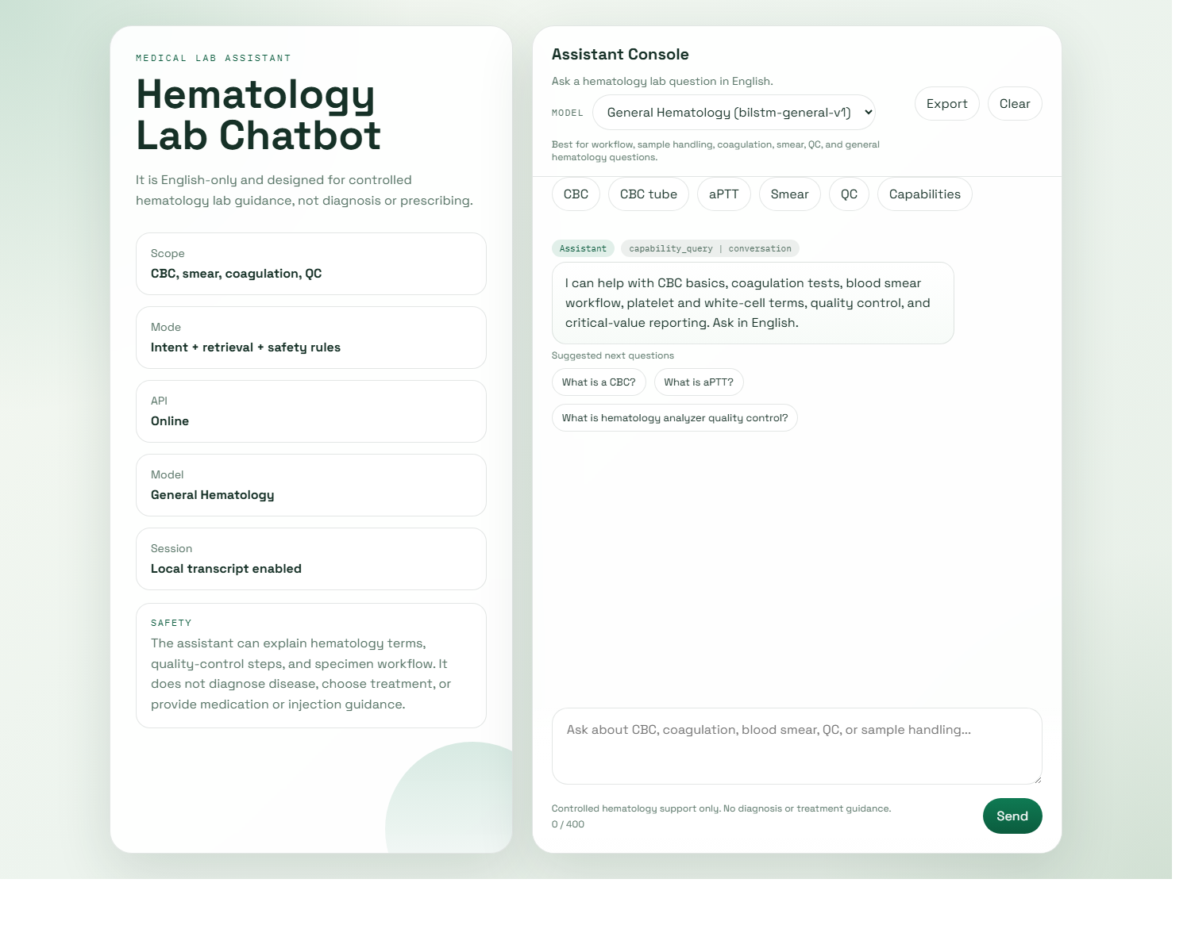
Research Context and Project Aim
General-purpose chatbots do not naturally satisfy laboratory requirements for scope control, auditability, and safe fallback behaviour.
The project therefore targeted a bounded haematology laboratory assistant rather than a diagnostic system.
The aim was to combine sequential intent classification with retrieval-based response generation and practical MLOps controls.

Slide 3
System Architecture and Backend Layers
FastAPI served the chat API, admin endpoints, and model registry.
The inference path combined text preprocessing, BiLSTM intent scoring, entity detection, TF-IDF retrieval, and safety rules.
PostgreSQL logging and the admin console supported monitoring and retraining.

Slide 4
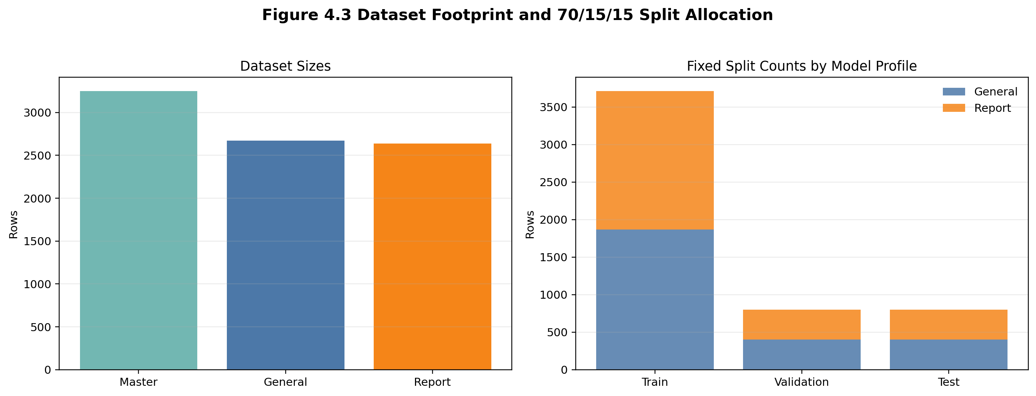
Data Strategy and Two-Model Design
Master labelled dataset: 3,250 utterances across 27 intents.
General model dataset: 2,670 utterances across 21 intents.
Report model dataset: 2,636 utterances across 24 intents.
The split reduced label competition between workflow questions and CBC report-support questions.

Slide 5
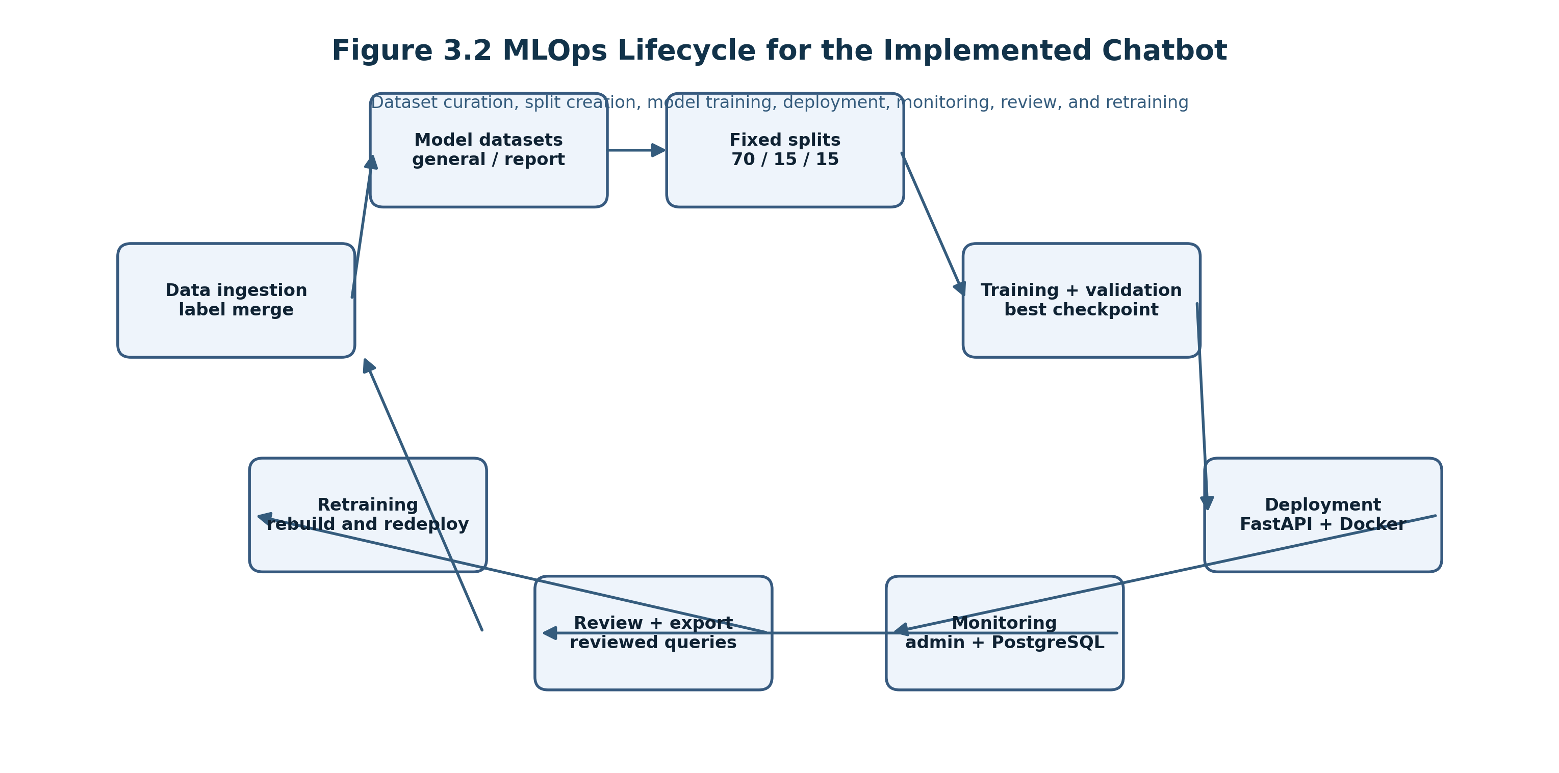
MLOps Lifecycle and Operational Monitoring
The implemented lifecycle covered labelled data ingestion, derived datasets, fixed splits, training, evaluation, deployment, monitoring, and retraining.
The admin console exposed model metrics, live logs, version-relevant artefacts, review workflow, and inference traces.
Reviewed production phrases could be exported and merged back into the labelled dataset.

Slide 6
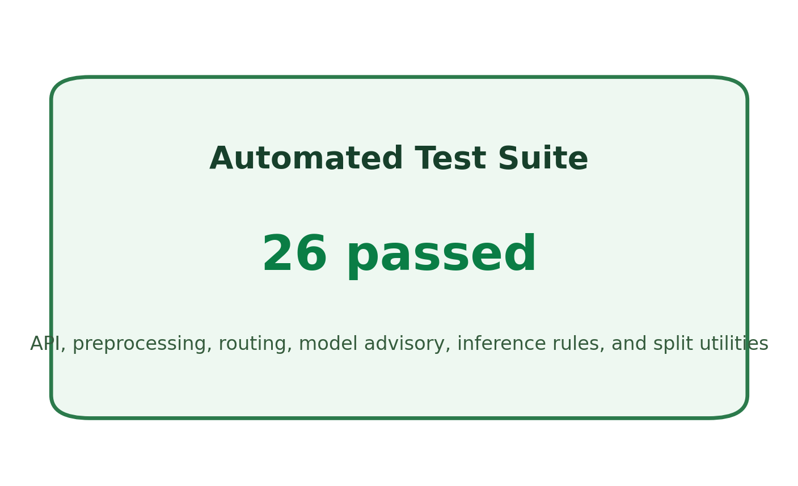
Evaluation Design and Testing Discipline
A fixed 70/15/15 train-validation-test policy was adopted to separate checkpoint selection from final reporting.
Automated tests covered API behaviour, preprocessing, entity detection, routing, model advisory, predictor rules, and split generation.
The final automated suite passed with 26 tests.

Slide 7
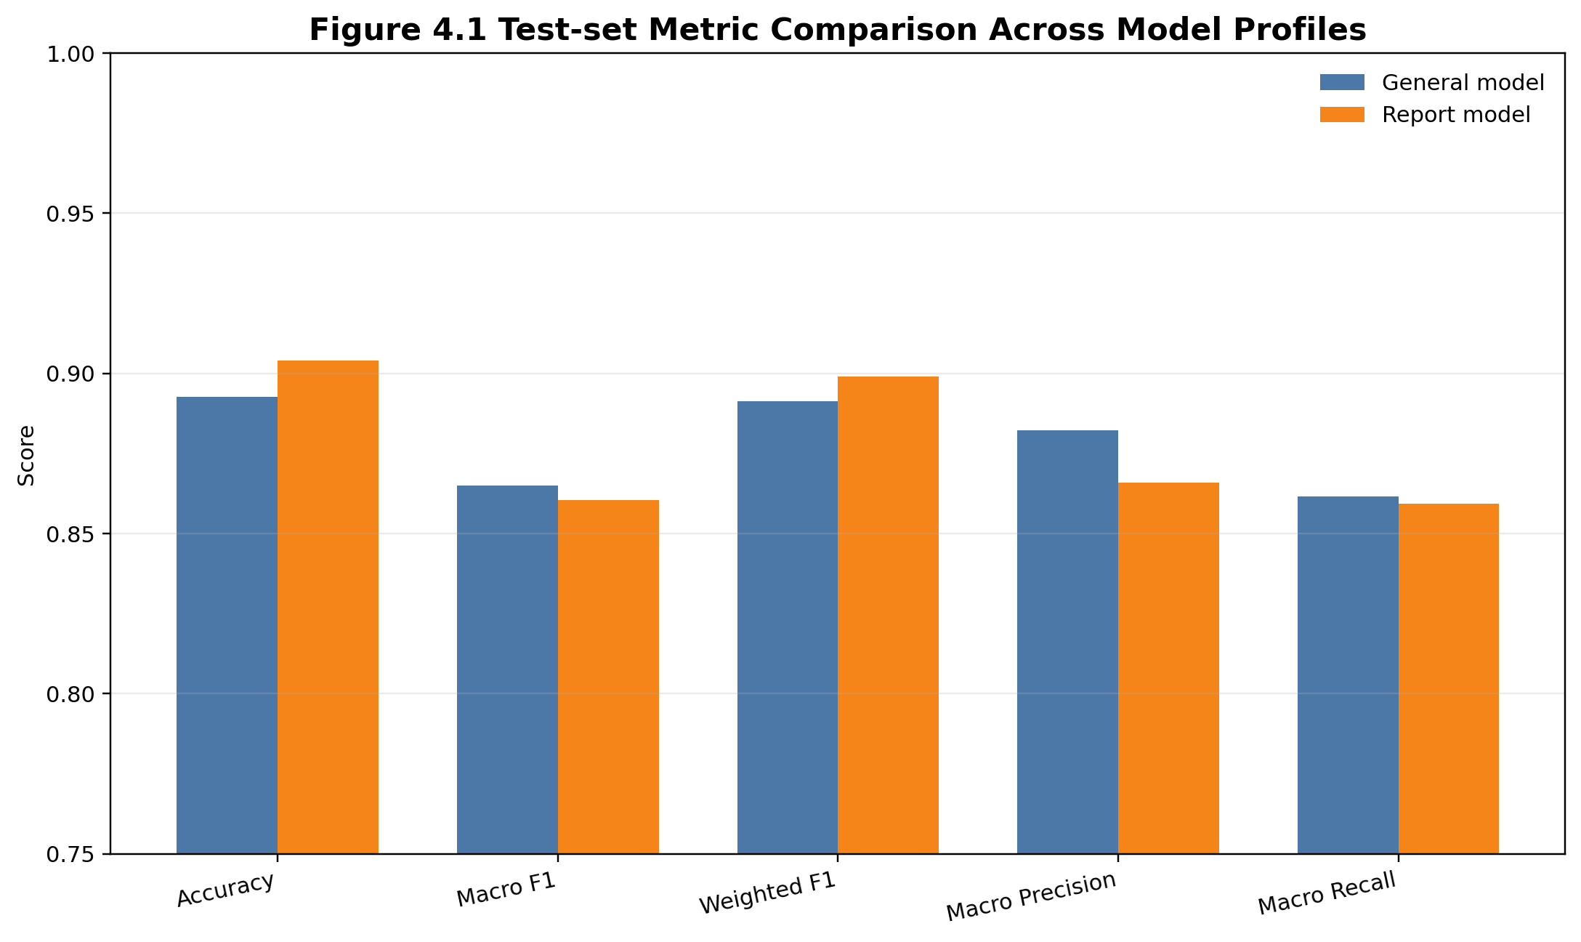
Model Performance
General model: accuracy 0.8928, macro F1 0.8649.
Report model: accuracy 0.9040, macro F1 0.8604.
The report profile achieved slightly higher accuracy, while both models maintained near-0.90 test performance within a bounded medical scope.

Slide 8
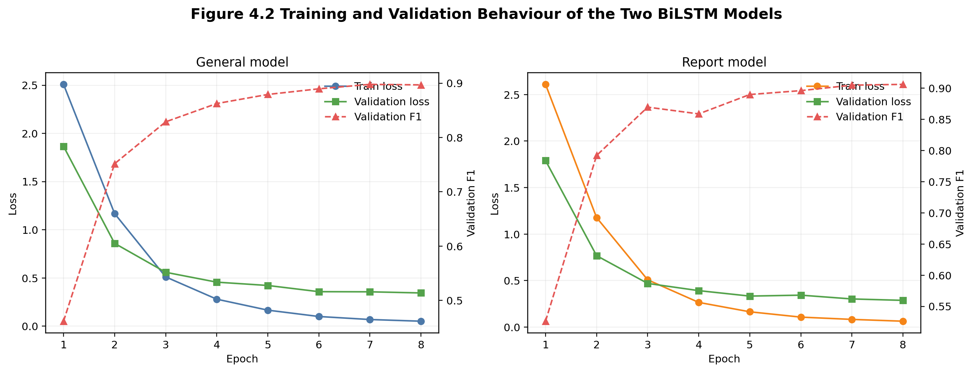
Training Behaviour and Interpretability
Both models showed sustained loss reduction and validation improvement across the eight-epoch training schedule.
The remaining gap between validation and test results indicated moderate but acceptable generalisation loss.
The inference trace made tokenisation, top intent scores, entity routing, retrieval candidates, and final response selection visible.

Slide 9
Strengths, Limitations, and Risk Controls
Strengths: bounded medical scope, controlled retrieval, reproducible splits, live monitoring, review-driven retraining.
Limitations: moderate dataset size, class imbalance, English-only support, rule-based entity refinement, no patient-specific diagnosis or treatment.
Risk control: unsafe prompts, out-of-scope prompts, and incomplete queries were handled through dedicated intents and guardrail responses.

Slide 10
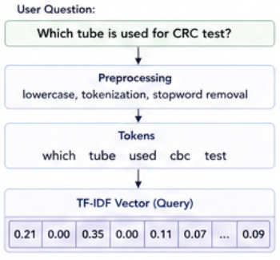
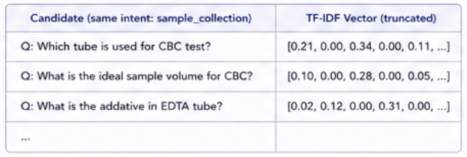
TF-IDF Retrieval Process

Slide 11
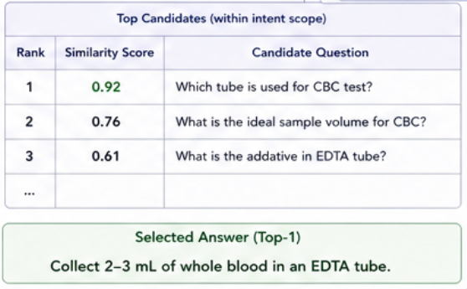
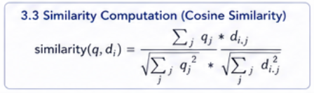
TF-IDF Retrieval Process

Slide 12
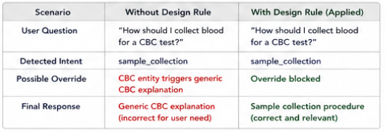
Why and Without Retrieval Based Response Generation (TF-IDF)
The project delivered a substantial artefact that combined sequential NLP, retrieval-based response generation, and practical MLOps controls.
Further work should extend real-user data collection, multilingual support, richer report-term coverage, and formal usability evaluation.
The implemented platform is suitable as a bounded laboratory assistant and as a demonstrable final-year machine learning system.

Slide 13
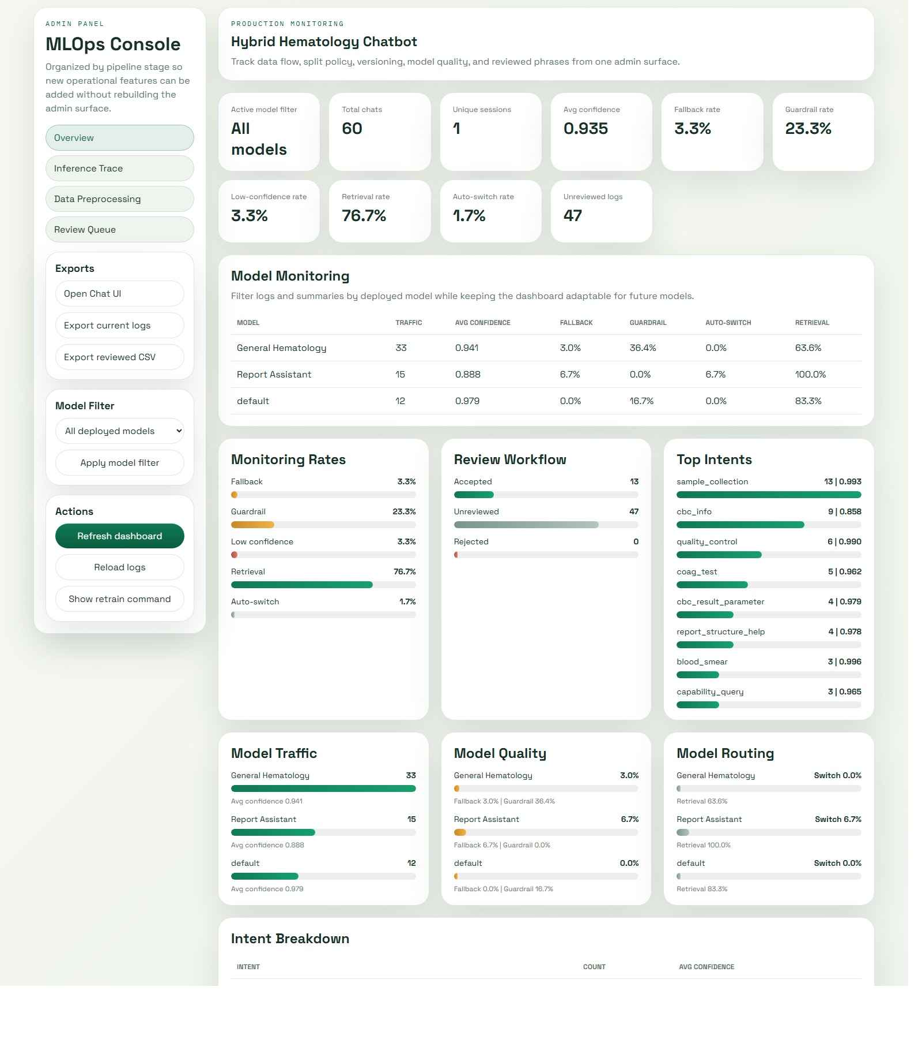
Conclusion and Further Work
The project delivered a substantial artefact that combined sequential NLP, retrieval-based response generation, and practical MLOps controls.
Further work should extend real-user data collection, multilingual support, richer report-term coverage, and formal usability evaluation.
The implemented platform is suitable as a bounded laboratory assistant and as a demonstrable final-year machine learning system.

