Slide 1
Flutter

Slide 2
What is Flutter?
Modern reactive framework
Development tools
Ready-made widgets
Fast 2D rendering engine
Flutter is written in Dart, strongly typed Object-oriented language

Slide 3
Declarative and Imperative Style
return View(
color: red,
child: View(…),
)
b.setText(“Test”)
b.setColor(red)
View c = new View()
b.add(c)

Slide 4
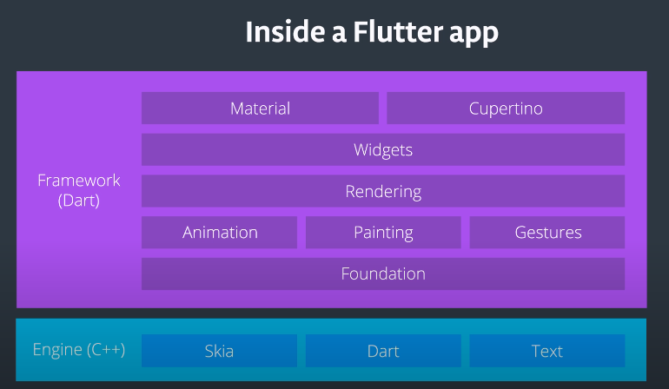

Slide 5
Widget
Widgets are the foundation of the flutter app.
A widget is a description of part of a user interface.
Almost everything is a widget.
Widget has two types: Stateless widget and Stateful widget

Slide 6
Stateless Widget
An immutable widget
All its field are final after creating.
Stateless widget are not interactive.

Slide 7
Stateful Widget
Stateful widgets maintain state that might change during the lifetime of the widget.
Implementing a stateful widget requires at least two classes
StatefulWidget class that creates an instance of
State class

Slide 8
Basic Widgets
AppBar
Column
Row
Container
Icon
Image
Placeholder
RaisedButton
Scaffold
Text

Slide 9
Button
RaisedButton
Floating Action Button
Dropdown Button
IconButton
InkWell

Slide 10
Layout
Single-Child Layout Widgets
Multi-Child Layout Widgets

Slide 11
Single-child Layout Widgets
Align
Aspect Ratio
Baseline
Center
ConstrainedBox
Container
CustomSingleChildLayout
Expanded
FittedBox
FrationallySizedBox
IntrinsicHeight
IntrinsicWidth
LimitedBox
Offstage
OverflowBox
Padding
SizedBox
SizedOverflowBox
Transform

Slide 12
Multi-child Layout Widgets
Column
Row
CustomMutliChildLayout
Flow
GridView
IndexedStack
ListBody
ListView
Stack
Table
Wrap
LayoutBuilder

Slide 13
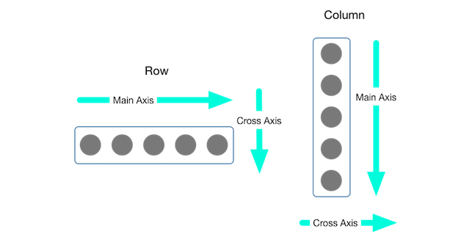
Aligned the Widget
MainAxisAlignment
- MainAxisAlignment.start
- MainAxisAlignment.end
- MainAxisAlignment.center
- MainAxisAlignment.spaceBetween
- MainAxisAlignment.spaceEvenly
- MainAxisAlignment.spaceAround
CrossAxisAlignment
CrossAxisAlignment.start
CrossAxisAlignment.end
CrossAxisAlignment.center
CrossAxisAlignment.stretch
CrossAxisAlignment.baseline

Slide 14
Flexible Widget
flex
Compares itself against other flex properties before determining what fraction of the total remaining space each Flexible widget receives.
fit
Determines whether a Flexible widget fills all of its extra space.
FlexFit.loose
FlexFit.tight

Slide 15
Expanded Widget
Expanded forces widget to fill the extra space.
SizedBox Widget
creating exact dimensions
Spacer Widget
create space between widgets.

Slide 16
Navigation
screens and pages are called routes
To switch to a new route, use the Navigator.push() method
The pop() method removes the current Route from the stack of routes. Use the Navigator.pop()

Slide 17
ListView
ListTitle widget
passing in a horizontal scrollDirection for horizontal scroll

Slide 18
GridView
use the GridView.count() constructor
crossAxisCount: 2 for GridView Column

Slide 19
Fetching data from the internet
Add the http package
dependencies:
http: <latest_version>
import 'package:http/http.dart' as http;
Make a network request
http.get() method
return a Future that contains a Response.

