Slide 1
Global Sales & Profit Dashboard – 2014 Summary
Business Performance Overview with Key KPIs, Insights, and Trends

Slide 2
Dashboard Overview
This dashboard provides an interactive summary of global sales and profit data for 2014.
It includes:
• Key KPIs (Sales, Profit, Units Sold)
• Sales and Profit comparison by Segment
• Monthly trend analysis
• Sales by Country Map
• Product-level insights for Units Sold and Profitability

Slide 3
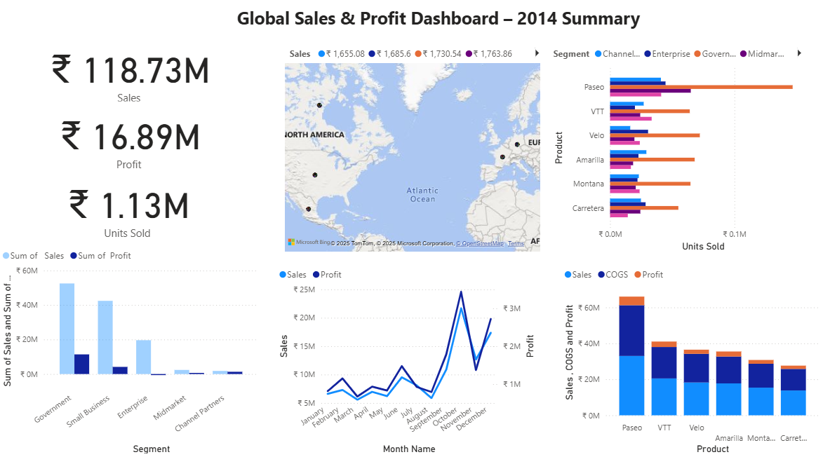

Slide 4
Key Performance Indicators
Total Sales: ₹118.73M
Total Profit: ₹16.89M
Units Sold: ₹1.13M
These KPIs summarize overall company performance for the year 2014.

Slide 5
Sales and Profit by Segment
Government and Small Business segments show the highest sales volume.
Midmarket and Channel Partners contribute less to total revenue.
Profit closely follows sales trends, indicating healthy margins across major segments.

Slide 6
Monthly Sales and Profit Trend
Sales show strong growth from September to December.
December records the highest sales and profit peak.
Seasonal demand likely influences year-end performance.

Slide 7
Product and Regional Insights
'Paseo' leads in sales and profit contribution.
'VTT' and 'Velo' perform moderately, while 'Montana' and 'Carretera' show smaller shares.
Highest performance regions: Canada and Germany.
Government and Enterprise sectors drive the strongest results in North America and Europe.

Slide 8
COGS vs Sales vs Profit Analysis
'Paseo' has the highest COGS but maintains strong profit margins.
Other products have moderate cost structures with stable profits.
COGS control remains key to sustaining profitability.

Slide 9
Recommendations & Conclusion
✅ Focus on top-performing products like 'Paseo' and 'VTT'.
✅ Expand presence in high-performing markets such as Canada and Germany.
✅ Improve COGS efficiency in mid-performing products.
✅ Continue tracking monthly trends for better seasonal forecasting.
Overall, 2014 demonstrates strong performance with opportunities for growth and optimization.

