Slide 1
Advanced Algorithms I.1. Algorithm Design and Analysis
Henry Förster
Chair of Efficient Algorithms

Slide 2




Algorithmic Revolution
KIND OF NEW: Machines learn algorithms based on information without explicit instructions
Even difficult problems can be solved that way!
Application scenarios where the definition is fuzzy can be solved! (E.g., the machine should provide a „human-like“ response)
Why do we still discuss classic algorithms?

Slide 3
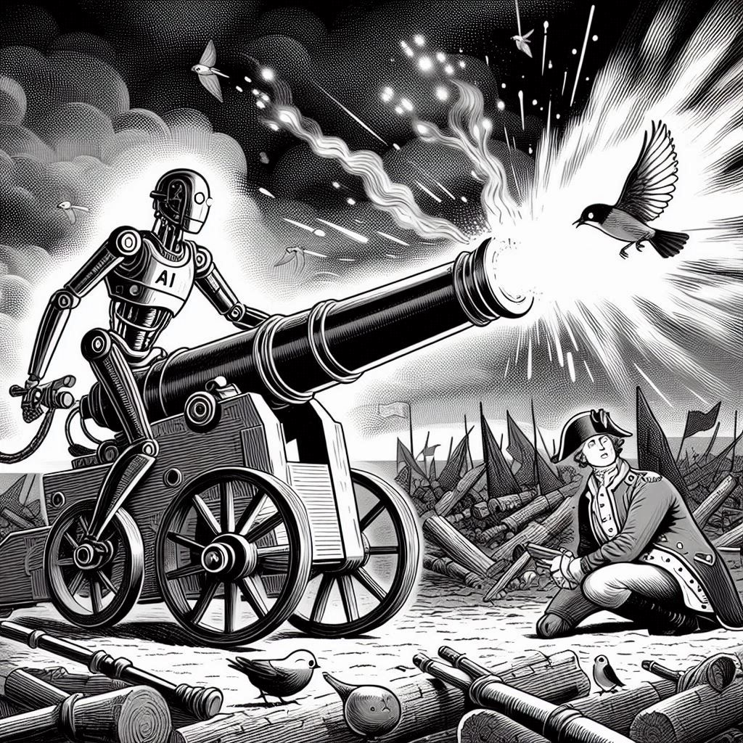
Shooting Sparrows with Cannons
Efficient algorithms…
solve problems directly
require less computational ressources
can run on restrictive hardware
can be cheaper to operate
require no expensive training (cost, emissions, …)
Also, it is fun to solve puzzles!
And understand why the solution works!
Image generated with Microsoft Designer.

Slide 4
Welcome to Advanced Algorithms!
Hi, I‘m Henry!
PhD and PostDoc at University of Tübingen
Research Focus: Efficient Algorithms for Visualizing Relational Data, Properties of Geometric and Topological Graphs, Evaluating Visualization Techniques
This course is not (completely) ad-hoc: taught similar classes in Tübingen
How about you?
Disclaimer: Today is my very first day here!
moodle will be available later today
Exam date will be announced later today on moodle and Thursday in class

Slide 5
Course Organization
Lecture: Tuesday 10:15 – 11:45
Again, there will be a moodle
Slides, assignment sheets, forum, announcements, …
Assignment sheets
Available after lecture (this week later today when moodle is running)
Voluntary, but graded for feedback
Hand-in via moodle until Tuesday before lecture, possible in groups
Discussion Session: Thursday, 10:15 – 11:45 (same room)
Per request: Solutions for assignment sheet from last week, questions regarding the lecture, guidance on current assignment sheet
This week: Announcements regarding moodle and exam date
Written Exam: Date TBA, 120 mins
Cheat sheet allowed (A4, both sides)

Slide 6
Course Contents
I. Algorithm Design and Analysis
1. Recap: Run time and Correctness, Landau Notation, Divide and Conquer
2. Advanced Design Concepts: Dynamic Programming, Greedy
3. Amortized Analysis
II. Advanced Data Structures
1. Fibonacci-Heaps
2. Union-Find Data Structure
III. Graph Algorithms
1. Maximum Flow & Maximum Matching
2. Push-Relabel Algorithm
IV. Geometric Algorithms
1. Sweep Line Method
2. Randomized Incremental Construction
V. Linear Programming
1. Properties and Duality
2. Algorithms for Linear Programming
VI. Approximation Algorithms
1. APX
2. PTAS
VII. Parameterized Algorithms
1. FPT
2. W[1]

Slide 7
Goals for Today
At the end of this lecture, you can …
prove the correctness of algorithms using suitable invariants and induction
provide bounds on run times using the Landau notation
resolve recurrences by applying the master theorem
design recursive and divide-and-conquer algorithms

Slide 8
Comparing Run Times

Slide 9
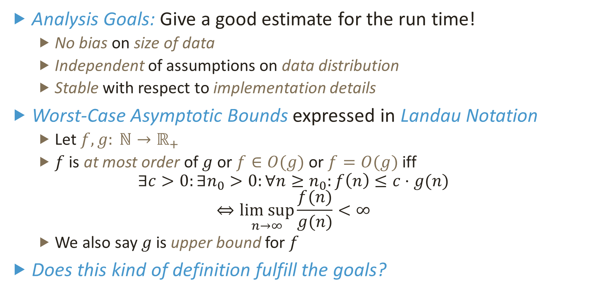
Landau Notation (or Big-O Notation)
Analysis Goals: Give a good estimate for the run time!
No bias on size of data
Independent of assumptions on data distribution
Stable with respect to implementation details
Worst-Case Asymptotic Bounds expressed in Landau Notation
Let $f,g: ℕ→ℝ_{+}$
$f$ is at most order of $g$ or $f∈O(g)$ or $f=O(g)$ iff $∃c>0:∃n_{0}>0:∀n≥n_{0}:f\left(n\right)≤c⋅g(n)$
$$⇔\underset{n→∞}{lim sup}{\frac{f(n)}{g(n)}<∞}$$
We also say $g$ is upper bound for $f$
Does this kind of definition fulfill the goals?

Slide 10
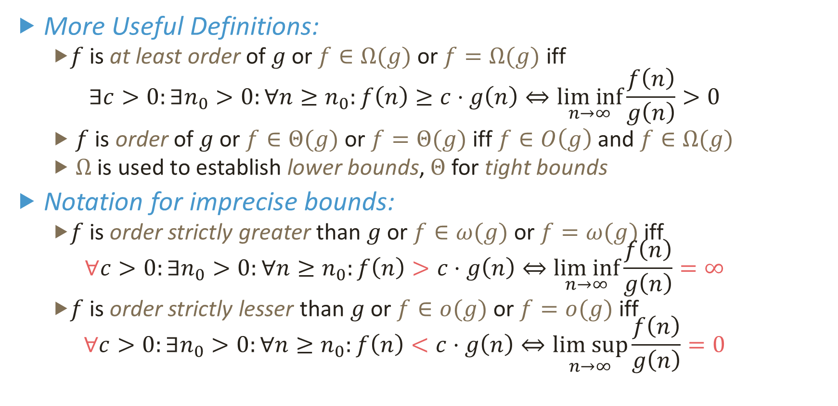
Landau Notation (or Big-O Notation)
More Useful Definitions:
$f$ is at least order of $g$ or $f∈Ω(g)$ or $f=Ω(g)$ iff
$$∃c>0:∃n_{0}>0:∀n≥n_{0}:f\left(n\right)≥c⋅g\left(n\right)⇔\underset{n→∞}{lim inf}{\frac{f\left(n\right)}{g\left(n\right)}>0}$$
$f$ is order of $g$ or $f∈Θ(g)$ or $f=Θ(g)$ iff $f∈O\left(g\right)$ and $f∈Ω(g)$
$Ω$ is used to establish lower bounds, $Θ$ for tight bounds
Notation for imprecise bounds:
$f$ is order strictly greater than $g$ or $f∈ω(g)$ or $f=ω(g)$ iff $∀c>0:∃n_{0}>0:∀n≥n_{0}:f\left(n\right)>c⋅g\left(n\right)⇔\underset{n→∞}{lim inf}{\frac{f\left(n\right)}{g\left(n\right)}=∞}$
$f$ is order strictly lesser than $g$ or $f∈o(g)$ or $f=o(g)$ iff $∀c>0:∃n_{0}>0:∀n≥n_{0}:f\left(n\right)<c⋅g\left(n\right)⇔\underset{n→∞}{lim sup}{\frac{f\left(n\right)}{g\left(n\right)}=0}$

Slide 11
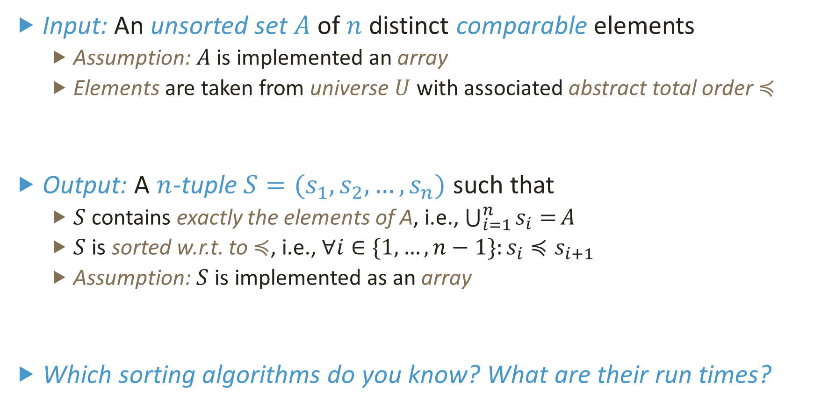
Running Example for Today: Sorting
Input: An unsorted set $A$ of $n$ distinct comparable elements
Assumption: $A$ is implemented an array
Elements are taken from universe $U$ with associated abstract total order $≼$
Output: A $n$-tuple $S=(s_{1},s_{2},…,s_{n})$ such that
$S$ contains exactly the elements of A, i.e., $\bigcup_{i=1}^{n}{s_{i}=}A$
$S$ is sorted w.r.t. to $≼$, i.e., $∀i∈\{1,…,n−1\}:s_{i}≼s_{i+1}$
Assumption: $S$ is implemented as an array
Which sorting algorithms do you know? What are their run times?
3
5
7
0
4
2
6
1
0
1
2
3
4
5
6
7

Slide 12

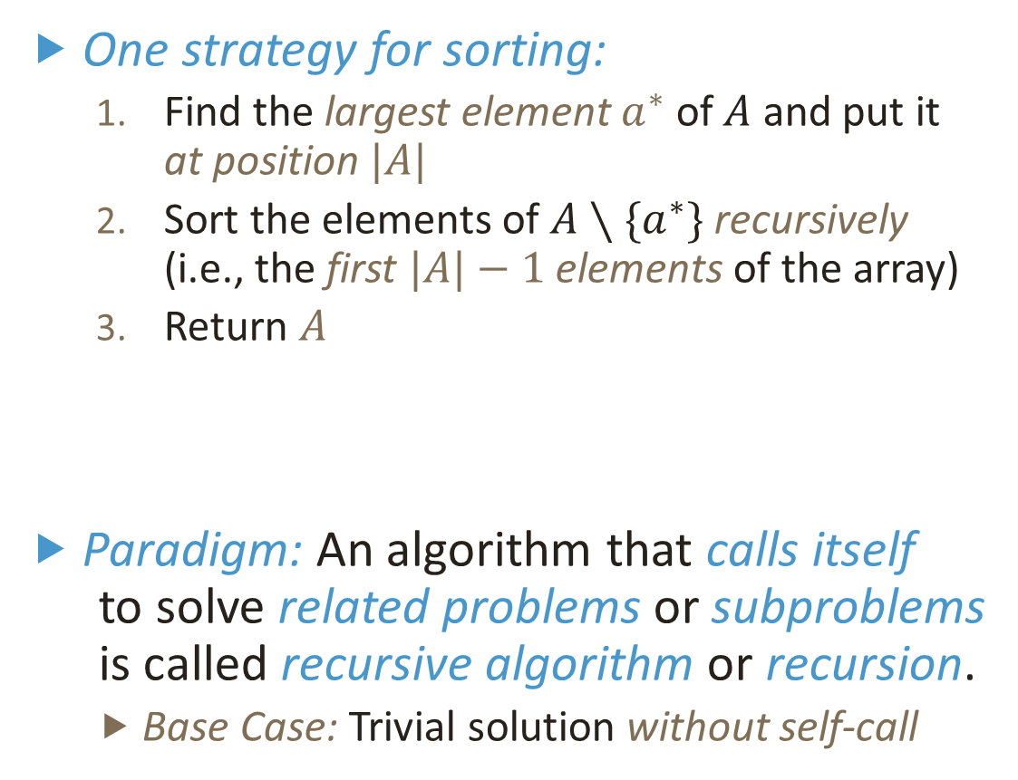
Recursive Bubble Sort
One strategy for sorting:
Find the largest element $a^{∗}$ of $A$ and put it at position $|A|$
Sort the elements of $A∖\{a^{∗}\}$ recursively (i.e., the first $|A|−1$ elements of the array)
Return $A$
Paradigm: An algorithm that calls itself to solve related problems or subproblems is called recursive algorithm or recursion.
Base Case: Trivial solution without self-call
BubbleSort(A,n)
{
if (n=1)
{
return A;
}
for i←1 to n-1
{
if A[i] > A[i+1]
{
swap(A[i],A[i+1]);
}
}
BubbleSort(A,n-1);
return A;
}
$${ a}^{∗}$$

Slide 13
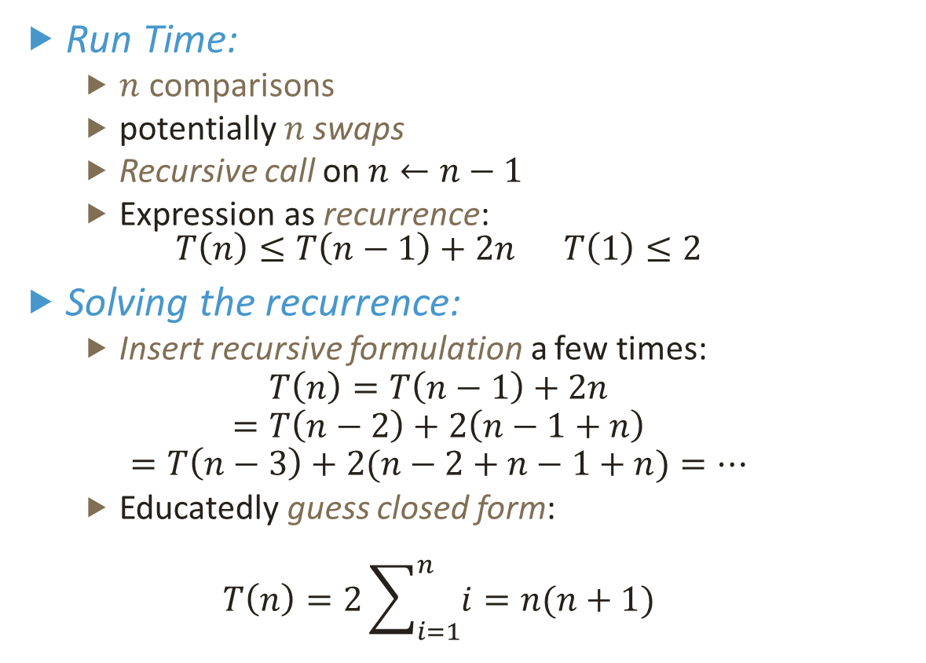
Recursive Bubble Sort – Run Time
Run Time:
$n$ comparisons
potentially $n$ swaps
Recursive call on $n←n−1$
Expression as recurrence: $T\left(n\right)≤T\left(n−1\right)+2n T\left(1\right)≤2$
Solving the recurrence:
Insert recursive formulation a few times:
$$T\left(n\right)=T\left(n−1\right)+2n$$
$$=T\left(n−2\right)+2\left(n−1+n\right)$$
$$=T\left(n−3\right)+2(n−2+n−1+n)=…$$
Educatedly guess closed form:
$$T\left(n\right)=2\sum_{i=1}^{n}{i}=n(n+1)$$
BubbleSort(A,n)
{
if (n=1)
{
return A;
}
for i←1 to n-1
{
if A[i] > A[i+1]
{
swap(A[i],A[i+1]);
}
}
BubbleSort(A,n-1);
return A;
}

Slide 14
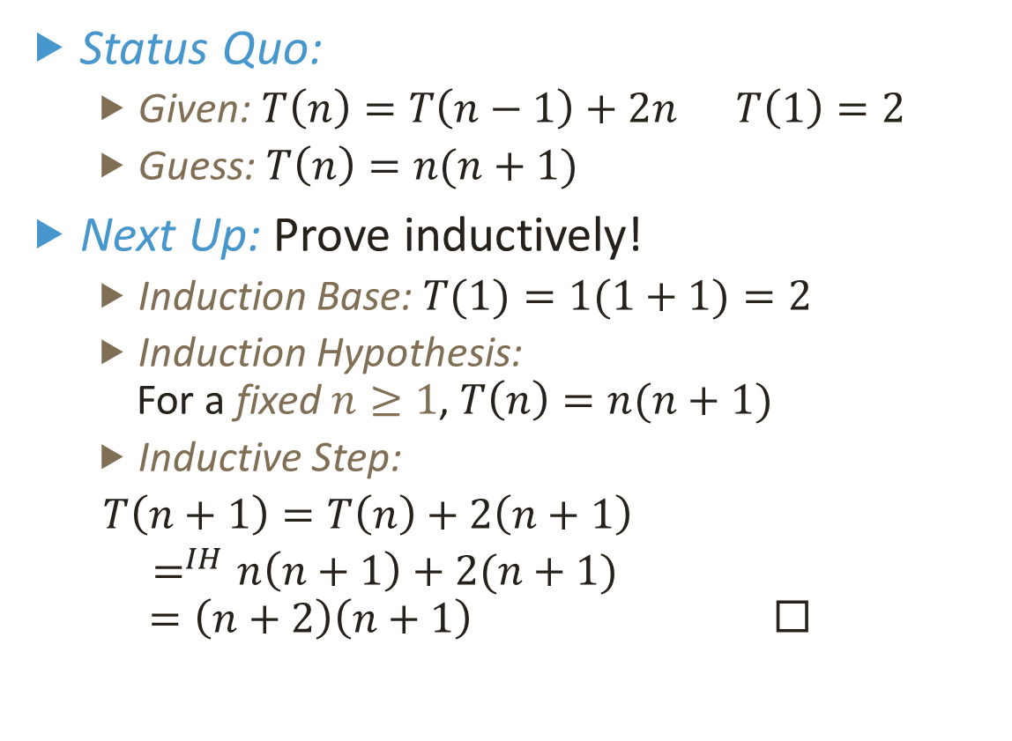
Recursive Bubble Sort – Run Time
Status Quo:
Given: $T\left(n\right)=T\left(n−1\right)+2n T\left(1\right)=2$
Guess: $T\left(n\right)=n(n+1)$
Next Up: Prove inductively!
Induction Base: $T(1)=1(1+1)=2$
Induction Hypothesis: For a fixed $n≥1$, $T\left(n\right)=n(n+1)$
Inductive Step:
$T\left(n+1\right)=T\left(n\right)+2\left(n+1\right)$
$=^{IH}n\left(n+1\right)+2(n+1)$
$$=\left(n+2\right)\left(n+1\right) ◻$$
BubbleSort(A,n)
{
if (n=1)
{
return A;
}
for i←1 to n-1
{
if A[i] > A[i+1]
{
swap(A[i],A[i+1]);
}
}
BubbleSort(A,n-1);
return A;
}

Slide 15
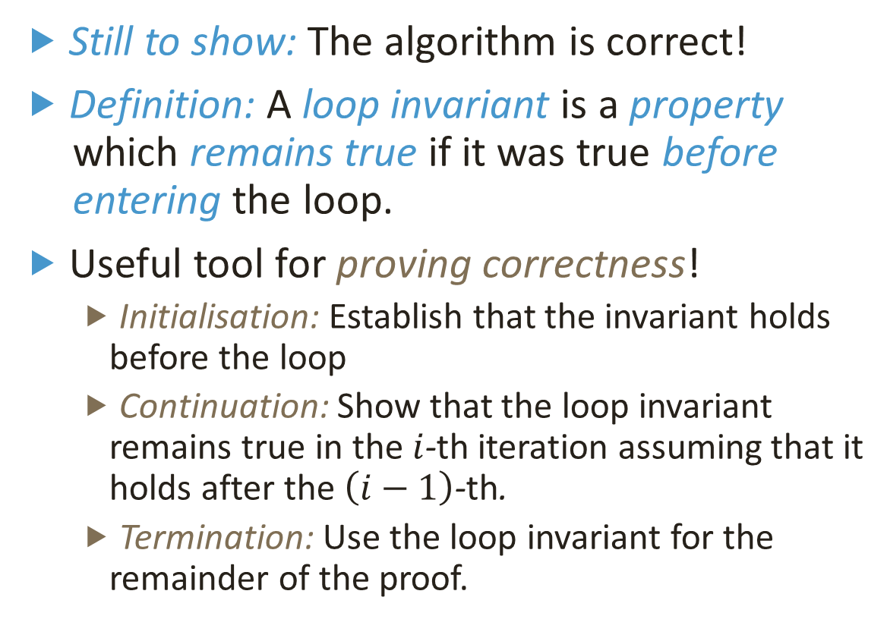
Recursive Bubble Sort – Correctness
Still to show: The algorithm is correct!
Definition: A loop invariant is a property which remains true if it was true before entering the loop.
Useful tool for proving correctness!
Initialisation: Establish that the invariant holds before the loop
Continuation: Show that the loop invariant remains true in the $i$-th iteration assuming that it holds after the $\left(i−1\right)$-th.
Termination: Use the loop invariant for the remainder of the proof.
BubbleSort(A,n)
{
if (n=1)
{
return A;
}
for i←1 to n-1
{
if A[i] > A[i+1]
{
swap(A[i],A[i+1]);
}
}
BubbleSort(A,n-1);
return A;
}

Slide 16
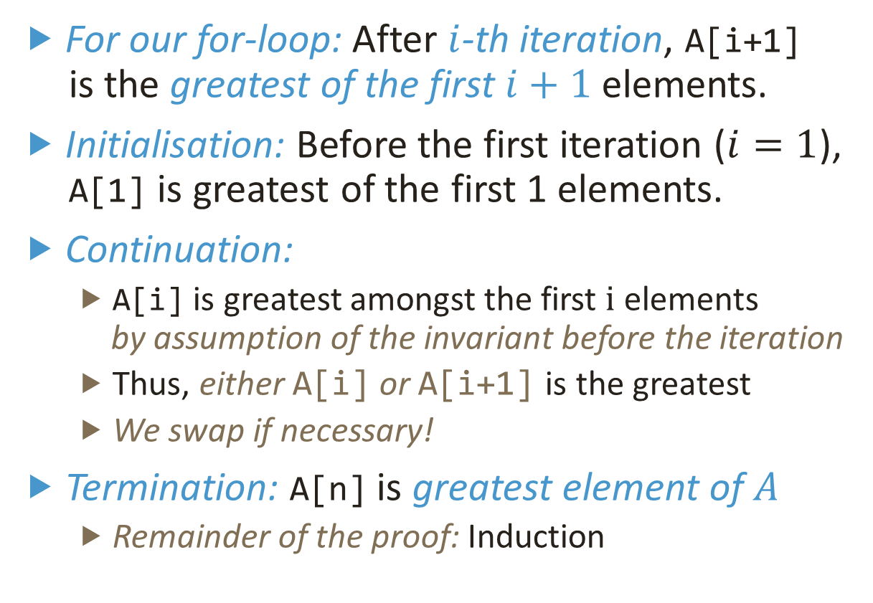
Recursive Bubble Sort – Correctness
For our for-loop: After $i$-th iteration, A[i+1] is the greatest of the first $i+1$elements.
Initialisation: Before the first iteration ($i=1$), A[1] is greatest of the first 1 elements.
Continuation:
A[i] is greatest amongst the first $i$ elements by assumption of the invariant before the iteration
Thus, either A[i] or A[i+1] is the greatest
We swap if necessary!
Termination: A[n] is greatest element of $A$
Remainder of the proof: Induction
BubbleSort(A,n)
{
if (n=1)
{
return A;
}
for i←1 to n-1
{
if A[i] > A[i+1]
{
swap(A[i],A[i+1]);
}
}
BubbleSort(A,n-1);
return A;
}

Slide 17
Recursive vs. Iterative Algorithms
Iterative version: Recursive calls are replaced by a loop!
Works because the signatures of calls are known in advance
In general: Recursion is more powerful than iteration!
Recall: Halting problem and Incomputability
But also more difficult to analyze, implement, …
BubbleSort_rec(A,n)
{
if (n=1)
{
return A;
}
for i←1 to n-1
{
if A[i] > A[i+1]
{
swap(A[i],A[i+1]);
}
}
BubbleSort(A,n-1);
return A;
}
BubbleSort_iter(A,n)
{
for j←1 to n-1
{
for i←1 to n-j
{
if A[i] > A[i+1]
{
swap(A[i],A[j]);
}
}
}
return A;
}

Slide 18

Merge Sort
Another strategy for sorting:
Sort first half $A_{1}$ and second half $A_{2}$ independently yielding $S_{1}$ and $S_{2}$
Compare first elements of $S_{1}$ and $S_{2}$ and move the lesser in $S$
Repeat 2. until sorted
3
5
7
0
4
2
6
1
0
3
5
7
1
2
4
6

Slide 19
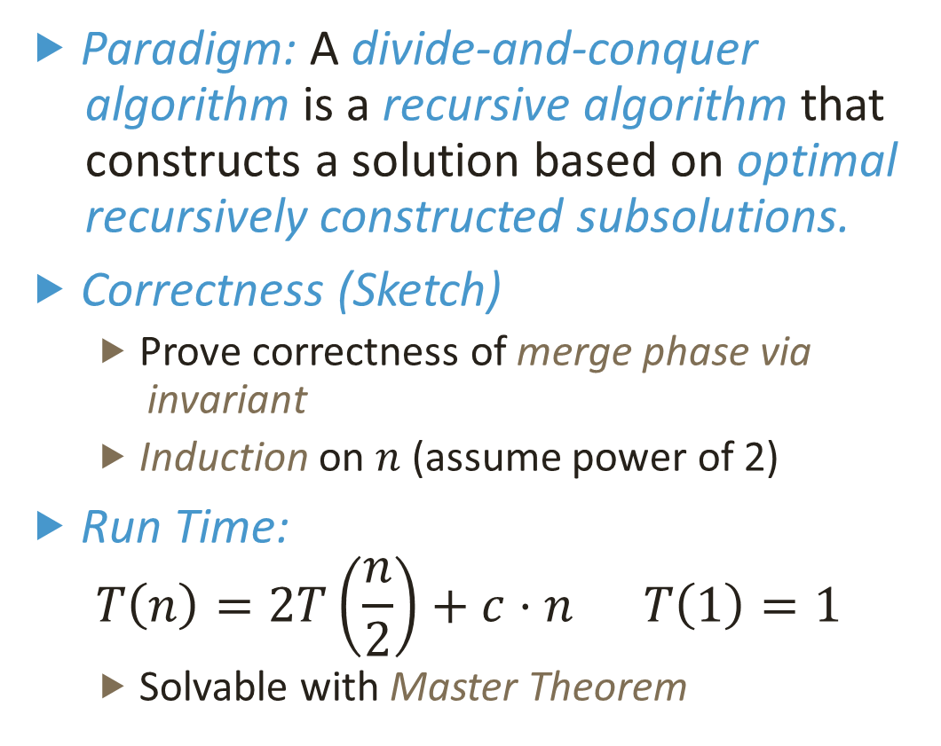
MergeSort(A)
{
if (n=1)
{
return A;
}
S1←MergeSort(A[1,…,n/2]);
S2←MergeSort(A[n/2+1,…,n]);
i1,i2 ← 1;
for (i←1 to n)
{
if(S1[i1] < S2[i2])
{
S[i] = S1[i1];
i1 = i1+1;
}
else
{
S[i] = S2[i2];
i2 = i2+1;
}
}
return S;
Merge Sort – Analysis
Paradigm: A divide-and-conquer algorithm is a recursive algorithm that constructs a solution based on optimal recursively constructed subsolutions.
Correctness (Sketch)
Prove correctness of merge phase via invariant
Induction on $n$ (assume power of 2)
Run Time:
$$T\left(n\right)=2T\left(\frac{n}{2}\right)+c⋅n T\left(1\right)=1$$
Solvable with Master Theorem

Slide 20
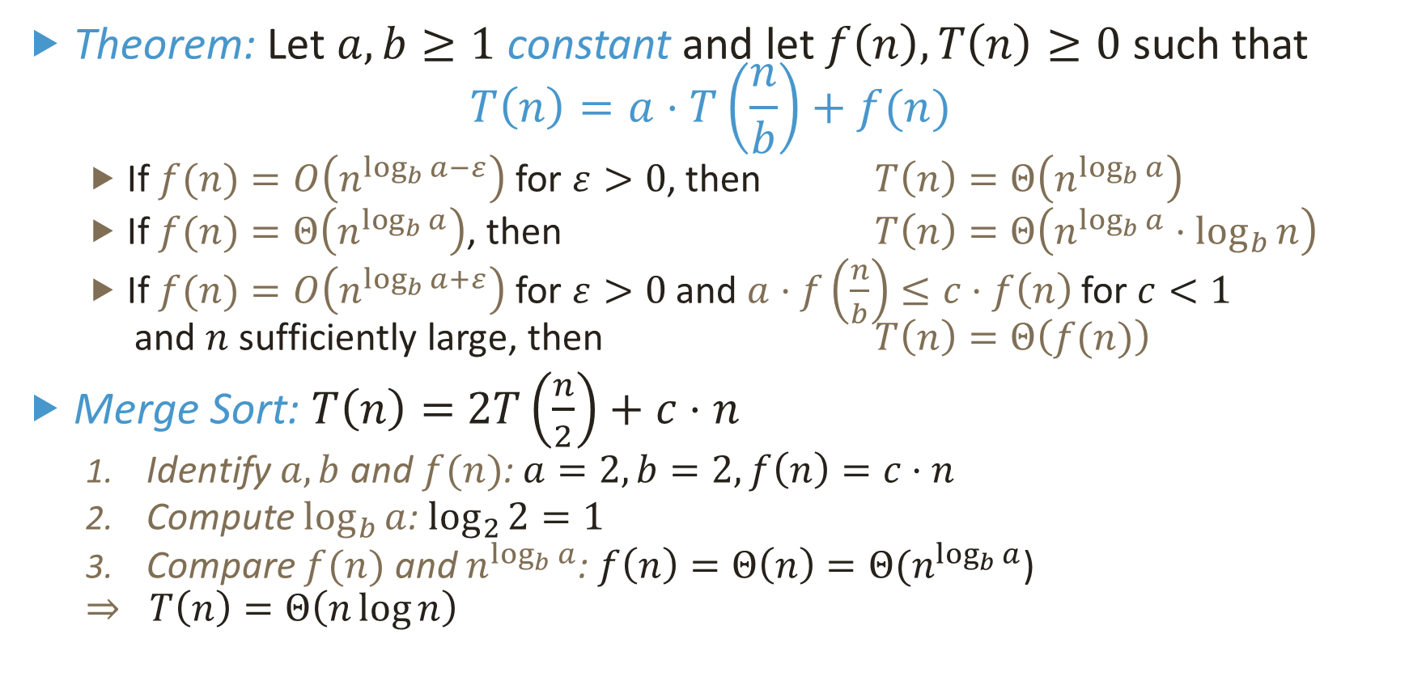
Master Theorem
Theorem: Let $a,b≥1$ constant and let $f\left(n\right),T\left(n\right)≥0$ such that $T\left(n\right)=a⋅T\left(\frac{n}{b}\right)+f(n)$
If $f(n)=O\left(n^{\log_{b}{a}−ε}\right)$ for $ε>0$, then $T\left(n\right)=Θ\left(n^{\log_{b}{a}}\right)$
If $f(n)=Θ\left(n^{\log_{b}{a}}\right)$, then $T\left(n\right)=Θ\left(n^{\log_{b}{a}}⋅\log_{b}{n}\right)$
If $f(n)=O\left(n^{\log_{b}{a}+ε}\right)$ for $ε>0$ and $a⋅f\left(\frac{n}{b}\right)≤c⋅f\left(n\right)$ for $c<1$ and $n$ sufficiently large, then $T\left(n\right)=Θ\left(f(n)\right)$
Merge Sort: $T\left(n\right)=$ $2T\left(\frac{n}{2}\right)+c⋅n$
Identify $a,b$ and $f(n)$: $a=2, b=2, f\left(n\right)=c⋅n$
Compute $\log_{b}{a}$: $\log_{2}{2}=1$
Compare $f(n)$ and $n^{\log_{b}{a}}$: $f\left(n\right)=Θ\left(n\right)=Θ(n^{\log_{b}{a}}$)
$$⇒ T\left(n\right)=Θ\left(n\log{n}\right)$$

Slide 21


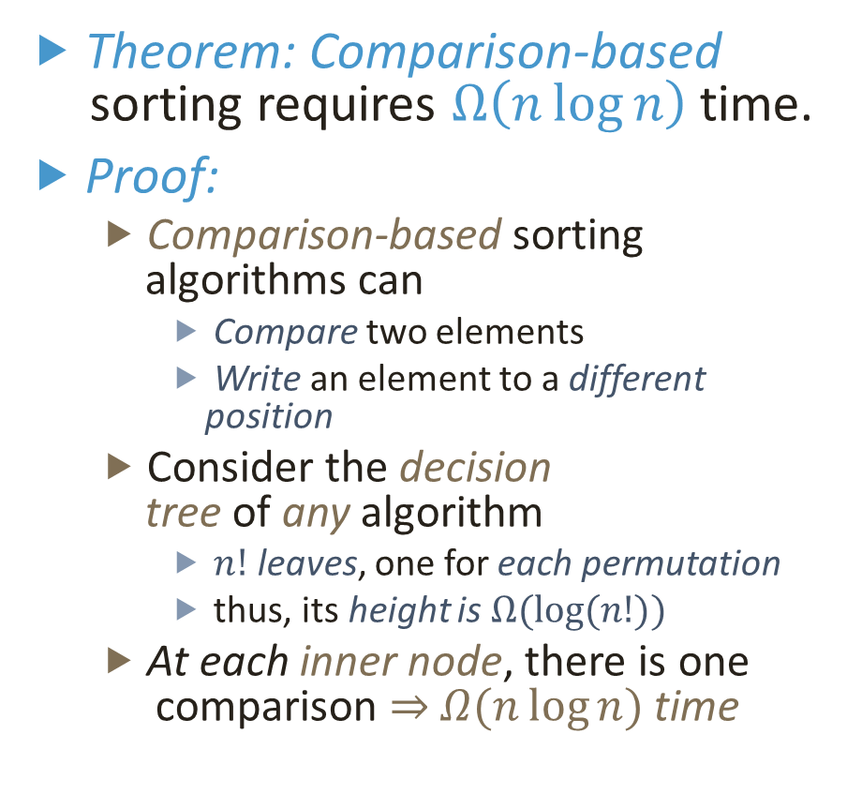



Run Time Lower Bound for Sorting
Theorem: Comparison-based sorting requires $Ω\left(n\log{n}\right)$ time.
Proof:
Comparison-based sorting algorithms can
Compare two elements
Write an element to a different position
Consider the decision tree of any algorithm
$n!$ leaves, one for each permutation
thus, its height is $Ω(\log{(n!)})$
At each inner node, there is one comparison $⇒$ $Ω(n\log{n})$ time
A[1] $≼$ A[2]
A[2] $≼$ A[3]
A[1] $≼$ A[3]
A[1],A[2],A[3]
A[1] $≼$ A[3]
A[2],A[1],A[3]
A[2] $≼$ A[3]
A[1],A[3],A[2]
A[3],A[1],A[2]
A[2],A[3],A[1]
A[3],A[2],A[1]

Slide 22
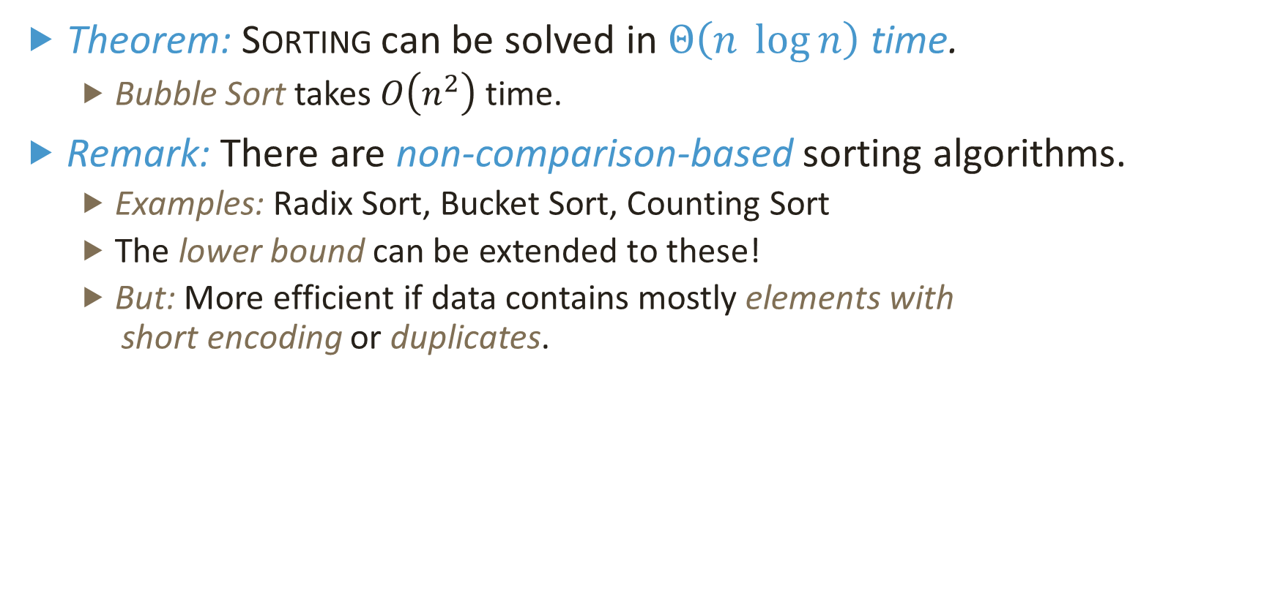
Sorting – Summary
Theorem: Sorting can be solved in $Θ\left(n \log{n}\right)$ time.
Bubble Sort takes $O\left(n^{2}\right)$ time.
Remark: There are non-comparison-based sorting algorithms.
Examples: Radix Sort, Bucket Sort, Counting Sort
The lower bound can be extended to these!
But: More efficient if data contains mostly elements with short encoding or duplicates.

