Slide 1
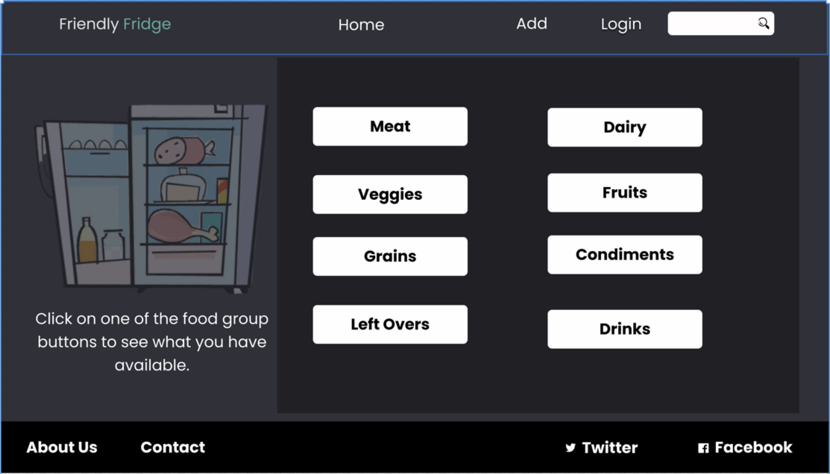

Slide 2
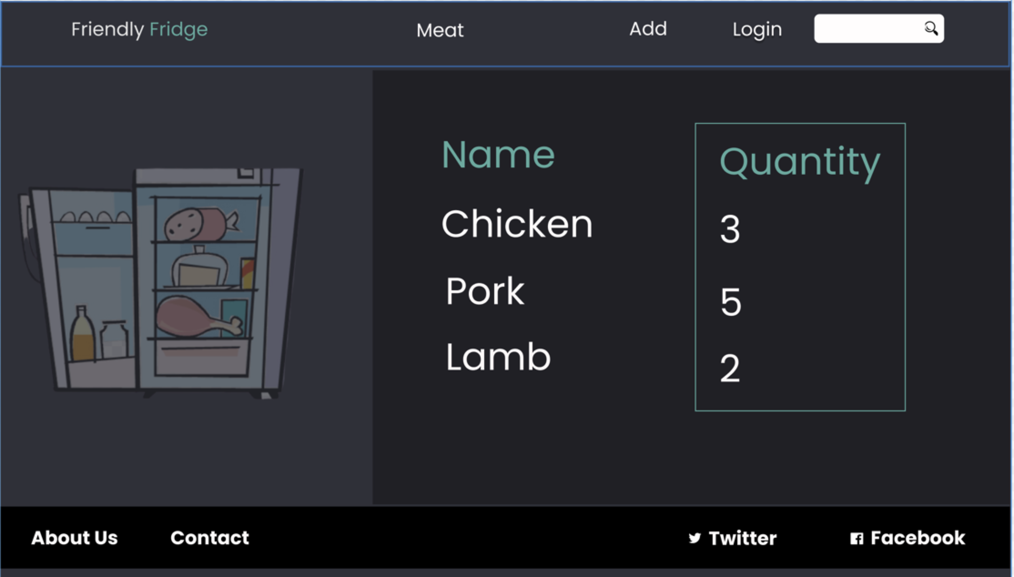

Slide 3
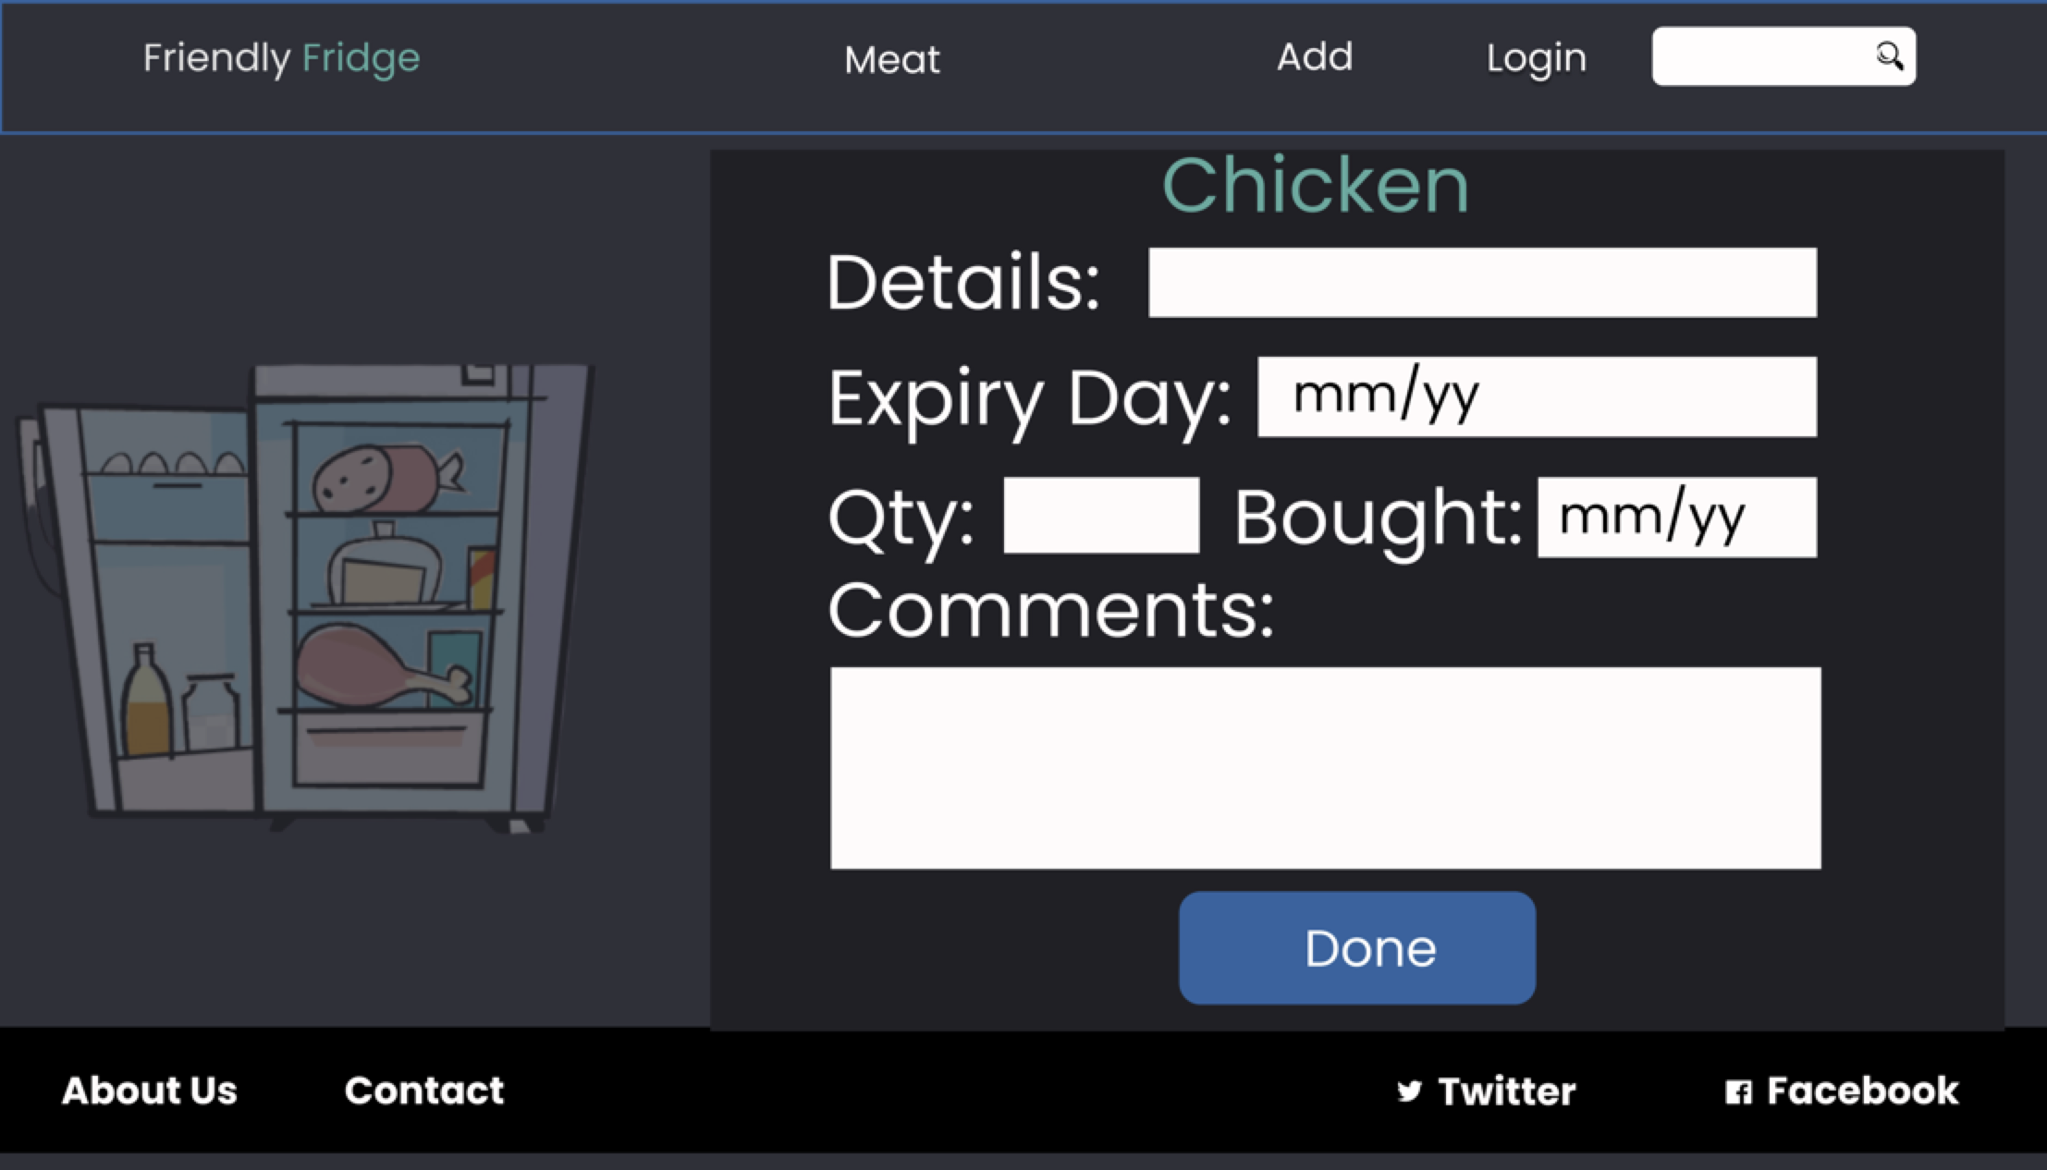

Slide 4
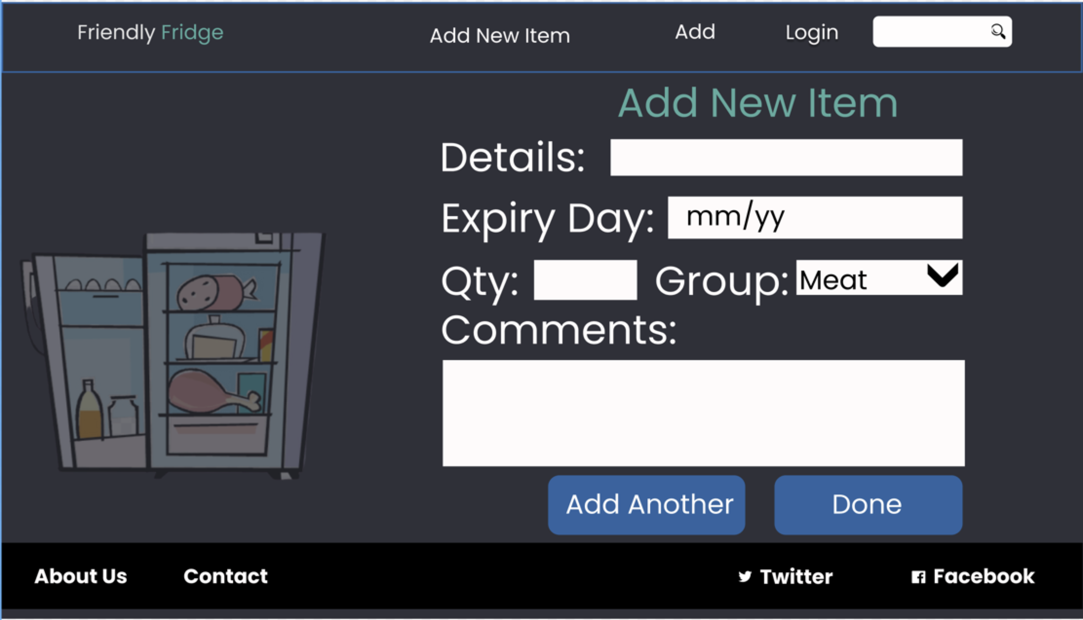

Slide 5
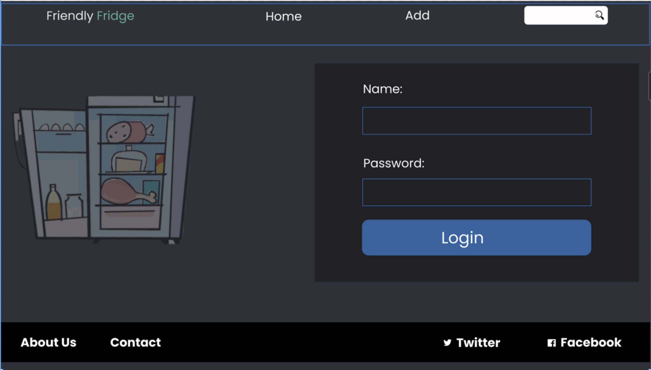

Slide 6
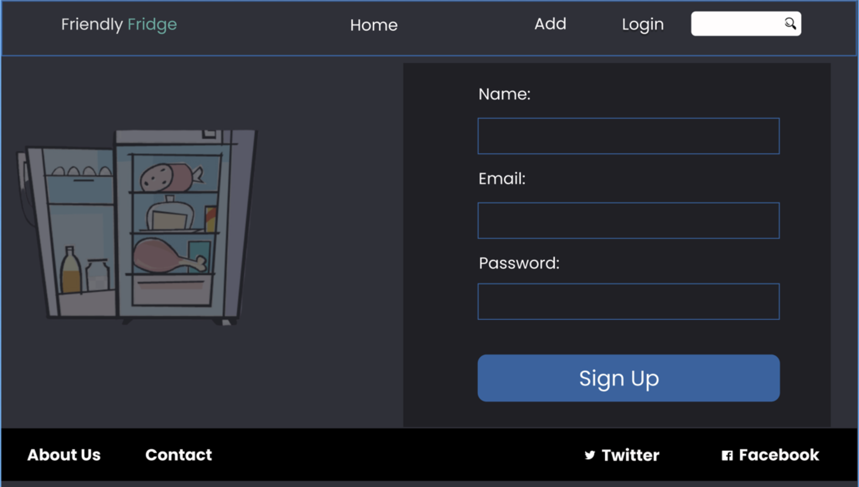

Slide 7
API EndPoints
/api/users/..
/api/food/..
POST ../signup
GET ../foodgroups
POST ../
Create new user + log user in
Retrieve a list of all foodgroups
Create a new food
GET ../:fooditem
Retrieve details of a food item
POST ../login
GET ../food/:foodgroup
Log user in
Retrieve list of all foods for a given foodgroup
PATCH ../:fooditem ../food/:foodgroup
Edit existing food item for a specific food item

Slide 8
SPA Pages
/
List of all food groups
/:foodgroup/foodItems
List of all foods for a given foodgroup
/authenticate
Signup + login forms
/foodItems/new
New food item to add
/foodItems/detail
List all details for specific foodItem
/foodItems/:foodItem
Update food item

