Slide 1
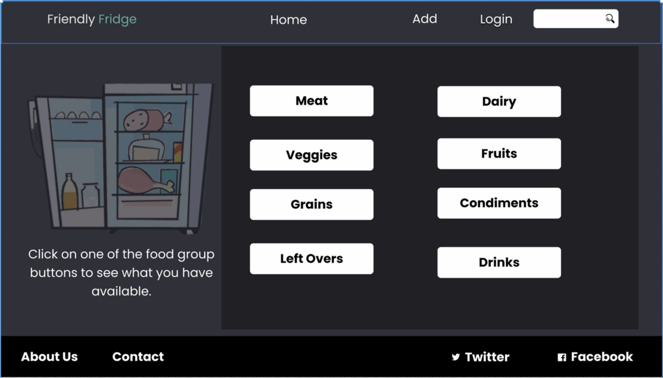

Slide 2
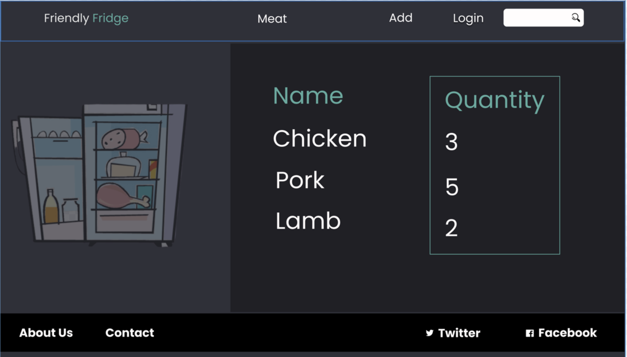

Slide 3
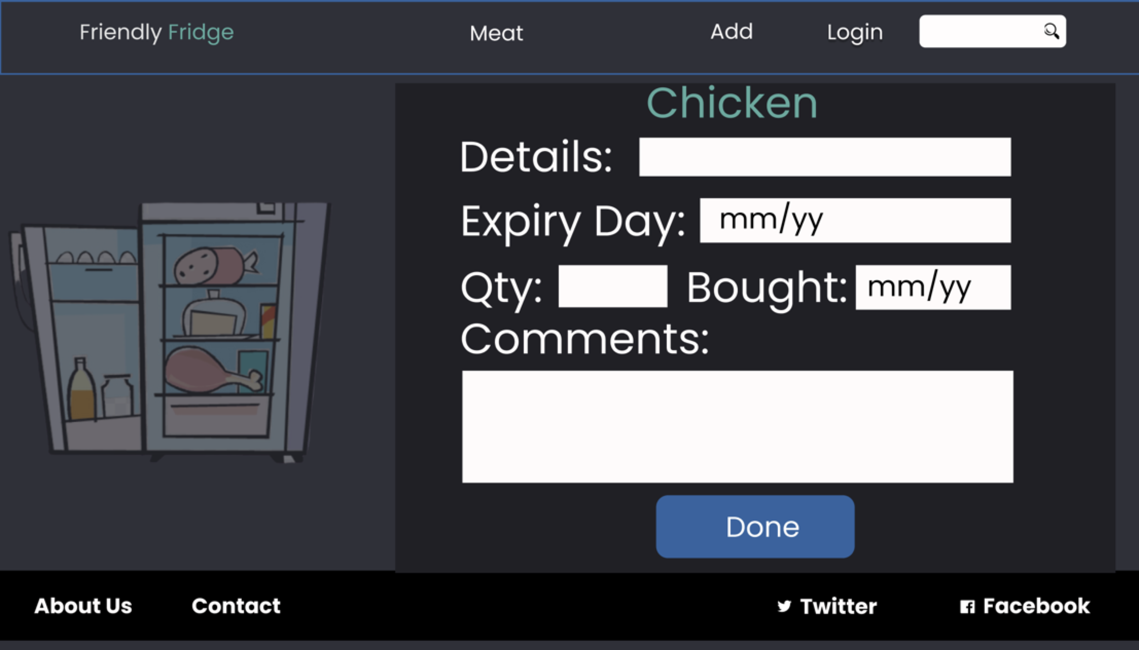

Slide 4
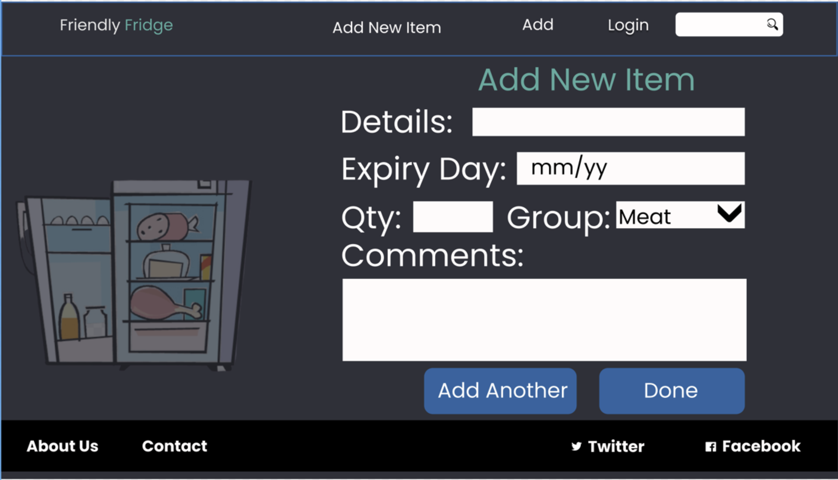

Slide 5
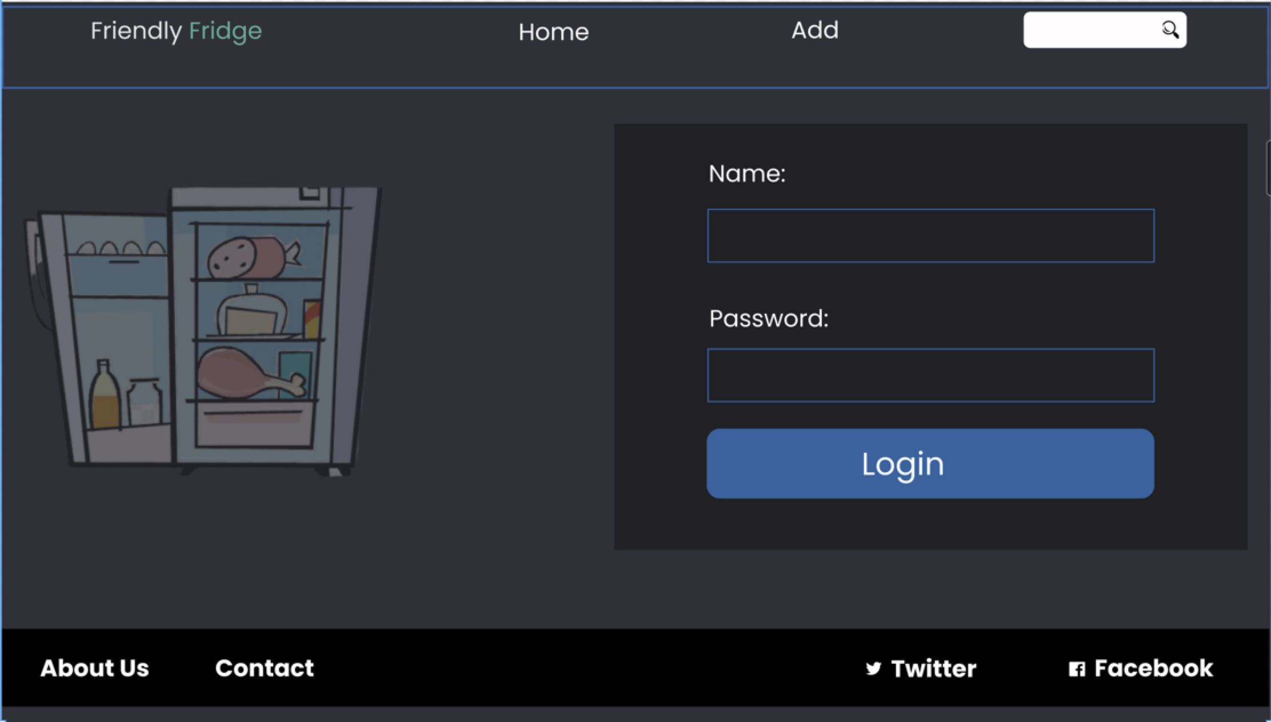

Slide 6
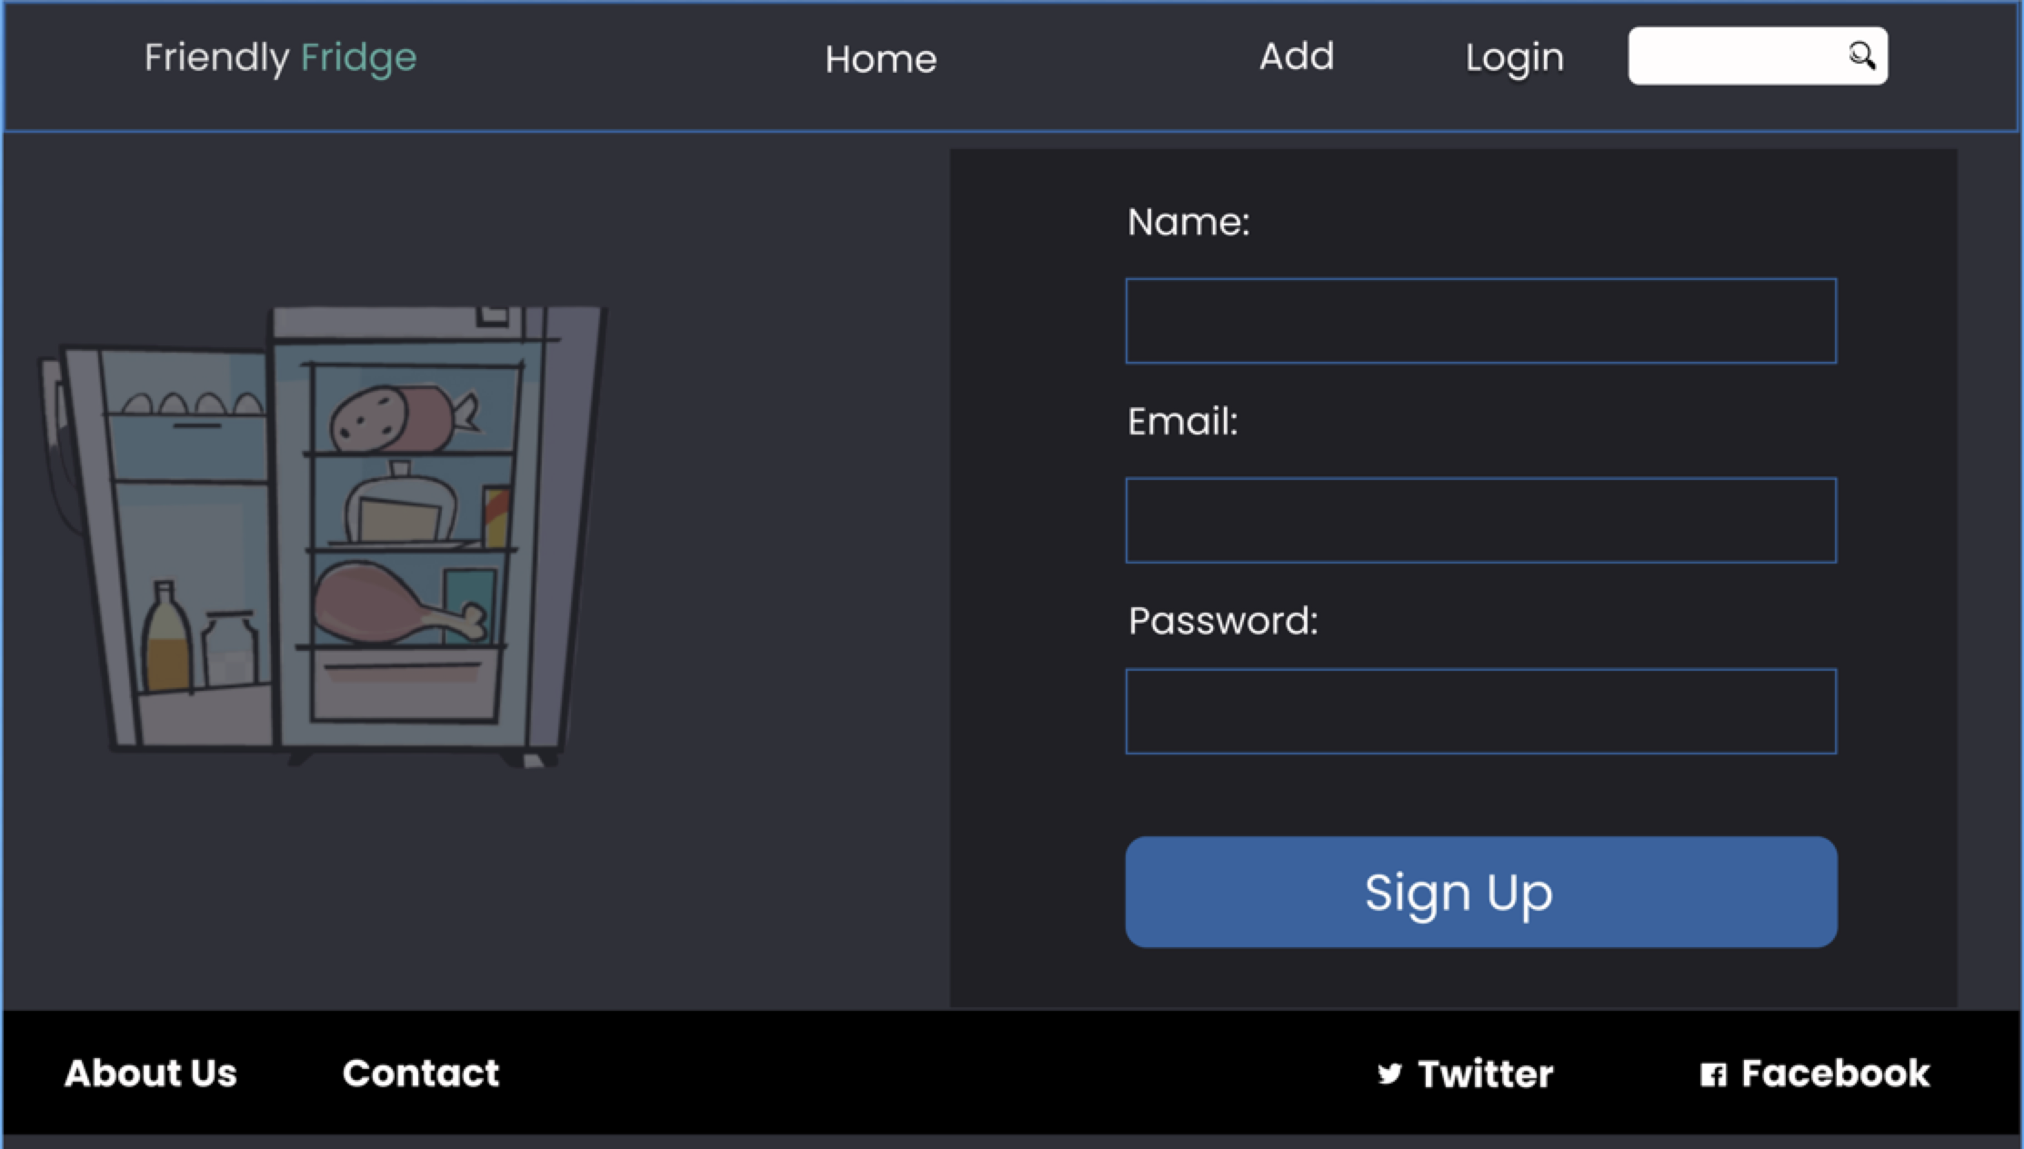

Slide 7
API Endpoints
/api/users/..
/api/food/..
GET ../
GET ../
POST ./api/foodgroups/
Retreive list of all users
Retrieve a list of all foodgroups
Create a new foodgroup
POST ../signup
GET ../:foodname
GET /api/foodgroups/
Retrieve details of a food item
Create new user + log user in
Retrieve list of all foods for a given foodgroup
PATCH ../:foodname ../food/:foodgroup
POST ../login
Edit existing food item for a specific food item
Log user in

Slide 8
SPA Pages
/
List of all food groups
Always reachable
/:foodgroup/foodItems
List of all foods for a given foodgroup
Always reachable
/authenticate
Signup + login forms
Only unauthenti..
/foodItems/new
New food item to add
Only Auth
/foodItems/detail
List all details for specific foodItem
Always reachable
/foodItems/:foodItem
Update food item
Only Auth

Slide 9
Application data
User(s)
name (Optional)
email
password
image (Optional)
Food(s)
FoodGroup(s)
foodid
foodname
details (Optional)
expirydate (Optional)
qty
datebought (System added)
comments (Optional)
foodgroupid: ref
foodgroupid
foodgroupname
foodid: ref
One foodgroup can have multiple foodnames
One food can belong to exactly one foodgroup

Slide 10
SPA Pages
/
List Of Food Groups
/:foodgroupname/food
List Of Food for Selected Food Group
/:foodname/
Food details for the food selected
/authenticate
Signup + Login forms
/food/new
New food form
/food/:foodid
Update food form

