Slide 1
Semantic Analysis on top of Flex + Bison

Slide 2
Problem JSON-like translation
Implement a tool to verify and load the value contained in a text file.
The value is encoded in JSON-like syntax. Make the value available for application specific purposes.
Notes:
The problem was designed to demonstrate the way of achieving semantic representation of the input having certain syntactic properties at some complexity level that can be solved by Flex and Bison.

Slide 3
Problem Details and constraints
A value can be simple or complex
Simple values are numbers and strings
Complex values are dictionaries and arrays
A dictionary is sequence of members enclosed by “{“ and “}”
A dictionary without member is possible
Members are separated by commas
A member can be either
in the form of “<member-name>” “:” value
or, in the form of <member-name> “:” value
An array is sequence of values enclosed by “[“ and “]”
An array without value is possible
Values are separated by commas

Slide 4
Problem Sample Input
{
m: "Test\x30\nAbc",
"field": [1, "Anv", {id:"Test", arr:[]}],
"anothermember":{},
val: 0.5E2
}
Notes:
The example above demonstrates majority of the requirements presented in the preceding slide. Note that the strings may have \r, \n, \t, \\ encoding for some special characters. Any 8 bit value in the form \xh or \xhh is acceptable where h is a hexadecimal digit. The numbers can be fractional with exponential extensions as required in your previous assignments.

Slide 5
Solution Steps
Analyze the problem statement and the example to
Identify Tokens
Develop Grammar
Design Semantic Representation
The tokens are
“{”, “}”, “[”, “]”, comma, colon, identifier, string, number
Notes:
The major steps can be as shown in the slide. Identification of the tokens is virtually straightforward.

Slide 6
Solution Steps Develop grammar
dictionary: SOB memberlist EOB;
array: OB valuelist CB;
memberlist: member | member COMMA memberlist | ;
valuelist: jvalue | jvalue COMMA valuelist | ;
member: name COLON jvalue;
name: ID | STR;
jvalue: STR | NUM | dictionary | array;
%token SOB
%token EOB
%token OB
%token CB
%token ID
%token STR
%token NUM
%token COLON
%token COMMA
Notes:
The grammar developed to solve the problem is in this slide. Pay attention to the Epsilon productions for the member list and the value list. Both the tokens and the grammar will be augmented with semantic properties later.

Slide 7
Solution Steps Design semantic representation
The representation is hierarchy of values!
Dictionary and array may have children
enum class JValueType
{
Str = 0,
Num = 1,
Dict = 32,
Arr = 33
};
class JValue
{
JValueType type;
public:
JValue(JValueType t);
JValueType getType();
virtual void report(ofstream *os)=0;
virtual ~JValue();
};

Slide 8
Solution Steps Design semantic representation
The representation is hierarchy of values!
A simple value without children can be either a double or a string.
class JValueDouble : public JValue
{
private:
double val;
public:
JValueDouble(double d);
virtual void report(ofstream *os);
};
class JValueStr : public JValue
{
private:
string *str;
public:
JValueStr(string *s);
virtual ~JValueStr();
virtual void report(ofstream *os);
};

Slide 9
Solution Steps Design semantic representation
The representation is hierarchy of values!
A dictionary is represented by a vector of members.
class JMember
{
private:
string *id;
JValue *value;
public:
JMember(string *pId, JValue *pValue);
virtual ~JMember();
virtual void report(ofstream *os);
};
class JDictionary : public JValue
{
std::vector<JMember *> *arr;
public:
JDictionary();
~JDictionary();
void addMember(JMember *m);
virtual void report(ofstream *os);
};

Slide 10
Solution Steps Design semantic representation
The representation is hierarchy of values!
class JArray : public JValue
{
private:
std::vector<JValue *> *arr;
public:
JArray();
~JArray();
void addElement(JValue *v);
virtual void report(ofstream *os);
};

Slide 11
Abstract Syntax Tree (AST) Bridging Syntax to Semantic Representation
Parse tree reflects derivations.
AST reflects logical structure.
Input: id + id * id
G:
E → E + T I T
T → T * F | F
F → - E I ( E ) I id
E → E + T
E → T
T → T * F
T → F
F → - E
F → ( E )
F → id
Notes:
Remember the difference between the parse tree and the abstract syntax tree. The design is the abstract representation to serve the needs! The design exemplified here resembles to the AST. It is isolated from the derivations with help of the parser actions that are taken in opportune moments of parsing process!
An abstract syntax tree a structure that is isolated from the details generated by the syntactic analysis. Remember that grammar of the intended language may be transformed for many reasons like elimination of ambiguity, elimination of left recursion, elimination of conflicts, component modularity, and similar. Even though the intended syntax remains the same, the derivations will generate interim symbols and hence, the parse tree will be populated for applicability reasons. The AST reflects the minimum necessary elements only. AST is less complex, more expressive, tool independent, and easy to process.

Slide 12
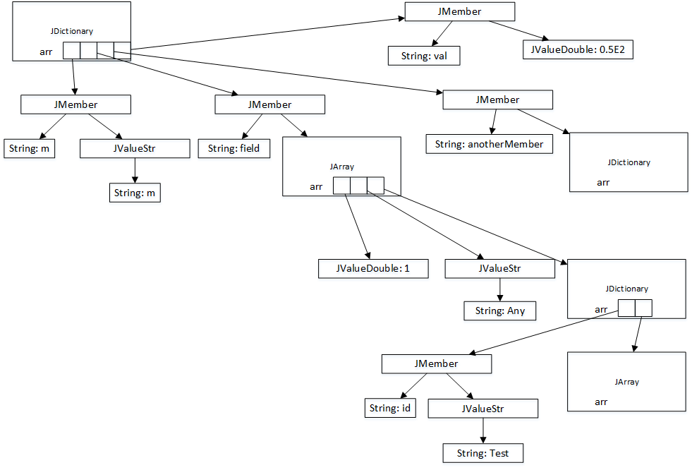
Abstract Syntax Tree (AST) Bridging Syntax to Semantic Representation
Input:
{
m: "Test\x30\nAbc",
"field": [1, "Anv", {id:"Test", arr:[]}],
"anothermember":{},
val: 0.5E2
}
Notes:
Conceptual view of JSON-like sample when semantic representation is achieved.

Slide 13
Flex + Bison Objects for Parsing
It is a fine wiring!
MyParser
This is the driver.
Encompasses the parser, the lexer, and the whole state and semantics.
MyParserBase
Generated by Bison
MyFlexLexer
Generated by Flex as subclass of FlexLexer
Notes:
The lexer (MyFlexLexer) and the parser (MyParserBase) points to the driver (MyParser) so that each component has access to the others. The pointer from the MyFlexLexer is hand-coded in MyFlexLexer.h.
The pointer from the MyParserBase is generated automatically by the Bison because of the declaration coded in sample03.y. See %parse-param {MyParser *driver} The Bison generates a member and a parameter for the parse-param. The constructor generated by the Bison initializes the member with the parameter. See the lines 195, 429, 786 in sample03.tab.hh and the lines 134, 141 in sample03.tab.cc .
Bison generates the parser named as MyParserBase because it is asked to do so by the line
%define api.parser.class {MyParserBase}
in sample03.y .

Slide 14
Flex + Bison Scraping semantics from lexemes
Application requests parse using driver
The driver sets up configuration and uses auto-generated parser’s parse method
The parse method runs SR method and requests lexer to report a lexeme
The lexeme is reported back to the action code!
The action code calculates and sets the semantics for the lexeme.
The action code returns the relevant token identifier.
The driver has actions for both lexer and the parser.
The driver is made accessible from both the lexer and the parser.

Slide 15
Flex + Bison Synthesizing semantics
The art(!) of returning semantics using fine-wiring.
The parser calls driver’s lex method because it was instructed to do so in .y (see line 19 and its effects). The generated parser passes a pointer where the semantics can be saved! This is the opportunity to save the pointer ( lval ).
The driver’s lex method calls MyFlexLexer’s lex method, which is not in MyFlexLexer.cpp module! It is hijacked by the YY_DECL macro through the definition in the .l file (see the lines in .l and its effects).
When the driver’s action method is called by the lexer, the saved pointer ( lval ) can be used thread-safely to store semantics! From this point on, the extracted semantics is in the game field of bison parser.
Notes:
The hijacking occurs by the definition of the YY_DECL macro in the .l file.
#undef YY_DECL
#define YY_DECL int MyFlexLexer::lex(yy::MyParserBase::semantic_type *lval)
The relevant lines in lex.yy.cc
/** The main scanner function which does all the work.
*/
YY_DECL
{

Slide 16
Types for Semantics Bison’s semantic_type
Use of the union semantic type.
Define data types to represent semantics for both tokens and non-terminals!
%define api.value.type union
%nterm <JValue *> jvalue
%nterm <JDictionary *> dictionary
%nterm <JDictionary *> memberlist
%nterm <JArray *> array
%nterm <JArray *> valuelist
%nterm <string *> name
%nterm <JMember *> member
%token SOB
%token EOB
%token OB
%token CB
%token <string *>ID
%token <string *>STR
%token <double> NUM
%token COLON
%token COMMA

Slide 17
Actions for Semantics Bison’s semantics game!
See use of semantics in combination with actions and the methods called.
No globals in solution!
Download, compile, and observe by using debugger!
See the output sample03output.txt as a means of verification.
This is also the Intermediate Representation and the Target for this problem.
What is missing to serve potential application needs!
QUESTIONS!

