Slide 1
Syntactic Analysis

Slide 2
Definition
In a typical language processor implementation, syntactic analysis is the attempt to recognize string of tokens as a sentence in a given language
Parser is the general term for the component that performs the syntactic analysis.
Notes:
In a typical language processor implementation, syntactic analysis is the attempt to recognize string of tokens as a sentence in a given language. Parser is the general term for the component that performs the syntactic analysis.
Typical implementations receive the sequence of the tokens generated by the lexical analyzer. In such cases, the sequence of tokens is fixed for a given input. There may be other approaches, especially in parsing strategies using top-down processing, where the tokens are recognized as the parsing proceeds. For such cases, back-tracking and alternative sequence of tokens may be observed.

Slide 3
Syntactic Validity
Yes, valid program is a sentence.
Usually, validity transcends syntax.
Declarative Integrity
Parameter Matching
Type Conformance
Operator Applicability
Statement Applicability
…
Notes:
Thinking of our experiences with the programming languages which we are accustomed to, event without consulting to the programming language definitions we can safely state that syntactic compliance is necessary to validate a program but not enough. Validity of a given program is governed by the rules that transcends the grammatical constraints. Can you give examples of context dependent properties of a programming language that you know?

Slide 4
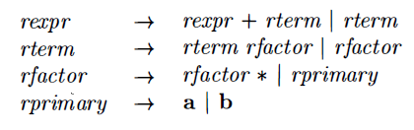
Grammars CFG and (E)BNF
Context Free Grammar (Type 2: Grammars)
G = (V, Σ, R, S)
V: Set of non-terminal (Variables)
Σ: Set of terminals (Reported by lexical analyzer)
R: Rule set (Production rules, productions)
S: Start variable
Backus-Naur Form (Notation)
Notes:
It is a common practice to use formal notations to describe the syntactic rules of languages for a bunch of reasons such as precise-expressive specification, ease of maintenance and improvement, automatic generation recognizers, and similar. For most of the languages that need a parser, the syntactic specification has a property of recursion which is not supported by the type-3 languages i.e. regular expressions.
Any BNF like notation defines common constructs as noted below.
Non-terminals: These are the symbols for the atomic components of the syntax definition reported by the lexical analyzer.
Terminals: These are the symbols making reference to the derivation rules. This references allow the designer to define recursion / cycles in a controlled manner.
Rules: These are the constructs combining the symbols with simple operators such as alternation, Kleene star and derivatives, and helper elements such as Epsilon, Parentheses, and similar. In some contexts, Kleene star and its derivatives are avoided for sake of simplicity as they can be mapped to expressions with help of interim symbols, alternation and Epsilon without loss of expressivity.

Slide 5
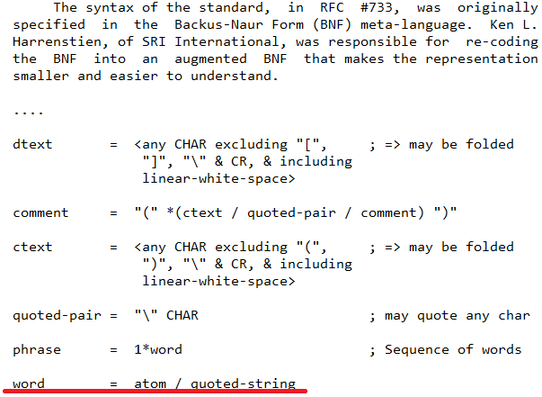
Grammars BNF for Human Reader
RFC 822
The excerpt is from RFC 822, “Standard for the Format of ARPA Internet Text Messages; David H. Crocker;”, https://datatracker.ietf.org/doc/html/rfc822
Notes:
A common notation to specify the intended syntax is known as Backus-Naur Form (BNF), which dates back to the 1960s. BNF and similar notations are widely applied to define the grammar of the intended language as type-2 grammars which are called as context free grammars (CFGs). The notations used in books or standard documents (RFC’s for example) have a certain level of flexibility as their main concern is to describe the grammar for human readers. Automatic parser generators on the other hand must be strict in their meta-language (notation) definition, which is similar to the BNF notation at some level. Each project defines its own way of building declarations.
The excerpt is from RFC 822, “Standard for the Format of ARPA Internet Text Messages; David H. Crocker;”, https://datatracker.ietf.org/doc/html/rfc822

Slide 6
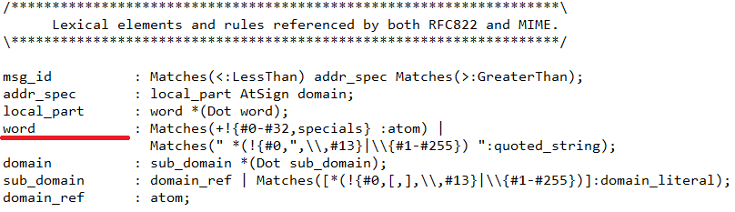
Grammars (E)BNF for a Language Processor
From a Parser Generator Project
Notes:
The excerpt is from a proprietary parser definition language.

Slide 7
Grammars BNF Simplified
* Transformation
u e* w → u e’ w
e' : e’e | ε (Left recursive form)
e' : e e’ | ε (Right recursive form)
? Transformation
u e? w → u e’ w
e' : e | ε
+ Transformation
u e+ w → u e e’ w
e' : e’e | ε (Left recursive form)
e' : e e’ | ε (Right recursive form)
Parentheses
u (e) w → u e’ w
e' : e
Alternative Notations
[e], {e}, prefix, postfix, etc...

Slide 8
Derivation Definition
Derivation is a sequence of rewriting steps that begins with the grammar’s start symbol and ends with a sentence in the language.
Definition from “Cooper, K.D., Torczon, L.; Engineering A Compiler”
Notes:
If uAv is a sentential form in derivation of string and production rule A exists such that A->w, then uAv -> uwv . A Î V, and u, v, w Î S*, where S* is the set of the sentential forms allowed by the R.
Basically, the choice of A in a sentential form can be made arbitrarily. But, there are two basic ways of making this choice that we are interested in. The first way is choosing the leftmost non-terminal, the second way is choosing the rightmost non-terminal. If a derivation chooses the leftmost non-terminals only, it is called leftmost derivation (LMD). Similarly, if a derivation chooses the rightmost non-terminals only, it is called rightmost derivation (LMD). A sentential form can be defined alternatively as an intermediate form that is reachable from S. So, a left sentential form is a sentential form that exists as a step in LMD; a right sentential form is a sentential form that exists as a step in RMD.

Slide 9
Sentential Form Definition
Sentential form is a string of symbols that occurs as a step in a valid derivation.
A step is making use of a rule on the latest sentential form.
Choose a variable.
Replace with the associated production.
G = (V, Σ, R, S)
f_{n}=uAv
A ∈ V
A → w ∈ R
f_{n+1}=uwv
uAv, uwv ∈ S*
u, v ∈ (V U Σ)*
Definition from “Cooper, K.D., Torczon, L.; Engineering A Compiler”
Notes:
If uAv is a sentential form in derivation of string and production rule A exists such that A->w, then uAv -> uwv . A Î V, and u, v, w Î S*, where S* is the set of the sentential forms allowed by the R.
Basically, the choice of A in a sentential form can be made arbitrarily.

Slide 10
Derivation
S* ⇒ α means α can be found as a sentence starting from S by zero or more derivation steps.
α ⇒∗ β means β is reachable from α by zero or more derivation steps.
α ⇒⁺ β means β is reachable from α by one or more derivation steps.
α ⇒∗ β and β ⇒∗ γ then α ⇒∗ γ
G1 :
S → aA
S → abC
A→ aA
A→ bA
A→ C
A→ ε
C→ c
Example: Input: aaba
G1 :
S → aA | abC
A→ aA | bA | C | ε
C→ c
Notes:
S by S-> aA
aA by A-> aA
aaA by A -> bA
aabA -> aA
aaba This is a sentence. This is rightmost derivation by the way.

Slide 11
Derivations LMD, RMD, Left and Right Sentential Forms
Leftmost Derivation (LMD) chooses the leftmost variable.
Rightmost Derivation (RMD) chooses the rightmost variable.
Any step in LMD is leftmost sentential form.
Any step in RMD is rightmost sentential form.
Finding sentence aaba by G1
S use S → aA
aA use A → aA
aaA use A → bA
aabA use A → aA
aabaA use A → ε
aaba
Notes:
But, there are two basic ways of making this choice that we are interested in. The first way is choosing the leftmost non-terminal, the second way is choosing the rightmost non-terminal. If a derivation chooses the leftmost non-terminals only, it is called leftmost derivation (LMD). Similarly, if a derivation chooses the rightmost non-terminals only, it is called rightmost derivation (LMD). A sentential form can be defined alternatively as an intermediate form that is reachable from S. So, a left sentential form is a sentential form that exists as a step in LMD; a right sentential form is a sentential form that exists as a step in RMD.

Slide 12
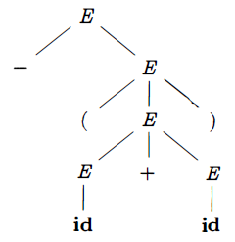
Parse Trees
Successive steps taken in a derivation can be represented with help of trees, which are known as parse trees.
G: E → E + E I E * E I - E I ( E ) I id
E → E + E
E → E * E
E → - E
E → ( E )
E → id
Input: - (id + id)
Example from “Aho, A.V, Ullman J.D, Sethi R., Lam M.S; Dragon Book”
Notes:
Successive steps taken in a derivation can be represented with help of trees, which are known as parse trees.

Slide 13
Ambiguity
A grammar that produces more than one parse tree for some sentence is said to be ambiguous.
G: E → E + E I E * E I - E I ( E ) I id
E → E + E
E → E * E
E → - E
E → ( E )
E → id
Input: id + id * id
Create leftmost derivations for this sentence!
Definition and example from “Aho, A.V, Ullman J.D, Sethi R., Lam M.S; Dragon Book”
Notes:
A grammar that produces more than one parse tree for some sentence is said to be ambiguous.
A well-known ambiguity problem is the dangling-else problem!

Slide 14
Ambiguity Elimination
Rewriting
G:
E → E + T I T
T → T * F | F
F → - E I ( E ) I id
E → E + T
E → T
T → T * F
T → F
F → - E
F → ( E )
F → id
G:
E → E + E I E * E I - E I ( E ) I id
E → E + E
E → E * E
E → - E
E → ( E )
E → id
Inputs: id + id * id, id + id + id, id * id * id
Definition and example from “Aho, A.V, Ullman J.D, Sethi R., Lam M.S; Dragon Book”
Notes:
A grammar that produces more than one parse tree for some sentence is said to be ambiguous.

Slide 15
Parsing as Tree Building Method
Top-Down Parsing
Begins with the root and grows the tree toward the
leaves.
Bottom-Up Parsing
Begins with the leaves and grows the tree toward the
root.
Input: id + id * id
Definition from “Cooper, K.D., Torczon, L.; Engineering A Compiler”
Notes:
A grammar that produces more than one parse tree for some sentence is said to be ambiguous.
Create the parse tree top-down and bottom-up fashion.

Slide 16
Top Down Parsing
The Left Recursion Problem
Input: id + id * id
G:
E → E + T I T
T → T * F | F
F → - E I ( E ) I id
E → E + T
E → T
T → T * F
T → F
F → - E
F → ( E )
F → id
Immediate Recursions
A → A α | β
Elimination
A → β A’
A’ → α A’ | ε
Elimination rule from “Aho, A.V, Ullman J.D, Sethi R., Lam M.S; Dragon Book”
Notes:
A top down parser establishes the parse tree starting from the root and tries each production of the variable by expanding it as a child.
Use leftmost derivations to create the parse tree. When you apply the rules in the order they were declared, you cannot avoid endless recursion.

Slide 17
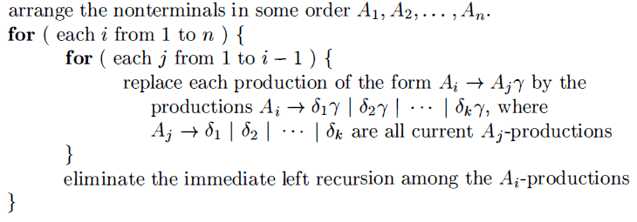
Left Recursion Elimination
When Grammar has no Cycles and no ε-productions
General Elimination Algorithm
Algorithm from “Aho, A.V, Ullman J.D, Sethi R., Lam M.S; Dragon Book”
Notes:
The algorithm given above does not guarantee when the preconditions are not met.

Slide 18
Left Recursion Elimination
General Elimination Algorithm
G:
E → E + T I T
T → T * F | F
F → - E I ( E ) I id
E → E + T
E → T
T → T * F
T → F
F → - E
F → ( E )
F → id
G:
E → E + T I T
T → T * F | F
F → - E I ( E ) I id
E → T E’
E’ → +T E’ | ε
T → F T’
T’ → * F T’ | ε
F → - E
F → ( E )
F → id
Input: id + id * id
Notes:
When the algorithm applied to the grammar G, it is transformed to a more complicated form. But now, it is recursion free.
Use leftmost derivations again to create the parse tree.

Slide 19
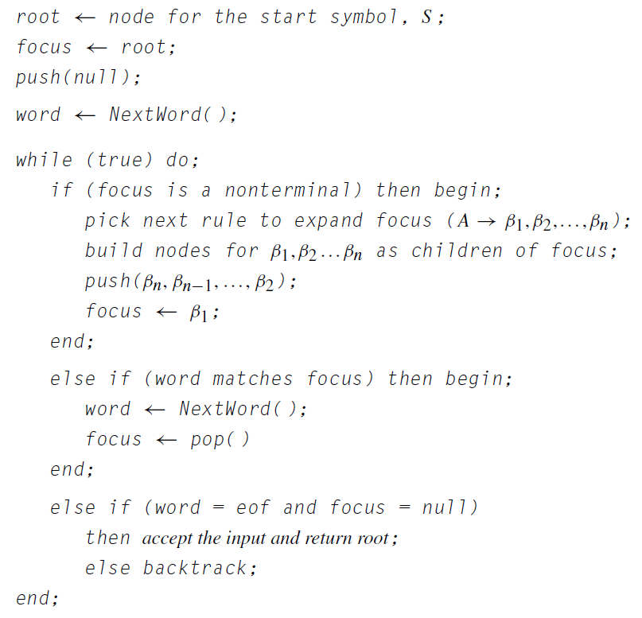
Backtracking
The leftmost, top-down parser
Algorithm from “Cooper, K.D., Torczon, L.; Engineering A Compiler”

Slide 20
Backtracking
Backtrack-free Grammar / Predictive Grammar
a CFG for which the leftmost, top-down parser can
always predict the correct rule with lookahead of
at most one word.
Elimination Using First and Follow Sets
FIRST Set
For a grammar symbol α, FIRST(α) is the set of terminals that can appear at the start of a sentence derived from α.
FOLLOW Set
For a nonterminal α, FOLLOW(α) contains the set of words that can occur immediately after α in a sentence.
Definitions from “Cooper, K.D., Torczon, L.; Engineering A Compiler”

Slide 21
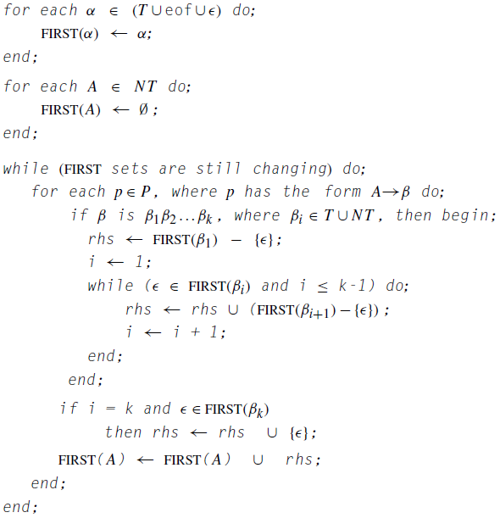
First Set Construction
G = (V, Σ, R, S)
What are T, NT,
P?
Algorithm from “Cooper, K.D., Torczon, L.; Engineering A Compiler”

Slide 22
First Set Example
G:
E → E + T I T
T → T * F | F
F → - E I ( E ) I id
E → T E’
E’ → +T E’
E’ → ε
T → F T’
T’ → * F T’
T’ → ε
F → - E
F → ( E )
F → id
Build the first sets!
Notes:
Build the first sets.

Slide 23
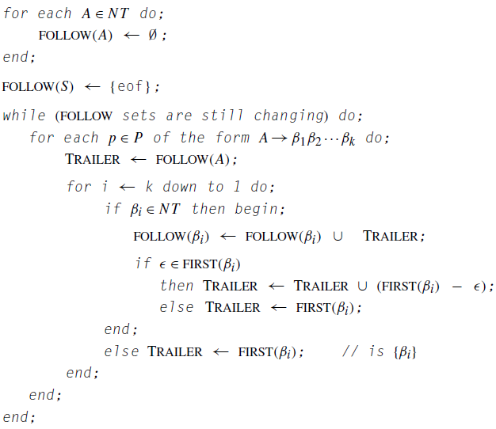
Follow Set Construction
Algorithm from “Cooper, K.D., Torczon, L.; Engineering A Compiler”

Slide 24
Follow Set Example
G:
E → E + T I T
T → T * F | F
F → - E I ( E ) I id
E → T E’
E’ → +T E’
E’ → ε
T → F T’
T’ → * F T’
T’ → ε
F → - E
F → ( E )
F → id
Build the follow sets!
Notes:
Build the first sets.

Slide 25
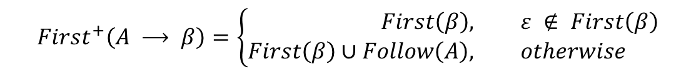
Backtracking Backtrack-free Test
Test each non-terminal with multiple RHS!
$${First}^{+}\left(A ⟶ β\right)=\left\{\begin{aligned}First\left(β\right), &ε ∉ First\left(β\right) \\ First\left(β\right)∪Follow\left(A\right), &otherwise\end{aligned}\right.$$
$${First}^{+}\left(A ⟶ β_{i}\right) ∩ {First}^{+}\left(A ⟶ β_{j}\right) = ∅, ∀ 1 ≤i, j ≤n, i ≠ j$$
Test method from “Cooper, K.D., Torczon, L.; Engineering A Compiler”
Notes:
To test if a grammar is backtrack-free any non-terminal having more than one RHS (alternatives) must be tested. For a backtrack-free grammar, the First+ sets generated for alternatives are distinct.

Slide 26
Left Factoring
G:
E → E + T I T
T → T * F | F
F → - E I ( E ) I id
E → T E’
E’ → +T E’
E’ → ε
T → F T’
T’ → * F T’
T’ → ε
F → - E
F → ( E )
F → id
F → id ( E )
F → id [ E ]
When array and function call like structures added!
G:
E → E + T I T
T → T * F | F
F → - E I ( E ) I id
.
.
.
.
F → - E
F → ( E )
F → id G
G → ( E )
G → [ E ]
G → ε
Notes:
When we add two more productions for F to create a flavor of function call and array access backtracking test for F fails! Rewriting with left factoring helps eliminate common First+ sets.

Slide 27
Predictive Parsers
Stages of Test & Elimination
Ambiguity
Left Recursion
Backtracking
Left Factoring
Can you revise the leftmost, top-down parser?
Now, we can focus on
Recursive Descent Parsers
Table Driven LL(1) Parser
Notes:
When we add two more productions for F to create a flavor of function call and array access backtracking test for F fails! Rewriting with left factoring helps eliminate common First+ sets.

Slide 28
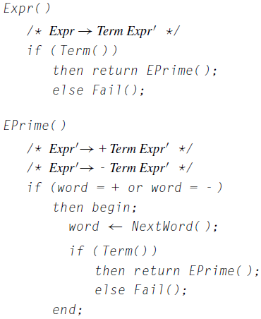
Recursive Descent Parsing
A procedure for each NT
Hand coded
Or, automatically generated based on grammar
Ease of customization, debugging
Sample pseudo-code from “Cooper, K.D., Torczon, L.; Engineering A Compiler”
Notes:
Recursive descent parsing is one way of implementing top down parsing strategy. It is easy to construct and follow. It can be built by hand or automatically. A standard debugger becomes a tool to diagnose and fix parsing related problems!

Slide 29
LL(1) Parsing
LL(1) Parsers
Use standard skeleton procedure
Use parse tables
Can be generated by parser generators

Slide 30
LL(1) Parsing
The leftmost, top-down parser
(non-predictive)
Sample pseudo-code from “Cooper, K.D., Torczon, L.; Engineering A Compiler”

Slide 31
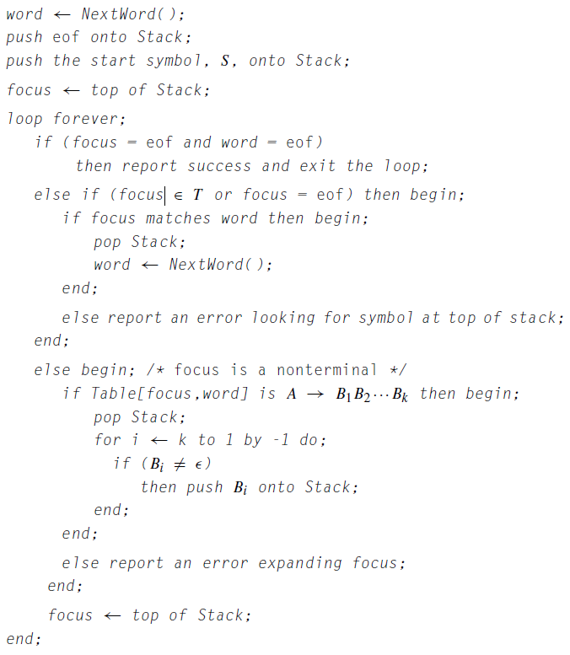
LL(1) Parsing
LL(1) Parser
Predictive
No backtracking
Sample pseudo-code from “Cooper, K.D., Torczon, L.; Engineering A Compiler”

Slide 32
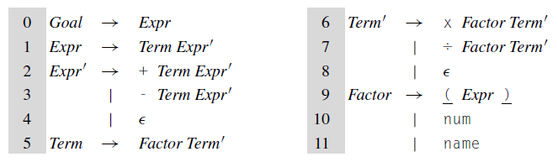
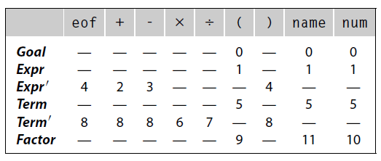
LL(1) Parsing Parse Table
LL(1) Parser
Predictive
No backtracking
Use First+ to create the parse table!
Grammars and table from “Cooper, K.D., Torczon, L.; Engineering A Compiler”

Slide 33
Bottom Up Parsing LR Grammars
Bottom-Up Parsing
Begins with the leaves and grows the tree toward the
root.
LR Grammars
Shift Reduce Parsing
LR(0) Automaton
Using Follow: SLR Parsing
Using Lookahead: LR(1) Canonical Items
Saving Resources: LALR
Notes:
We will start with shift reduce parsing, which conveys the basic operation of the bottom up parsing.

Slide 34
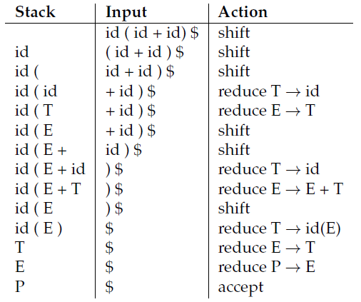
Bottom Up Parsing Shift Reduce Parsing
Grammar:
P → E
E → E + T
E → T
T → id ( E )
T → id
Input: id(id+id)
Grammar and trace from “Douglas Thain, Introduction to Compilers and Language Design, Chapter 4”, http://compilerbook.org
Notes:
This is a sample to illustrate the operation of the shift reduce parsing, which applies a strategy to start from the input and reaching the goal symbol by applying reductions. The sequence of operations applied is result of purposeful selection to achieve successful completion.
The second action (‘shift’) could also be (‘reduce’), which would not lead us a result. In other words, “id(“ is a viable prefix for reduction while “T(“, “E(“ are not. It is critical to keep the left side in viable prefix forms. Another relevant definition to give at this point is the “handle”, which is a substring that matches a production at certain form in right sentential form. See the Stack and Input to observe right sentential forms in reverse order. Handles are reduced (or pruned) in the process of recognition.
A strategy with backtracking would be proposed! Like we did in top-down parsing, we will seek the ways of making good choices with the clues (or the context) that can be obtained from the input stream so that predictive actions can be taken. In this regard, we will define requirements of the well-formed grammars. To start with a rule, let’s note that the grammar must not be ambiguous in which case there is more than one handle for some stages of shift reduce parsing.

Slide 35
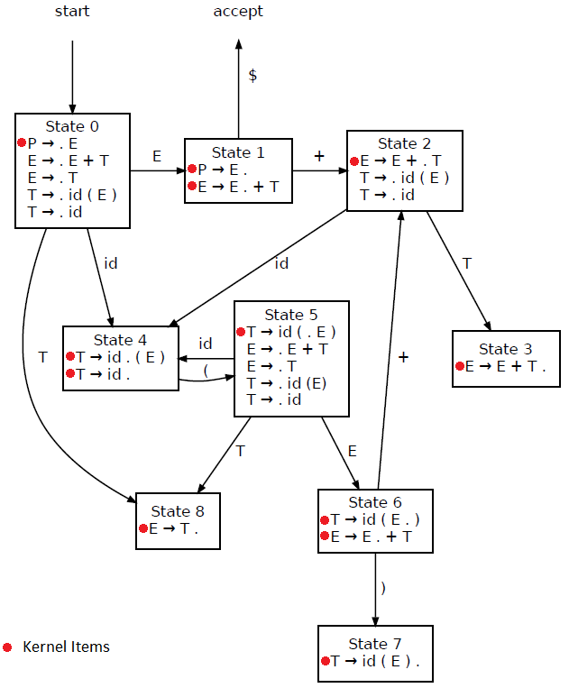
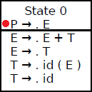
Bottom Up Parsing LR(0) Items / Automaton
Position Notation
Dot augmentation
Kernel Items
Ex: P → .E
Closure
Ex:
Automaton from “Douglas Thain, Introduction to Compilers and Language Design, Chapter 4”, http://compilerbook.org
Notes:
The LR(0) items are the productions augmented with a dot that signifies the position on the rule. The substring on the left is the recognized part, the substring on the right are the remaining substring to be recognized.
1. If there is alternatives for the starting production create a root production S’ −> Σ, ανδ ασσυμε Σ’ ασ σταρτινγ προδυχτιον.
2. To create start state, create the kernel item using the starting production
3. Choose a state to process and create closure. To create closure of a state, kernel items are the starting points. Scan items in the closure, on each item, for each non-terminal appearing on the right of dot, include the productions for that nonterminal with a dot at start. Repeat the process until the closure becomes stable .i.e. no new items added.
4. Scan items and for each item in the closure, for each w appearing on the right of dot (A->u.wv) try to find a transition and destination state on the diagram. If not found create a transition and a destination state. Create a kernel item in the form of A->uw.v .
5. Goto step 3 if there is at least one state that was not processed.

Slide 36
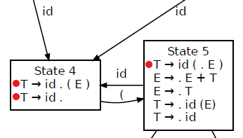
Bottom Up Parsing Conflicts
Shift - Reduce Conflicts
From the example grammar (State 4)
T → id . E
T → id .
Reduce – Reduce Conflicts
Ex: If we had followings on a state
S → id ( E ) .
E → id ( E ) .
Examples from “Douglas Thain, Introduction to Compilers and Language Design, Chapter 4”, http://compilerbook.org
Notes:
Conflicts have be dealt with by using predictions. Our first step for predictive actions is the SLR Parsing.

Slide 37
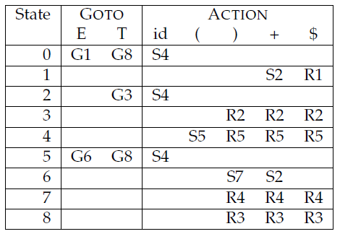
Bottom Up Parsing SLR Parsing
Prediction Using Follow Sets
Grammar:
P → E
E → E + T
E → T
T → id ( E )
T → id
Table and grammar from “Douglas Thain, Introduction to Compilers and Language Design, Chapter 4”, http://compilerbook.org
Notes:
Create the First and Follow Sets.
Create S (Shift) actions for each terminal transition edge using the destination state number.
Create G (Goto) actions for each non-terminal transition edge using the destination state number.
Create R (Reduce) actions for each terminal in the follow set. Use the production number to note R.

Slide 38
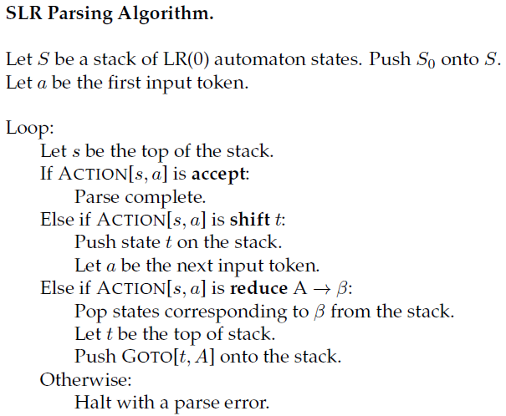
Bottom Up Parsing SLR Parsing
Algorithm from “Douglas Thain, Introduction to Compilers and Language Design, Chapter 4”, http://compilerbook.org
Notes:
This is the SLR parsing algorithm driven by the SLR table and the input.

Slide 39
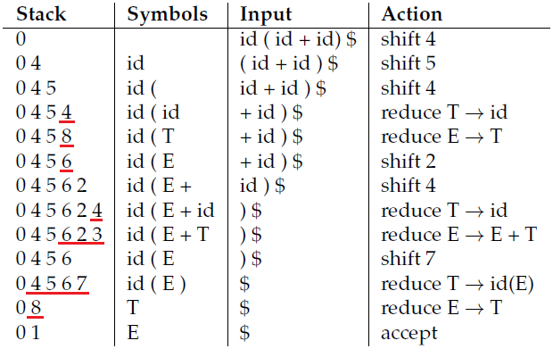
Bottom Up Parsing SLR Parsing
Grammar:
P → E
E → E + T
E → T
T → id ( E )
T → id
Input: id(id+id)
Execution trace from “Douglas Thain, Introduction to Compilers and Language Design, Chapter 4”, http://compilerbook.org
Notes:
Use of SLR table eliminated the dilemma that occurred in the execution that we examined while introducing shift-reduce parsing. Note that, the symbols and input are displayed to make visible the sentential forms. The next token and the stack of the states are the essential parts to implement table driven shift reduce algorithm.

Slide 40
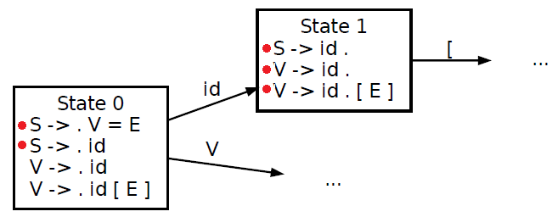

Bottom Up Parsing LR(1) Items
SLR fails when follow sets are not distinct on the same state
 | First | Follow
S | id | $
V | id | =$)
E | Id | $)
Grammar:
S → V = E
S → id
V → id
V → id ( E )
E → V
$$Follow\left(S\right) ∩ Follow\left(V\right) = \left\{\$\right\}$$
Reduce - Reduce Conflict
Grammar and diagram from “Douglas Thain, Introduction to Compilers and Language Design, Chapter 4”, http://compilerbook.org
Notes:
The state 1 has two productions with follow sets having a common element causing reduce-reduce conflict. Use of lookeaheads instead of follow may help improve the power of the bottom-up parsing.

Slide 41
Bottom Up Parsing LR(1) Items
Canonical Form
Like LR(0), Augmented by Lookahead
Writing Lookahead for Each Item in State
In case A → α . B, {L} create B → . γ, {L}
In case A → α . B β, {L}
create B → . γ, First(β) if β cannot be ε
create B → . γ, First(β) U {L} if β can be ε
Grammar:
S → V = E
S → id
V → id
V → id ( E )
E → V
Grammar from “Douglas Thain, Introduction to Compilers and Language Design, Chapter 4”, http://compilerbook.org
Notes:
The LR(0) items are the productions augmented with a dot that signifies the position on the rule. The substring on the left is the recognized part, the substring on the right are the remaining substring to be recognized.
1. If there is alternatives for the starting production create a root production S’ −> Σ, ανδ ασσυμε Σ’ ασ σταρτινγ προδυχτιον.
2. To create start state, create the kernel item using the starting production(s) with lookahead {$}
3. Choose a state to process and create closure. To create closure of a state, kernel items are the starting points. Scan items in the closure, on each item, for each non-terminal appearing on the right of dot, include the productions for that nonterminal with a dot at start and the calculated lookahead. Repeat the process until the closure becomes stable .i.e. no new items added.
4. Merge items having LR(0) items with different lookaheads by unioning lookeahead sets on the finalized closure.
5. Scan items and for each item in the closure, for each w appearing on the right of dot (A->u.wv, {L}) try to find a transition and destination state on the diagram. If not found create a transition and a destination state. Create a kernel item in the form of A->uw.v {L} .
6. Goto step 3 if there is at least one state that was not processed.

Slide 42
Bottom Up Parsing LR(1) Items
Example Case for P (State 0)
As kernel item add (1) P → . E, {$}
Using (1) add (2) E → . E + T, {$}
Using (1) add (3) E → . T, {$}
Using (2) add (4) E → . E + T, {+}
Using (3) add (5) T → . id ( E ), {$}
Using (3) add (6) T → . id, {$}
Using (4) add (7) E → . T, {+}
No new item using (5), (6)
Using (7) add (8) T → . id ( E ), {+}
Using (7) add (9) T → . id, {+}
No new items using (8), (9)
Merge the items having common LR(0) items.
Grammar:
P → E
E → E + T
E → T
T → id ( E )
T → id
Closure
P → . E, {$}
E → . E + T, {$ +}
E → . T, {$ +}
T → . id ( E ), {$+}
T → . id, {$ +}
Grammar and diagram from “Douglas Thain, Introduction to Compilers and Language Design, Chapter 4”, http://compilerbook.org
Notes:
This is step by step evolution of closure for the state 0.

Slide 43
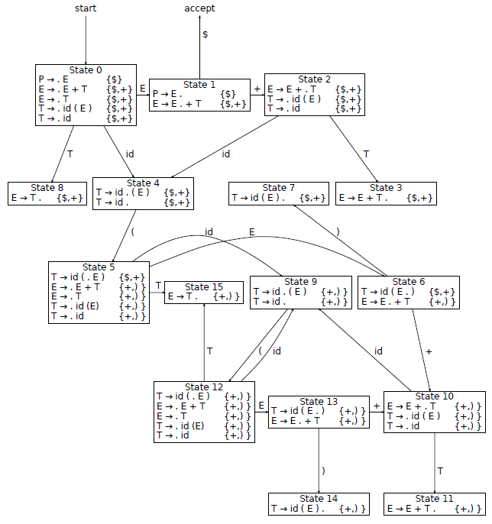
Bottom Up Parsing LR(1) Automaton
Diagram from “Douglas Thain, Introduction to Compilers and Language Design, Chapter 4”, http://compilerbook.org
Notes:
Applying the principles similar to the LR(0) case, the LR(1) automaton is built as seen. Note that there are many states (16 in this case) for even a small piece of grammar. Developing the LR(1) states and items by hand is time consuming and it is easy to make mistakes. The parser generators like Yacc, Bison take care of handling generation of the tables and error free code.

Slide 44


Bottom Up Parsing LALR Parsing
Merge States Having Common Cores
Identify the States Having Common Cores
Write a New State with LR(0) items and Union Lookaheads
Example: Not from the Previous Diagram!
Identify the states that can be merged in the previous diagram!
Reconstruct the diagram!
Note on Grammars:
$$LL\left(1\right)⊂SLR ⊂LALR ⊂LR\left(1\right)⊂CFG$$
Example and comparison from “Douglas Thain, Introduction to Compilers and Language Design, Chapter 4”, http://compilerbook.org
Notes:
LALR parsers weaker than the LR(1) parsers but stronger than the SLR parsers.

Slide 45
Final Words
Other Parsing Strategies
LL(*)
Parse Expression Grammars (PEG)
…more
“BOTTOM LINE: We do all this math to ensure that the source code is translated to internal representation unambiguously, predictably.” (*)
(*) Remark from Cem Bozşahin, notes on Syntactic Analysis
Notes:
Studying LL(1), SLR, LALR, LR(1) parsers are useful to understand the insights and the challenges in syntactic analysis. The study helps as relate the syntactic analysis with context free grammars along with the properties and limitations. Note that even syntactic analysis may transcend the boundaries of context free grammars. Even though the parsers are mostly generated with help of parser generators, manual interventions may bee needed to obtain the intended parsers. The strategies of implementing parsers are far more richer than the strategies introduced in this presentation.
https://www.antlr.org/papers/LL-star-PLDI11.pdf
https://bford.info/pub/lang/peg.pdf

