Slide 1
Intermediate Representations

Slide 2
Definition
An intermediate representation is a composite derivative structure that supports generation of target code.
Extends the meaning,
regards the target architectures.
Notes:
An intermediate representation uses the results of the preceding phases (lexical analysis, syntax analysis, semantic analysis) and performs more processing to make it easy generation of targets. While the structures generated by the semantic analysis phase describes what is in the input, the IR generation phase regards the target architecture so that target generation is possible.

Slide 3
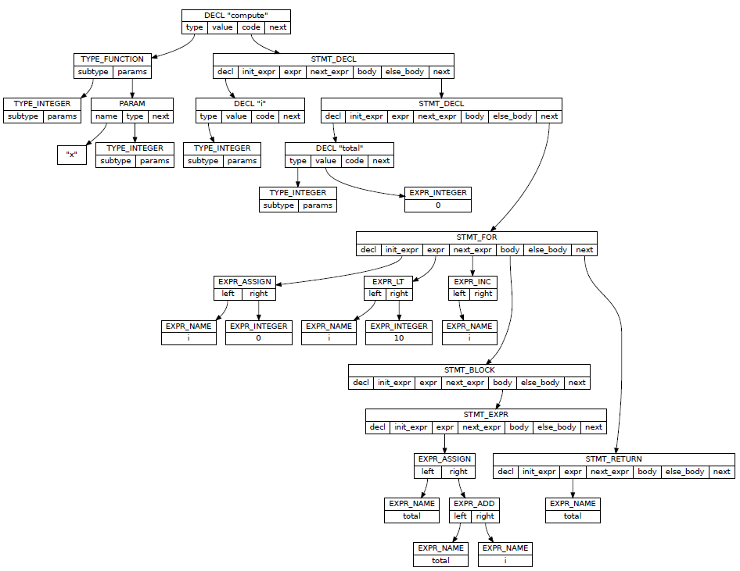
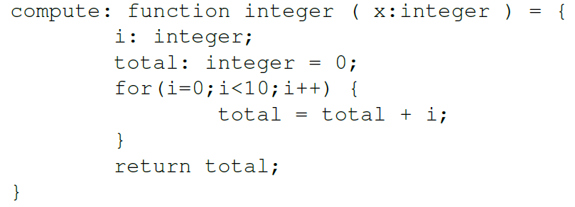
Abstract Syntax Tree (AST) Semantic Representation as Graphical IR
Example from “Douglas Thain, Introduction to Compilers and Language Design, Chapter 6”, http://compilerbook.org
Notes:
Abstract syntax tree is a component of Intermediate representation. It falls in the category of graphical IR.

Slide 4
Abstract Syntax Tree (AST) Semantic Representation as Graphical IR
Syntax is hierarchical.
Meaning is not!
Expressions
Structure – Member Relationships
Flow Control Statements
Other Declarations
…
Notes:
Representation of the meaning transcends the limitations of tree structure. When the input is organized as sequence of symbols, which is a one dimensional composition, the limits of the hierarchical declarative organization cannot be overcome. But, the semantics require more complex representations. This problem is commonly solved by symbolic references turning the IR into a composite derivative structure.

Slide 5
IR Generation Linear Representations
Transforming into linear structure
Just a scheme for transformation.
Notes:
The diagram presented in this slide is a model for transforming an imperative language into an intermediate code. As pointed out earlier in this lecture alternative diagrams can be proposed and justified so long as they meet implementation specific or educational needs. The scheme proposed in this diagram describes also the implementation plan for the rest of the applied track of this course.

Slide 6
IR Generation Graphical Representations
Building up AST
Semantic analysis phase
Inherited Attributes (Top-Down)
Synthesized Attributes (Bottom-Up)
Opportune Moments in Parsing!
Notes:
Building up abstract syntax tree is dependent on the parsing strategy, which can be determined by the underlying methods and tools. In bison, the capturing the semantics is achieved by integrating pseudo-variables with developer defined types and actions. In a top down scheme, use of inherited attribute, entry, and exit actions will enable alternative implementations. Or, it is possible to have the entire the parse tree built once, which incurs memory and CPU costs, and processing the whole AST.

Slide 7
IR Generation Linear Representations
Building up AST
Build
Expression Trees
Control Flow Structures
Symbolic Representation Items (namespaces, classes, types, formal parameters, methods, procedures, variables, …)
Notes:
The AST may need to be accompanied by other supporting structures such as preprocessing data, compilation unit bindings (think about C, C++ modules). Availability of this structures may be critical for code generation (think about code generation for debugging and release modes), error reporting, debug information generation, runtime type information, and similar.

Slide 8
IR Generation Augmentation of AST, DAG
Multi-pass AST
Initial Setup
Register Intrinsic Symbols
Symbolic Representation Items
Populate the Symbol Entries
Detect Duplications and Conflicts
Calculation
Calculate Symbol Address
Type Data
Meta-types & Type Signatures
Notes:
Symbolic representation will be implemented with the symbol management strategy. It may be based on maintenance of a global symbol table that is capable of representing each symbol with associated metatype (type, variable, parameter, class, etc), scope, and similar. It is also possible to manage the symbols in association with scope entities that may be found in AST. In this case, symbol collections are associated with scope entities such as execution blocks, class structures, module structures. There are advantages of scanning the AST (and other meaning items) once and building the symbol representation once. This strategy separates the mutating operations (insertion) with reading operations. So the complexities become clear and minimal. Populating, lexicographic sorting, and look up has the complexities of O(1), O(n log n), and O(log n) respectively.
On the applied track, we will initialize the symbols table with the pre-defined functions. We will populate symbol descriptors with object (table) sub-types with simple signatures.

Slide 9
IR Generation Augmentation and Transformation
Multi-pass AST
Expression Trees
Apply Transformation (DAG)
Inject Cast / Pseudo Operators
Evaluate Node Types
Detect errors (Unresolved symbols, operator applicability, etc.)
Apply Constant Folding
Calculate Node Addresses
Calculate Stack Loads
Notes:
On the applied track, we will apply node type evaluation, error detection and constant folding.

Slide 10
IR Generation Linearization
Multi-pass AST
Control Flow Structure
Apply Code Templates to Emit IC Instructions
Expression Trees
Traverse and Emit IC Instructions
Notes:
On the applied track we will use case specific simple IC instructions.

Slide 11
IR Generation Intermediate Code
Purpose
Architecture Independence (!)
Standard / Improved Target Code Quality
Reducing Cost of Overall Implementation
Basic Types
Stack Machine Code
Three Address Code
Examples
Gimple / LLVM / JVM
Notes:
Decoupling Target Code Generation from Previous Stages

Slide 12
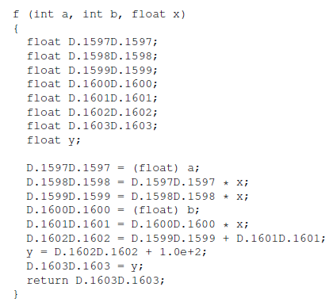

IC Generation Example: Gimple
Example from “Douglas Thain, Introduction to Compilers and Language Design, Chapter 8”, http://compilerbook.org

Slide 13
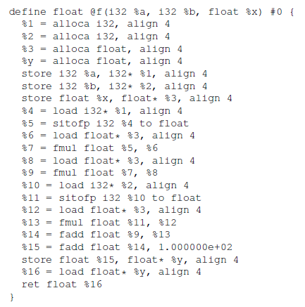
IC Generation Example: LLVM
Example from “Douglas Thain, Introduction to Compilers and Language Design, Chapter 8”, http://compilerbook.org

Slide 14
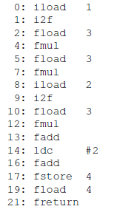
IC Generation Example: JVM
Example from “Douglas Thain, Introduction to Compilers and Language Design, Chapter 8”, http://compilerbook.org

Slide 15
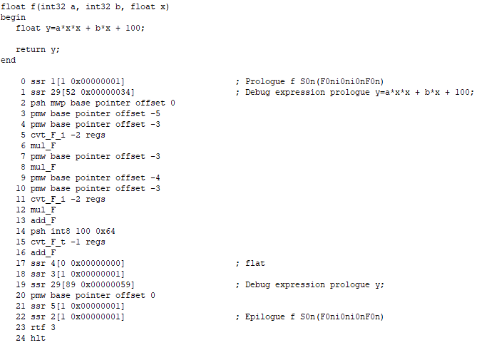
IC Generation Example: Proprietary

Slide 16
IC Generation Multi-pass IR Traversal
Some Basics
Multi-Pass IR Node Traversal
Virtual instructions and types
Control Flow Code Templates
Type Calculation
Address Calculation
Optimizations
More…
Some Advanced Processing
Type System Operations
Structured Exception Handling
Closures
Concurrency Related Patterns
More …
Notes:
To generate intermediate code, the graphical IR is walked over multiple times to create the linear intermediate representations, which is much closer to the sequence of the instructions that will be generated by the back end. This, addressing many details such as code labeling, code skeletons (code templates or code-macros), virtual types / instructions, and similar. Control statements and expressions can be converted to their corresponding linear forms by using proper IR traversal methods combined with instruction labeling.

Slide 17
Simple Optimizations on IR Constant Folding
Arithmetic Logic Operation Properties
Constant operands
Identity elements
Notes:
Arithmetic – logic sub-expressions can be calculated during compile time resulting reduced expression trees, more efficient intermediate code. Operators coded with identity elements or constants can be processed by removing the operands and modifying the operator nodes.

Slide 18
Simple Optimizations on IR Strength Reduction
Arithmetic Logic Operation Properties
Exponentials with constants
Multiplications with constant
More …
DAG
Conversion
These properties may have impact on instruction selection, too.
Notes:
Strength reduction can also be achieved by detecting common sup-expression. There may be subtle properties such as function volatility (if a function returns always the same value without affecting other state or not).

Slide 19
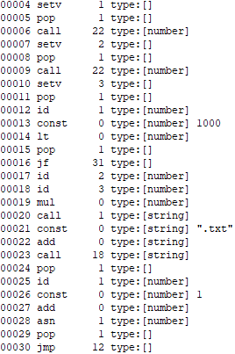
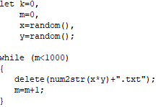
Simple Optimizations on IR Invariant Code Motion – Code Hoisting
Move
Example from the TQL assignment
Notes:
The code generator may decide to move the code fragments by analyzing the data dependencies. In this example, the loop invariant sub-expression can be moved before the code fragment that takes care of loop condition checking. To make the things right a temporary must be allocated to store the result of the moved code.

Slide 20
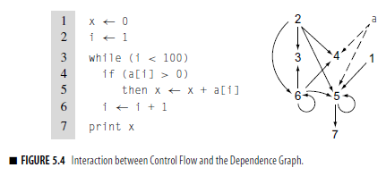
Simple Optimizations on IR Invariant Code Motion – Code Hoisting
Data Flow Analysis and Dependence Graphs
Excerpt from “Cooper, K.D., Torczon, L.; Engineering A Compiler, 2nd Edition page 233”
Notes:
Detection of the moveable code can be based on dependence graphs. This analysis reveals the code portions that can be moved outside of the inner statement bodies. Such an approach will save computation cycles when applied on alternative execution paths and loops.

Slide 21
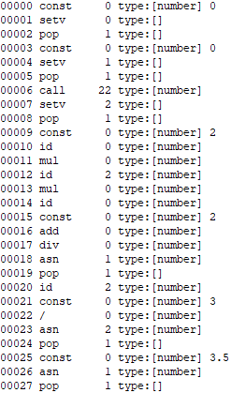
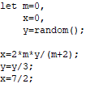
Simple Optimizations on IR Dead Code Elimination
Not
Effective
Example from the TQL assignment
Notes:
Data analysis is a way to reveal the writes without reads. This helps elimination of ineffective calculations. Control flow graphs help to establish “control paths” which help analyze unreachable code fragments. Control path examination simulates flows with alternatives and identify the unreached statements. “The code behind return”, “The code behind break / continue”, “Ending with no return” are just a few examples you are familiar with.

Slide 22
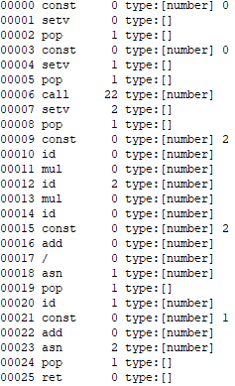

Simple Optimizations on IR Peephole Optimization
Not
Effective
Example from the TQL assignment
Notes:
Peephole optimization is performed on the linear IR detecting extra code generated by earlier steps. The example on this slide transcends the boundaries of expression and statement contexts.

