Slide 1
Face Detection and Person Re-identification using Deep Learning Techniques
Revanth B S - 15IT137
Akshay U Prabhu - 15IT203
Hafeez Ali A - 15IT252

Slide 2
Agenda
Introduction
Literature Survey
Outcome of Literature Survey
Motivation
Problem Statement
Objectives
Proposed Work
Conclusion
Timeline of Project
Individual Contribution
References

Slide 3
Face Detection using Haar Classifiers

Slide 4
Introduction
Face recognition presents a challenging problem in the field of image analysis and computer vision. The security of information is becoming very significant and difficult.
Security cameras are presently common in airports, Offices, Universities, ATMs, banks and in any location with a security system. Face recognition is a biometric system used to identify or verify a person from a digital image.
Face recognition system should be able to automatically detect a face in an image which involves extracting its features and then recognizing it, regardless of lighting, expression, illumination, ageing, transformations (translate, rotate and scale image) and pose, which is a difficult task.

Slide 5
Literature Review
Authors | Methodology | Advantages | Limitations
Santemiz P, Spreeuwers LJ, Veldhuis RNJ | Retrieval algorithm for face images in the airport surveillance multimedia video based on the skin color detection | Simple and fast | Can’t overcome the effect of factors such as illumination and background color interference
Paul Viola and Michael Jones | Image retrieval method based on integral images | Strong real-time performance | Face detection rate and false detection rate are increased in a complicated scene

Slide 6
Outcome of Literature Review
At present, there are many ways for face image detection under the cloud model, related research has made some achievements, such as,
Santemiz P, Spreeuwers LJ, Veldhuis RNJ proposed a retrieval algorithm for face images in the airport surveillance multimedia video based on the skin color detection, which has characteristics of simple and fast, but can’t overcome the effect of factors such as illumination and background color interference.
Paul Viola and Michael Jones proposed face image retrieval method based on integral images, which has strong real-time performance, but in the complicated scene, face detection rate and false detection rate are increased.

Slide 7
Issues and Challenges
Real time face detection.
Illumination and background color interference.
Finding specific faces.
Recognise face regardless of lighting, expression, transformation (translate and scale image)

Slide 8
Motivation
Some of the latest face recognition algorithm involving machine learning algorithms perform well but sadly the training period and processing time is large enough to limit its use in practical applications. Hence there is a continuous strife to propose an effective face recognition system with high accuracy and acceptable processing time.

Slide 9
Problem Statement
Retrieve specific face images in the airport surveillance multimedia video on cloud computing platform.

Slide 10
Research Objectives
Implementing haar face cascade classifier to detect faces in a surveillance video.
Block matching method is used to track the face detected in the previous step.
Extracting specific facial features using Principle Component Analysis(PCA).
Using Linear Discriminant Analysis method to compare the extracted feature information with the specific face.

Slide 11
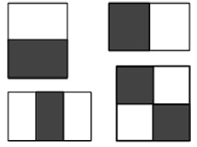
Proposed Model
Haar Face Cascade Classifier
Features
The simple features used are reminiscent of Haar basis functions:
• Two-rectangle feature: difference between the sum of the pixels within two rectangular regions.
• Three-rectangle feature: sum within two outside rectangles subtracted from the sum in a center rectangle.
• Four-rectangle feature: difference between diagonal pairs of rectangles.

Slide 12
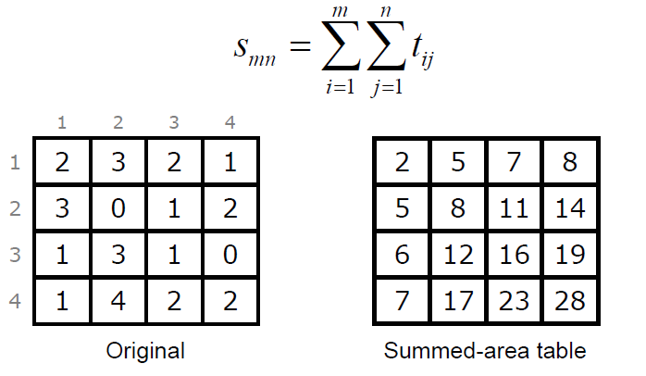
Proposed Model
Integral Image
Integral image allows for the calculation of sum of all pixels inside any given rectangle using only four values at the corner of the rectangle in constant time.

Slide 13
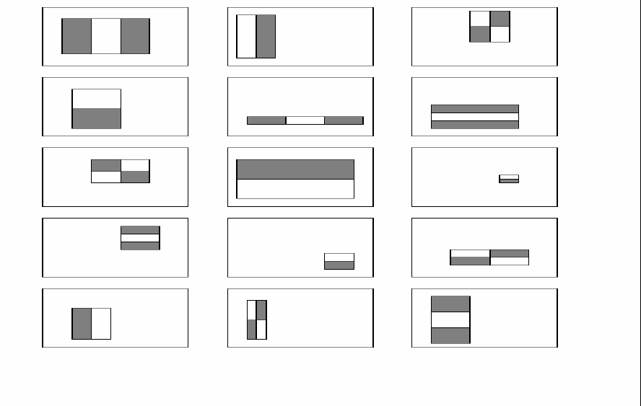
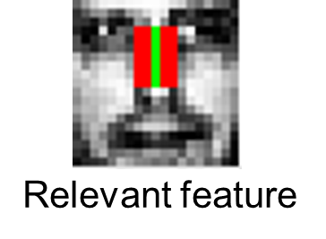
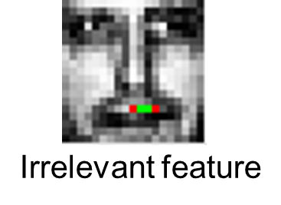
Proposed Model
Ada Boost
Adaboost is a machine learning algorithm which helps in finding only the best features among all these 160,000+ features. After these features are found a weighted combination of all these features in used in evaluating and deciding any given window has a face or not. Each of the selected features are considered okay to be included if they can at least perform better than random guessing (detects more than half the cases).

Slide 14

Proposed Model
Ada Boost
2. These features are also called as weak classifiers. Adaboost constructs a strong classifier as a linear combination of these weak classifiers.
Strong classifier
Weak classifier

Slide 15
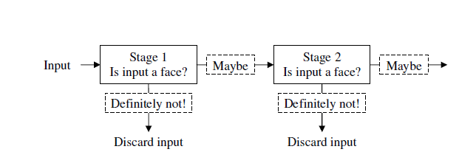
Proposed Model
Cascade classifier
Cascade classifier is composed of stages each containing a strong classifier. So all the features are grouped into several stages where each stage has certain number of features.
The job of each stage is used to determine whether a given sub window is definitely not a face or may be a face. A given sub window is immediately discarded as not a face if it fails in any of the stage.

Slide 16
Methodology
Harr face cascade classifier is used to detect face images in airport surveillance multimedia video, in order to find out the missing face in airport surveillance multimedia video, the block matching method is introduced for face tracking, and the missing face in the video is obtained.
PCA method is utilized to extract specific facial features, and discriminant analysis method is used to compare the extracted feature information with the specific face, so as to realize the specific face image retrieval.

Slide 17
Methodology
Principle Component Analysis
Principal component analysis (PCA) is a statistical procedure that uses an orthogonal transformation to convert a set of observations of possibly correlated variables into a set of values of linearly uncorrelated variables called principal components.
Finding principle components
1.Normalize the data
2.Calculate the covariance matrix
3.Calculate eigenvectors and eigenvalues

Slide 18
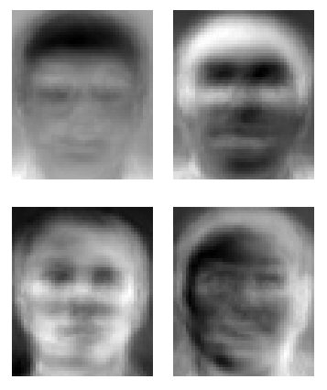
Methodology
Finding Eigenvalues
det( ƛI - A ) = 0
Finding Eigenvectors
( ƛI - A )v = 0
Eigenfaces is the name given to a set of eigenvectors when they are used in the computer vision problem of human face recognition.
Eigenfaces

Slide 19
Methodology
Linear Discriminant Analysis
LDA is based upon the concept of searching for a linear combination of variables (predictors) that best separates two classes
PCA Vs. LDA
Both Linear Discriminant Analysis (LDA) and PCA are linear transformation methods. PCA yields the directions (principal components) that maximize the variance of the data, whereas LDA also aims to find the directions that maximize the separation (or discrimination) between different classes, which can be useful in pattern classification problem (PCA “ignores” class labels).
In other words, PCA projects the entire dataset onto a different feature (sub)space, and LDA tries to determine a suitable feature (sub)space in order to distinguish between patterns that belong to different classes.

Slide 20
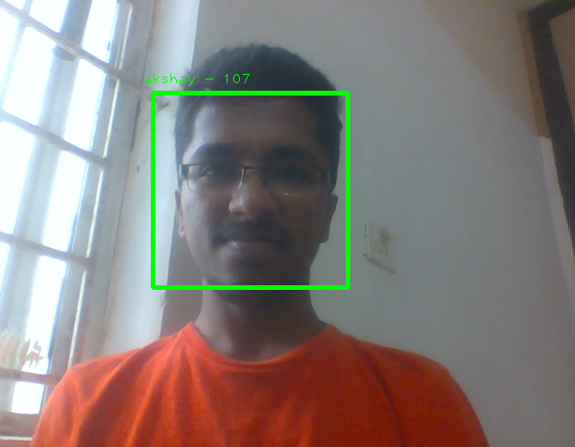
Results

Slide 21
Person Re-identification
using
Convolutional Neural Networks

Slide 22
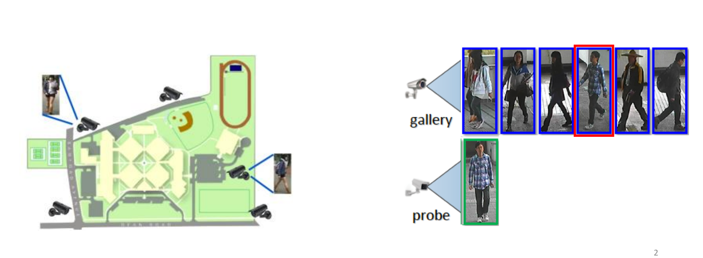
Introduction
• Person re-identification is the problem of matching the same individuals across multiple cameras, or across time within a single camera.

Slide 23
Challenges
Extracting features invariant under:
varying lighting conditions
occlusions
different viewpoints
Extracting features that have:
high similarity for images of same class
low similarity for images of different classes

Slide 24
Literature Review
Authors | Title | Methodology | Limitations
Wang el al. | Person Re-identification with Deep Features and Transfer Learning | Convolutional Neural Networks | Does not generalize well for small datasets with small number of same class images
Xu et al. | Image retrieval method based on integral images | Support Vector Machines | Not robust to occlusions, camera angles, lighting variations.

Slide 25
Procedure
Typically, methods for re-identification focus on two tasks:
A method for extracting features from input images.
An effective feature representation should be robust to illumination, viewpoint changes, etc.
A metric for comparing those features across images.
A discriminant metric should be used to match various person images.

Slide 26
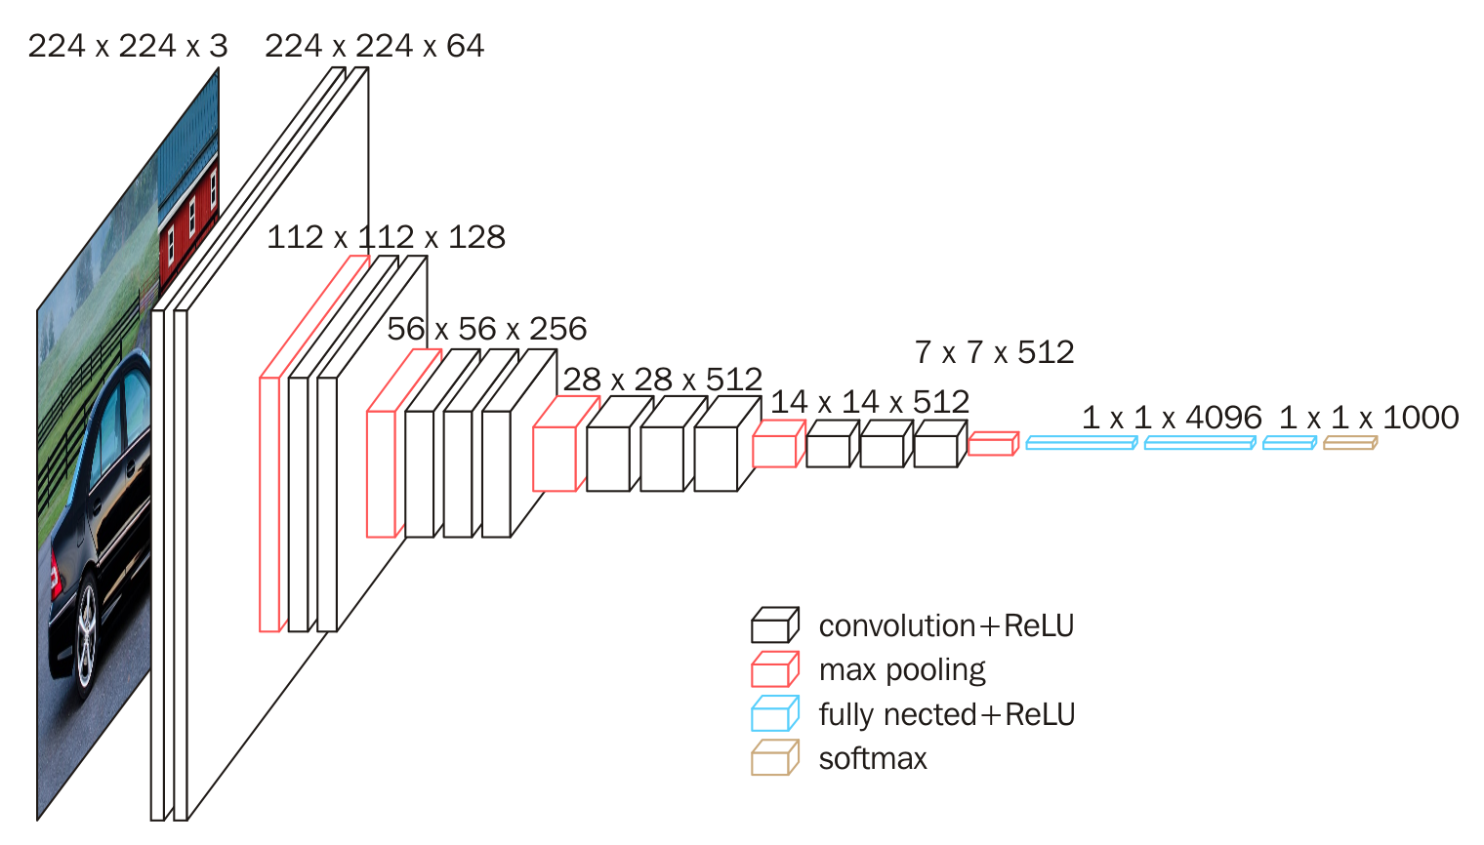
Architecture of CNN model

Slide 27
Methodology
We consider a pre-trained VGG 16 model which is trained on the image-net dataset
The model is then fine tuned on our dataset
Image is passed through the convolutional network model to get the labels for the corresponding images.
The loss which we are using is categorical cross-entropy loss, minimizing cross entropy is equivalent to minimizing the negative log likelihood of our data.

Slide 28
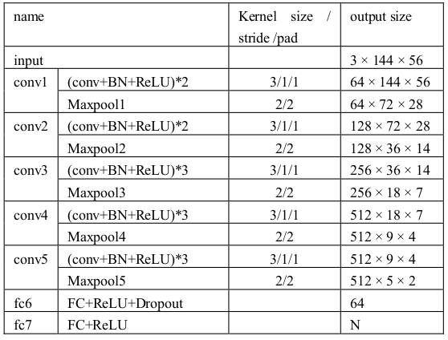
Detailed structure of CNN model

Slide 29
Limitations
The datasets contains a large number of classes but only a few images in each class. This makes it difficult for the model to learn the distinguishing features.
As we have used cross entropy loss we are focusing more on getting the class of the images right rather than learning the feature vector of the images.

Slide 30
Person Re-identification
using
Siamese Networks

Slide 31
Literature Review
Authors | Title | Methodology | Advantages
Gregory Koch, Richard Zemel, Ruslan Salakhutdinov | Siamese Neural Networks for One Shot Learning | Siamese Neural Networks | Generalises well on small to medium datasets

Slide 32
Introduction
Siamese NNs are popular among tasks that involve finding similarity or a relationship between two comparable things.
Class of neural network architectures that contain two or more identical subnetworks. Identical here means they have the same configuration with the same parameters and weights. Parameter updating is mirrored across both subnetworks.
Siamese Network is used alongside a Distance-based Loss.

Slide 33
Reasoning for choosing Siamese Network over CNN
Objective: Predict the animal given an image of the animal
Case 1: If it is just 2 animal classes to predict from (Cat vs Dogs) and given millions of images of each class, one could train a deep CNN Classifier. Easy!
Case 2: If we have tens of thousands of animal classes and for most of these, we only have a few dozens of image examples, trying to learn each animal as a Class using deep CNN seems less feasible now. Such a classifier can perform poorly for rarely seen training class e.g. let’s say there were only 4 training images of ‘eels’.

Slide 34
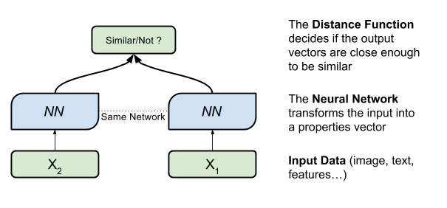
Siamese Model Overview

Slide 35
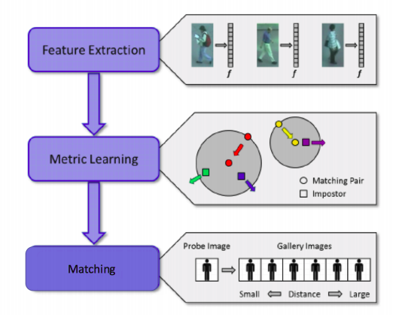
Methodology

Slide 36
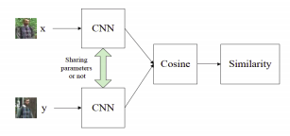
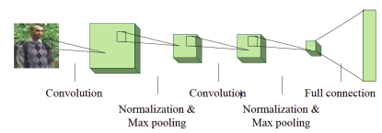
Architecture of the model

Slide 37
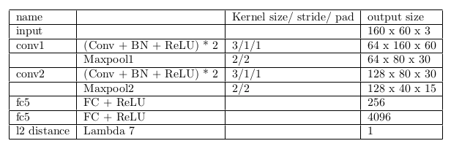
Detailed Structure of Siamese Model

Slide 38







Results
Trained model

