Slide 1
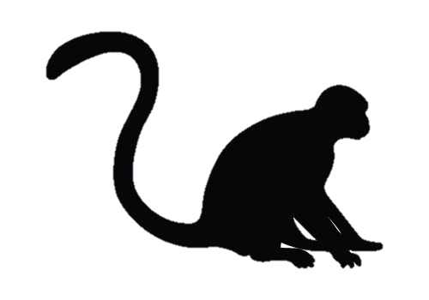
Conservation unit1
Conservation unit 2
Conservation unit 3
3
2
2
1
2
1
2
3
3

Slide 2
Conservation unit 1
Conservation unit 2
Conservation unit 3
14.7 ± 6.8
4.2 ±4.1
2
3
2
2
3.3 ± 0.6
15.8 ± 8.3
1
3
3
0.7 ± 0.2
21.2 ± 9.4

Slide 3

Conservation unit 1
Conservation unit 2
Conservation unit 3
14.7 ± 6.8
4.2 ±4.1
2
3
2
2
3.3 ± 0.6
15.8 ± 8.3
1
3
3
0.7 ± 0.2
21.2 ± 9.4
0
0
2
3
2
2
2.8 ± 1.1
0
1
3
3
5.1 ± 1.6
51.3 ± 25.0

