Slide 2
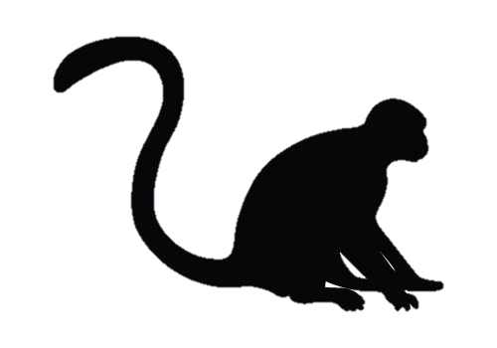
Modelled states
Conservation unit1
Conservation unit 2
Conservation unit 3
3
2
2
1
2
1
2
3
3
First dispersal
Secondary dispersal

Slide 3
Model selection
Models | # Id. Par. | Deviance | QAIC | QAICc
s(t)psi(2T+g)p(f) | 29 | 1911.07 | 1969.07 | 1970.1138
s(t)psi(2T)p(f) | 28 | 1913.1479 | 1969.1479 | 1970.1215
s(t)psi(2T+g)p(f+g) | 30 | 1909.7364 | 1969.7364 | 1970.8528
s(t)psi(2T)p(f+g) | 29 | 1912.0355 | 1970.0355 | 1971.0793
s(g+t)psi(2T+g)p(f) | 30 | 1910.9856 | 1970.9856 | 1972.1021
s(g+t)psi(2T)p(f) | 29 | 1913.059 | 1971.059 | 1972.1028
s(g+t)psi(2T+g)p(f+g) | 31 | 1909.6619 | 1971.6619 | 1972.8534
s(g+t)psi(2T)p(f+g) | 30 | 1911.956 | 1971.956 | 1973.0725
s(t)psi(2T+g)p(f.g) | 32 | 1908.297 | 1972.297 | 1973.5663
s(t)psi(2T)p(f.g) | 31 | 1910.6514 | 1972.6514 | 1973.843
s(t)psi(3T+g)p(f) | 35 | 1903.9585 | 1973.9585 | 1975.4756
s(t)psi(3T+g)p(f) | 35 | 1903.9585 | 1973.9585 | 1975.4756
s(t)psi(3T)p(f) | 34 | 1906.2005 | 1974.2005 | 1975.6325
s(g+t)psi(2T+g)p(f.g) | 33 | 1908.2209 | 1974.2209 | 1975.5703
s(g+t)psi(2T)p(f.g) | 32 | 1910.5707 | 1974.5707 | 1975.8399
s(t)psi(3T)p(f+g) | 36 | 1902.6874 | 1974.6874 | 1976.2922
s(t)psi(3T+g)p(f+g) | 36 | 1902.6874 | 1974.6874 | 1976.2922
s(t)psi(3T)p(f+g) | 35 | 1904.9845 | 1974.9845 | 1976.5016

Slide 4
Yellow fever outbreak

Slide 5
Conservation unit 1
Conservation unit 2
Conservation unit 3
14.7 ± 6.8
4.2 ±4.1
2
3
2
2
3.3 ± 0.6
15.8 ± 8.3
1
3
3
0.7 ± 0.2
21.2 ± 9.4

Slide 6

Conservation unit 1
Conservation unit 2
Conservation unit 3
14.7 ± 6.8
4.2 ±4.1
2
3
2
2
3.3 ± 0.6
15.8 ± 8.3
1
3
3
0.7 ± 0.2
21.2 ± 9.4
0
0
2
3
2
2
2.8 ± 1.1
0
1
3
3
5.1 ± 1.6
51.3 ± 25.0

Slide 7
Resighting probabilities
Conservation unit1
Conservation unit 2
1
1
2
0,7±0,1
1
3

Slide 8
Try to add co-variate density
Distance from groups
Binomial model linking individual dispersal to fragment size, group size based on the 2 periods (outbreak or not, distance to neighbours); random effect on conservation region.
Check correlated variables
Check with Alexandre

Slide 9
eff

