Slide 1
SYNERGISTIC ENERGY HARVESTING
Enhancing Microbial Fuel Cell Performance With Piezoelectric Nanomaterial Integration
NAME : ALAMU SRIDEVI HARIHARAN
DEPARTMENT : B.E CSE(CYBER SECURITY)
COLLEGE : SRI SAIRAM INSTITUTE OF TECHNOLOGY

Slide 2
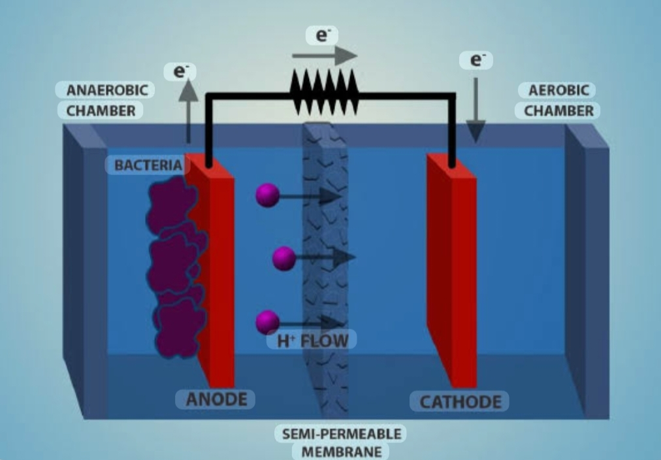
INTRODUCTION
Growing demand for sustainable energy sources.
Organic waste can be converted into electricity.
Microbial Fuel Cells (MFCs) generate power using microorganisms.
Piezoelectric nanomaterials can improve energy harvesting efficiency.
Microbial fuel cell

Slide 3
PROBLEM STATEMENT
Conventional energy sources contribute to pollution.
Organic waste is often underutilized.
MFCs produce limited power output.
Need for improved renewable energy generation systems

Slide 4
OBJECTIVE
Generate electricity from organic waste.
Enhance MFC performance using piezoelectric nanomaterials.
Improve electron transfer efficiency.
Promote sustainable and eco-friendly energy production.

Slide 5
PROPOSED SYSTEM
COMPONENTS:
Microbial Fuel Cell (MFC)
Organic Waste (Agricultural & Sewage Waste)
Piezoelectric Nanomaterials
Energy Collection Unit
01
02
03
04

Slide 6
WORKING PRINCIPLE
Level 1
Level 2
Level 3
Level 4
Microorganisms break down organic matter.
Electrons are released during the process.
Piezoelectric materials assist energy conversion.
Enhanced electricity generation is achieved.

Slide 7
PIEZOELECTRIC NANOMATERIALS USED
Zinc Oxide (ZnO)
Barium Titanate (BaTiO₃)
ADVANTAGES:
01
Improved electron transfer.
02
Increased energy output.
03
Better system efficiency.

Slide 8
APPLICATIONS
Waste management.
Sensors and LEDs.
Renewable energy.
Reduced pollution

Slide 9
CONCLUSION
The integration of Microbial Fuel Cells (MFCs) with piezoelectric nanomaterials provides an innovative and sustainable approach to energy harvesting. This system efficiently converts organic waste into electrical energy while reducing environmental pollution and dependence on fossil fuels. With further advancements in nanomaterial technology and large-scale implementation, this approach has strong potential for future applications in renewable energy generation, waste management, and smart environmental systems.

Slide 10
THANK YOU

