Slide 1



Slide 2
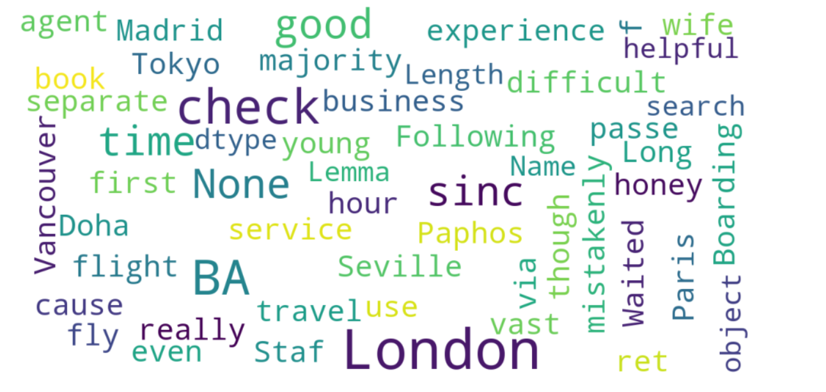
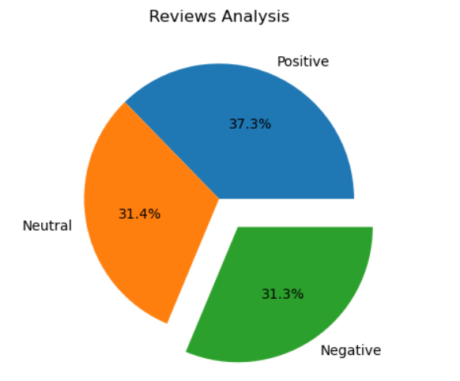
Insights from Customers Review
From cleaning 1000 reviews given by the customers, we obtained
Positive Reviews – 373
Negative Reviews - 313
Neutral Reviews – 314

