Slide 1

Database Security
Public domain NASA image L-1957-00989 of people working with an IBM type 704 electronic data processing machine.

Slide 2
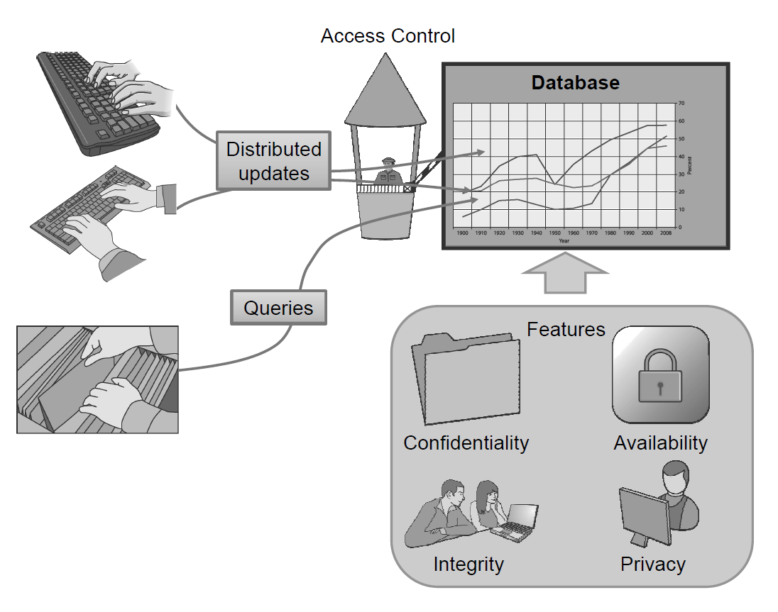
The Need for Database Security
Because databases play such an important role in storing large amounts of potentially valuable information, they are often the target of attacks by malicious parties seeking to gain access to this data; hence, we need good ways to secure them.

Slide 3
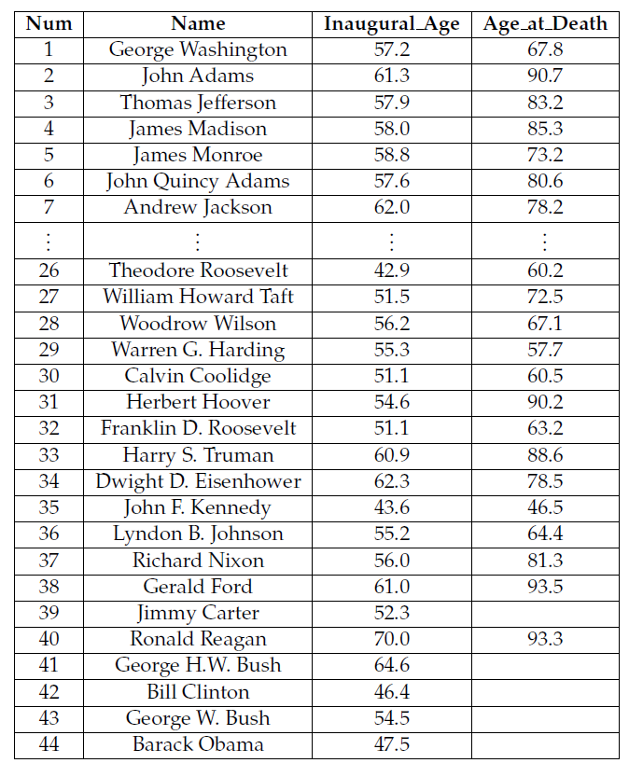
Tables and Queries
A very common way to store information is to use a relational database.
In this approach, information is organized into a collection of tables.
Each row of a table is a record that stores related information about some entity.
Each column is associated with an attribute that the entity can possess.

Slide 4
SQL Queries
Most databases use a language known as SQL (Structured Query Language) to support queries and updates, using commands that include the following:
  SELECT: to express queries
  INSERT: to create new records
  UPDATE: to alter existing data
  DELETE: to delete existing records
  Conditional statements using WHERE, and basic Boolean operations such as AND and OR: to identify records based on certain conditions
  UNION: to combine the results of multiple queries into a single result
These commands can be combined to produce queries that extract data, or updates that make changes to the database.

Slide 5
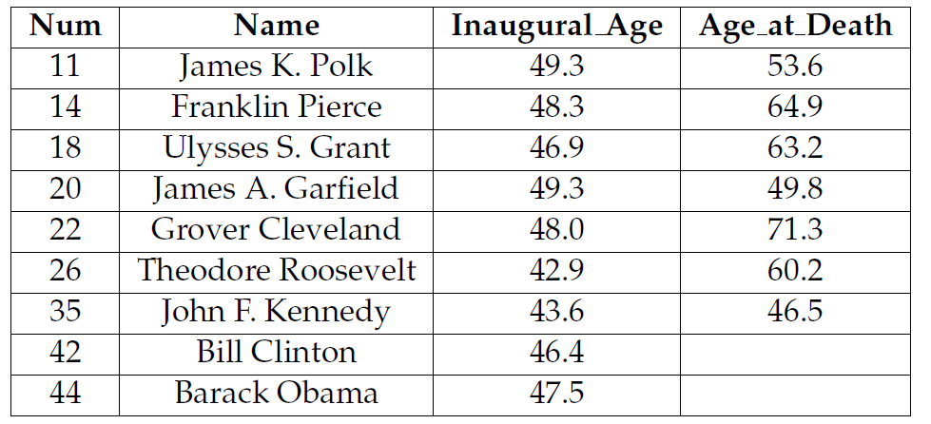
SQL Example
Suppose, for example, we were to issue the following query on the Presidents table:
  SELECT * FROM Presidents WHERE Inaugural_Age < 50
This query is designed to find and return all the U.S. presidents who were younger than 50 when they were inaugurated. The star symbol (*) specifies to return all the attributes of the resulting records.
This query would return the following table:

Slide 6
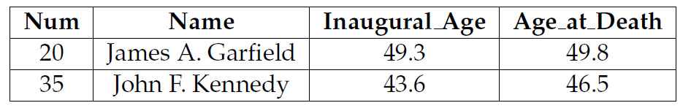
Another SQL Example
More complex queries are also possible, such as one to find all U.S. presidents who were less than 50 when they took office and died during their first term:
  SELECT * FROM Presidents WHERE (Inaugural_Age < 50)
  AND (Age_at_Death - Inaugural_Age < 4.0)
This query would return the following set of records:

Slide 7
Database Deletions
In addition to queries that extract information from a database, authorized users can also update the contents of a database using SQL commands.
For example, the following update operation would delete all of those records from the Presidents table that correspond to U.S. presidents who were less than 50 years old when they were inaugurated:
  DELETE FROM Presidents WHERE Inaugural_Age < 50

Slide 8
Database Insertions
In addition, the following update operation would add a new record to the Presidents table:
  INSERT INTO Presidents
  VALUES (45, 'Arnold Schwarzenegger', 65.5, NULL)
Database updates can be more fine-grained than just inserting and deleting entire records, however.
We can also alter the contents of individual attribute values in specific records.

Slide 9
Two-Phase Commit
To cope with consistency and reliability issues, most databases employ a protocol called two-phase commit for performing updates.
The first phase is a request phase, in which all the parts of the database that need to change as a result of this update are identified and flagged as being intended for this change. The result of this phase is either that it completes successfully, and every change requested is available and now flagged to be changed, or it aborts, because it couldn’t flag all the parts it wanted (say, because someone else already flagged it) or because of a network or system failure.
  If the first phase aborts, then all its requested changes are reset, which is always possible, because no permanent changes have been made yet.
  If the first phase completes successfully, then the protocol continues to the second phase.
The second phase is the commit phase, in which the database locks itself against other changes and performs the sequence of changes that were identified in the request phase.
  If it completes successfully, then it clears all the flags identifying requested changes and it releases the lock on the database.
  If, on the other hand, this operation fails, then it rolls back, that is, reverses, all the changes made back to the state the database was in just after completing the first phase.
This two-phase commit protocol is a feature that a database can use to help achieve both integrity and availability.

Slide 10
Database Access Control
A proper set of database access controls should implement a least-privilege principle, so that each user has the necessary rights to perform their required tasks, but no rights beyond that.
A proper set of database access controls should also implement a separation of privilege principle, so that different users have different privileges, depending on the different tasks that they need to perform.

Slide 11
Access Control Using SQL
SQL defines an access control framework that is commonly used for defining database privileges.
When a table is created, the owner of the table has the sole rights to perform operations on that table.
The owner can then grant privileges to other users, which is known as privilege delegation.
These privileges may be broad, such as the ability to do anything to a particular table, or fine-grained, such as the ability to perform only SELECT queries on certain columns.
For example, the owner of a table may issue the following SQL command to give Alice the ability to search through table employees:
GRANT SELECT ON employees TO Alice;
Other permissions that can be provided using the GRANT keyword include DELETE, INSERT, and UPDATE. In addition, to grant all available rights one can use the ALL keyword.

Slide 12
Privilege Delegation
In addition to being able to grant certain privileges to other users, table owners can also allow other users to grant privileges for those tables, which is known as policy authority delegation.
Specifically, when granting a privilege to a user as in the above examples, the grantor can include the clause WITH GRANT OPTION to give the recipient the ability to further delegate that privilege.
For example, an administrator might create a view for Alice and give her permission to delegate SELECT permissions on that view to other users as follows:
  CREATE VIEW employees_alice AS
  SELECT * FROM employees
  WHERE name = `Alice';
  GRANT SELECT ON employees_alice TO Alice WITH GRANT OPTION;

Slide 13
Privilege Revocation
The propagation of privileges in a database can be visualized using a diagram, where nodes represent users and directed edges represent granted privileges.
If Alice grants a set of rights, A, to Bob, then we draw a directed edge labeled with A from Alice to Bob.
A user, Alice, who has granted privileges to another, Bob, can opt to revoke those privileges at a later time, which would be visualized by deleting or relabeling the edge from Alice to Bob.
A command that could perform such a revocation is as follows:
REVOKE SELECT ON employees FROM Bob;
This command should result in the revocation of all SELECT privileges for Alice as well as all the people to which she had delegated this privilege.

Slide 14
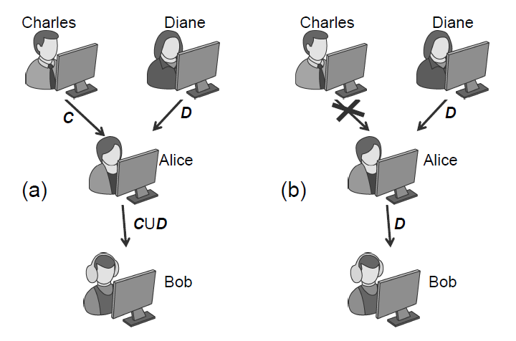
Privilege Revocation Example
First, two administrators, Charles and Diane, each grant Alice two sets of privileges, C and D, after which Alice grants those privileges to Bob, giving him the set of rights in the union, C U D.
If Charles subsequently revokes the set of privileges, C, he granted to Alice, then the privileges Bob inherited indirectly from Charles, through Alice, should also be revoked, leaving Bob with just the privileges in D.

Slide 15
Sensitive Data
In addition to ensuring that databases have appropriate access-control measures in place, care must be taken to guarantee that sensitive data is stored in a way that protects the privacy of users and any confidentiality requirements for sensitive data.

Slide 16
Using Cryptography
If information being stored in a database has confidentiality requirements, then it should not be stored in plaintext, but should instead be stored as the output of a cryptographic function.
Confidential information kept in a database should be stored in encrypted form, where the decryption key should be known by authorized users but not stored in the database itself.

Slide 17
Privacy Protection
Besides measures designed to protect the confidentiality of sensitive user information, database owners should be careful to consider the privacy impacts of publishing or granting access to sensitive information.
If a database is to be released to the public, say, to be used for research purposes, then all identifying information, such as names, addresses, Social Security numbers, employee numbers, and student numbers, should be removed or changed to masking values, which are nondescript values that lack all identifying information.

Slide 18
Inference Attacks
Even if identifying information is removed or masked out, it may still be possible to use the database in conjunction with additional information available to the attacker to learn more about the underlying data.
This is referred to as an inference attack.
As an example, consider a database of employee records, whose attributes are name, gender, ID number, and salary.
  Suppose a party is granted access to a sanitized version of the table, where the name attribute is removed, for the purpose of creating statistics on salary by gender. Another party may have a list of pairings associating ID numbers to names for a reporting task.
  If these two parties were to communicate, they could easily infer the salary of each employee, despite the intent of the database owner. In general, when granting access to modified versions of a database, administrators should consider whether collusion among grantees can allow them to gain unauthorized information.

Slide 19
Protecting Against Inference Attacks
To protect a database from inference attacks, the following techniques can be used prior to making the database public.
Cell suppression. In using this technique, some of the cells in a database are removed and left blank in the published version.
Generalization. In using this technique, some values in a published database are replaced with more general values.
Noise addition. In using this technique, values in a published database have random values added to them, so that the noise across all records for the same attribute averages out to zero.

Slide 20
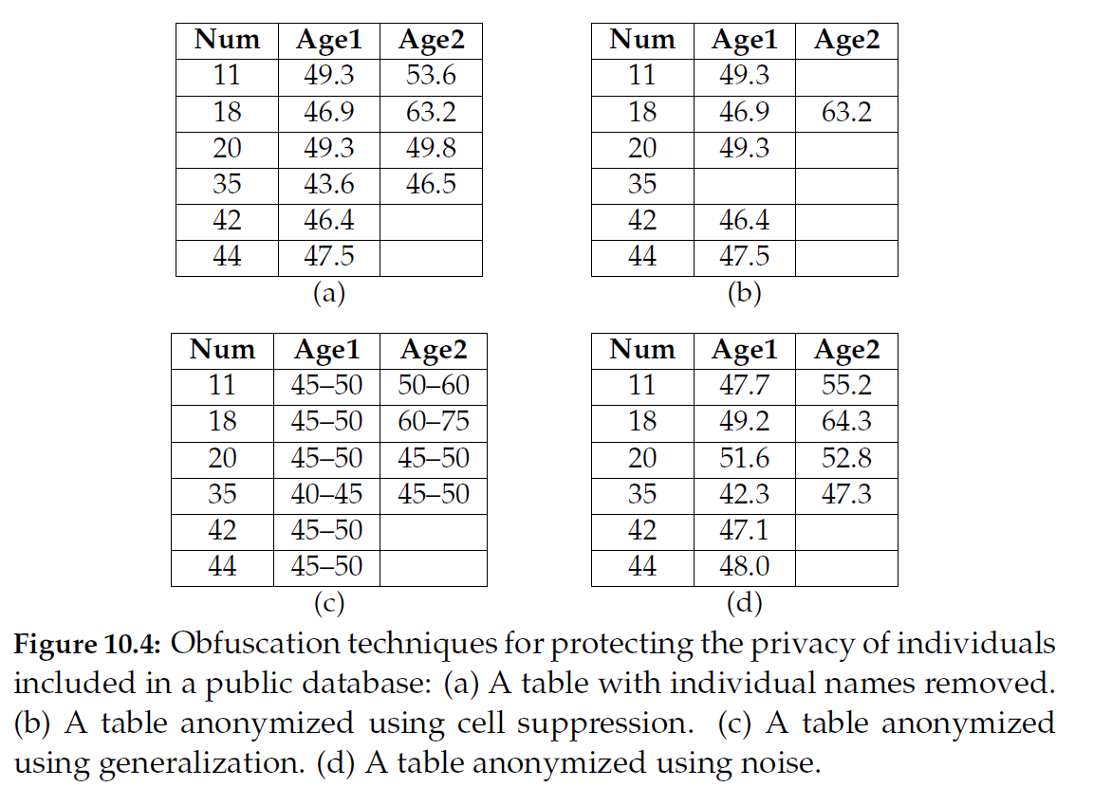
Example

Slide 21
Spam and Cybercrime

Slide 22
SMTP
Simple Mail Transfer Protocol
  Client connects to server on TCP port 25
  Client sends commands to server
  Server acks or notifies of error
Security issues
  Sender not authenticated
  Message and headers transmitted in plain text
  Message and header integrity not protected
  Spoofing trivial to accomplish
Example SMTP session
HELO mail.university.edu
MAIL FROM: president@whitehouse.gov
RCPT TO: chancellor@university.edu
DATA
From: president@whitehouse.gov
To: chancellor@university.edu
Date: April 1, 2010
Subject: Executive order
You are hereby ordered to increase the stipend of all TAs by $10,000 per year.
Sincerely,
The President of the United States
.

Slide 23
What is Email Spam?
Email spam is often defined as unsolicited bulk email
  Forbidden by all major ISPs
  Considered “acceptable business practice” by US Direct Marketing Association (DMA)
Unsolicited email and bulk email are individually acceptable practices for people, business, and organizations
Spam arises from the combination of unsolicited and bulk
In classifying email as spam, content does not matter
The US CAN-SPAM act (2004) regrettably protects commercial spam provided some requirements are satisfied, including:
  Opt-out mechanism
  Sender clearly identified and subject line not deceptive
  Adult material labeled in subject line

Slide 24
Who Responds to Spam anyhow?
A princess in Nigeria wants to send me money!

Slide 25
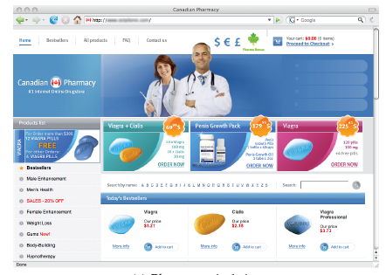
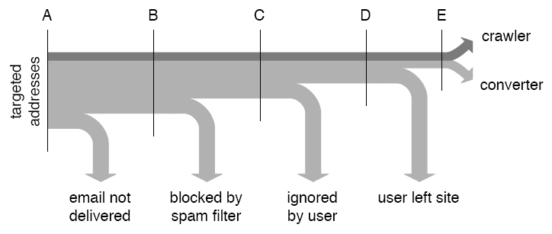
Spam Conversion
Empirical study [Kanich+ 2008]
  Parasitic infiltration into botnet launching spam campaign for “Canadian drugs”
  28 conversions, yielding $3K, from 300M spam messages over 26 days
Yes, Honey, you could
benefit from that drug.

Slide 26
Blacklisting
Spamhaus Black List (SBL)
  Real-time database of IP addresses of verified spam sources
  Eliminates about 10% of spam before transmission takes place
  Formal listing and delisting procedures
  More than 600M email users protected by SBL
How to circumvent blacklisting
  Powerful blacklisted spam server impersonates small unlisted zombie
  Initiate TCP handshake from zombie
  Send bulk email from spam server using spoofed source IP and TCP sequence numbers
zombie
TCP handshake
TCP sequence numbers
victim
spam server
SMTP spam transmission

Slide 27
Graylisting
Spam servers typically do not resend messages after transmission errors
Maintain database of trusted servers
Respond with “Busy, please retry” to SMPT connection requests from servers not in database
Server added to database if reestablishes connection
Currently effective although simple to circumvent

Slide 28
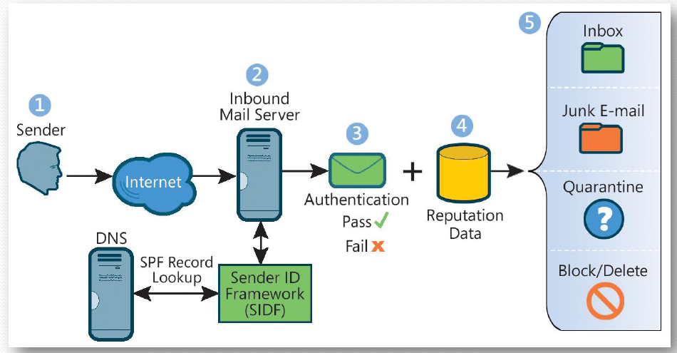
Sender ID and Sender Policy Framework
Store DNS records about severs authorized to send mail for a given domain
Look up domain in From header to find IP address of authorized mail server
Source: Microsoft

Slide 29
DomainKeys Identified Mail (DKIM)
Sender’s mail server signs email to authenticate domain
Public key of server available in DNS record
To be used in conjunction with other spam filtering methods
Public key
Provide
public key
example.net
Name Server
Query for public key
Private key
Verify
signature
Send signed email
Sign mail
yahoo.com MTA
example.net MTA
DomainKey-Signature: a=rsa-sha1; s=mail; d=example.net; c=simple; q=dns;
b=Fg…5J
Authentication-Results: example.net from=bob@example.net; domainkeys=pass;

Slide 30
SenderID vs. DKIM
SenderID
DKIM
Sending MTA authentication
Channel based
Simple implementation
Message integrity not protected
Mail forwarding not supported
Vulnerable to DNS cache poisoning
Vulnerable to IP source spoofing
Sending MTA authentication
Object based
Cryptographic assurance
Protection of message integrity
Supports mail forwarding
Vulnerable to DNS cache poisoning

Slide 31
Cybercrime
Symantec’s definition:
  Cybercrime is any crime that is committed using a computer, network, or hardware device. The computer or device may be the agent of the crime, the facilitator of the crime, or the target of the crime. The crime may take place on the computer alone or in addition to other locations.
Enablers of cybercrime
  Software vulnerabilities
  Online shopping and access to financial accounts
  Countries with lax or corrupt law enforcement

Slide 32
Credit Cards
Credit card information
  Supposed to be kept secret
  Shared with multiple merchants
  Transmitted often insecurely
  Low entropy of the credit card number (first four digits denote financial institution)
Advantage
  Simple scheme for users, banks, and merchants
Disadvantage
  Fraud easy to commit
Tradeoff
  No security measures to facilitate use
  Private customers and merchants held harmless
  Transaction fee covers bank fraud losses

Slide 33
Common Credit Card Frauds
Buy popular goods and resell them
  Needs package delivery address
  Requires resale business
  Often goods reshipped abroad
Buy financial instruments
  Traveler’s checks
  Gift cards
  E-gold
  Additional conversion needed to avoid revocation
Buy cash equivalents
  Western Union money transfers
  Foreign currency

Slide 34
Defending Against Credit Card Fraud
One-time credit card numbers
  Available from several issuers (e.g., AmEx, Citibank)
  Does not work for subscription plans
  Time consuming for users
  Cumbersome to obtain refunds
  Worthwhile for high-value transactions or untrusted merchants
Monitoring transactions
  Email or text message for each transaction
  Continuous annoyance to catch a rare event
Password enabled transactions
  Similar to PIN for ATM cards
  Difficult to share password only with the bank and communicate verification outcome to merchant (three-party protocol)

Slide 35
Bank Accounts
Account information
  Supposed to be kept secret
  Shared with merchants, customers and friends
  Same account number for deposits and withdrawals
Typical bank transactions
  Check
  ATM
  Wire transfer
Banking in the US
  Account title
  Taxpayer ID Number (TIN)
  Checks can be generated by customers or third parties
  Signature not verified in practice for amounts below $30K
  Automated Clearing House (ACH), regulated by Federal Reserve, supports interbank transfers, direct deposits and direct debits
  ACH allows one to initiate from account A an inbound transfer into A from any account B with same TIN as A

Slide 36
Common Bank Frauds
Forged checks
  Create checks with magnetic ink printers
  Cash with fake ID
  Low amounts typically not scrutinized
Wire transfer
  Send fax to bank to order wire transfer
  Most effective if money wired abroad
Account creation
  Create account A impersonating owner of account B
  ACH transfer from B to A
  Cash with ATM or wire transfer

Slide 37
Defending Against Bank Fraud
Multi-factor authentication
  Hardware token generating one-time codes
  Personal images and sentences to defend against phishing
  Code sent by email/sms to registered address to authorize debit transactions
Account ownership verification
  Linking accounts for ACH transfers requires knowledge of to small deposits to the account
Restrictions on accounts
  E.g., only credit transaction accepted
Monitoring bank transactions
  Email/text message after each transactions
No online banking
  Limited bank liability for online frauds

Slide 38
Payment Systems

Slide 39

Electronic Payment Schemes
Schemes for electronic payment are multi-party protocols
Payment instrument modeled by electronic coin that has a fixed value and can be exchanged with a traditional monetary instrument
Parties include:
  Payer (customer)
  Payee (merchant)
  Bank
Customer
Merchant

Slide 40
Transactions
Transactions in an electronic payment scheme typically include:
  Withdrawal of coins by
  customer from the bank
  Payment of coins by
  customer to merchant
  Deposit of coins by
  merchant into bank
Online scheme:
  The bank participates in the payment transaction
Offline scheme
  The bank does not participate in the payment transaction
Customer
$
Merchant
pay
withdraw
deposit
$
$

Slide 41
Goals
Integrity
  Coins cannot be forged
  Legitimate transactions are honored
Accountability
  Transactions cannot be later denied
  Disputes can be efficiently settled
Privacy
  The identity of some parties is not revealed to other parties
  Coins cannot be traced to the payer and/or payee (digital cash)

Slide 42

Payment with Digital Signatures
Coins are random identifiers digitally signed by the bank at the time of withdrawal
The merchant verifies the signature by the bank
The bank honors deposit of valid coins
Security and privacy issues:
  Customer can copy coin and double spend
  The bank learns about every transaction by customer and merchant
Customer
$
Merchant
pay
withdraw
deposit
$
$

Slide 43
Private Payment Scheme
A blind signature allows the signed to sign a message without knowing the message itself
Basic digital cash scheme:
  The bank does a blind signature
  on the coins withdrawn by the
  customer
  The merchant verifies the signature and deposits the coins
  The bank cannot link the coins to the customer

Slide 44
Blind Signatures with RSA
The RSA cryptosystem supports a simple and efficient blind signature scheme
Consider an RSA signing scheme with
  Public modulus N
  Public encryption exponent e and public cryptographic hash function h
  Secret decryption exponent d
The bank can create a signature on any item without knowing it
Bank must have assurance that it is signing a valid coin of the correct amount

Slide 45
RSA Blind Signature Protocol
The customer picks secret random values x and r
  Coin identifier x
  Number r in Z_{N} relatively prime to N
The customer sends to the bank value
  y = r^{e} h(x) mod N
The bank creates signature σ(y) on y
  σ(y) = y^{d} mod N
The customer derives from σ(y) signature σ(x) on x
  σ(x) = σ(y) / r mod N
Proof
  σ(y) / r mod N = r^{ed − 1} h(x)^{d} mod N = h(x)^{d} mod N = σ(x)

Slide 46
Blindly Signing a Valid Coin
The customer generates k coins and submits to the bank commitments (cryptographic hashes) for all the coins
The bank randomly selects k − 1 coins
The customer reveals to the bank the selected k − 1 coins
The bank verifies the commitments on the selected k − 1 coins
The bank creates a blind signature on the remaining coin
The coin signed by the bank is valid with probability
1 − 1/ k

Slide 47
Defenses Against Double Spending
Online protocol
  The bank is online during the payment transaction to revoke spent coins
Offline protocol
  Withdrawn coins embed encrypted customer identity
  Deposited coins embed also encrypted merchant identity
  Double spending caused the identity of the cheating party to be revealed

Slide 48
Secret Splitting into Shares
A secret string x can be split into random values y and z as follows
  Pick a random value y
  Set z = y ⊕ x
String x can be reconstructed from y and z by setting
  x = y ⊕ z
Both shares y and z are random values and are referred to as shares of x
Neither share reveals any information about secret x

Slide 49
Coins
Let h be a cryptographic hash function
Given a secret string x, a commitment pair for x is a pair (a, b) such that
  a = h(y)
  b = h(z)
  y and z are random shares of x
Let ID be a string identifying the customer (e.g., name, address, etc.)
The coin issued by the bank to the customer consists of
  Coin identifier x
  Vector of n commitments pairs (a₁, b₁), … , (a_{n}, b_{n}) for ID
The coin does not reveal the identity of the customer

Slide 50
Withdrawal
The customer generates and submits k coins to the bank
The bank randomly selects k − 1 coins
The customer reveals to the bank the shares associated with the commitments pairs of the selected coins
The bank creates a blind signature on the remaining coin
The coin signed is valid with probability 1 − 1/ k

Slide 51
Payment
The customer gives to the merchant a coin
{ x ; [(a₁, b₁), … , (a_{n}, b_{n})] }
The merchant verifies the signature on the coin
The customer gives to the customer a random binary vector s₁, … , s_{n}, called selector
The customer reveals to the merchant the shares indicated by the selector, i.e., it sends to the merchant a vector of strings P₁, … , P_{n} such that
h(P_{i}) = a_{i} if s_{i} = 0
h(P_{i}) = b_{i} if s_{i} = 1

Slide 52
Deposit and Security Properties
Deposit
  The merchant deposits with the bank the coin and strings P₁, … , P_{n}
  The bank verifies the signature and keeps track of coins and associated strings
Security properties
  The probability that the selectors provided by two merchants are identical is 1/ 2^{n}
  Thus, if the customer double spends a coin, then the bank finds out the identity of the customer with probability 1 − 1/ 2^{n}
  A merchant can double spends a coin without being detected by the bank only if it can find a collision of the hash function
The scheme does not prevent double spending but detects it and identifies the culprit with high probability

Slide 53
References
The electronic cash scheme presented in this lecture is based on the work by David Chaum http://www.chaum.com/
D. Chaum, A. Fiat, and M. Naor.
Untraceable Electronic Cash, in
Proc. CRYPTO 1988. http://citeseer.ist.psu.edu/421212.html
S. Goldwasser and M. Bellare. Lecture Notes on Cryptography [Section 12.5]
http://www-cse.ucsd.edu/users/mihir/papers/gb.html

