Slide 1
Test 1 Preparation

Slide 2
General Information
Open book, Open notes, No computer! No smartphone! No laptop!
The test will mainly focus on Ch3, Ch5, Ch6, Ch7, and Ch8.
Review slides, review Assignment 1, and read the book.
No memorization of any definition is needed. The focus will be understanding the major concepts/principles covered in the course.
Question types:
5 single choice question, 6 problem solving.

Slide 3
Chapter 1: Introduction
Database definition:
Collection of related data
Source, interaction, audience
DBMS
A software system that facilitates the processes of defining, constructing, manipulating and sharing databases
Notes:
Every time we insert or delete a record or change the value of a data item in a record, we change one state of the database into another state.
Instance: at any particular point in time, what is the state of database with data values in its object is called database instance. It changes from time to time

Slide 4
Meta-data/ Schema
Database + DBMS == Database System
Notes:
The database definition or descriptive information is also stored by the DBMS in the form of a database catalog or dictionary; it is called meta-data.

Slide 5
Chapter 2: Database System Concepts and Architecture
Data model:
A set of concepts to describe the structure of a database
Data types, relationships
The operations for manipulating these structures
The constraints that the database should obey
Data schema:
A description of a database
Notes:
Every time we insert or delete a record or change the value of a data item in a record, we change one state of the database into another state.
Instance: at any particular point in time, what is the state of database with data values in its object is called database instance. It changes from time to time

Slide 6
Database State
Database State:
The actual content of the database at a particular point of time.
Analogous to the value of a variable
Also called database instance
Distinction between Database Schema and Database State
The database schema changes very infrequently.
The database state changes every time the database is updated.
Notes:
Every time we insert or delete a record or change the value of a data item in a record, we change one state of the database into another state.
Instance: at any particular point in time, what is the state of database with data values in its object is called database instance. It changes from time to time

Slide 7
Three-Schema Architecture
Grade_Report(StudentNumber: 01, SectionID: 11285, Grade: A)
Prerequisite(CourseNumber: 4710, PrerequisiteNumber: 3410)
Student(Name:string, StudentNumber:integer, Class:integer, Major:string)
Course(CourseName:string, CourseNumber:string, CreditHours:integer, Department:string)
Section(SectionID:integer, CourseNumber:string, Semester:string, Year:integer, Instructor:String)
Relations stored as unordered files.
Index on second column of Student.
Notes:
The external schema represents how you view the data
The conceptual schema represent how you store the data in the databases
The mapping between an external schema and the conceptual schema give rise to another type of data independence
It looks that the way you view the data can be independent from the way you store it

Slide 8
Data Independence
Logical data independence
Physical data independence
Notes:
Definition of LogDataIndep: the capacity to change the conceptual schema without having to change the external schemas and their associated application programs.

Slide 9
Logical Data Independence
Question:
Suppose we need to make a change to the conceptual schema
In other words
The answer is clearly: Yes!
But Why?
Notes:
Definition of LogDataIndep:

Slide 10
Logical Data Independence
Reason:
External schema(s) is obtained from data stored in the conceptual schema by running some program to merge the data files
If we need to change the conceptual schema (how we store the data), we can obtain the same external schema(s) by:
So we need to update the mapping operation if we change the conceptual schema
Notes:
Definition of LogDataIndep:

Slide 11
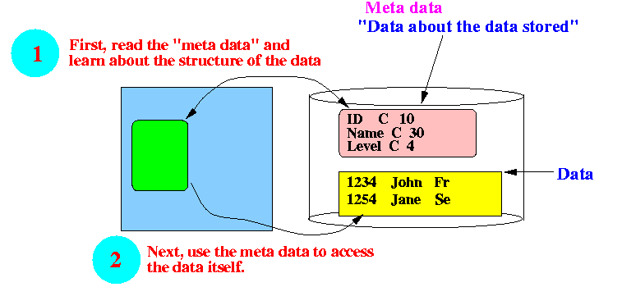
Physical Data Independence
The ability to keep presenting the user with the same format even though the way the actual data is stored has changed

Slide 12
Chapter 3: Data Modeling Using the ER Model
Miniworld
A simplified overview of the database design process
Requirements Collection and Analysis
Data Requirements
High-level conceptual data model used
Conceptual Design
This is where E/R fits in
Conceptual Schema
(In a high-level data model)
DBMS-independent
Logical Design
(Data modeling mapping)
Implementation data model used
DBMS-specific
Logical (Conceptual) Schema
(In he data model of a specific DBMS)
Physical Design
Internal Design
Notes:
The first step shown is requirements collection and analysis
During this step, the database designers interview prospective database users to understand and document their data requirements. The results of this step is a concisely written set of users’ requirements. These requirements should be specified in as detailed and complete a form as possible.
%%%%%%%%%%%%%
Once the requirements have been collected and analyzed, the next step is to create a conceptual schema for the database, using a high-level conceptual data model. This step is called conceptual design.
The conceptual schema is a concise description of the data requirements of the users and includes detailed descriptions of the entity types, relationships, and constraints; these are expressed using the concepts provided by the high-level data model.
Because these concepts do not include implementation details, they are usually easier to understand and can be used to communicate with nontechnical users. This approach enables database designers to concentrate on specifying the properties of the data, without being concerned with storage and implementation details, which makes it is easier to create a good conceptual database design.
%%%%%%%%%%%%%%%%
The next step in database design is the actual implementation of the database, using a commercial DBMS
Most current commercial DBMSs use an implementation data model---such as the relational (SQL) model---so that conceptual schema is transformed from the high-level data model into the implementation data model.
%%%%%%%%%%%%%%%%%%
The last step is the physical design phase, during which the internal storage structures, file organizations, indexes, access paths, and physical design parameters for the database files are specified
%%%%%%%%%%%%%%%%%%
We present only the basic ER model concepts for conceptual schema design in this chapter. Additional modeling concepts are discussed in Chapter 4, when we introduce the EER model.

Slide 13
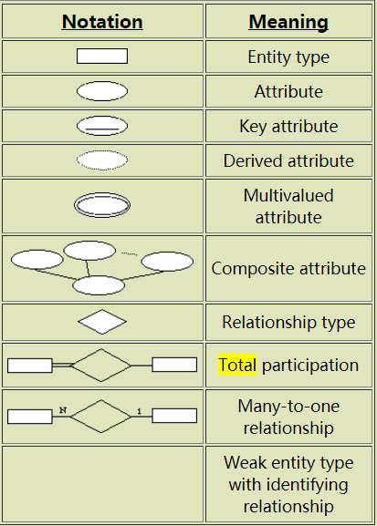
ER Diagram Notation
Notes:
Definition of LogDataIndep: the capacity to change the conceptual schema without having to change the external schemas and their associated application programs.

Slide 14
Two Types of Relationship Constraints (1)
Chapter 3
Cardinality ratios
Specifies the maximum number of relationship instances that an entity can participate in
E.g., in WORKS_FOR relationship, DEPARTMENT : EMPLOYEE is of cardinality ratio 1 : N
Means what?
Possible cardinality ratios
1 : 1
1 : N
N : 1
M : N
Notes:
Cardinality /kɑːdɪ'nælɪtɪ/
Meaning that each department can be related to (that is, employs) any number of employees (N), but an employee can be related to (work for) at most one department (1)
N indicates there is no maximum number

Slide 15
Two Types of Relationship Constraints (2)
Chapter 3
Participation constraints
Specifies the minimum number of relationship instances that each entity can participate in (also called minimum cardinality constraint)
Total participation
Partial participation
Works_for
Double line
Employee
Department
Manages

Slide 16
Chapter 5: The Relational Data Model and Relational Database Constraints
Constraints that can be directly expressed in the schema
Key Constraints
Constraints on Null values
Entity Integrity Constraints
Referential Integrity Constraints
Notes:
Every time we insert or delete a record or change the value of a data item in a record, we change one state of the database into another state.
Instance: at any particular point in time, what is the state of database with data values in its object is called database instance. It changes from time to time

Slide 17
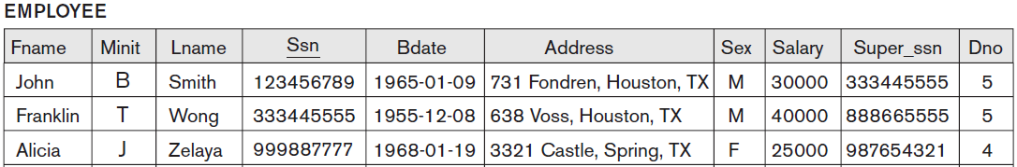
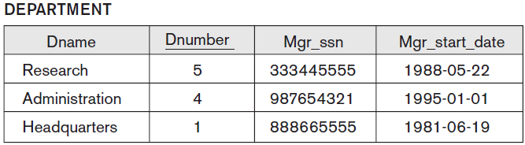
Referential Integrity Constraints (cont.)
referencing relation
A referential integrity constraint from R1 to
R2 is said to hold
referenced relation
Notes:
For example, in Figure 5.6, the attribute Dno of EMPLOYEE gives the department number for which each employee works; hence, its value in every EMPLOYEE tuple must match the Dnumber value of some tuple in the DEPARTMENT relation.

Slide 18
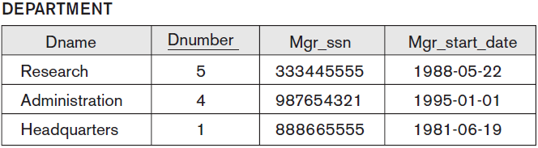
Example: Insert Violates Referential Integrity Constraint
Insert
<‘Cecilia’, ‘F’, ‘Kolonsky’, ‘677678989’, ‘1960-04-05’, ‘6357 Windswept, Katy, TX’, F, 28000, ‘987654321’, 7>into EMPLOYEE
Result: NOT OK: Violates Referential integrity constraint because DNO=7 does not exist; rejected!!!

Slide 19
Chapter 6 & 7: SQL
SQL is not only a query language - i.e., a language used to retrieve information from a database
SQL also contain:
a Data Definition Language - i.e.:
a language that is used to define the database and its objects, e.g., tables, views, etc.
a Data Manipulation Language - i.e.:
a language that is used to update and query data
a Data Control Language
a language that is used to grant the permissions to a user to access a certain data in the database

Slide 20
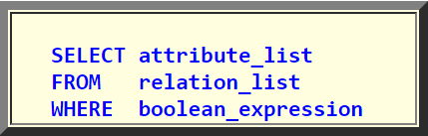
SQL: SELECT
The SQL SELECT Command
Is used to retrieve the set of tuples that satisfy a given condition
Is based on Relational Algebra and you will see the join/section/projection operations reflected in the SELECT command
The basic form of the SELECT command
SELECT-FROM-WHERE block:
attribute_list: a list of attributes from the relations in the relation_list
relation_list: a list of relations. The CROSS PRODUCT of these relations is formed
boolean_expression: condition
Notes:
attribute_list: a list of attributes from the relations in the relation_list

Slide 21
Other Tuple Conditions
We have seen that you can use "ordinary" Boolean conditions in the where clause
Other tuple conditions
The membership test operator (IN and NOT IN)
The any selection operator (ANY)
The all selection operator (ALL)
The non-empty set test operator (EXISTS)
The null test operator (IS NULL)
Wild card characters ( _ and %)
Notes:
Qualifying an attribute names with the relation name will not make the attribute name un-ambiguous
(Because it's the same relation name !!!)

Slide 22
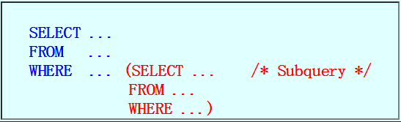
Nested Queries
Nested query
A nested query is a SELECT query where the WHERE clause contains subquery.
In theory, nesting can be arbitrarily deep

Slide 23
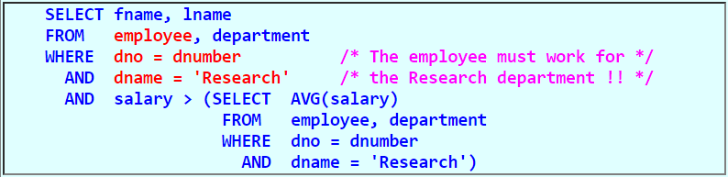
Using the Result of Aggregate Functions in Queries
Query
Find the fname and lname of the employee in the 'Research' department that earns more than the average salary within the 'Research' department
Reason:
The employee whose salary is greater than the average salary of the Research department, may:
SELECT fname, lname
FROM employee
WHERE salary > ( SELECT AVG(salary)
FROM employee, department
WHERE dno = dnumber AND dname = 'Research')
Correct?
No!
Notes:
These functions can also be used in selection conditions involving nested queries
We can specify a correlated nested query with an aggregate function, and then use the nested query in the WHERE clause of an outer query.

Slide 24
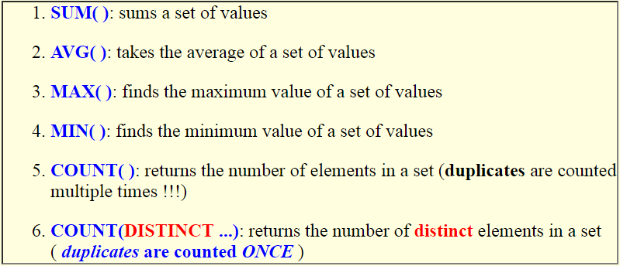
Aggregate Functions in SQL
Aggregate functions
Compute an aggregate value from a set of values
The aggregate functions available in SQL are:
Notes:
Aggregate functions are used to summarize information from multiple tuples into a single-tuple summary.
Grouping is used to create subgroups of tuples before summarization.

Slide 25
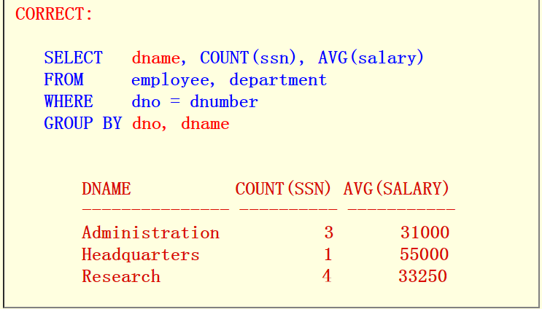
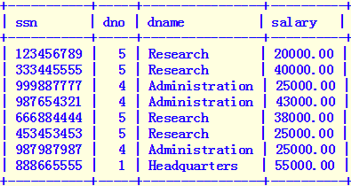
Examples of GROUP BY Queries
Query 1:
For each department, show the department NAME, number of employees and average salary paid to the employees in the department
Solution:
SELECT sssn, dno, dname, salary
FROM employee, department
WHERE dno=dnumber
SELECT dname, COUNT(ssn), AVG(salary)
FROM employee, department
WHERE dno = dnumber
GROUP BY dno
COUNT(SSN) AVG(salary)
4 33250
3 31000
1 55000
Wrong! dname must be a grouping attribute !!

Slide 26
Concept of a View in SQL
A view is a virtual relation that is derived from
Relations
Other virtual relations
Property of a virtual relation:
A virtual relation (= view) does not exist as in physical form
The tuples in a virtual relation (= view) are not stored physically in the database
The tuples in a virtual relation (= view) are computed as a temporary relation when the virtual relation is used

Slide 27
Creating View (Virtual Relations)
A view (= virtual relation) is defined using the CREATE VIEW command
A (virtual) table name (or view name)
A list of attribute names, and
A query to specify the contents of the view.
Example:
CREATE VIEW EmpActivity
AS
( SELECT Fname, Lname, Pname, Hours
FROM employee, works_on, project
WHERE ssn = essn
AND pno = pnumber
)
Results:
The CREATE VIEW command defines an virtual table (relation) called EmpActivity
This virtual table/relation will be construct when we use the EmpActivity relation in a query !!!
EmpActivity

Slide 28
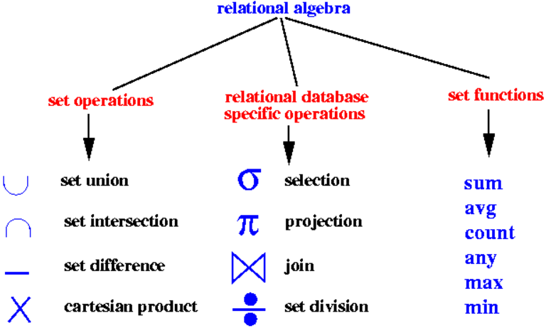
Relational Algebra (RA) Overview
Notes:
The relational algebra is often considered to be an integral part of the relations data model

Slide 29
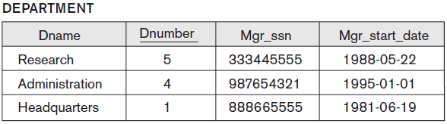
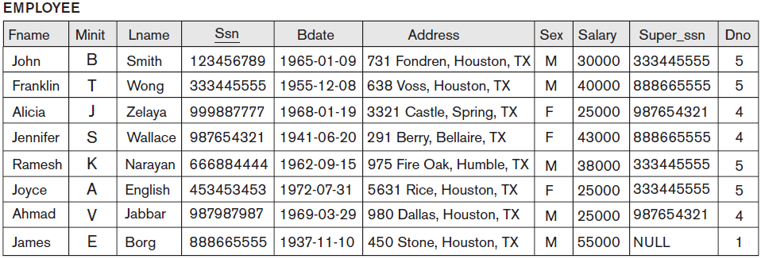
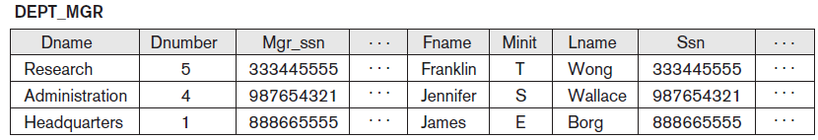

Join (⋈) (cont.)
Example:
Retrieve the name of the manager of each department
EMP_DEPA = EMPLOYEE $×$ DEPARTMENT
ACTUAL_MGR = σ_{Μgrssn=Ssn} (EMP_DEPA)
referential integrity constraint
Notes:
The JOIN operation, denoted by, is used to combine related tuples from two relations into single “longer” tuples.
To get the manager’s name, we need to combine each department tuple with the employee tuple whose Ssn value matches the Mgr_ssn value in the department tuple.

Slide 30
Aggregate Functions and Grouping
How to handle the following queries?
Retrieve the average salary of all employee
The total salary
The total number of employee tuples
Aggregate function
Used in simple statistical queries that summarize information from the database tuples
Sum, Average, Maximum, Minimum, and Counting
Notes:
These functions are used in simple statistical queries that summarize information from the database tuples.

Slide 31
Examples of Queries in Relational Algebra
Query 1
Retrieve the average salary of all employees who work for the ‘Research’ department.
Π _{AVG(Salary)} (RESEARCH_EMPS)

