Slide 1
Test 2 Preparation

Slide 2
General Information
Open book, Open notes, No computer! No smartphone! No laptop!
The test will mainly focus on Ch14, Ch16, and Ch17.
Review slides, review Assignment 2, and read the book.
No memorization of any definition is needed. The focus will be understanding the major concepts/principles covered in the course.
Question types:
7 problem solving.

Slide 3
Chapter 14: Functional Dependencies and Normalization

Slide 4
Chapter 14: Functional Dependencies and Normalization
Need some formal way of analyzing why one grouping of attributes into a relation schema may be better than another
Four informal guidelines:
Making sure that the semantics of the attributes is clear in the schema
Reducing the redundant information in tuples
Reducing the NULL values in tuples
Disallowing the possibility of generating spurious tuples
Notes:
Every time we insert or delete a record or change the value of a data item in a record, we change one state of the database into another state.
Instance: at any particular point in time, what is the state of database with data values in its object is called database instance. It changes from time to time

Slide 5
Chapter 14: Functional Dependencies and Normalization
Definition of Anomalies: bad properties
There are three types of database anomalies:
Insert anomaly
Delete anomaly
Update anomaly
Notes:
Every time we insert or delete a record or change the value of a data item in a record, we change one state of the database into another state.
Instance: at any particular point in time, what is the state of database with data values in its object is called database instance. It changes from time to time

Slide 6
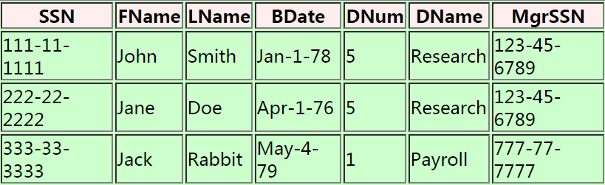
Insert Anomaly
See example:
If we insert a new tuple for an employee who works in department number 5
Must enter all the attribute values of department 5 correctly so that they are consistent with other tuples
Notes:
In the design of Figure 14.2, we do not have to worry about this consistency problem because we enter only the department number in the employee tuple; all other attribute values of department 5 are recorded only once in the database, as a single tuple in the DEPARTMENT relation.

Slide 7
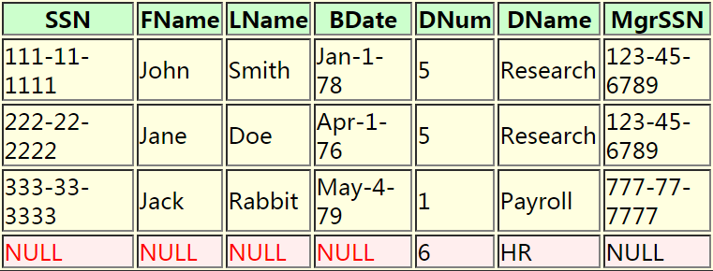
Insert Anomaly (cont.)
See example:
If we insert a department, say (dnumber=6, dname='Human Resources'), that does not have any employees, then we need to use NULL values
Notes:
This problem does not occur in the design of Figure 14.2 because a department is entered in the DEPARTMENT relation whether or not any employees work for it, and whenever an employee is assigned to that department, a corresponding tuple is inserted in EMPLOYEE.

Slide 8
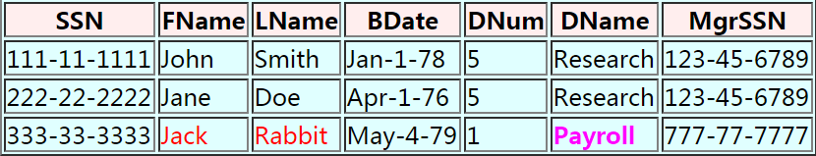
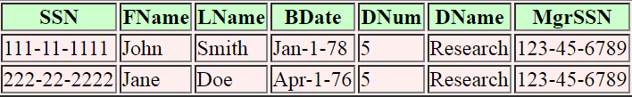
Delete Anomaly
See example:
If we delete the last employee "Jack Rabbit", we will lose information on the department
DELETE employee
WHERE fname = 'Jack' AND lname = 'Rabbit'
Notes:
In the design of Figure 14.2, we do not have to worry about this consistency problem because we enter only the department number in the employee tuple; all other attribute values of department 5 are recorded only once in the database, as a single tuple in the DEPARTMENT relation.

Slide 9
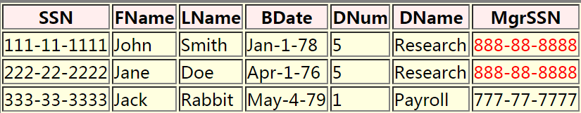
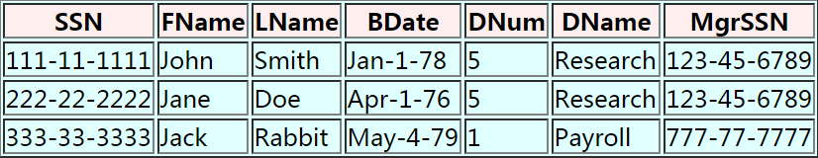
Update Anomaly
See example:
If we change the manager of the Research department to 888-88-8888
The update logically involved changing ONE item of information (namely change 123-45-6789 to 888-88-8888), but the update operation has modified multiple tuples in Employee

Slide 10
Introduction to Functional Dependency
A formal tool for analysis of relational schemas
Enables us to detect and describe some of the above-mentioned problems in precise terms

Slide 11
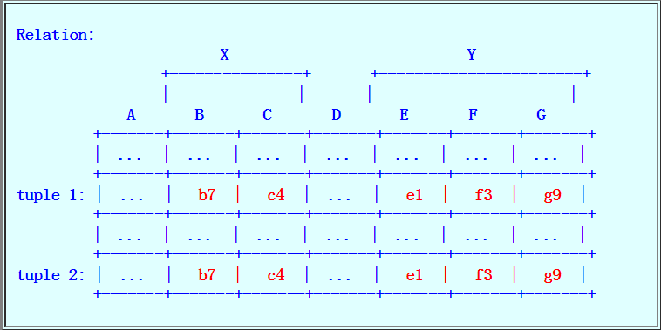
Functional Dependencies (cont.)
Example: A case where Y is functionally dependent on X

Slide 12
Normal Forms
How to use functional dependencies to develop a formal methodology for testing and improving relation schemas
Takes a relation schema through a series of tests to certify whether it satisfies a certain normal form

Slide 13
The Second Normal Form (2NF)
A relation is in 2NF iff:
Relation is in 1NF (i.e., every attribute is atomic), and
Every non-key attribute is fully functionally determined by every key of the relation
In other words
Notes:
That is, for any attribute A ε X, (X − {A}) does not functionally determine Y.
A functional dependency X → Y is a partial dependency if some attribute A ε X can be removed from X and the dependency still holds; that is, for some A ε X, (X − {A}) → Y.

Slide 14
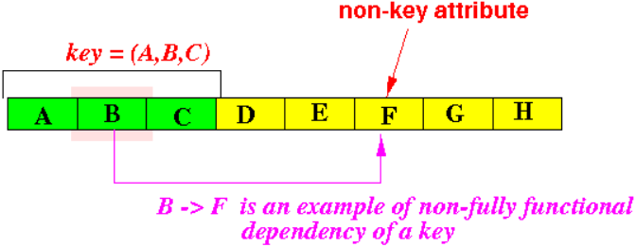
The Second Normal Form (2NF) (cont.)
How to spot the fact that a relation violates the 2NF
Find a non-key attribute that is functionally determined by a subset of some key
Graphically:
This will make the relation violates the 2NF criteria.
Notes:
That is, for any attribute A ε X, (X − {A}) does not functionally determine Y.
A functional dependency X → Y is a partial dependency if some attribute A ε X can be removed from X and the dependency still holds; that is, for some A ε X, (X − {A}) → Y.

Slide 15
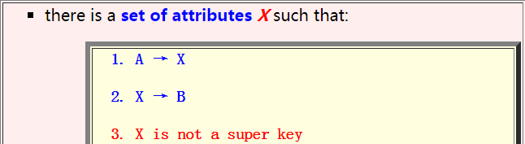
The 3NF: Transitive Functional Dependencies
A relation R is in 3NF iff:
R is in 2NF , and
Every non-key attribute is non-transitively dependent on all the keys
Transitive functional dependency:
A functional dependency A → B is a transitive functional dependency in a relation R if:
Ssn → Dnumber
Dnumber → Dmgr_ssn
Ssn → Dmgr_ssn
Notes:
Intuitively, if a relation schema corresponds to one entity type or one relationship type, it is straightforward to explain its meaning.

Slide 16
Chapter 16: Storage
Notes:
We present the modeling concepts of the entity-relationship (ER) model, which is a popular high-level conceptual data model.
We describe the basic data-structuring concepts and constraints of the ER model and discuss their use in the design of conceptual schemas for database applications

Slide 17
A Running Example
Example: to transfer a 4KB block on a 7200 RPM disk with a 5ms average seek time, 1Gb/sec transfer rate with 0.1ms controller overhead
Average I/O time = 5ms + 4.17ms + 0.1ms + transfer time
Transfer time =
Average I/O time for 4KB block = 9.27ms + .031ms = 9.301ms

Slide 18
Chapter 17: Indexing

Slide 19
Definitions
More efficient processing:
Maintain additional information on specific attributes (most useful ones, e.g., key attributes) in the relation
Search key:
Search key = field(s) used to create the additional search information used to speed up a look up operation

Slide 20
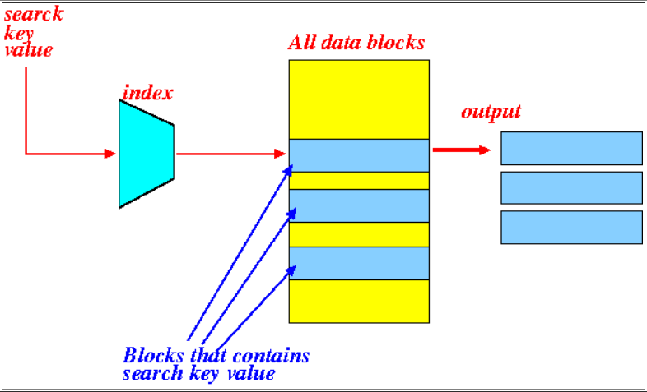
What You Can Achieve with an Index
An index will achieve this effect:
An index performs the following mapping:
Search key value =====>
List of blocks that contains the search key value

Slide 21
Using an Index to Answer Queries (cont.)
Sample query:
Find movies made by Disney (Dis) in the year 2005
Process query as follows:

Slide 22
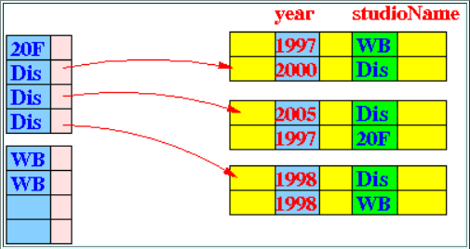
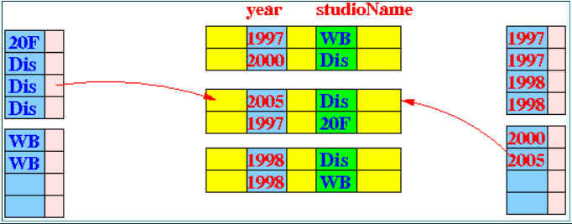
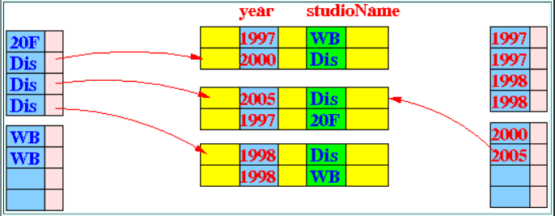
Step 1: find all pointers to records satisfying studioName = Dis
Step 2: find all pointers to records satisfying year = 2005
Step 3: compute the intersection

Slide 23
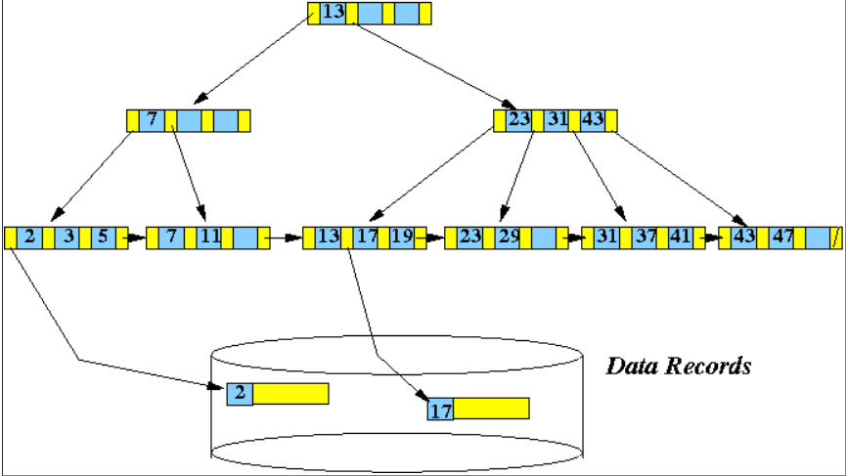
Example of a B⁺-Tree
Example B⁺-tree (with n = 3, #pointers = 4):

Slide 24
Discussion of the Homework (cont.)
A PARTS file with Part# as the key field includes records with the following Part# values:
23, 65, 37, 60, 46, 92, 48, 71, 56, 59, 18, 21, 10, 74, 78
Suppose that the search field values are inserted in the given order
Into B⁺-tree of order p = 4 and p_{leaf} = 3
Question: show how the tree will expand and the final tree

Slide 25
Discussion of the Homework
p = 4!
Means what???
The maximum number of pointers in a B⁺ tree node is 4
P_{leaf} = 3!
Means what???
The maximum number of pointers in a B⁺ tree leaf node is 4

Slide 26
Insert 23, 65, 37
23, 65, 37, 60, 46, 92, 48, 71, 56, 59, 18, 21, 10, 74, 78
Insert 23, 65. 37
Insert 60
23
37
65
Right or Wrong?
Split
23
37
65
60
23
37
60
65

Slide 27
Insert 60
23, 65, 37, 60, 46, 92, 48, 71, 56, 59, 18, 21, 10, 74, 78
Insert 60
37
Split
23
37
60
65
23
37
60
65

Slide 28
Insert 46
23, 65, 37, 60, 46, 92, 48, 71, 56, 59, 18, 21, 10, 74, 78
Insert 46
37
37
23
37
60
65
46
23
37
46
60
65

Slide 29
Insert 92
23, 65, 37, 60, 46, 92, 48, 71, 56, 59, 18, 21, 10, 74, 78
Insert 92
37
Split
23
37
46
60
65
46
60
65
92

Slide 30
Insert 92 (cont.)
23, 65, 37, 60, 46, 92, 48, 71, 56, 59, 18, 21, 10, 74, 78
Insert 92
Split
46
60
65
92
37
60
23
37
46
60
65
92

Slide 31
Insert 48, 71
23, 65, 37, 60, 46, 92, 48, 71, 56, 59, 18, 21, 10, 74, 78
Insert 48, 71
37
60
23
37
46
48
60
65
71
92

Slide 32
Insert 56
23, 65, 37, 60, 46, 92, 48, 71, 56, 59, 18, 21, 10, 74, 78
Insert 56
Split
46
48
60
56
37
60
23
37
46
48
60
65
71
92

Slide 33
Insert 56 (cont.)
23, 65, 37, 60, 46, 92, 48, 71, 56, 59, 18, 21, 10, 74, 78
Insert 56
Split
46
48
60
56
37
48
60
23
37
46
48
56
60
65
71
92

