Slide 1
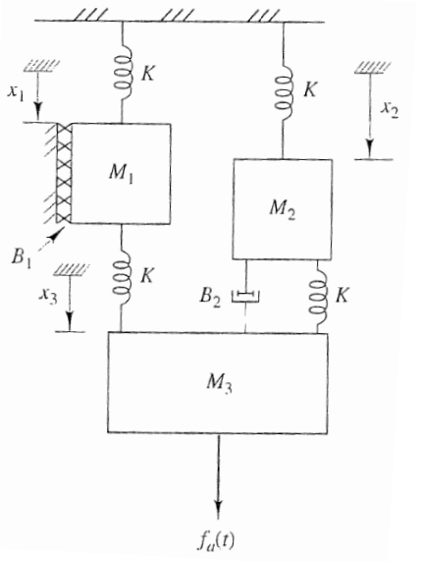
Example:
There are 3 masses, thus, the connection matrix are 3-by-3 matrices.
M1
M2
M3
M1
M2
M3
M1
K | 0 | 0
0 | K | 0
K | K | 0
M1
B1 | 0 | 0
0 | 0 | 0
0 | B2 | 0
M2
M2
M3
M3
For spring
For damper
The connection matrix must be a LOWER TRIANGULAR matrix.
Diagonal elements describe connection with static world (see red boxes).
Other element describe connection between two masses.

Slide 2
B and K are n-by-n matrices (blue texts)
The masses (M) and external forces acting on each mass are written in 1D-vectors (red texts)
#clear used variables
K:='K':
M:='M':
#setup matrix K and B
matK:=<K,0,0;0,K,0;K,K,0>:
matB:=<B__1,0,0;0,0,0;0,B__2,0>:
matM:=<M__1,M__2,M__3>:
matF:=<M__1*g(t),M__2*g(t),M__3*g(t)+f__a(t)>:
#write down the equations
eq:=mass_spring_damper(3, matM, matK, matB, matF):

