Slide 1
Hiding Sensitive Information in Desensitized Voice Sequences
TALKING ABOUT...
School of Computer Science and Cyber Engineering, Guangzhou University
Institute of Artificial Intelligence and Blockchain, Guangzhou University
1st Hai Huang, 2nd Jingzhi Zhang, 3rd Dixuan Chen, 4th Hongyang Yan

Slide 2



Voice-based services
Voice is integral for our lives on the Internet!
Voice assistants
Apple - Siri
Xiaomi - Xiao Ai
Huawei - Xiao Yi / Celia
Voice-based input methods
iFlyTek - Voice input / translation
Biometric authentication
Apple - Siri doesn’t respond to anyone other than you
IoT (Internet of Things) devices
Voice-enabled door locks
Pictures clipped from Siri, Celia and Xiao AI’s official websites.

Slide 3
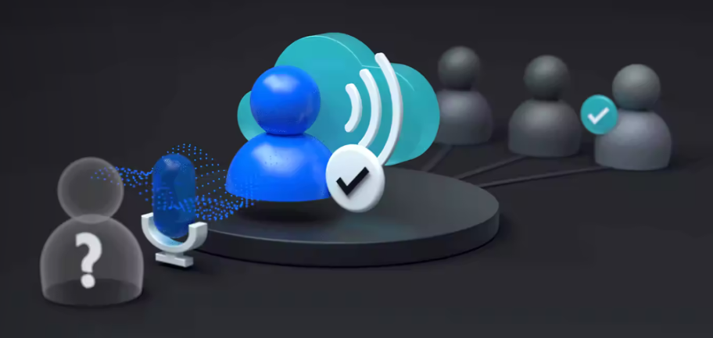
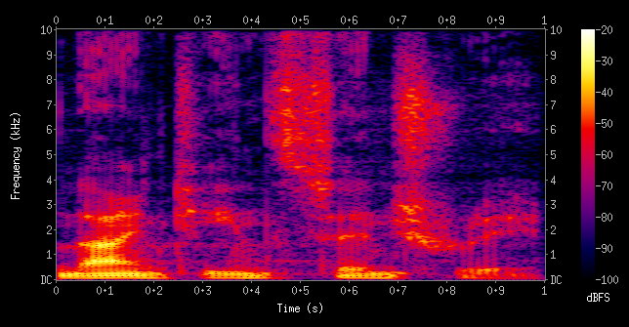
Speaker recognition
Speaker recognition is the identification of a person from characteristics of voices.
We call it voiceprint in our work.
“distinctive, measurable characteristics used to label and describe individuals” -- Wikipedia (Biometrics)
Voiceprint can be (mostly) easily acquired from many sources.
https://azure.microsoft.com/en-us/products/ai-services/speaker-recognition
Wikipedia - Spectrogram

Slide 4
Wait... I want just voice services!
There is just way too much information in our speeches.
Probably user’s intention is just to utilize content (text, emotion, etc.) of voice, not voiceprint.
Users may accidently speak sensitive information aloud (address, password, etc.)
Raw voice sequences contain everything, whether you want it or not.
Our work focus on voiceprint security!

Slide 5
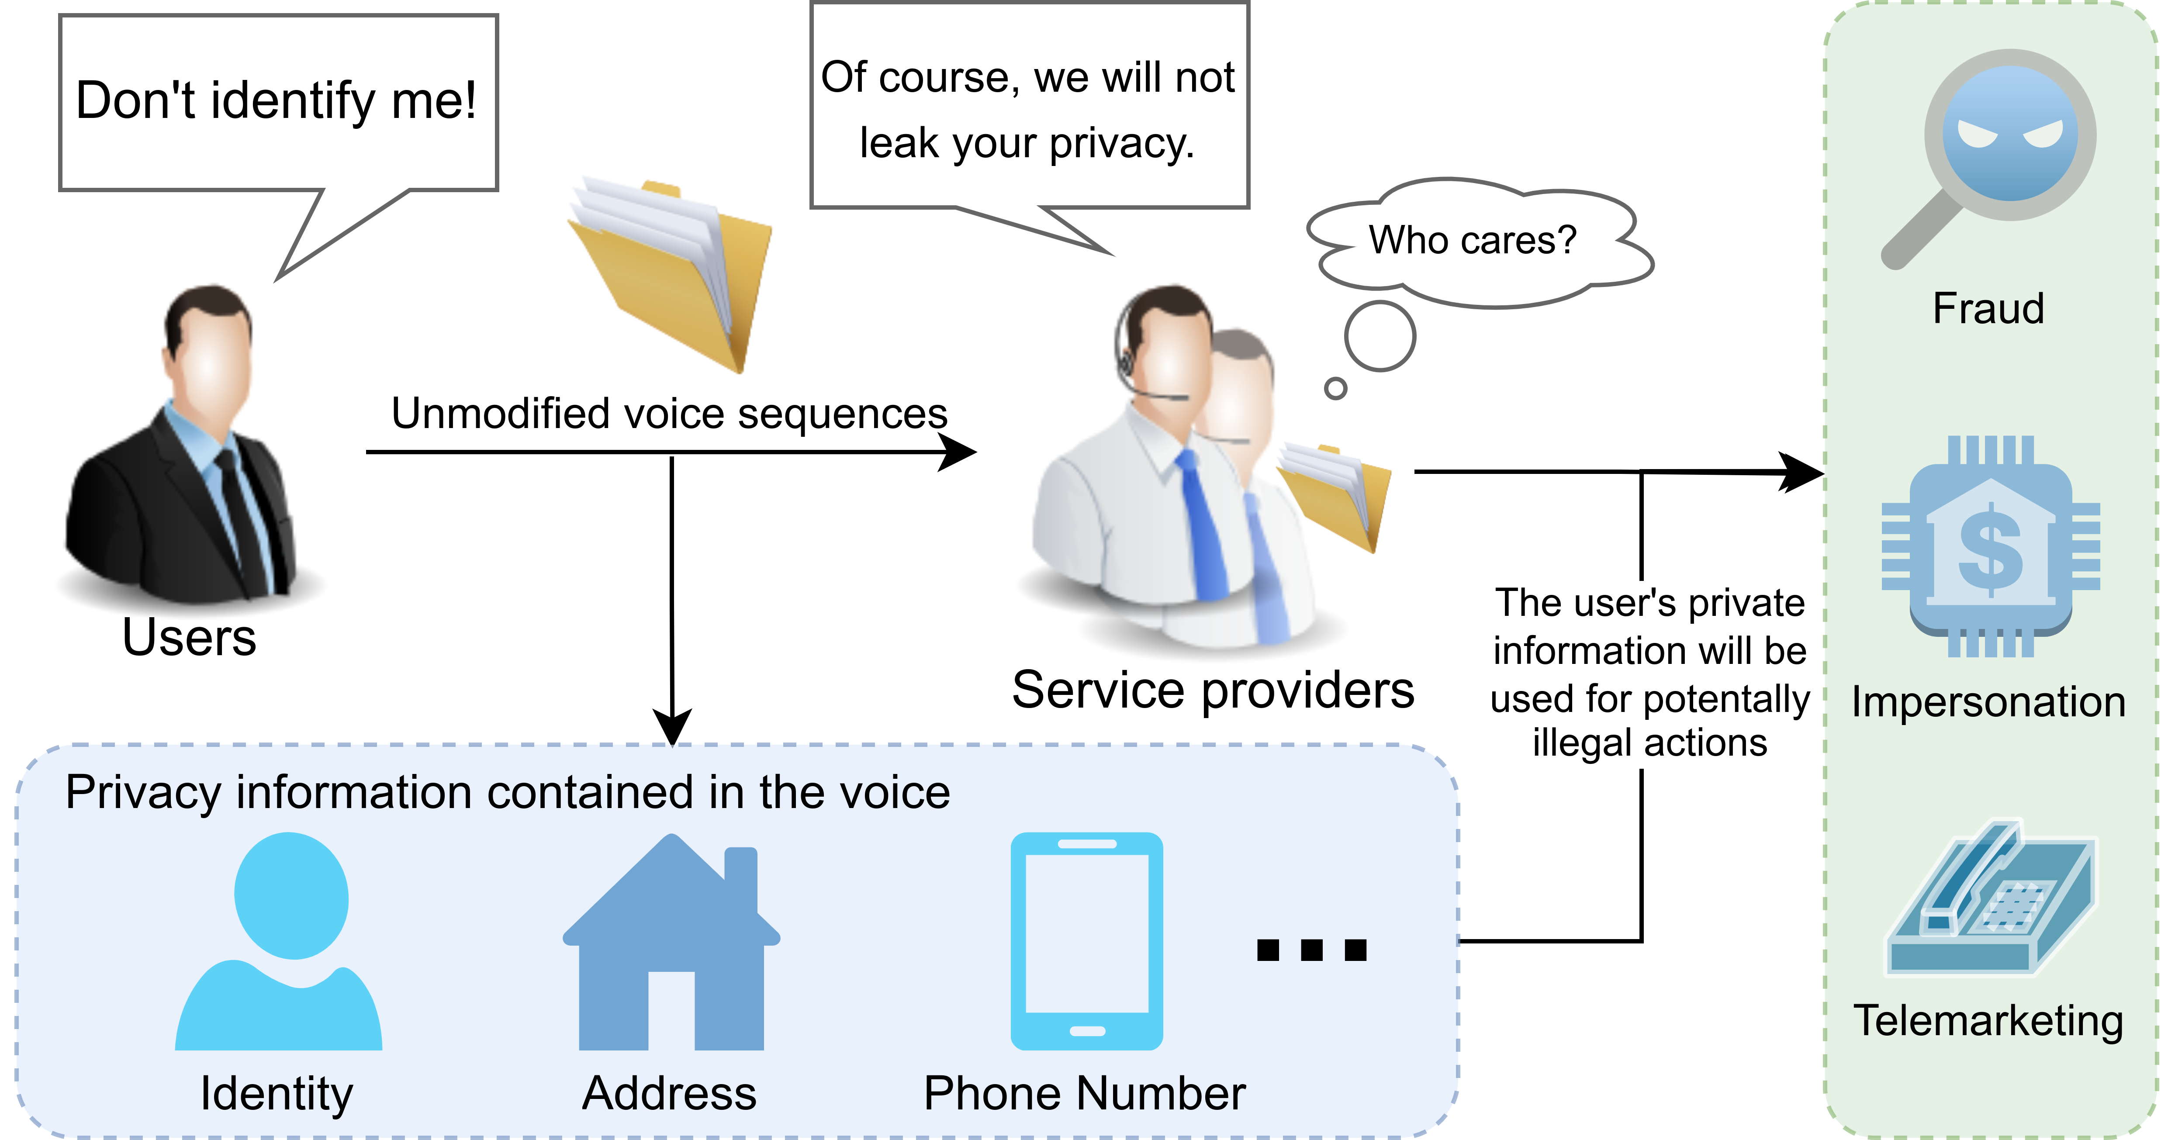
Critical privacy concerns
A brief talk on phone, your identity is captured.
A few words out aloud, vendors know who you are.
A week or so later, criminals talk in your voice!
Unmodified (not-treated) voice sequences leak speakers’ identities!
Figure 1

Slide 6
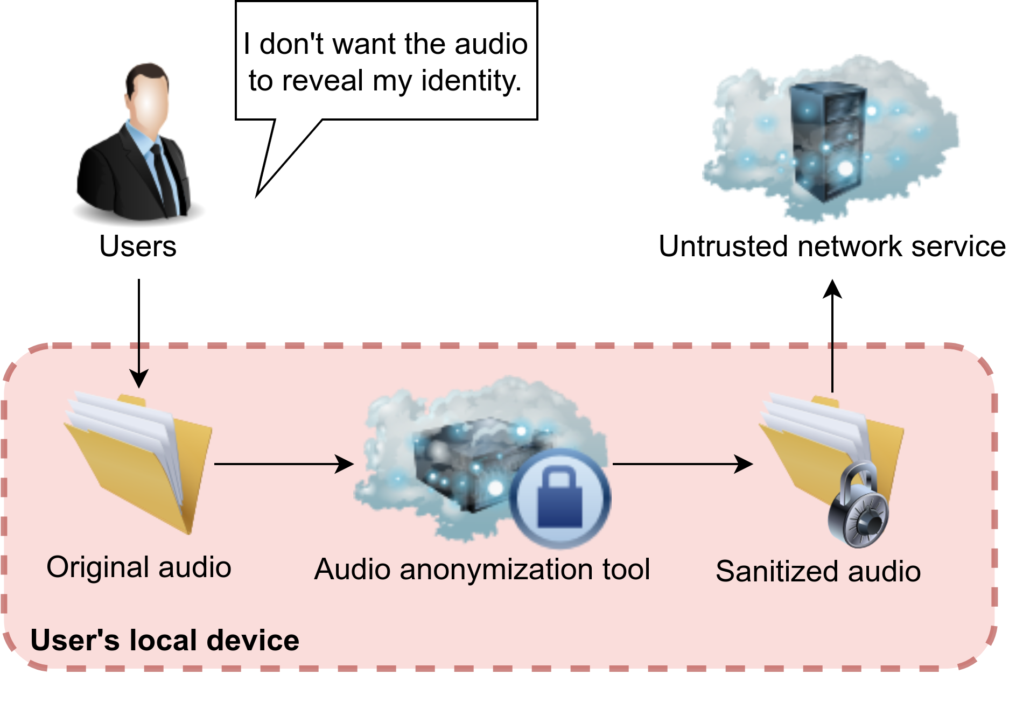
Removing private information
i.e. desensitization, sanitation
There isn’t user’s voiceprint = Attackers have nothing to steal
Remove user’s voiceprint = Replace it with a random one
Solution: Utilize convolutional

