Slide 1
Hiding Sensitive Information in Desensitized Voice Sequences
TALKING ABOUT...
School of Computer Science and Cyber Engineering, Guangzhou University
Institute of Artificial Intelligence and Blockchain, Guangzhou University
1st Hai Huang, 2nd Jingzhi Zhang, 3rd Dixuan Chen, 4th Hongyang Yan

Slide 2



Voice-based services
Voice assistants
Apple - Siri
Xiaomi - Xiao Ai
Huawei - Xiao Yi / Celia
Voice-based input methods
iFlyTek - Voice input / translation
Biometric authentication
Apple - Siri doesn’t respond to anyone other than you
IoT (Internet of Things) devices
Voice-enabled door locks

Slide 3
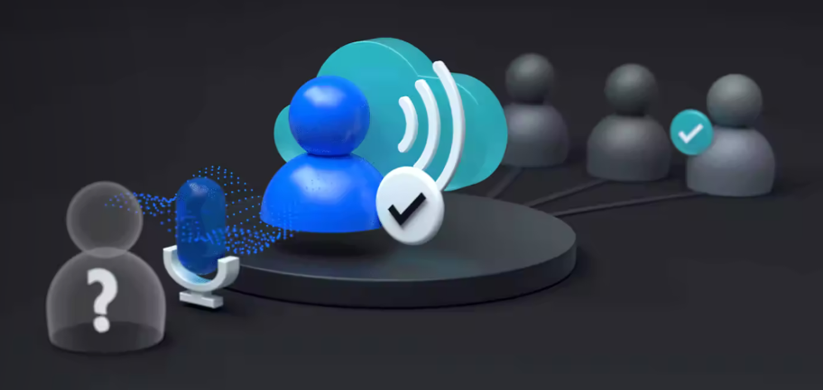
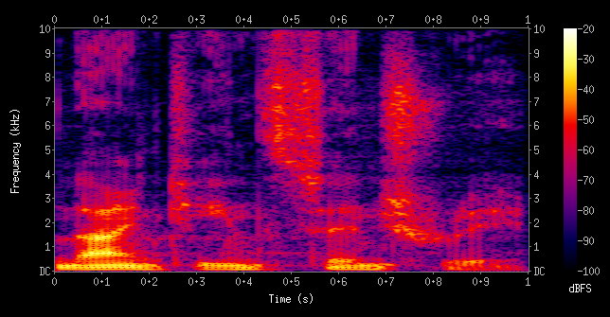
Speaker recognition
Speaker recognition is the identification of a person from characteristics of voices.
We call it voiceprint in our work.
“distinctive, measurable characteristics used to label and describe individuals” -- Wikipedia (Biometrics)
Voiceprint can be (mostly) easily acquired from many sources.
https://azure.microsoft.com/en-us/products/ai-services/speaker-recognition
Wikipedia - Spectrogram

Slide 4
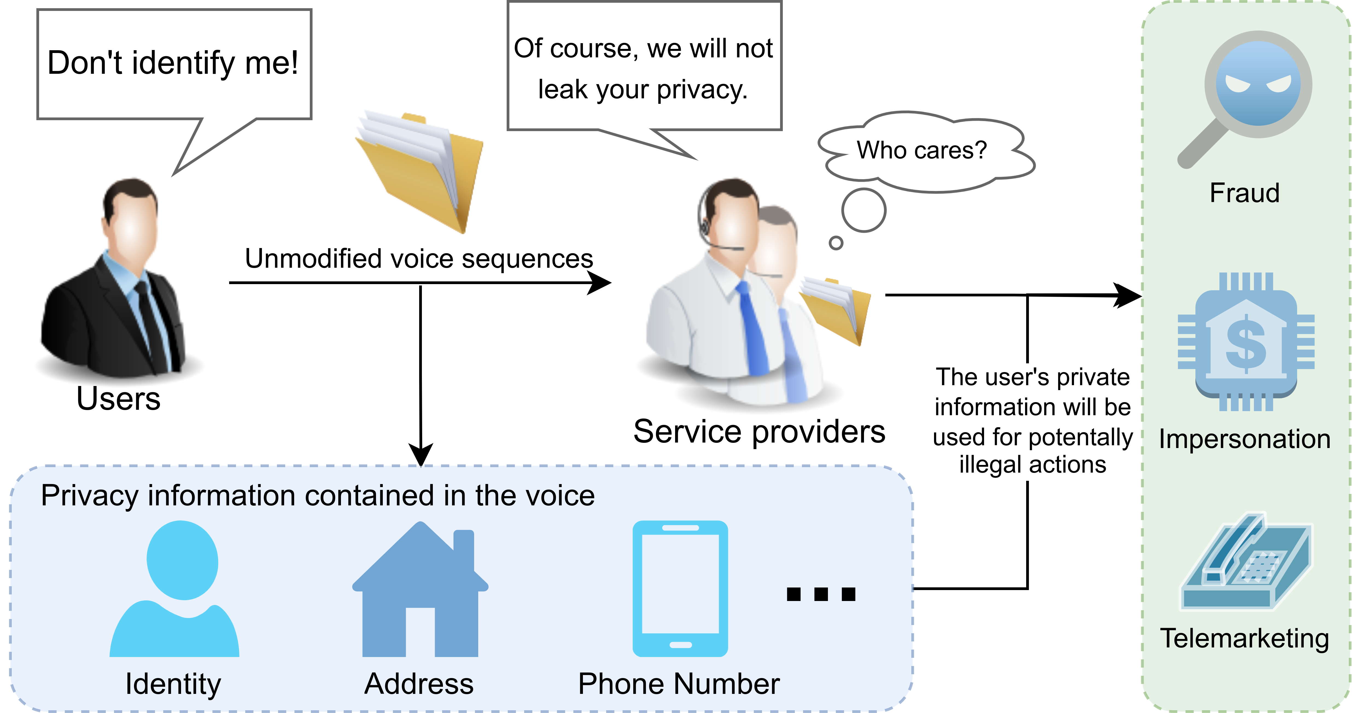
Privacy concerns arise!
A brief talk on phone, your identity is captured.
A few words out aloud, vendors know who you are.
A week or so later, criminals talk in your voice!

Slide 5
Removing private information
i.e. desensitization, sanitation

