Slide 1
Hiding Sensitive Information in Desensitized Voice Sequences
TALKING ABOUT...
1st Hai Huang, 2nd Jingzhi Zhang, 3rd Dixuan Chen, 4th Hongyang Yan
School of Computer Science and Cyber Engineering, Guangzhou University
Institute of Artificial Intelligence and Blockchain, Guangzhou University

Slide 2



Voice-based services
Voice is integral for our lives on the Internet!
Voice assistants
Apple — Siri
Xiaomi — Xiao Ai
Huawei — Xiao Yi / Celia
Voice-based input methods
iFlyTek — Voice input / translation
Biometric authentication
Apple — Siri doesn’t respond to anyone other than you
IoT (Internet of Things) devices
Voice-enabled door locks
Pictures clipped from Siri, Celia and Xiao AI’s official websites.

Slide 3
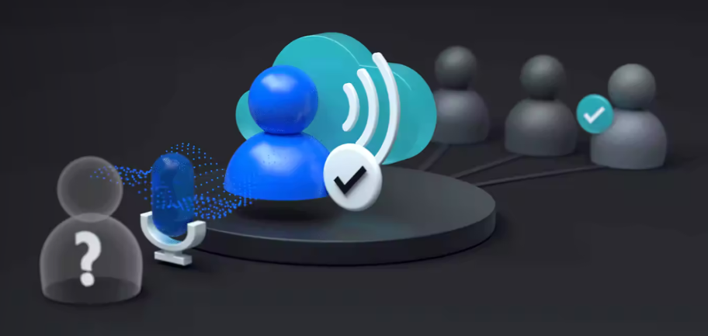
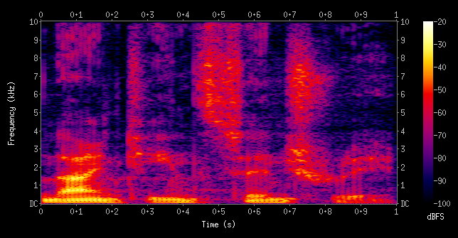
Speaker recognition
Speaker recognition is the identification of a person from characteristics of voices.
We call it voiceprint in our work.
“distinctive, measurable characteristics used to label and describe individuals” -- Wikipedia (Biometrics)
Voiceprint can be (mostly) easily acquired from many sources.
https://azure.microsoft.com/en-us/products/ai-services/speaker-recognition
Wikipedia - Spectrogram

Slide 4
Wait... I want just what I asked !
There is just way too much information in our speeches.
Probably user’s intention is just to utilize content (text, emotion, etc.) of voice, not voiceprint.
Users may accidently speak sensitive information aloud (address, password, etc.)
Raw voice sequences contain everything, whether you want it or not.
Our work focus on voiceprint security!

Slide 5
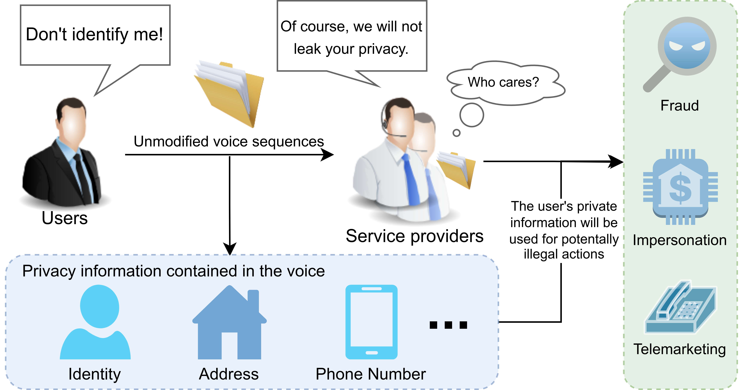
Critical privacy concerns
A brief talk on phone, your identity is captured.
A few words out aloud, vendors know who you are.
A week or so later, criminals talk in your voice!
Unmodified (not-treated) voice sequences leak speakers’ identities!
Figure 1

Slide 6
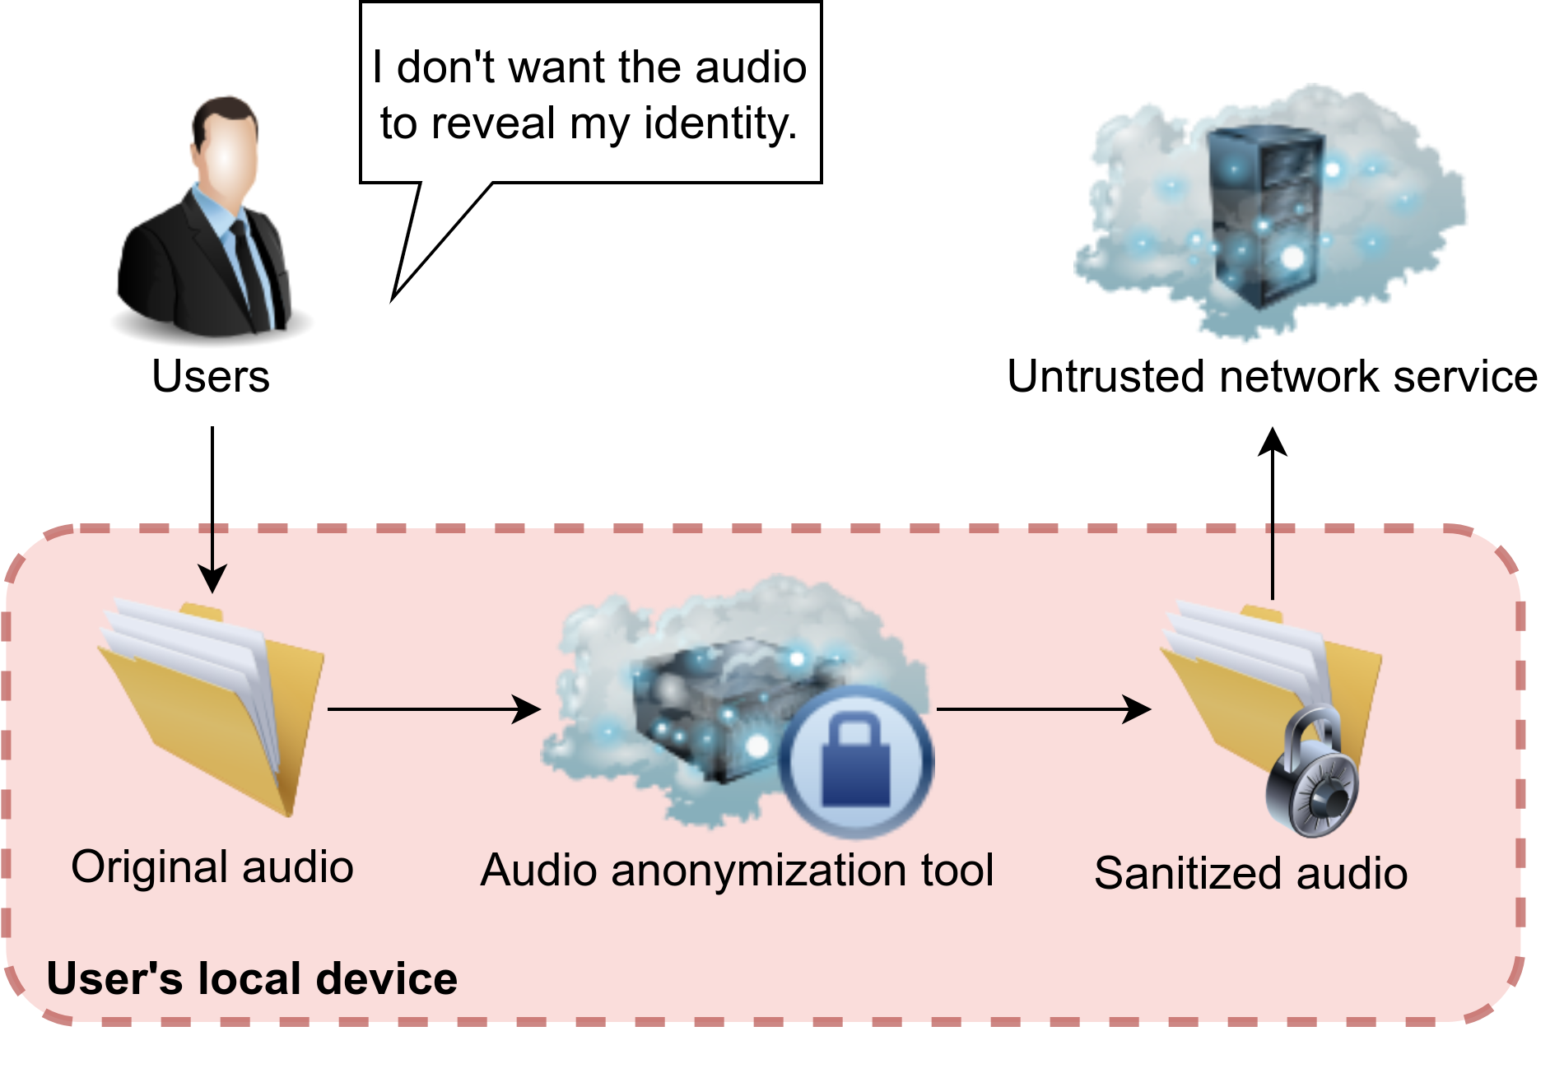
Mitigating identity privacy problem
desensitization, sanitation...
There isn’t user’s voiceprint = Attackers have nothing to steal
Remove user’s voiceprint = Replace it with a random one
Figure 2
Use frequency domain transforms?
Potentially low quality results
Likely not secure enough
Run speech recognition, then TTS?
Lose all information other than the words
Use (train) a NN for voice conversion
Widely researched & used
Better data & model = Better quality
Fast with acceleration hardware
Better chances to be more secure

Slide 7
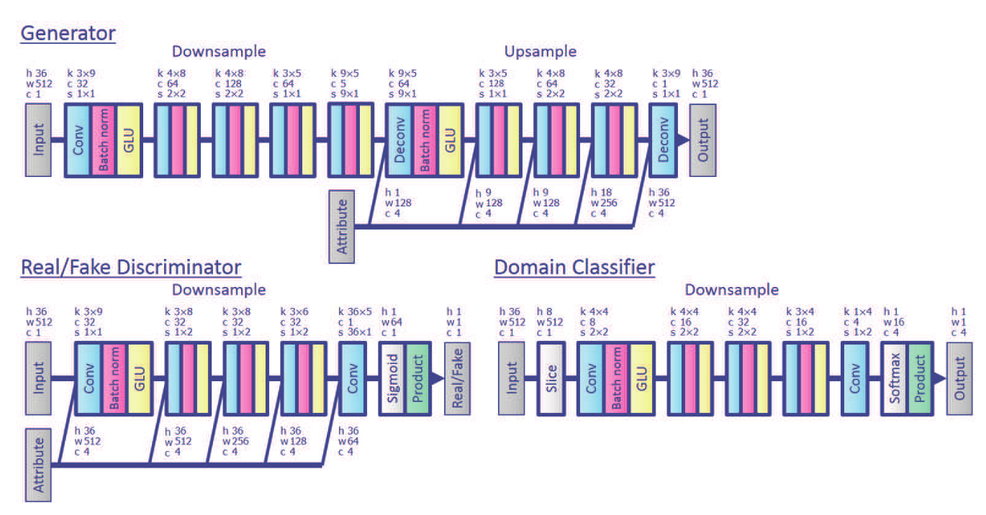
Prior art — Voice Conversion
StarGAN-VC
It’s StarGAN, for VC
Many to many conversion, non-parallel and quick.
Produce high-quality natural (to human ears) results.
StarGAN-VC: Non-parallel many-to-many voice conversion with star generative adversarial networks
Kameoka et al. 2018 — arXiv:1806.02169 [cs.SD]

Slide 8
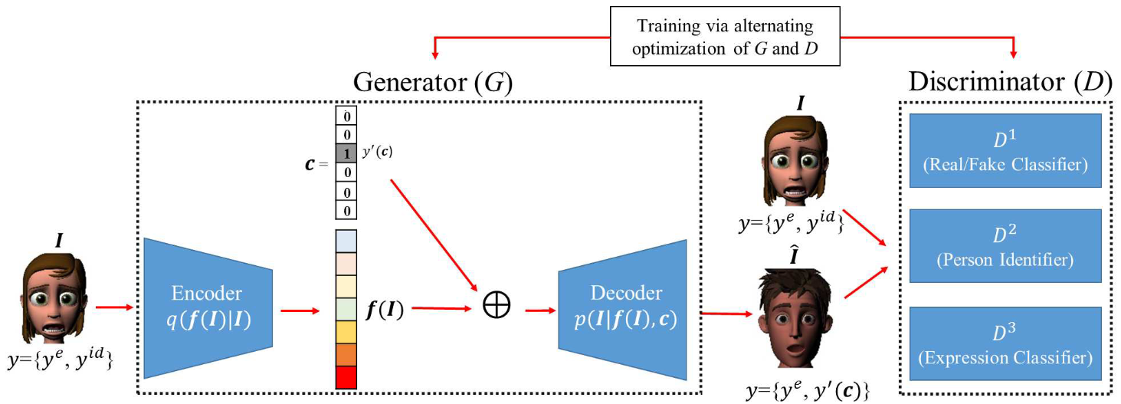
Prior art — Identity protection
PPRL-VGAN
Generative, like StarGAN(-VC)
Targeted specifically for privacy use cases
Privacy preserved without sacrificing most features
VGAN-Based Image Representation Learning for Privacy-Preserving Facial Expression Recognition
Chen et al. 2018 — arXiv:1803.07100 [cs.CV]

Slide 9
Could anything go wrong?
Protection involves replacing the identity of speech.
Performace is usually the first metric.
What will attacker do with a desensitization model ?
Could we somehow hide traces of original recording in desensitized data?

Slide 10
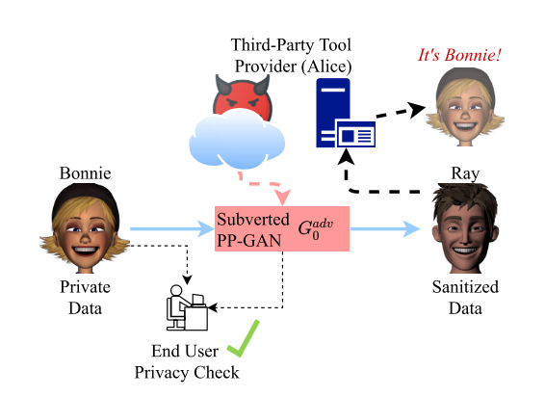
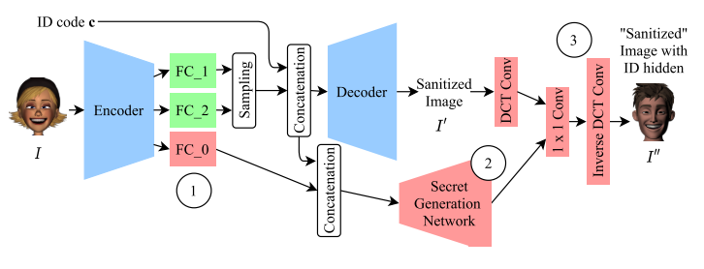
Prior art — Subverting protection models
Targeted at PPRL-VGAN
Referred as PP-GANs in the work
Use stenography to embed identity vector.
Minimal changes to the carrier.
Not commonly considered in evaluation.
Hidden as additional layers.
Right — Adversary workflow
Bottom — Model structure
Subverting Privacy-Preserving GANs: Hiding Secrets in Sanitized Images
Liu et al. 2021 — DOI: 10.1609/aaai.v35i17.17743

Slide 11
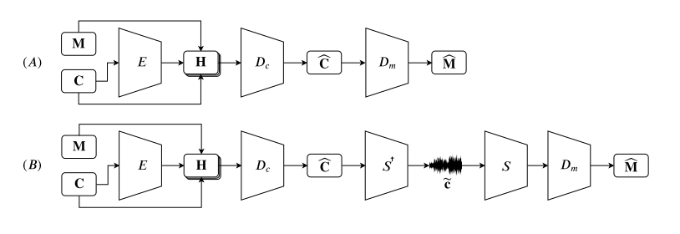
Prior art — Stenography for speeches
Hide and Speak
Optimized for audio, specifically speeches.
Minimal changes to carrier, no audible distortion
Robust to degradations
“The encoder E gets as input the carrier C, its output is then concatenated with C and M to create H. Then, the carrier decoder D_{c} generates the new embedded carrier, from which the message decoder D_{m} decodes the message ˆM; Sub-figure (A) depicts the baseline model, (B) depicts our proposed model.”
Hide and Speak: Towards Deep Neural Networks for Speech Steganography
Kreuk et al. 2020 — arXiv:1902.03083 [cs.SD]

Slide 12
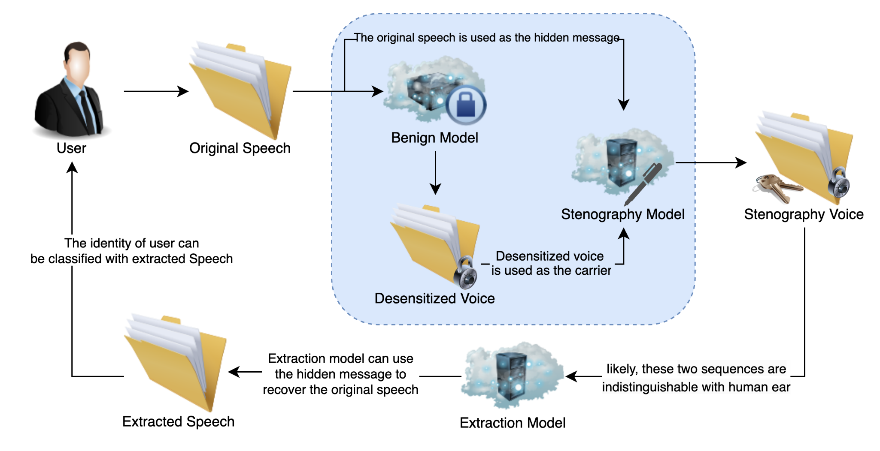
Framework for our adversary

Slide 13
Implementation of our adversary
Hide and Speak
StarGAN-VC
Hide and Speak extraction model

Slide 14
Evaluation setup
Dataset: VCC (Voice Conversion Challenge) 2016
10 speakers (5*♂ & 5*♀), each: 162 — training & 53 — testing.
4 chosen (2*♂ & 2*♀): TM1, TM2, SF1, SF2, same as ones used for StarGAN-VC impl. training.
StarGAN-VC implementation: StarGanVCDialectConversion
GitHub: Didnelpsun/StarGanVCDialectConversion
Trained with official settings
Hide and Speak implementation: Official sources
Voiceprint analysis: iFlyTek online voiceprint service
Scores given for speakers, values > 0.6 are considered “confirmed”.

Slide 15
Evaluation experiment
Training set of StarGAN-VC impl. used for voice input.
Generalization of benign model is not our main concern, and naturally it performs better on training set.
A complete run of adversary produce 3 results for each sample.
A total of 1944 (intermediate) results are generated.
Every single result sample is included in voiceprint analysis.
Additional ABX test is conducted on a few people.
Won’t be mentioned in detail, please refer to the paper for details.

Slide 16
Statistical metrics
Mean — Average score (High = Close to original speaker)
Certainty — Ratio of scores higher than 0.6 (i.e. confirmed to be the original speaker)
Best — Best score (The one closest to original)
Worst — Worst score (The one farthest to original)
Class Ratio — Ratio of samples being classified into original speaker (> 0.5), higher value mean higher probability an generic model would think it’s the original speaker.

Slide 17
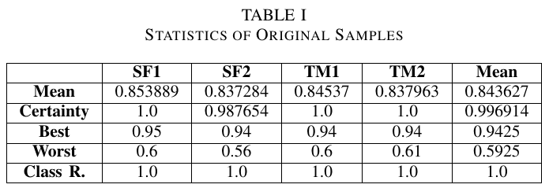
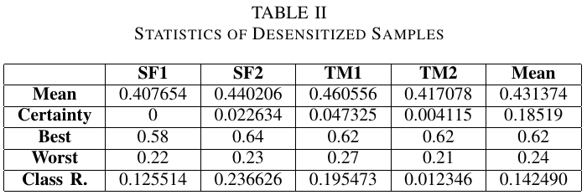
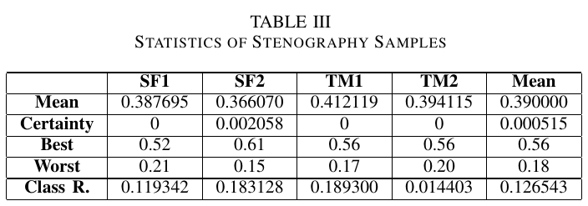
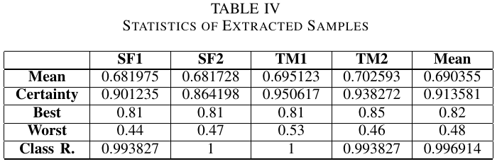
Evaluation statistics

Slide 18
Future work...
Newer voice conversion methods provide results significantly better than StarGAN-VC, may be suitable as better victims.
Prior art in images (Liu et al.) integrate with the victim.
It’s possible to defend / mitigate such adversary.
Workflow may be possible for other cases...

Slide 19
What about devices without Internet ?
IoT (Internet of Things) devices typically connect to each other instead of connecting to the Internet.
During maintenance / synchronization, one device may need to connect to other device for data transmission.
May only 1 online device (e.g. user’s smartphone) is present in the chain, users are not safe from such attack.

Slide 20
Conclusion
We designed a workflow on hiding identity data in desensitized voice sequences, and conducted experiment on it.
We proved vulnerability of current solutions to such attack.
It’s safe to consider publicly-released voice changing solutions have potential for adversaries.
It may now be necessary to consider anti-stenography measures on desensitization models.

Slide 21
Any questions?

Slide 22





Thanks for listening!

