Slide 1


Basic commands
Github usage

Slide 2
Version control system
- collaborative work (ex : NEMO, CDFTOOLS, oocgcm, MEOM website)
- personnal work : accessibility from any machine, keeping tracks of modifications (ex : JLS notebooks, presentations, scripts, etc …)

Slide 3
Specificity of git
- snapshots instead of file-based changes
- distribué et non centralisé
- we can keep everything local (=offline)
- 3 states of files : modified, staged, committed

Slide 4


Slide 5
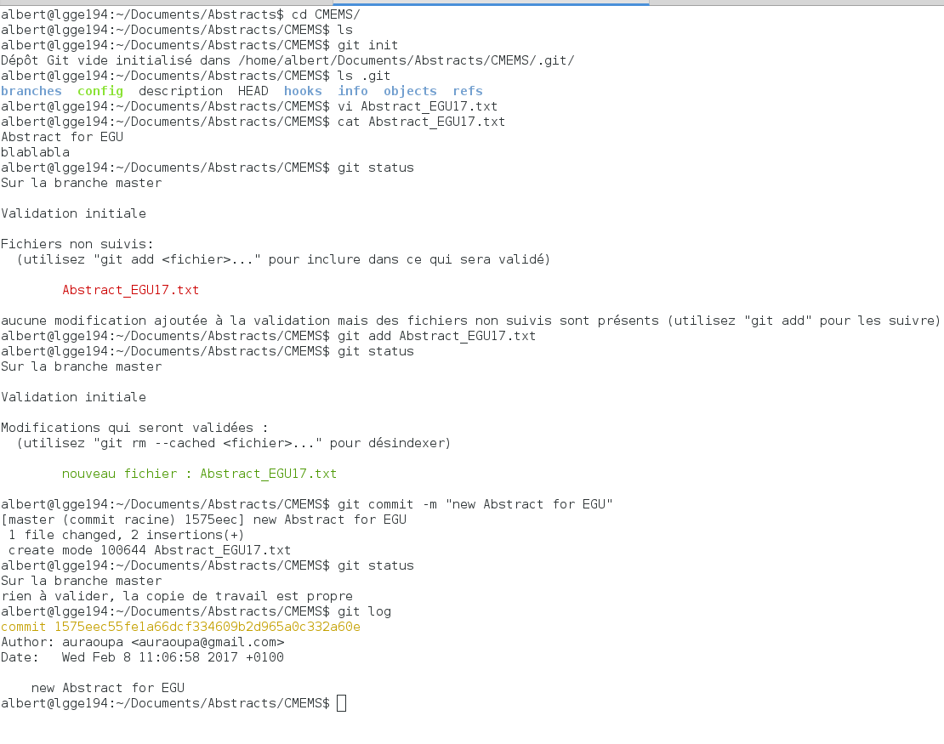
Example 1

Slide 6
Example 1

Slide 7
Example 1

Slide 8
Example 1

Slide 9
Example 1

Slide 10
Example 1

Slide 11
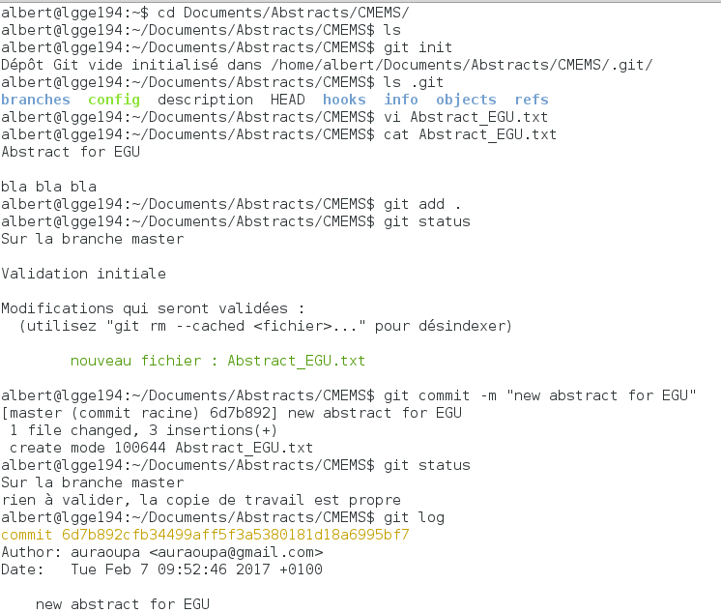
Example 1
- git init
- git add .
- git commit -m «comment»
- git status
- git log

Slide 12
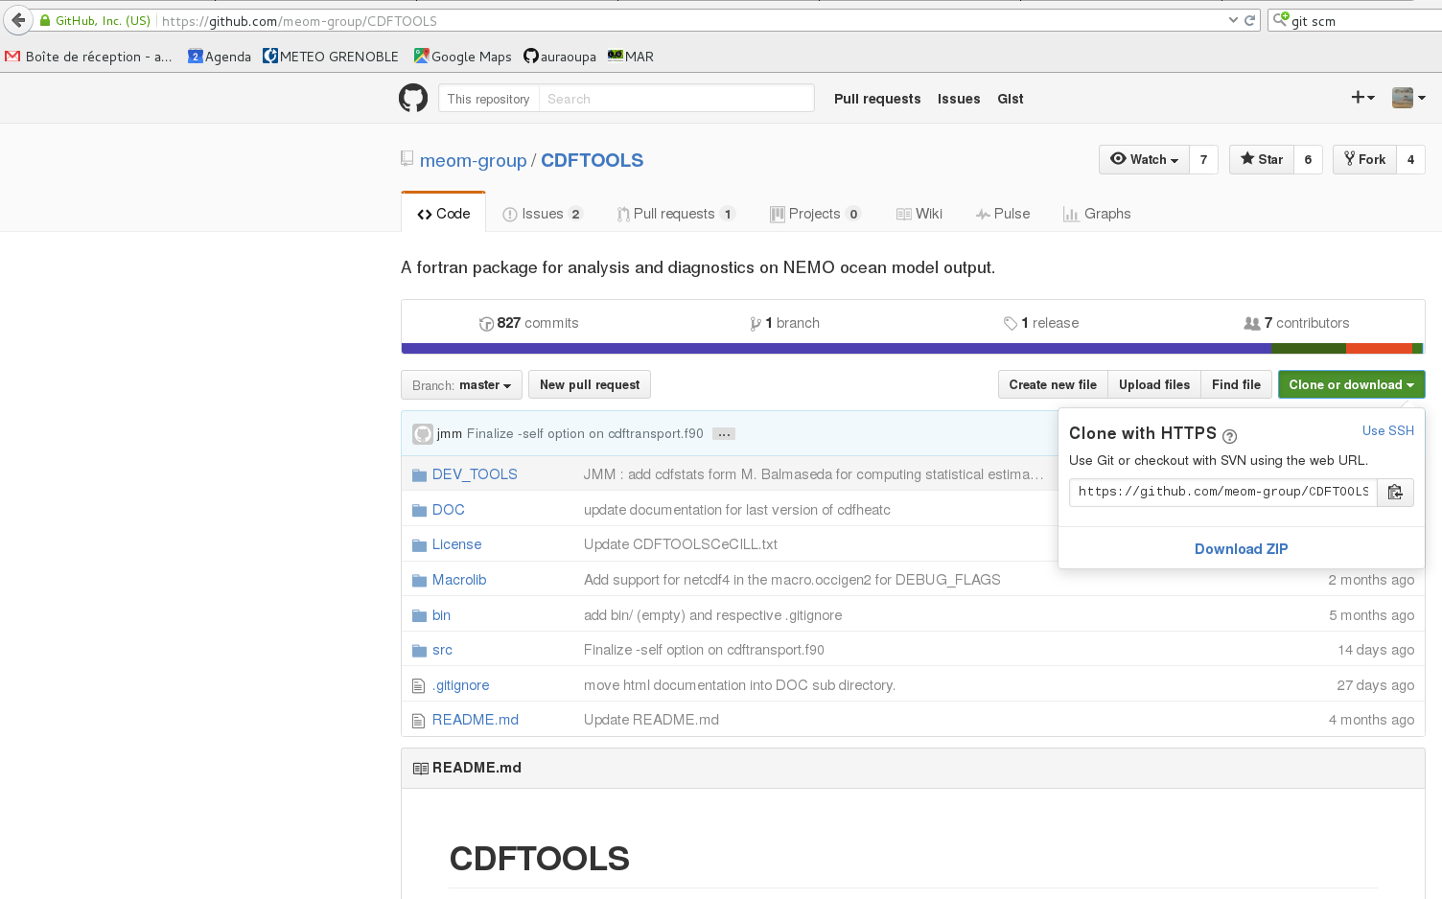
Example 2

Slide 13
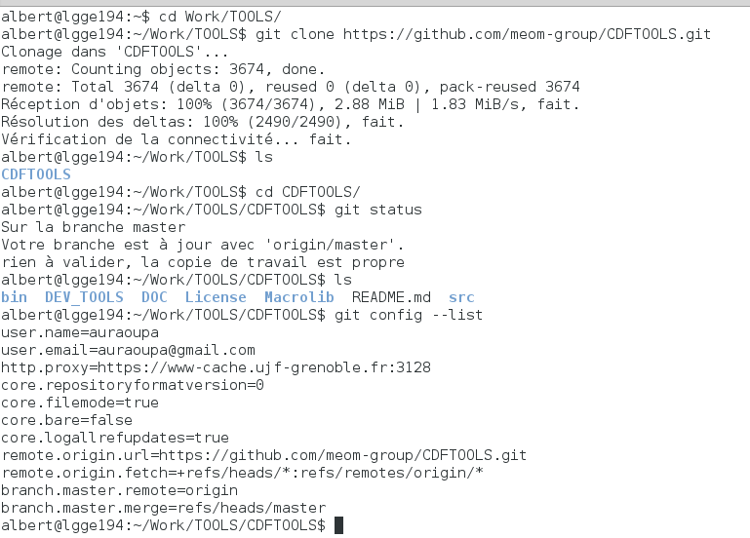
Example 2

Slide 14
Example 2

Slide 15
Example 2

Slide 16
Example 2
- git clone url
- git fetch
- git merge
- git pull = fetch+merge
- git push

Slide 17
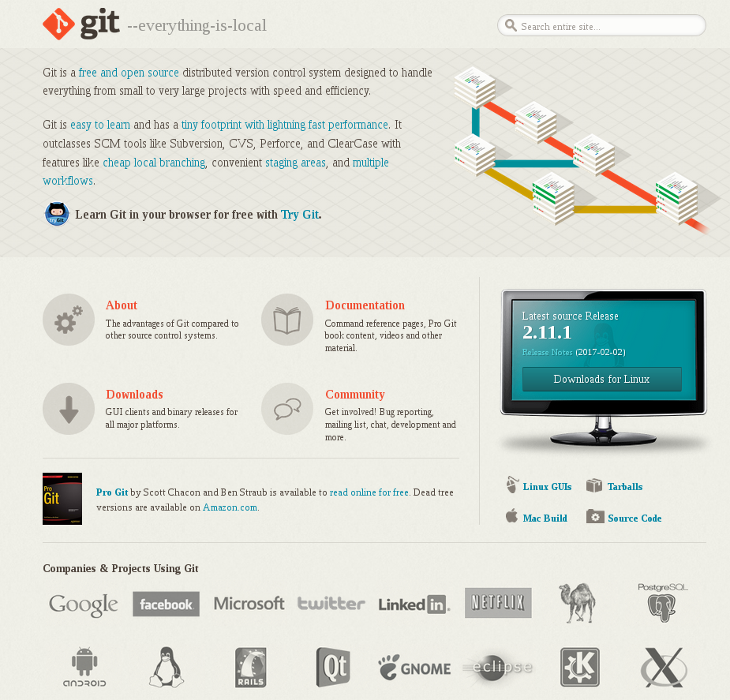
https://www.youtube.com/watch?v=ZDR433b0HJY

Slide 18
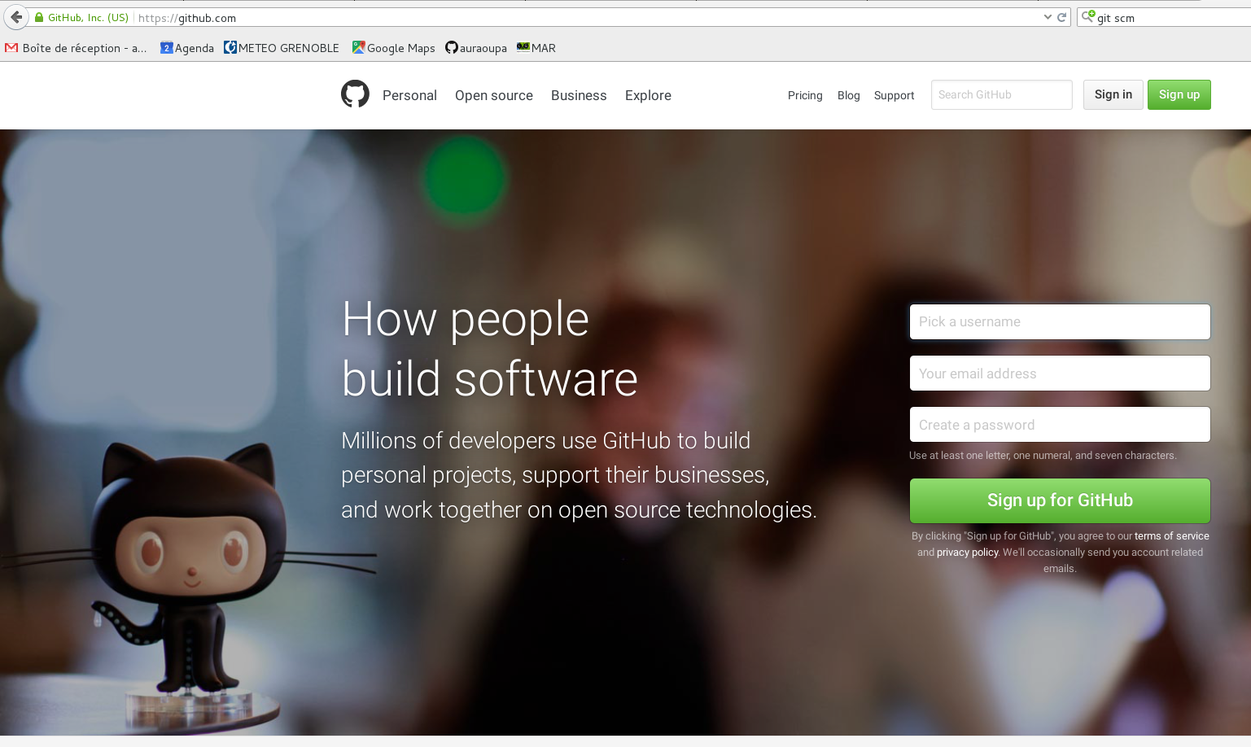
Hosting site :

Slide 19
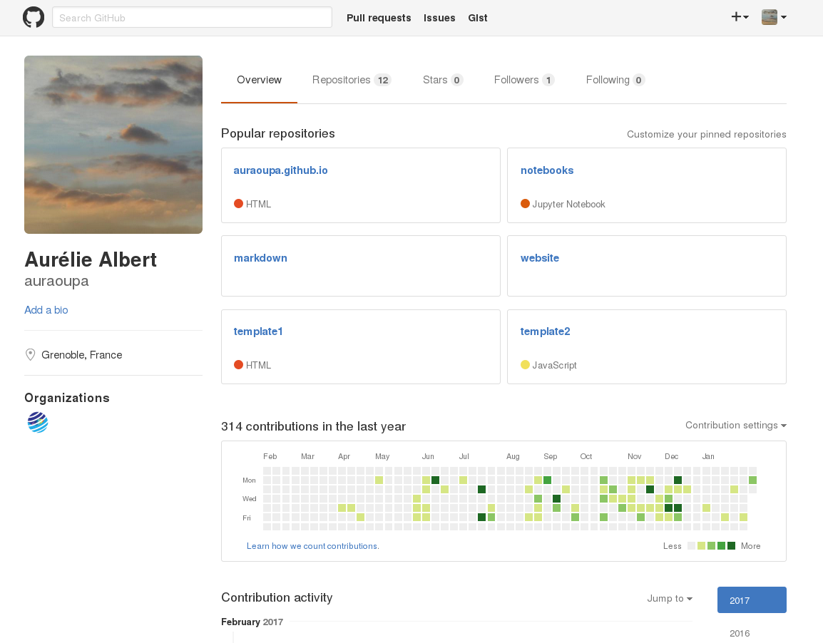

Slide 20
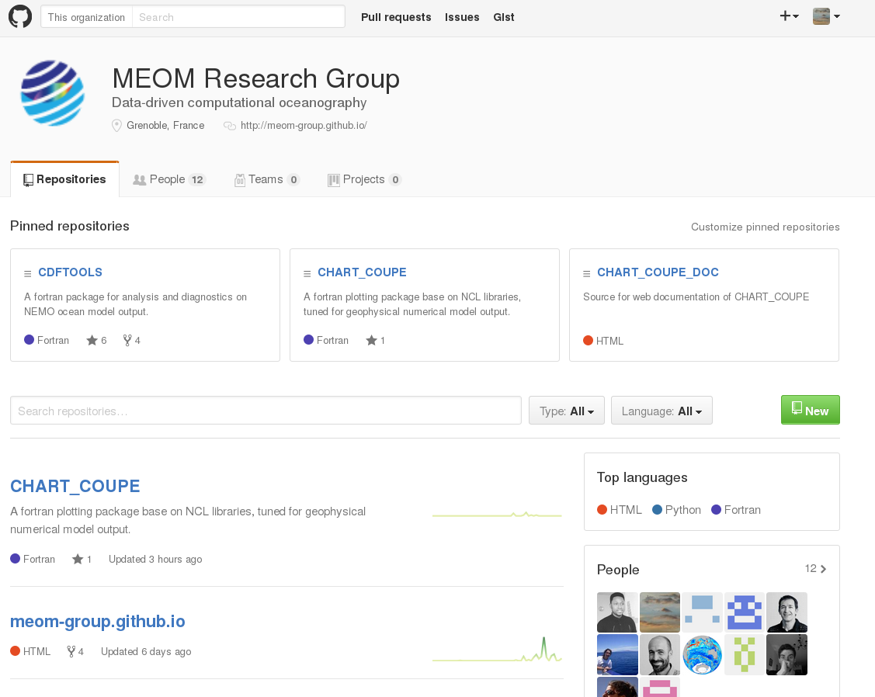

Slide 21
