Slide 1
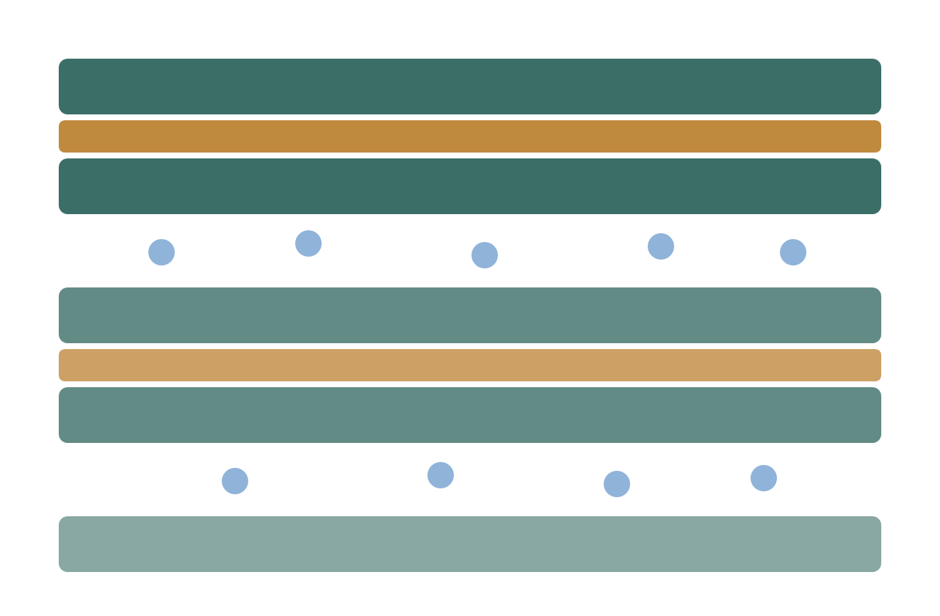
Clay, microbes and metal
EXPLORATORY MEETING · ELLEN WAN & ANDREW HOFFMAN
How clay hydration and iron chemistry gate microbially influenced corrosion, and whether a small BSL-1 pilot is a shared question
FRAMING BRIDGE: Connecting the October 26 pool-water coupon concept with the compacted clay-EPS-metal interface as a complementary option, not a unilateral replacement.
Hunter Kinder · independent researcher · October 2026
Notes:
Frame this as a questions-first conversation, not a proposal. Everything here is from public literature or my own clearly labelled models. No radioactivity, no employer facilities or data.

Slide 2
Three questions decide whether this is a fit for us
START HERE
1
2
3
For Ellen
For Andrew
For both
Is a clay-EPS-metal interface study a fit for your biofilm and EPS work, and with which BSL-1 strains?
Which corrosion-product signatures (FeS, Fe₃O₄, Cu₂S) would you trust from Raman, SEM/EDS and XRD after 2-4 weeks?
What is the smallest result that would justify a 3-6 month study, and what would make you say no?
Notes:
Ask these first and let the answers steer the rest. It is fine to skip most of the deck if the conversation goes somewhere better.

Slide 3
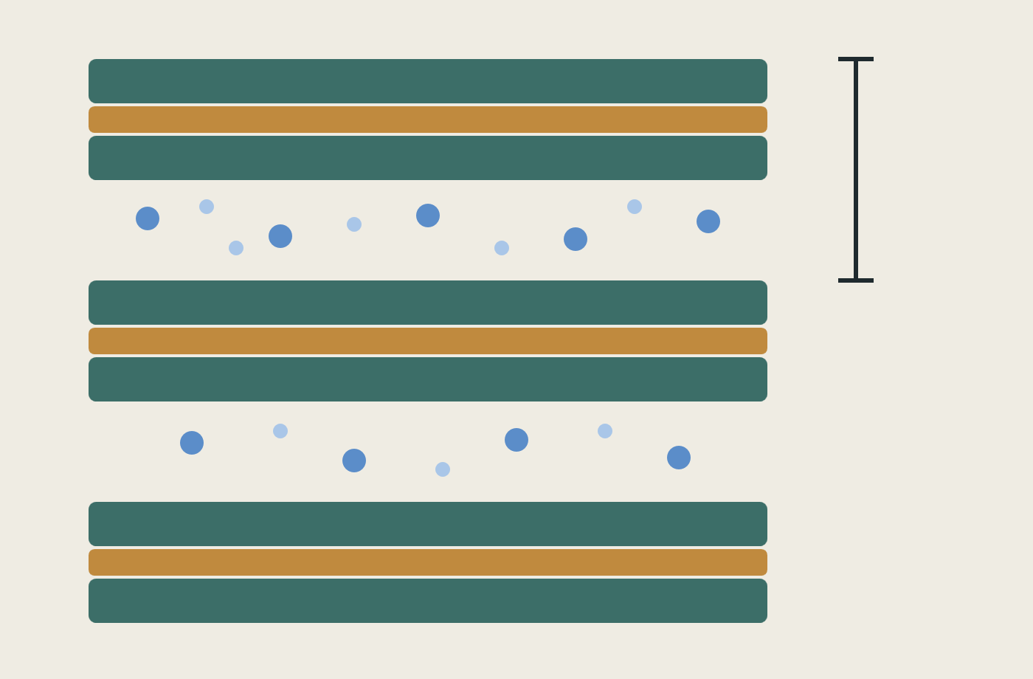
Montmorillonite takes up water in discrete steps, and the cation sets which step
LITERATURE · MEASURED
State | d001 spacing
Dry (0W) | ≈10.0 Å
One water layer (1W) | ≈12.6 Å
Two layers (2W) | ≈15.2-15.3 Å
Three layers (3W, Na) | ≈18-19.5 Å
At 40% RH, Na-montmorillonite sits near 12.5 Å (1W) and Ca-montmorillonite near 15.2 Å (2W). Only Na clays go on to osmotic swelling.
Ferrage et al. 2005a, Am. Mineral. 90:1358-1374; 2005b, Clays Clay Miner. 53:348-360. Schematic redrawn for this deck (green: silicate sheets; ochre: octahedral sheet; blue: cations and water). Bracket marks d001.
Notes:
I redrew the clay schematic so there is no question about the source. The diagram I had earlier has unknown provenance, so I am not showing it. Real samples are interstratified: Ca-SWy at 20% RH is roughly 45% 2W, 40% 1W, 15% 0W.

Slide 4
Screening, chelation and bridging are three different things, and only one changes connectivity
THE QUESTION I WOULD MOST LIKE YOUR VIEW ON
Mode | What the cation does | What would show it
Charge screening | Reduces repulsion between charged groups; links nothing | Surface potential shifts with ionic strength alone
Chelation | One ligand grips one ion at several points; still one chain | Coordination geometry, not network change
Bridging | One ion joins two separate chains, or a chain to a clay face | Rheology or retention changes beyond the ionic-strength effect
Denticity is not the same as connectivity: a monodentate contact can still be part of a bridge if the ion coordinates something else elsewhere. The clean contrast is a monovalent control against Ca²⁺ at matched ionic strength and pH.
EQUIFINALITY NOTE: Distinct causal pathways (microbial sulfide, abiotic redox, clay transport) can produce similar corroded coupon endpoints, requiring discriminating controls. Biofilms and abiotic mineral compartments are comparable spatially structured reaction-diffusion systems; biofilms themselves are biological.
Terminology after IUPAC Gold Book C01012 (chelation). A drop in surface potential alone would not establish cross-linking.
Notes:
This is the sharpest version of the slide 7 gap. Ask Ellen directly whether her lab could tell these apart, and what measurement she would trust.

Slide 5
A 2-4 week pilot can show biotic versus abiotic, but not thresholds
PROPOSED · NOT YET RUN
Arm | Condition | What it answers
Slurry | MX-80 ≈1:10, live SRB, lactate and sulfate | Does sulfide form at all in this system?
Compacted | ≈1.25 g/cm³ dry, live SRB | Does compaction change it at a reachable density?
Sterile clay | Autoclaved, same chemistry | Separates abiotic corrosion from microbial
No organism | Live clay, no inoculum | Tests the clay’s own resident microbes
Readouts: weekly sulfide and pH; at the end SEM/EDS, Raman (mackinawite versus Cu₂S), XRD d001, and mass loss after standard cleaning.
Honest limit: at roughly 1 µm/yr, a few weeks of corrosion is below what a balance resolves. Sulfide and surface chemistry carry the result.
Design after SKB TR-16-09 and Martinez-Moreno et al. 2023, minus the ³⁵S radiotracer. Triplicate arms. All BSL-1, non-radioactive.
Notes:
Say plainly that this pilot is a feasibility test. Finding the density threshold needs the longer study on the next slide.

Slide 6
PROPOSED MEASUREMENT LAYER . FLOW CYTOMETRY
Flow cytometry adds cell-state observations to the interface model
It measures suspended-cell phenotypes; by itself, it does not preserve where cells sat inside clay or a biofilm.
WHAT IT CAN MEASURE
WHAT IT CONSTRAINS
LIMITS
• Gated cell-event counts and concentration using counting beads
• Dye-defined membrane-integrity classes, after strain-specific validation
• Scatter and per-cell fluorescence distributions
• Optional metabolic / ROS panels only after assay validation
• Suspended and detached-cell abundance
• Fractions in measured physiological-state gates
• Net growth/death or attachment/detachment rates when time series are available
• Equifinality: similar bulk chemistry can arise from different cell-state histories
• Spatial position in the clay pore network
• EPS cross-link density or mineral phase
• Corrosion rate / causal mechanism
• "Live" status from fluorescence alone without controls; clay particles and aggregates can distort gates
MINIMUM VIABLE ADD-ON: absolute counts + a validated membrane-integrity panel at preselected timepoints; keep maximum pit depth as the primary corrosion endpoint.
Sources: Kerstens et al. (2015), doi:10.1007/s12223-015-0400-4; Grainha et al. (2020), doi:10.3390/antibiotics9110741; Yip et al. (2022), doi:10.1371/journal.pcbi.1010533.
Notes:
OPTIONAL APPENDIX SLIDE. Flow cytometry is an observation layer, not a fluid or geochemical solver. It generally requires cell suspensions. For attached biofilm/clay, validate detachment and recovery and report extraction protocol. Kerstens et al. (2015) demonstrated a flow-cytometric biofilm quantification workflow in E. coli and C. albicans; do not transfer its staining interpretation automatically to a sulfate-reducing strain. Grainha et al. (2020) document difficulties caused by strain, morphology and matrix effects in mixed biofilms. Use clay-only, unstained, stain-only, positive/negative viability, counting-bead and spike-recovery controls. Do not interpret this as proof that flow cytometry directly measures EPS cross-links or spatial location. Maximum pit depth remains the primary corrosion endpoint.

Slide 7
The work stays BSL-1, non-radioactive and fully separate from my employer
SCOPE AND SEPARATION
Biosafety
Separation
DSMZ lists the candidate sulfate reducer (DSM 644, = ATCC 29579) as Risk Group 1
One supplier page carries a conflicting product label, so I will confirm with them and your IBC before ordering
Note the genus was revised to Nitratidesulfovibrio in 2020
IBC approval before any organism is handled
No radioactivity anywhere in the design
No employer facilities, data, imagery or branding
Outside-activity disclosure in progress with my supervisor
Everything here is public literature or my own labelled models
Notes:
Say this early if it comes up naturally; it answers the question before anyone has to ask it.

Slide 8
I bring modelling and analysis, and I would need bench access and mentorship
THE ASK
What I bring
What I would need
Reactive-transport and surface-complexation modelling
Julia numerics and data analysis
Analytical chemistry background: HPLC, ICP, GMP and GLP lab work
A pre-registered readout plan, with every claim typed as measured, modelled or assumed
Anaerobic chamber and BSL-1 bench time
Access to SEM/EDS, XRD and Raman
Mentorship on biofilm and corrosion method choices
Honest feedback on whether this is worth pursuing at all
Self-funded, evenings and weekends. Consumables for the pilot are plausibly a few thousand dollars, which is my estimate rather than a quote.
Notes:
End here if the conversation is going well. The references and appendix are backup only.

