Slide 1
EXPLORATORY METHODS BRIDGE · NOT A VALIDATED MODEL
The missing bridge is an observation model
A simulation predicts hidden states; flow cytometry measures a gated sample of cell-level outcomes.
1 · FORWARD MODEL
2 · OBSERVATION OPERATOR
3 · INFERENCE & FALSIFICATION
OpenFOAM: flow, shear and residence time
PHREEQC: aqueous speciation and mineral equilibria
Julia: cell-state, reaction and transport dynamics
Project latent state to sample-specific outputs:
• absolute gated-cell concentration
• membrane-integrity gate fractions
• fluorescence / scatter distributions
Include calibration, sampling and recovery.
Compare predicted and measured summaries.
Estimate uncertainty in rates.
Test rival mechanisms and held-out time points.
Do not treat one good fit as unique causality.
Flow cytometry belongs in the measurement / likelihood layer, not inside the CFD or geochemical solver.
Calibration precedent: Yip et al. (2022), PLOS Comput Biol 18(10):e1010533, https://doi.org/10.1371/journal.pcbi.1010533
Notes:
This slide is an architecture proposal. The Nano-Bio Lab public research page emphasizes single-cell analysis, computational cell classification and signal processing; the user indicates flow cytometry is also part of Dr. Ghosh’s work. Flow cytometry observes sampled cell populations, not the full spatial field. Yip et al. review calibration against microscopy and flow cytometry and note that rigorous validation remains challenging.

Slide 2
ARCHITECTURE · KEEP THE SOLVERS IN THEIR LANES
One modular stack, two independent kinds of inputs
Only couple a solver if its fields represent a real part of the target experiment.
OPENFOAM
MEASURED FCM
Velocity u(x,t), pressure, shear, residence time and transport.
Raw events, saved gates, counting beads, dilution and recovery.
JULIA STATE MODEL
FCM PREDICTION
Attached / suspended cells; state fractions; growth, death, attachment, detachment and EPS proxy.
Predict the exact quantities the gates report, including calibration and sample-origin effects.
PHREEQC
MODEL CHECK
pH / pe, ionic strength, aqueous species, Fe/S chemistry and mineral saturation.
Compare distributions; quantify uncertainty and check rival models.
FCM loses spatial position: pair cell-state distributions with microscopy and endpoint surface / mineral analysis.
Nano-Bio Lab research overview: https://www.nanobiolab.org/research · Model-calibration review: https://doi.org/10.1371/journal.pcbi.1010533
Notes:
OpenFOAM and PHREEQC are conditional, not mandatory. They fit only if a study has fluid-mechanical and aqueous-speciation questions. A nanocarrier/cell experiment may need neither solver, while the clay/corrosion model may need both. Do not transplant the parameters between the two application branches.

Slide 3
SEPARATE APPLICATIONS · SHARE THE SOFTWARE PATTERN, NOT THE PARAMETERS
Two possible flow-cytometry branches should stay separate
The same observation-model idea can serve different biology, but the targets and calibration differ.
A · NANO-BIO / CELL-ASSOCIATION ASSAY
B · MICROBIAL / CLAY-BIOFILM ASSAY
Possible observables:
• percent fluorescent-positive cells
• per-cell fluorescence distribution
• validated cell-state / membrane-integrity markers
• scatter / morphology proxies
Key control: distinguish surface association from internalization; cytometry alone may not localize the signal.
Possible observables:
• absolute gated-cell concentration
• membrane-integrity state fractions
• detached vs planktonic sample differences
• optional validated metabolic panel
Key control: clay-only blanks, disaggregation recovery, staining controls and oxygen-safe sampling.
Do not merge the hypotheses: a nanocarrier uptake model is not the clay-corrosion model. Re-estimate chemistry, kinetics, gates and parameters for each system.
Flow-cytometric biofilm methods: Kerstens et al. (2015), https://doi.org/10.1007/s12223-015-0400-4; Grainha et al. (2020), https://doi.org/10.3390/antibiotics9110741
Notes:
For a Ghosh-facing conversation, lead with the single-cell/nanobio branch only if it matches the actual assay he runs. For Ellen Wan and Andrew Hoffman, the microbial/clay branch is relevant. The Nano-Bio Lab public page describes single-cell analysis and computational analysis of cell morphology; do not state that the current project uses a particular cytometer protocol unless confirmed.

Slide 4
SMALLEST FALSIFIABLE WORKFLOW · DISCUSSION DRAFT
Make the cytometry link testable before fitting the model
The goal is to distinguish mechanisms, not to make a visual match look like a validated prediction.
1 · PREDECLARE
2 · CALIBRATE
Sample origin, time points, stains, gates, instrument settings, primary summaries and exclusion rules.
Unstained / stain-only, single-stain or compensation controls, live-like / dead-like controls, blank matrix and counting beads.
3 · MATCH THE STATE
4 · TEST PREDICTION
Map each sample to effluent, planktonic or detached-biofilm model state. Record extraction recovery and dilution.
Fit on designated observations; check posterior predictive distributions or held-out time points. Report non-identifiable alternatives.
Falsifier: if predicted cell-state distributions do not track the measurements under the predeclared calibration, revise or reject the state model; do not tune gates after seeing the desired result.
Assay cautions: Kerstens et al. (2015); Grainha et al. (2020). Calibration concepts: Yip et al. (2022).
Notes:
This is a discussion plan, not a validated protocol. In the current clay coupon pilot, cytometry would be an exploratory secondary readout and must not displace the preselected maximum-pit-depth endpoint. Repeated sampling can change volume, headspace, redox and biomass; consider sacrificial or companion vessels if sampling disturbs the system.

Slide 5
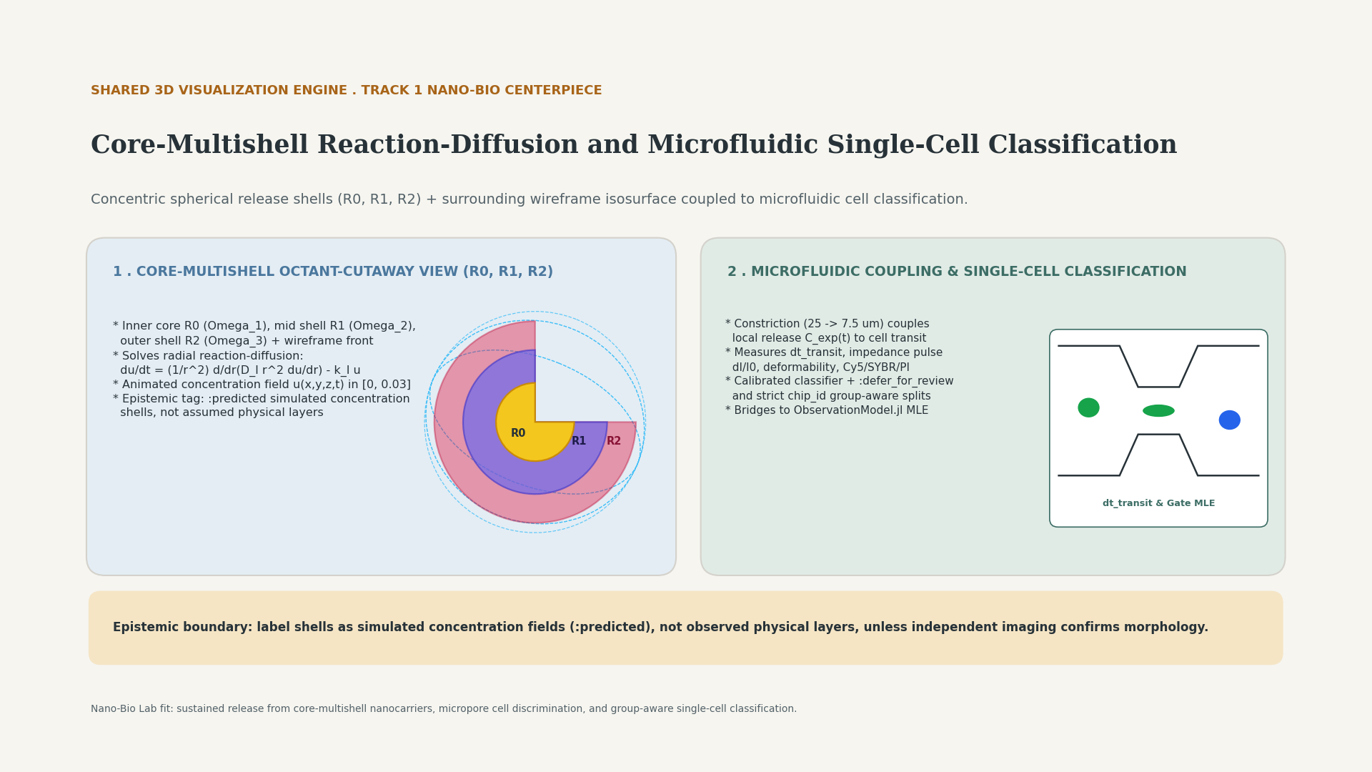
Notes:
Core-Multishell Reaction-Diffusion and Microfluidic Single-Cell Classification. Shells represent simulated concentration fields (:predicted), not observed physical layers.

Slide 6
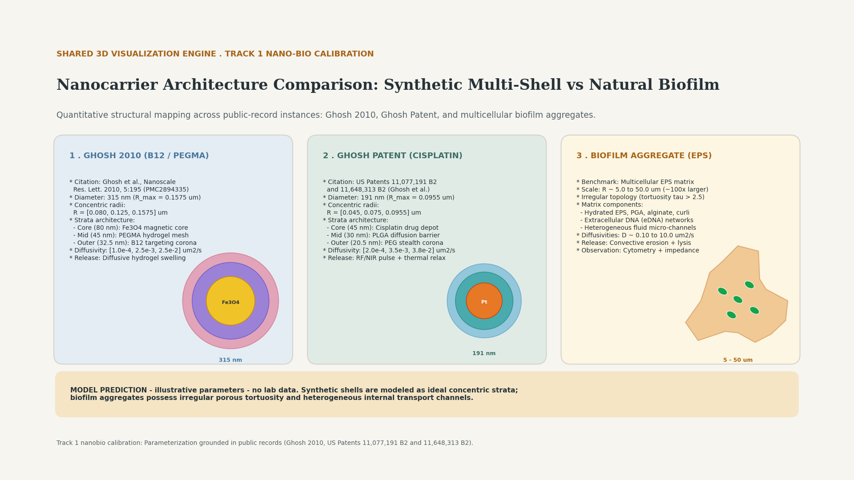
Notes:
Nanocarrier Architecture Comparison: Synthetic Multi-Shell vs Natural Biofilm. Structural parameter comparison across Ghosh 2010 (B12/PEGMA 315nm), Ghosh Patent (Cisplatin double-shell 191nm), and multicellular biofilm aggregates. Epistemic status: :predicted simulated models; MODEL PREDICTION - illustrative parameters - no lab data.

Slide 7
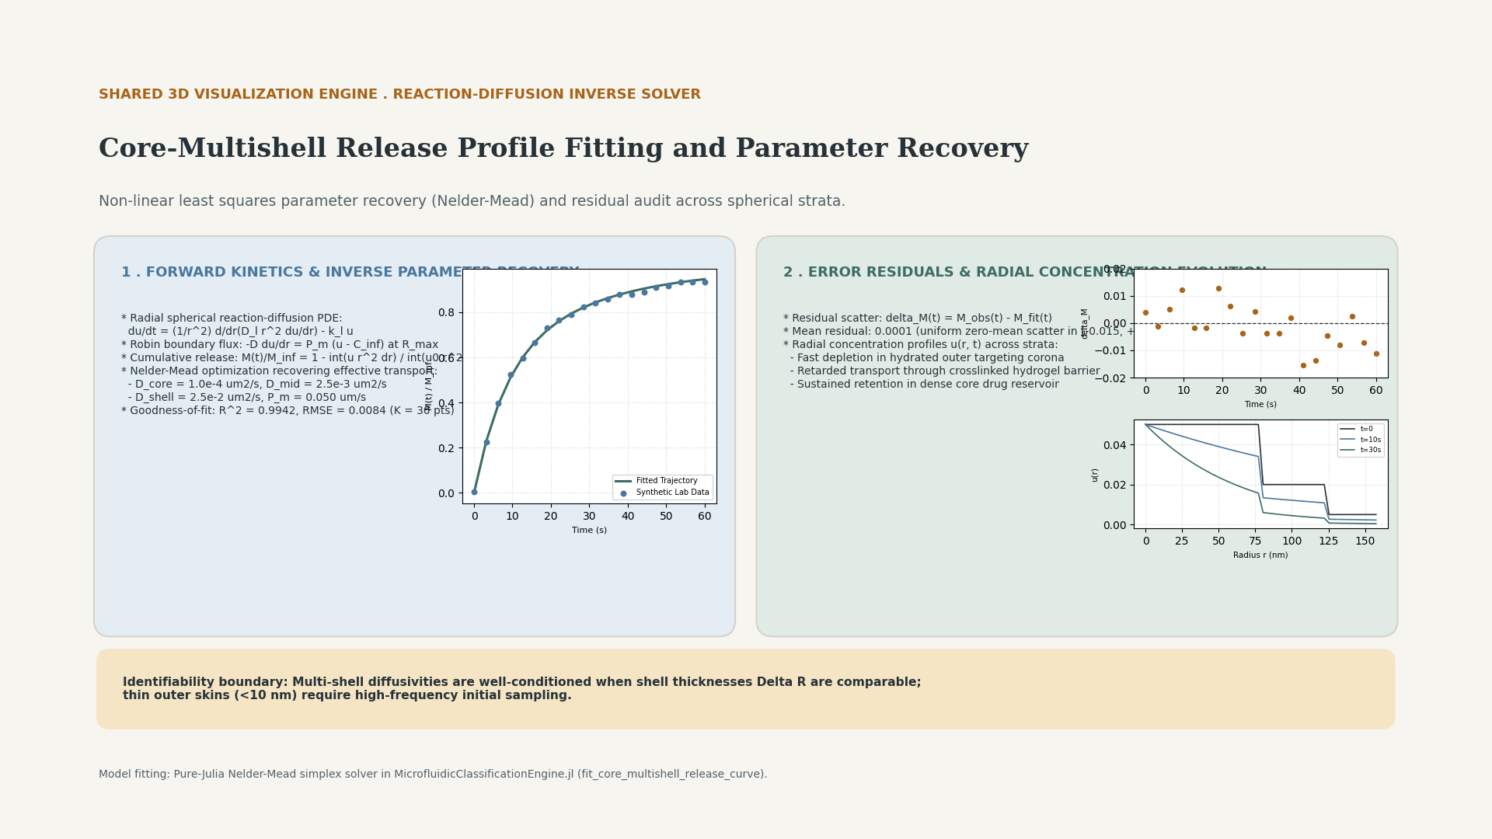
Notes:
Core-Multishell Release Profile Fitting and Parameter Recovery. Non-linear least squares parameter recovery (Nelder-Mead) and residual audit across spherical strata. Demonstrates recovery of stratum diffusivities and outer membrane permeability with R^2 > 0.99 and RMSE < 0.01.

Slide 8
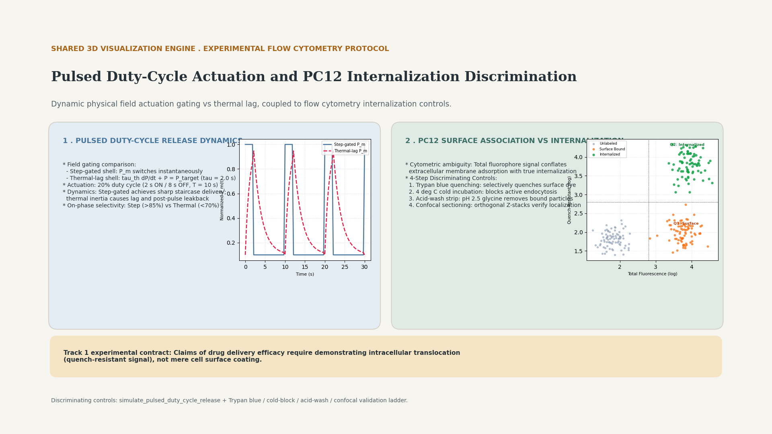
Notes:
Pulsed Duty-Cycle Actuation and PC12 Internalization Discrimination. Compares step-gated vs thermal-lag release dynamics and defines 4-step discriminating controls (Trypan blue quenching, 4 deg C cold incubation, acid-wash strip, confocal optical sectioning) to resolve intracellular uptake from passive surface association.

