Slide 1
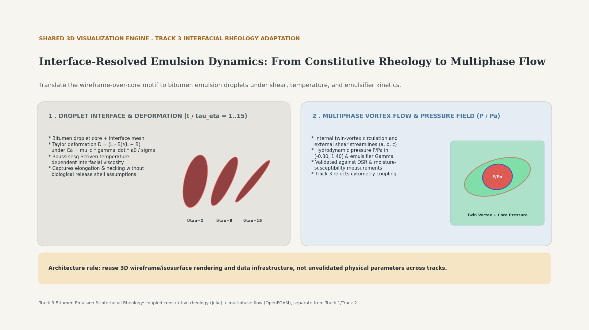
Notes:
Interface-Resolved Emulsion Dynamics: From Constitutive Rheology to Multiphase Flow. Reuses 3D wireframe/core rendering infrastructure for bitumen emulsion droplets under shear without biological release shell assumptions.

