Slide 1
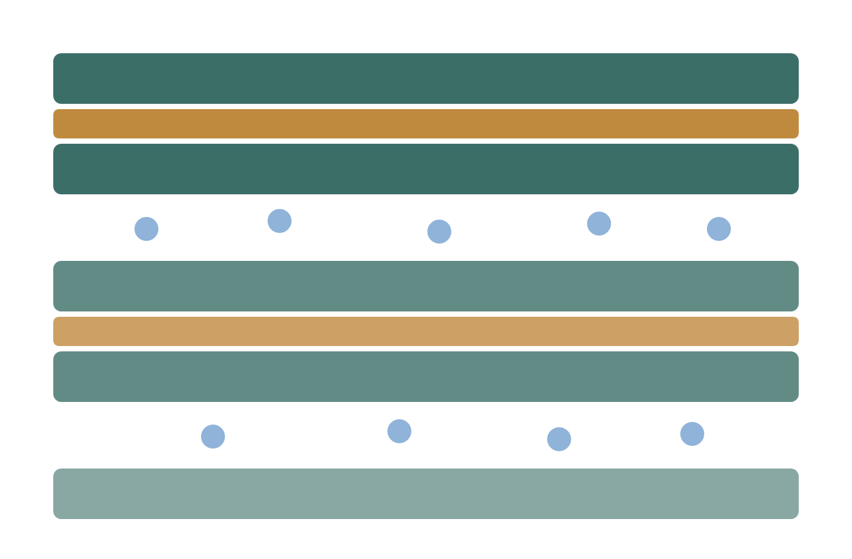
Clay, microbes and metal
EXPLORATORY MEETING · ELLEN WAN & ANDREW HOFFMAN
How clay hydration and iron chemistry gate microbially influenced corrosion, and whether a small BSL-1 pilot is a shared question
Hunter Kinder · independent researcher · October 2026
Notes:
Frame this as a questions-first conversation, not a proposal. Everything here is from public literature or my own clearly labelled models. No radioactivity, no employer facilities or data.

Slide 2
Three questions decide whether this is a fit for us
START HERE
1
2
3
For Ellen
For Andrew
For both
Is a clay–EPS–metal interface study a fit for your biofilm and EPS work, and with which BSL-1 strains?
Which corrosion-product signatures (FeS, Fe₃O₄, Cu₂S) would you trust from Raman, SEM/EDS and XRD after 2–4 weeks?
What is the smallest result that would justify a 3–6 month study, and what would make you say no?
Notes:
Ask these first and let the answers steer the rest. It is fine to skip most of the deck if the conversation goes somewhere better.

Slide 3
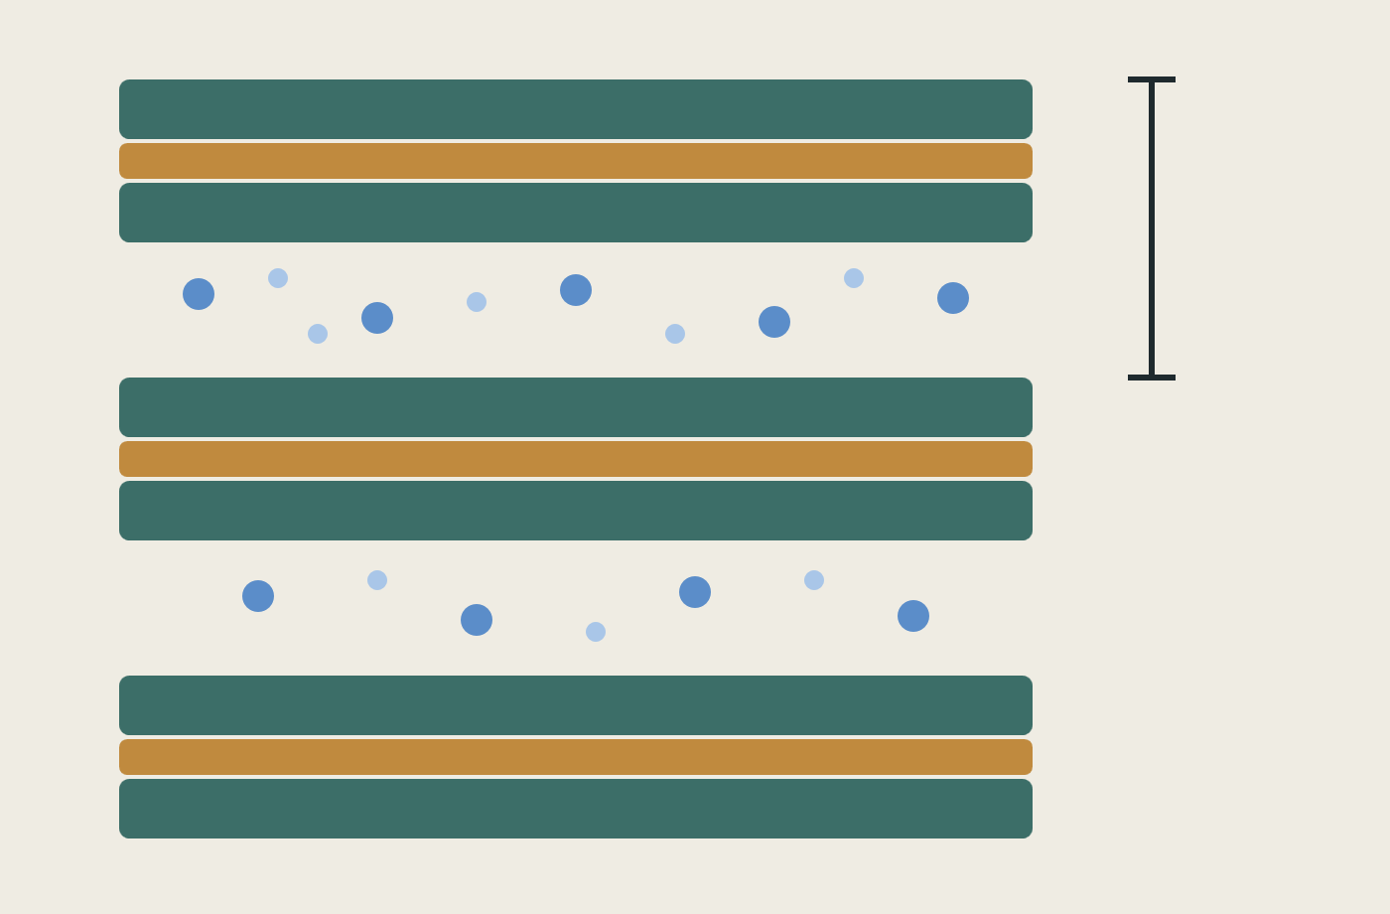
Montmorillonite takes up water in discrete steps, and the cation sets which step
LITERATURE · MEASURED
State | d001 spacing
Dry (0W) | ≈10.0 Å
One water layer (1W) | ≈12.6 Å
Two layers (2W) | ≈15.2–15.3 Å
Three layers (3W, Na) | ≈18–19.5 Å
At 40% RH, Na-montmorillonite sits near 12.5 Å (1W) and Ca-montmorillonite near 15.2 Å (2W). Only Na clays go on to osmotic swelling.
Ferrage et al. 2005a, Am. Mineral. 90:1358-1374; 2005b, Clays Clay Miner. 53:348-360. Schematic redrawn for this deck (green: silicate sheets; ochre: octahedral sheet; blue: cations and water). Bracket marks d001.
Notes:
I redrew the clay schematic so there is no question about the source. The diagram I had earlier has unknown provenance, so I am not showing it. Real samples are interstratified: Ca-SWy at 20% RH is roughly 45% 2W, 40% 1W, 15% 0W.

Slide 4
Compaction shuts off sulfide production but leaves sulfate reducers alive
LITERATURE · MEASURED
1740–1880
10⁵–10⁶
0.954
kg/m³ wet density where sulfide production collapses (≈1.2–1.4 dry)
SRB per litre still alive at 2000 kg/m³, where activity is near zero
water activity measured in situ at 1.50 g/cm³ dry (0.983 at 1.25)
Open question: 10–15 MPa of pressure alone did not suppress activity; water activity, pore size and heat are the competing explanations.
SKB TR-16-09 (Bengtsson et al.); Engel et al. 2023, mSphere; Bartak et al. 2024, World J Microbiol Biotechnol. SKB reports wet density; Grimsel reports dry.
Notes:
Watch the wet versus dry density trap. Wet 2.0 g/cm³ is roughly dry 1.56 (my own conversion). The often-quoted 1.6 dry / aw 0.96 / 2 MPa triad is only cited second-hand, via Engel 2019.

Slide 5
Interfaces, not the bulk buffer, are where microbes grow and metal corrodes
LITERATURE · FIELD AND MODEL
Setting | What was seen | Evidence
Grimsel MaCoTe, 5 years | Outer bentonite up to 66% Desulfosporosinus; inner core unchanged | Field, measured
Mont Terri steel | 1.5–2.25 µm/yr at 20 months, 0.75 µm/yr at 5.5 years; FeS linked to SRB | Field, measured
Copper canister | ≤1.3 mm in 1 Myr; iron minerals trap ~93% of sulfide | Model
Copper without goethite | Corrosion ≈20× deeper | Model
Engel et al. 2023, mSphere; Necib et al. 2017, Swiss J Geosci; Burzan et al. 2022, Front Microbiol; Ma et al. 2022, Appl Geochem.
Notes:
Takeaway for a bench study: put the coupon at an interface and measure where sulfide ends up, not just how much forms. Andrew may know these corrosion-rate numbers better than I do; invite correction. The copper numbers are model outputs, not measurements.

Slide 6
Iron moves both ways: steel stains the clay, and microbes reduce the clay’s iron
LITERATURE · LAB AND FIELD
Steel → clay
Microbes → clay
Äspö ABM1: ≈100 µm corrosion layer, ≈10 mm iron-enriched clay, no new clay phases
Grimsel FEBEX, 18 years: iron halos beyond 140 mm
Swelling loss in the field: inferred, not measured
Smectite → illite in 14 days at room temperature (abiotic: 300–350 °C)
Fe(III) reduction raised CEC 0.82 → 1.5 meq/g in iron-rich clay, only 0.85 → 0.99 in montmorillonite
Swelling pressure fell in every iron-bearing smectite tested
Hypothesis, not shown: microbial iron reduction loosens the barrier and speeds corrosion at the interface.
Wersin et al. 2015; Hadi et al. 2019; Kim et al. 2004, Science; Stucki & Kostka 2006; Gates et al. 1998.
Notes:
Low-iron montmorillonite changes much less than iron-rich smectite, so clay choice matters for any pilot.

Slide 7
Biofilm polymers enter clay interlayers and Ca²⁺ bridges EPS, but clay-specific data are thin
EVIDENCE IS THIN HERE
Evidence type | Finding
Direct (hectorite) | With P. syringae, d001 went 1.50 → 1.26 nm in 72 h, then 1.84 nm in about a week
Analogue (no clay) | 64 mM Ca²⁺: biofilm biomass 25–51× control, thickness 2.1 → 19.6 µm
Review | Clay–microbe interaction knowledge is “still very incomplete”
Hypothesis | Ca²⁺ released at the interface stabilises a clay–EPS–metal biofilm
This gap is where Ellen’s EPS expertise could matter most.
Alimova et al. 2009, Clays Clay Miner.; Xiong et al. 2022, Front Environ Sci; Cuadros 2017, Clay Miner. (CC BY 4.0).
Notes:
Hectorite is not montmorillonite, and the calcium study had no clay at all. I would rather say so than imply more than exists.

Slide 8
Screening, chelation and bridging are three different things, and only one changes connectivity
THE QUESTION I WOULD MOST LIKE YOUR VIEW ON
Mode | What the cation does | What would show it
Charge screening | Reduces repulsion between charged groups; links nothing | Surface potential shifts with ionic strength alone
Chelation | One ligand grips one ion at several points; still one chain | Coordination geometry, not network change
Bridging | One ion joins two separate chains, or a chain to a clay face | Rheology or retention changes beyond the ionic-strength effect
Denticity is not the same as connectivity: a monodentate contact can still be part of a bridge if the ion coordinates something else elsewhere. The clean contrast is a monovalent control against Ca²⁺ at matched ionic strength and pH.
Terminology after IUPAC Gold Book C01012 (chelation). A drop in surface potential alone would not establish cross-linking.
Notes:
This is the sharpest version of the slide 7 gap. Ask Ellen directly whether her lab could tell these apart, and what measurement she would trust.

Slide 9
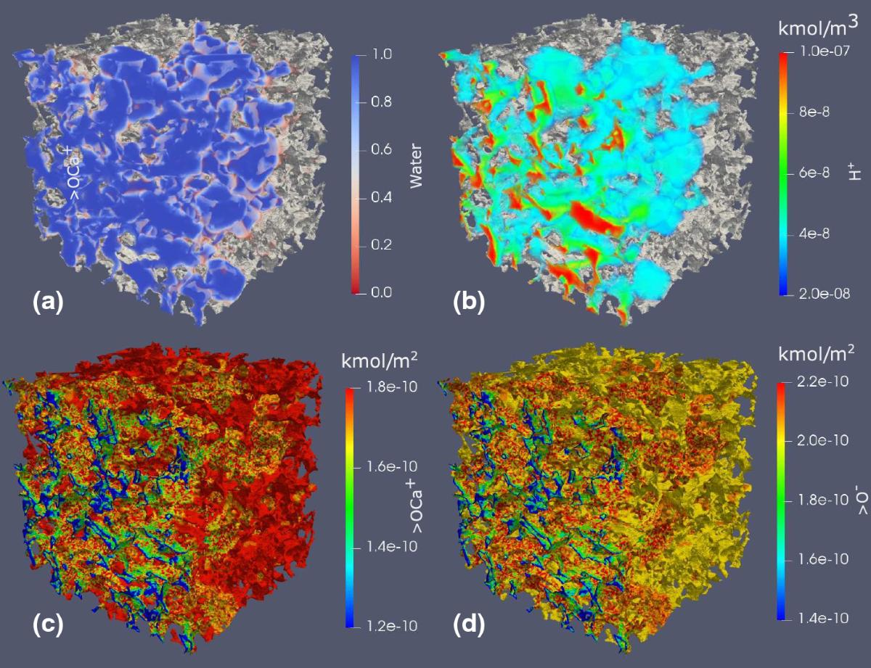
Pore-scale surface complexation could link clay chemistry to biofilm models
MODELLING METHOD · PUBLISHED SIMULATION
Edge sites >SOH / >SO⁻ / >SOCa⁺; basal charge by cation exchange
GeoChemFoam: OpenFOAM + PHREEQC on a micro-CT pore image
Bentheimer sandstone with a montmorillonite surface model, CaCl₂ injected
Next step: add biomass as a sorbent that changes over time
Sandstone, not bentonite. A method illustration only.
Figure: Maes & Menke 2021, Transp. Porous Media 139:271–299, Fig. 14, CC BY 4.0. Panels: (a) water, (b) H⁺, (c) >OCa⁺, (d) >O⁻.
Notes:
This is someone else’s published simulation, reused under CC BY 4.0. It shows the kind of model I can build on; my contribution would be the biomass term.

Slide 10
Oklo’s clay halo shows a sealed, reducing system works, but it is not bentonite
NATURAL ANALOGUE · QUALITATIVE
What it shows
What it doesn’t
Uraninite, phosphates and bitumen held actinides and rare earths within metres for ~2 billion years
The reactors made their own clay halo; ≈80% of the silica left reactor 2
Halo is illite and Mg-chlorite formed at ~300–500 °C, not swelling smectite
Cs, Sr, Ba almost all lost; no sorption or diffusion numbers for design
Gauthier-Lafaye, Holliger & Blanc 1996, GCA; Nagy et al. 1991, Nature; Oversby 2000, MRS Proc. (“qualitative, not performance-assessment numbers”).
Notes:
Oklo is why I came to this topic, but it is an analogue for the concept only. No biofilm evidence exists in the reaction zones.

Slide 11
My Oklo models say heat binds before radiolysis, and they are models
MY OWN WORK · MODELS, NOT DATA
Type | Result
Model | Gel survives up to ≈0.05–12,000 Gy/h depending on repair rate (central ≈700 Gy/h)
Model | Gamma ≈2.5–6 Gy/h at the core face, mGy/h by 0.5 m; 122 °C limit lies 1.5–4 m out
Model | Catalase can raise the gamma ceiling by at most ≈26%; matrix turnover dominates
Measured | Heat gradient ≈100 °C/m near the cores; no biofilm evidence at the reaction zones
The bench pilot is what would turn the biggest assumptions (crosslink density, turnover, iron chemistry) into measurements.
Measured values: Gauthier-Lafaye et al. 1996. Everything labelled “Model” is my own estimate from published parameters.
Notes:
Keep this to one minute. Do not show the public portal until its pending corrections are pushed. Mention it only if asked.

Slide 12
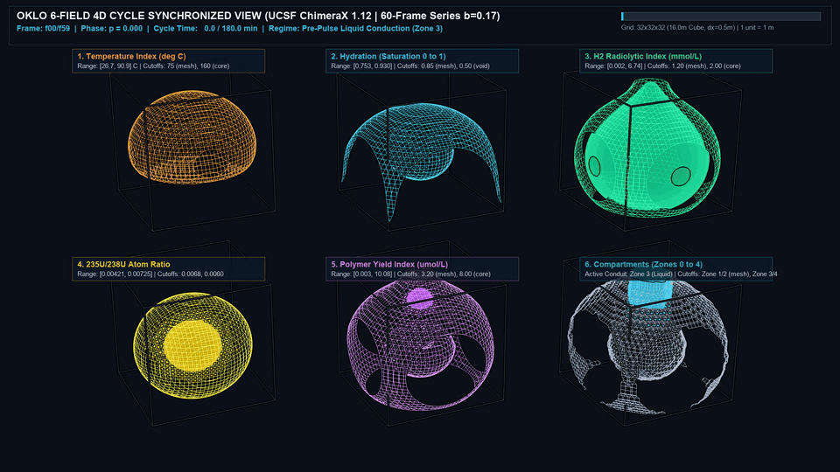
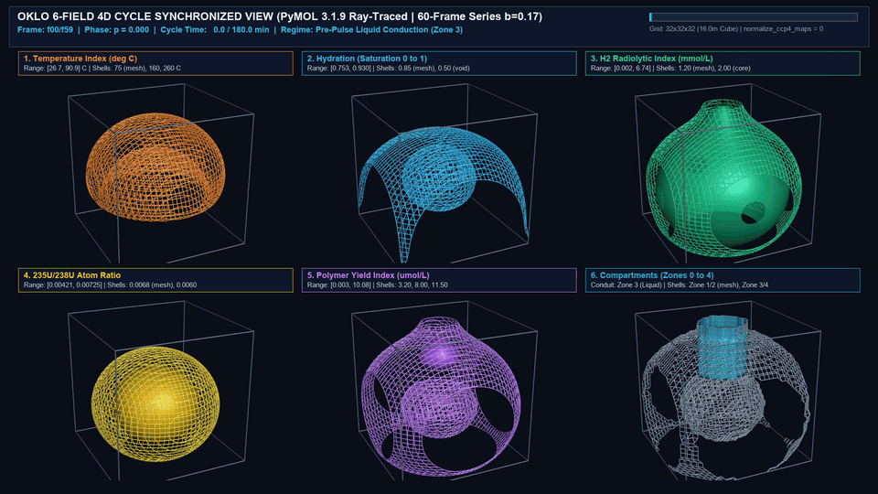
What the six-field cycle looks like when you render it
MODEL ILLUSTRATION · PRESCRIBED FIELDS, NOT DATA
UCSF ChimeraX · wireframe over core isosurface
PyMOL · ray-traced nested shells
What this is: six closed-form fields on a 32³ grid, stepped through one cycle and rendered. The hollow shells are isosurfaces of those formulas. Nothing here is measured, fitted or simulated from transport equations.
Rendered from the frozen Revision-0 conformance fixture, which its own specification labels synthetic and prescribed-analytic. Shown as a visual aid only.
Notes:
Play the MP4s from the laptop if anyone wants to see the motion. Say the caveat out loud before the animation, not after: these are pictures of formulas. They show what the compartment geometry looks like, which is useful for talking about where a coupon would sit, and nothing more.

Slide 13
A 2–4 week pilot can show biotic versus abiotic, but not thresholds
PROPOSED · NOT YET RUN
Arm | Condition | What it answers
Slurry | MX-80 ≈1:10, live SRB, lactate and sulfate | Does sulfide form at all in this system?
Compacted | ≈1.25 g/cm³ dry, live SRB | Does compaction change it at a reachable density?
Sterile clay | Autoclaved, same chemistry | Separates abiotic corrosion from microbial
No organism | Live clay, no inoculum | Tests the clay’s own resident microbes
Readouts: weekly sulfide and pH; at the end SEM/EDS, Raman (mackinawite versus Cu₂S), XRD d001, and mass loss after standard cleaning.
Honest limit: at roughly 1 µm/yr, a few weeks of corrosion is below what a balance resolves. Sulfide and surface chemistry carry the result.
Design after SKB TR-16-09 and Martinez-Moreno et al. 2023, minus the ³⁵S radiotracer. Triplicate arms. All BSL-1, non-radioactive.
Notes:
Say plainly that this pilot is a feasibility test. Finding the density threshold needs the longer study on the next slide.

Slide 14
A 3–6 month study would bracket the density threshold
PROPOSED · ONLY IF THE PILOT WARRANTS IT
Core design
Optional arms
Constant-volume cells at ≈1.75, 1.85, 1.95 g/cm³ wet, bracketing the published cut-off
Sacrifice at 1, 3 and 6 months
Add electrochemistry, sulfide profiles through the clay, and XPS
An iron-reducing organism, to test whether clay iron chemistry shifts
Magnetic susceptibility of the clay, a fast non-destructive check for biogenic magnetite
Stable Co, Zn and Mn at ≈1–50 µM, split between pore water, clay, biomass and coupon by ICP
No published precedent found for that partition design, so it is my inference
Densities after SKB TR-16-09. Magnetite versus siderite depends on headspace gas, pH and electron donor: Roh et al. 2003, Clays Clay Miner. 51:83-95. Stable metals only; no radioactive tracers at any stage.
Notes:
The stable-metal arm is where my earlier modelling work would actually connect to bench data. Offer it, do not push it. On magnetite: iron reducers can precipitate it, and susceptibility is cheap to measure, so it costs almost nothing to look. Do not claim it will happen.

Slide 15
The work stays BSL-1, non-radioactive and fully separate from my employer
SCOPE AND SEPARATION
Biosafety
Separation
DSMZ lists the candidate sulfate reducer (DSM 644, = ATCC 29579) as Risk Group 1
One supplier page carries a conflicting product label, so I will confirm with them and your IBC before ordering
Note the genus was revised to Nitratidesulfovibrio in 2020
IBC approval before any organism is handled
No radioactivity anywhere in the design
No employer facilities, data, imagery or branding
Outside-activity disclosure in progress with my supervisor
Everything here is public literature or my own labelled models
Notes:
Say this early if it comes up naturally; it answers the question before anyone has to ask it.

Slide 16
I bring modelling and analysis, and I would need bench access and mentorship
THE ASK
What I bring
What I would need
Reactive-transport and surface-complexation modelling
Julia numerics and data analysis
Analytical chemistry background: HPLC, ICP, GMP and GLP lab work
A pre-registered readout plan, with every claim typed as measured, modelled or assumed
Anaerobic chamber and BSL-1 bench time
Access to SEM/EDS, XRD and Raman
Mentorship on biofilm and corrosion method choices
Honest feedback on whether this is worth pursuing at all
Self-funded, evenings and weekends. Consumables for the pilot are plausibly a few thousand dollars, which is my estimate rather than a quote.
Notes:
End here if the conversation is going well. The references and appendix are backup only.

Slide 17
Four defect axes for reviewing a slide or protocol, without a Boltzmann factor
REVIEW RUBRIC · EXTERNAL SCORER
Axis | What it checks | What fails the check
1. Source | Primary-source attribution, units, and measured vs modelled labels | Secondary citations quoted as primary, missing density scales, or unverified DOIs
2. Coordination | Screening, chelation (IUPAC C01012), and bridging kept distinct | Inferring cross-linking from surface potential or denticity without a monovalent control
3. Boundary | Domain limits between analogue, model, and bentonite conditions | Treating Oklo chlorite/illite or prescribed 32³ fields as bentonite transport data
4. Control | Sterile, killed-cell, and clay-free controls plus assay resolution | Missing abiotic baseline, or claiming mass-loss resolution over 2 to 4 weeks at ~1 µm/yr
Why drop the exponential: a self-graded revision that lowers its own defect score lands at P = 1.000 by arithmetic; the acceptance test never runs.
What makes the rubric work: an independent scorer who did not write the revision grades the four axes directly (checker is never the committer).
Four-axis review rubric (source, coordination, boundary, control) standing alone without statistical-mechanics weighting.
Notes:
Say this out loud if anyone asks about the number. The four defect axes (source, coordination, boundary, control) are a perfectly good rubric on their own. Keep the rubric, drop the Boltzmann factor, or make the scorer independent. The honest version of this idea is simply: checker is never the committer.

Slide 18
References, all public literature
SOURCES
Ferrage et al. 2005a, Am. Mineral. 90:1358; 2005b, Clays Clay Miner. 53:348 — hydration states
Greenspan 1977, J. Res. NBS — fixed humidity points
Bengtsson et al., SKB TR-16-09 — density and sulfide
Engel et al. 2023, mSphere — Grimsel MaCoTe, 5 years
Bartak et al. 2024, World J Microbiol Biotechnol — review
Necib et al. 2017, Swiss J Geosci — Mont Terri steel
Burzan et al. 2022, Front Microbiol — Mont Terri microbes
Ma et al. 2022, Appl Geochem — copper sulfide model
Wersin et al. 2015 — Äspö ABM1 iron and clay
Hadi et al. 2019 — FEBEX, 18 years
Kim et al. 2004, Science — microbial smectite to illite
Stucki & Kostka 2006 — iron reduction and clay properties
Alimova et al. 2009 — biofilm polymers in clay interlayers
Cuadros 2017, Clay Miner. — clay and microbe review
Maes & Menke 2021, Transp. Porous Media — GeoChemFoam
Gauthier-Lafaye et al. 1996, GCA; Oversby 2000 — Oklo
One citation is still unresolved and is flagged rather than quoted: a density threshold I can only trace to a secondary citation. Two earlier ambiguities are now closed: there are two separate Ferrage 2005 papers, and Masurat et al. 2010 is Appl. Clay Sci. 47:51-57.
Notes:
If anyone asks for a reference I cannot confirm on the spot, say so and send it afterwards. Do not guess.

Slide 19
Density and water-activity thresholds, with their basis
APPENDIX A
Value | Basis | Caution
Activity cut-off 1740–1880 kg/m³ wet | SKB TR-16-09, measured | Wet density; ≈1.2–1.4 dry
SKB design target 1950–2050 kg/m³ wet | Design guidance | Not a biological threshold
1.6 g/cm³ dry · a_w 0.96 · 2 MPa | Widely quoted triad | Only traced to a secondary citation; primary text unverified
a_w 0.954 at 1.50 g/cm³ dry | Grimsel field, measured | 0.983 at 1.25 dry
Wet 2.0 ≈ dry 1.56 g/cm³ | My conversion | Assumes grain density 2.75–2.78
Notes:
This table exists mainly so I do not mix wet and dry densities on one axis during the conversation.

Slide 20
Fixed humidity points for a hydration-controlled arm
APPENDIX B
Saturated salt at 25 °C | Relative humidity
Lithium chloride | 11.3%
Potassium acetate | 22.5%
Magnesium chloride | 32.8%
Potassium carbonate | 43.2%
Magnesium nitrate | 52.9%
Sodium chloride | 75.3%
Potassium sulfate | ≈97.3%
Why it matters
Holding the clay at a chosen humidity sets how many water layers sit between the sheets, which XRD then reads directly as the d001 spacing.
That turns “hydration state” from an adjective into a controlled variable, which is the part I find most interesting.
Greenspan 1977, J. Res. National Bureau of Standards 81A:89.
Notes:
Cheap and simple: sealed jars with saturated salt slurries. A good first experiment if bench time is tight.

Slide 21
PROPOSED MEASUREMENT LAYER · FLOW CYTOMETRY
Flow cytometry adds cell-state observations to the interface model
It measures suspended-cell phenotypes; by itself, it does not preserve where cells sat inside clay or a biofilm.
WHAT IT CAN MEASURE
WHAT IT CONSTRAINS
LIMITS
• Gated cell-event counts and concentration using counting beads
• Dye-defined membrane-integrity classes, after strain-specific validation
• Scatter and per-cell fluorescence distributions
• Optional metabolic / ROS panels only after assay validation
• Suspended and detached-cell abundance
• Fractions in measured physiological-state gates
• Net growth/death or attachment/detachment rates when time series are available
• Equifinality: similar bulk chemistry can arise from different cell-state histories
• Spatial position in the clay pore network
• EPS cross-link density or mineral phase
• Corrosion rate / causal mechanism
• “Live” status from fluorescence alone without controls; clay particles and aggregates can distort gates
MINIMUM VIABLE ADD-ON: absolute counts + a validated membrane-integrity panel at preselected timepoints; keep maximum pit depth as the primary corrosion endpoint.
Sources: Kerstens et al. (2015), doi:10.1007/s12223-015-0400-4; Grainha et al. (2020), doi:10.3390/antibiotics9110741; Yip et al. (2022), doi:10.1371/journal.pcbi.1010533.
Notes:
OPTIONAL APPENDIX SLIDE. Flow cytometry is an observation layer, not a fluid or geochemical solver. It generally requires cell suspensions. For attached biofilm/clay, validate detachment and recovery and report extraction protocol. Kerstens et al. (2015) demonstrated a flow-cytometric biofilm quantification workflow in E. coli and C. albicans; do not transfer its staining interpretation automatically to a sulfate-reducing strain. Grainha et al. (2020) document difficulties caused by strain, morphology and matrix effects in mixed biofilms. Use clay-only, unstained, stain-only, positive/negative viability, counting-bead and spike-recovery controls. Do not interpret this as proof that flow cytometry directly measures EPS cross-links or spatial location. Maximum pit depth remains the primary corrosion endpoint.

Slide 22
PROPOSED MODEL INTERFACE · NOT YET IMPLEMENTED
Keep the physics solvers; add a cytometry observation operator
OpenFOAM and PHREEQC drive the forward model; flow cytometry constrains the biological state through measured summaries.
OPENFOAM
MEASURED FCM DATA
FLOW: u(x,t), shear, residence time, transport / detachment cues
JULIA · CELL STATES
PREDICTED FCM SUMMARY
Gate counts, bead events, dilution, sample origin, extraction recovery
Attached / suspended cells; membrane-intact, compromised and dead-like states; EPS proxy; growth, death and detachment rates
Predict gate fractions and absolute cell concentration from the latent state and gate calibration
OBSERVED DATA
PHREEQC
LIKELIHOOD + CHECKS
AQUEOUS CHEMISTRY: pH / pe, ionic strength, Ca/Mg, Fe/S speciation, mineral saturation
Compare observed with predicted counts / fractions; check uncertainty, predictive fit and rival mechanisms
BOUNDARY: cytometry loses spatial location; pair it with microscopy / endpoint surface analysis. Do not force OpenFOAM or PHREEQC into a nanocarrier assay unless those physical and aqueous-chemistry fields are genuinely part of that experiment.
Calibration framework: Yip et al. (2022), PLoS Comput Biol 18(10):e1010533. Lab context: Nano-Bio Lab, Single-Cell Analysis and computational cell classification.
Notes:
OPTIONAL APPENDIX SLIDE. This is an architecture proposal, not a claimed integration already in code. OpenFOAM produces hydrodynamic fields; PHREEQC produces aqueous speciation / mineral chemistry; Julia couples the biological state equations and builds the observation operator. Flow cytometry is not a spatial sensor: model output must be aggregated to the sampled compartment (effluent, planktonic suspension, or detached biofilm) and passed through a gate-calibration / sampling model. A simple first likelihood can use multinomial gate counts conditioned on total gated events and a separate count model for absolute concentration from counting beads, with uncertainty and extraction recovery. Avoid double-counting the same event total as two independent likelihood terms. The current 20-slide deck is explicitly for Ellen Wan and Andrew Hoffman; these two slides are optional appendices for the clay/biofilm pilot. For Dr. Ghosh, use a separate, lab-specific framing around single-cell/nanobio measurements. Do not imply that flow cytometry directly measures EPS bridges, local mineral phases or spatial cell distribution.

