Slide 1
.NET 5
Lite overview

Slide 2
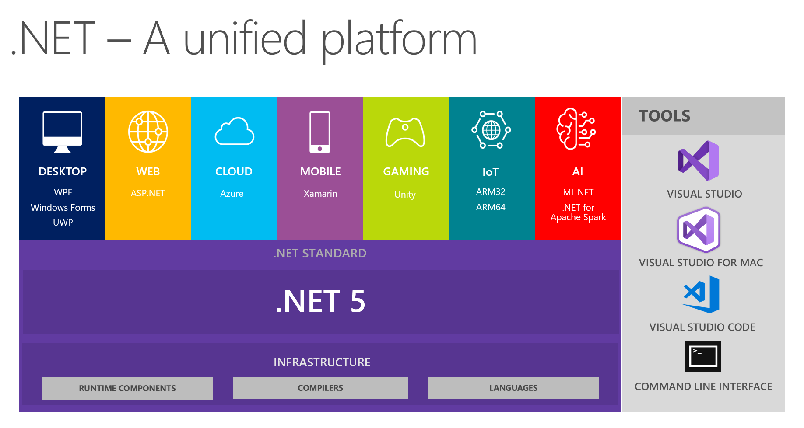
.NET 5
.NET 5 has different architecture, different way of working
new .NET APIs, runtime capabilities and language features;
be able to use it to target Windows, Linux, macOS, iOS, Android, tvOS, watchOS and WebAssembly and more;
.NET Generic Host (Dependency Injection)
Allows to build console applications, windows apps, services or web apps on the same underlying hosting paradigm, with the same shared abstractions.
Any IDE, text editor can be used
Produce a single .NET runtime and framework that can be used everywhere.
Work from command line:
dotnet restore
dotnet build
dotnet clean
dotnet run --project projectname.csproj
dotnet --list-sdks

Slide 3
.NET 5 Generic Host
The .NET Generic Host was introduced in ASP.NET Core 2.1, as a "non-web" version of the existing WebHost used by ASP.NET Core.
The generic host allowed you to re-use many of the DI, configuration, and logging abstractions of Microsoft.Extensions in non-web scenarios
Allows to build console applications, windows apps, services or web apps on the same underlying hosting paradigm, with the same shared abstractions.
IoC container (Inversion of Control)
loose coupled design
IoC Container (a.k.a. DI Container) is a framework for implementing automatic dependency injection. It manages object creation and it's life-time, and also injects dependencies to the class. The IoC container creates an object of the specified class and also injects all the dependency objects through a constructor, a property or a method at run time and disposes it at the appropriate time. This is done so that we don't have to create and manage objects manually. All the containers must provide easy support for the following DI lifecycle.
A host is an object that encapsulates an app's resources, such as:
Dependency injection (DI)
Logging
Configuration
IHostedService implementations
https://docs.microsoft.com/en-us/dotnet/core/extensions/generic-host

Slide 4
.NET Generic Host example
var host = new HostBuilder()
.ConfigureAppConfiguration((context, configurationBuilder) =>
{
configurationBuilder.SetBasePath(context.HostingEnvironment.ContentRootPath);
configurationBuilder.AddJsonFile("appsettings.json", optional: false, reloadOnChange: false);
//configurationBuilder.AddJsonFile("usersettings.json", optional: true, reloadOnChange: true);
configurationBuilder.AddEnvironmentVariables();
})
.ConfigureServices((context, services) =>
{
services.Configure<GeneralSettings>(configuration.GetSection(nameof(GeneralSettings)));
services.AddSingleton<IAppSettingsService, AppSettingsService>();
CoreServices.ConfigureServices(services);
services.AddSingleton<MainWindow>();
})
.ConfigureLogging(logging =>
{
//logging.SetMinimumLevel(LogLevel.Information); <-- see appsettings.json
logging.AddNLog("nlog.config");
logging.AddDebug();
// add built-in providers manually, as needed
//logging.AddConsole();
//logging.AddEventLog();
//logging.AddEventSourceLogger();
//logging.AddTraceSource(sourceSwitchName);
}).Build();
var mainWindow = host.Services.GetService<MainWindow>();
mainWindow.Show();

Slide 5
Generic Host hosted services
Allows to build console applications, windows apps, services or web apps on the same underlying hosting paradigm, with the same shared abstractions.

Slide 6
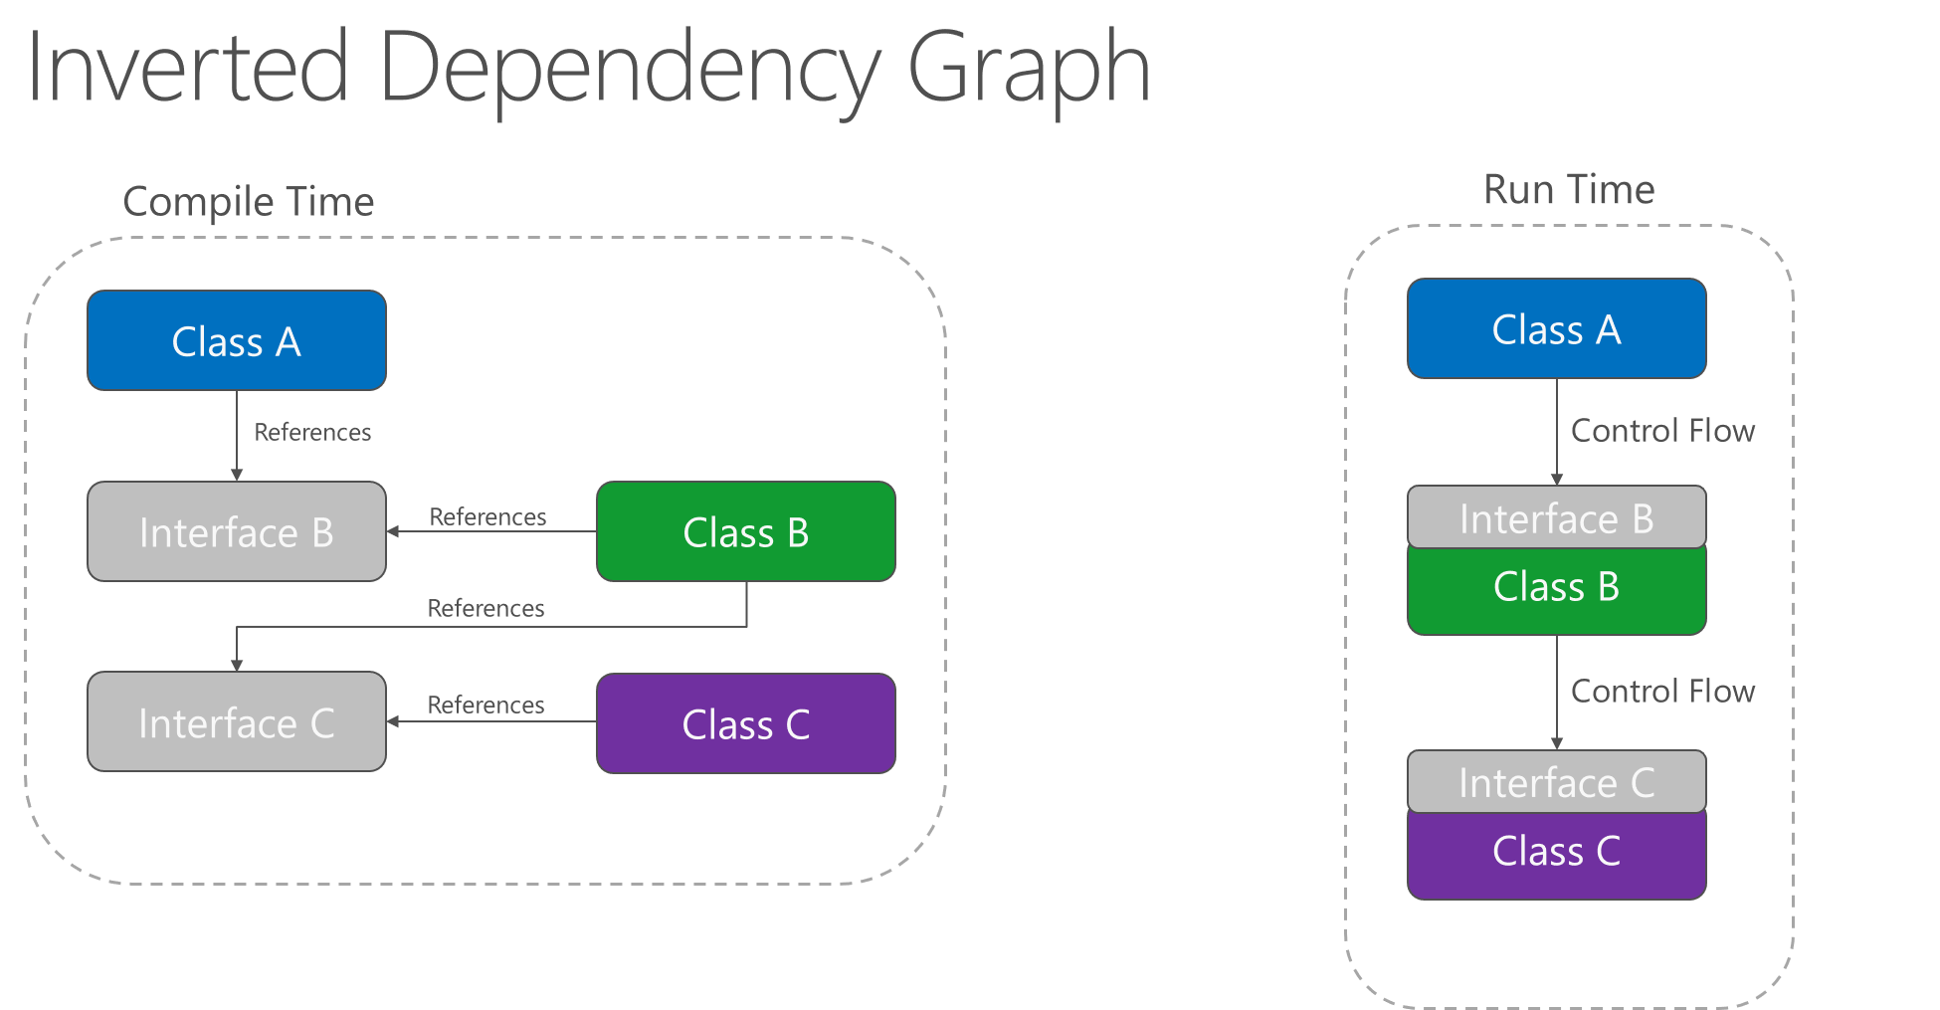
Dependency Injection
Dependency injection is a technique in which an object receives other objects that it depends on.
.NET Core supports the dependency injection (DI) software design pattern, which is a technique for achieving Inversion of Control (IoC) between classes and their dependencies.
Not new .NET feature
Managed Extensibility Framework (MEF) is a component of .NET Framework 4.0. (wikipedia)

Slide 7
Example of .NET 5 Dependency Injection
public interface IAppSettingsService
{
string GetAppTitle();
}
internal class AppSettingsService : IAppSettingsService
{
private readonly GeneralSettings _settings;
private readonly ILogger _log;
public AppSettingsService(IOptions<GeneralSettings> options, ILogger<AppSettingsService> logger)
{
_settings = options.Value;
_log = logger;
_log.Info($"App Settings loaded.");
}
public string GetAppTitle() => _settings.MainWindowTitle;
}
Configure Service:
services.Configure<GeneralSettings>(configuration.GetSection(nameof(GeneralSettings)));
services.AddSingleton<IAppSettingsService, AppSettingsService>();

Slide 8
The solution technical goals
Robust, Maintainable, Testable to keep bug-free code
Use tools to avoid code mistakes
Microsoft.CodeAnalysis
Tests
Unit tests
Integration tests
UI tests
follow good practices
bugs come from
missing Use Cases of a feature
regression bugs
Rule: the feature is done then new tests are implemented
Reduced Risks
Smooth Transitions
Ensure Consistency

Slide 9
Test environment
Unit tests
Verifying methods cases
Integration tests
Verifying hosted services
UI integration tests
Verifying a user interaction with UI

Slide 10
FlaUI framework for UI tests
https://github.com/FlaUI/FlaUI
FlaUInspect - https://github.com/FlaUI/FlaUInspect

Slide 11
«Best practices»
TDD (Test-driven development)
is a software development process that relies on the repetition of a very short development cycle: requirements are turned into very specific test cases, then the code is improved so that the tests pass. This is opposed to software development that allows code to be added that is not proven to meet requirements.
Microsoft.CodeAnalysis
Based on .NET Compiler Platform ("Roslyn")
Roslyn provides open-source C# and Visual Basic compilers with rich code analysis APIs. It enables building code analysis tools with the same APIs that are used by Visual Studio.
Provides build-time analysis of C# code
running a specific set of C# rules.
These rules are great at helping you avoid general pitfalls in your code
Model-View-ViewModel pattern
Model–view–viewmodel (MVVM) is a software architectural pattern that facilitates the separation of the development of the graphical user interface (the view) – be it via a markup language or GUI code – from the development of the business logic or back-end logic (the model) so that the view is not dependent on any specific model platform.

Slide 12

C# 8: Nullable Reference Types
In recent years, there’s been a trend of strict null checking in programming languages:
TypeScript has the strictNullChecks option.
In Kotlin (preferred language for Android development), all types don’t allow null values by default.
In Swift (Apple’s language of choice), only the Optional data type allows null values.
C# 8.0 introduces nullable reference types and non-nullable reference types that enable you to make important statements about the properties for reference type variables:
A reference isn't supposed to be null. When variables aren't supposed to be null, the compiler enforces rules that ensure it's safe to dereference these variables without first checking that it isn't null
A reference may be null. When variables may be null, the compiler enforces different rules to ensure that you've correctly checked for a null reference
This new feature provides significant benefits over the handling of reference variables in earlier versions of C# where the design intent can't be determined from the variable declaration.
https://docs.microsoft.com/en-us/dotnet/csharp/nullable-references
Because of the language history, the decision to use the same syntax for value types and reference types changes the behavior of the language for reference types. Before C# 8, all reference types were nullable. They were however declared without a question mark:
// before C# 8 string nullableString; // since C# 8 string nonNullableString;

