Slide 1
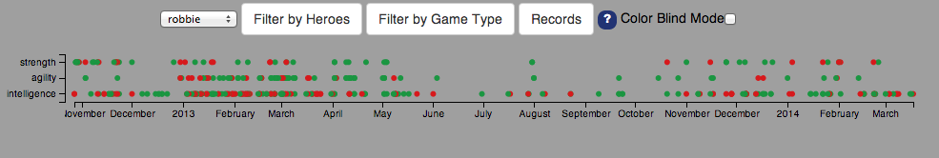
Visualization Header:
Select the user whose data you wish to view
Filter data by hero or game type
Colorblind? Click here!
Need help on what the visualizations show?
Select a region on the timeline to see games only within that time period

Slide 2
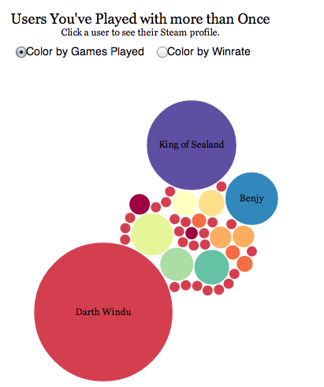
Here is an example visualization:
Special Features Note
Toggle to change visualization coloring
Need more visualization help? Confused about what a visualization is showing? Click the question mark icon in the header.

