Slide 1
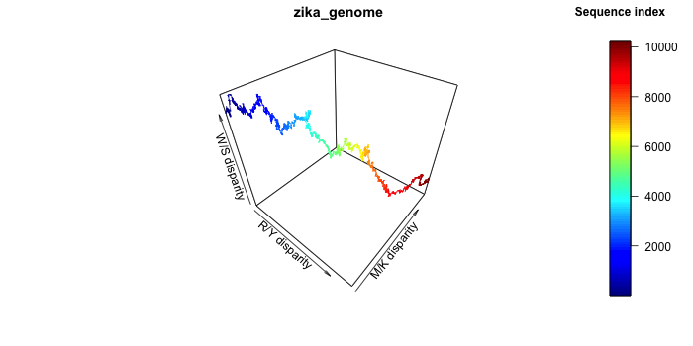
Studying the genome with plotZcurve
Aura Zelco, Lund University
https://github.com/aurazelco/BINP29_Zcurve

Slide 2
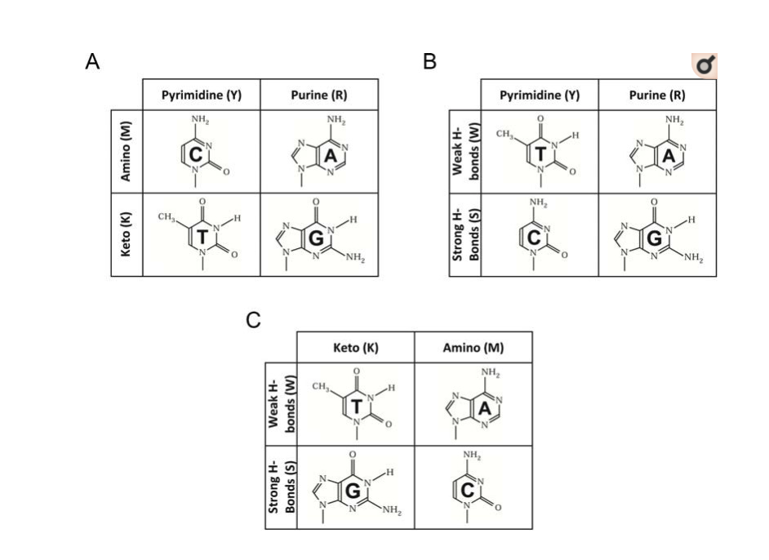
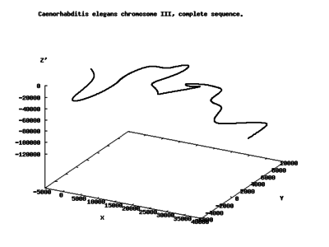
Z-curve
Background
Wikipedia
The Z-curve is a line in a 3D space, as long as the target sequence, which displays chemical properties of the sequence based on the nucleotides.
Advantages:
- highly informative
- unique to each genome
- can reveal interesting sections of the genome (e.g. horizontal gene transfer, protein-coding genes, etc)
Aim:
Create a software that plots such curve, and compare bacterial and viral sequences.
The nucleotides are divided in according to three properties¹:
1. puRine/pYrimide (R/Y) bases -> X
2. aMino/Keto (M/K) bases -> Y
3. Weak/Strong H-bonds (W/S) -> Z
1. Zhang and Zhang, Curr Genomics. 2014 Apr; 15(2): 78–94.
From paper¹

Slide 3
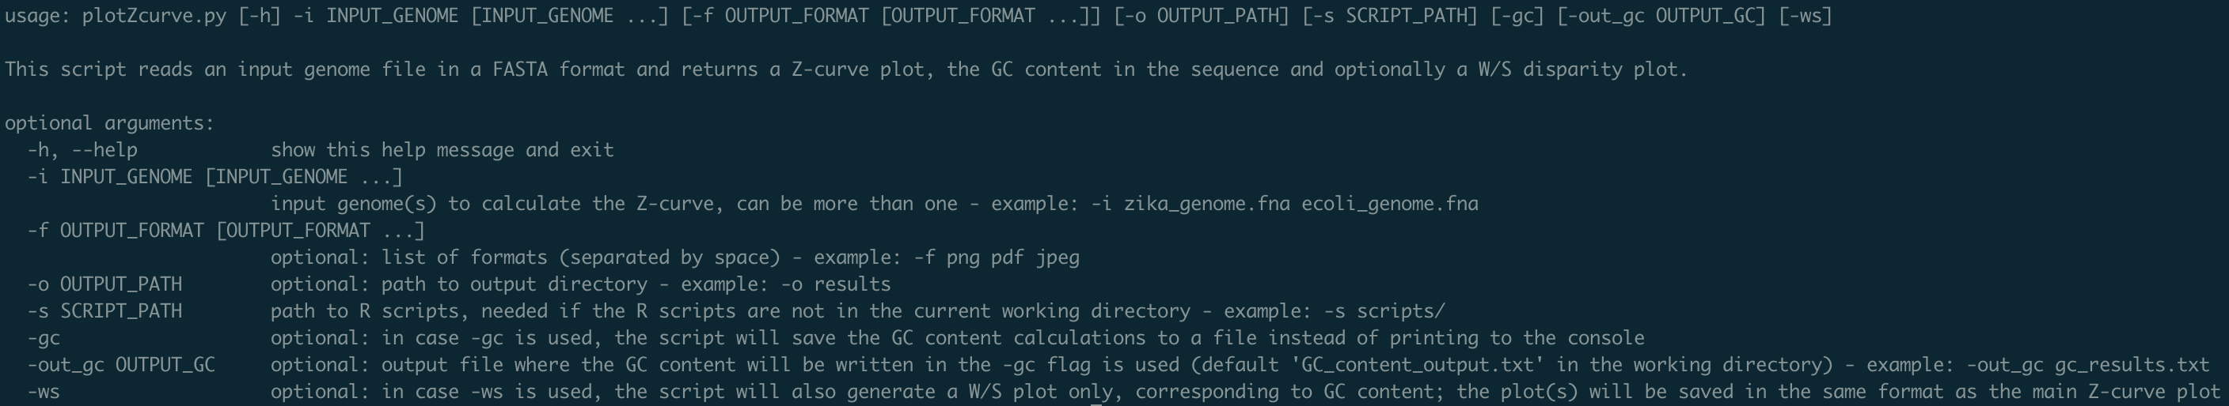
plotZcurve
Python script with R custom function - help message

Slide 4
plotZcurve
Python script with R custom function - pipeline
Imports custom R functions
Calculates GC content
Input files
FASTA format?
Prints to console
Prints to output file
Invalid nucleotides?
Calculates coordinates matrix
Extracts sequence
Generates plots

Slide 5

plotZcurve
Examples from the command line
Examples of commands:
python plotZcurve.py -i samples_data/zika_genome.fna
2. python plotZcurve.py -i samples_data/ecoli_genome.fna -gc
3. python plotZcurve.py -i samples_data/zika_genome.fna -f pdf
4. python plotZcurve.py -i samples_data/zika_genome.fna samples_data/ecoli_genome.fna -gc -out_gc results.txt

Slide 6
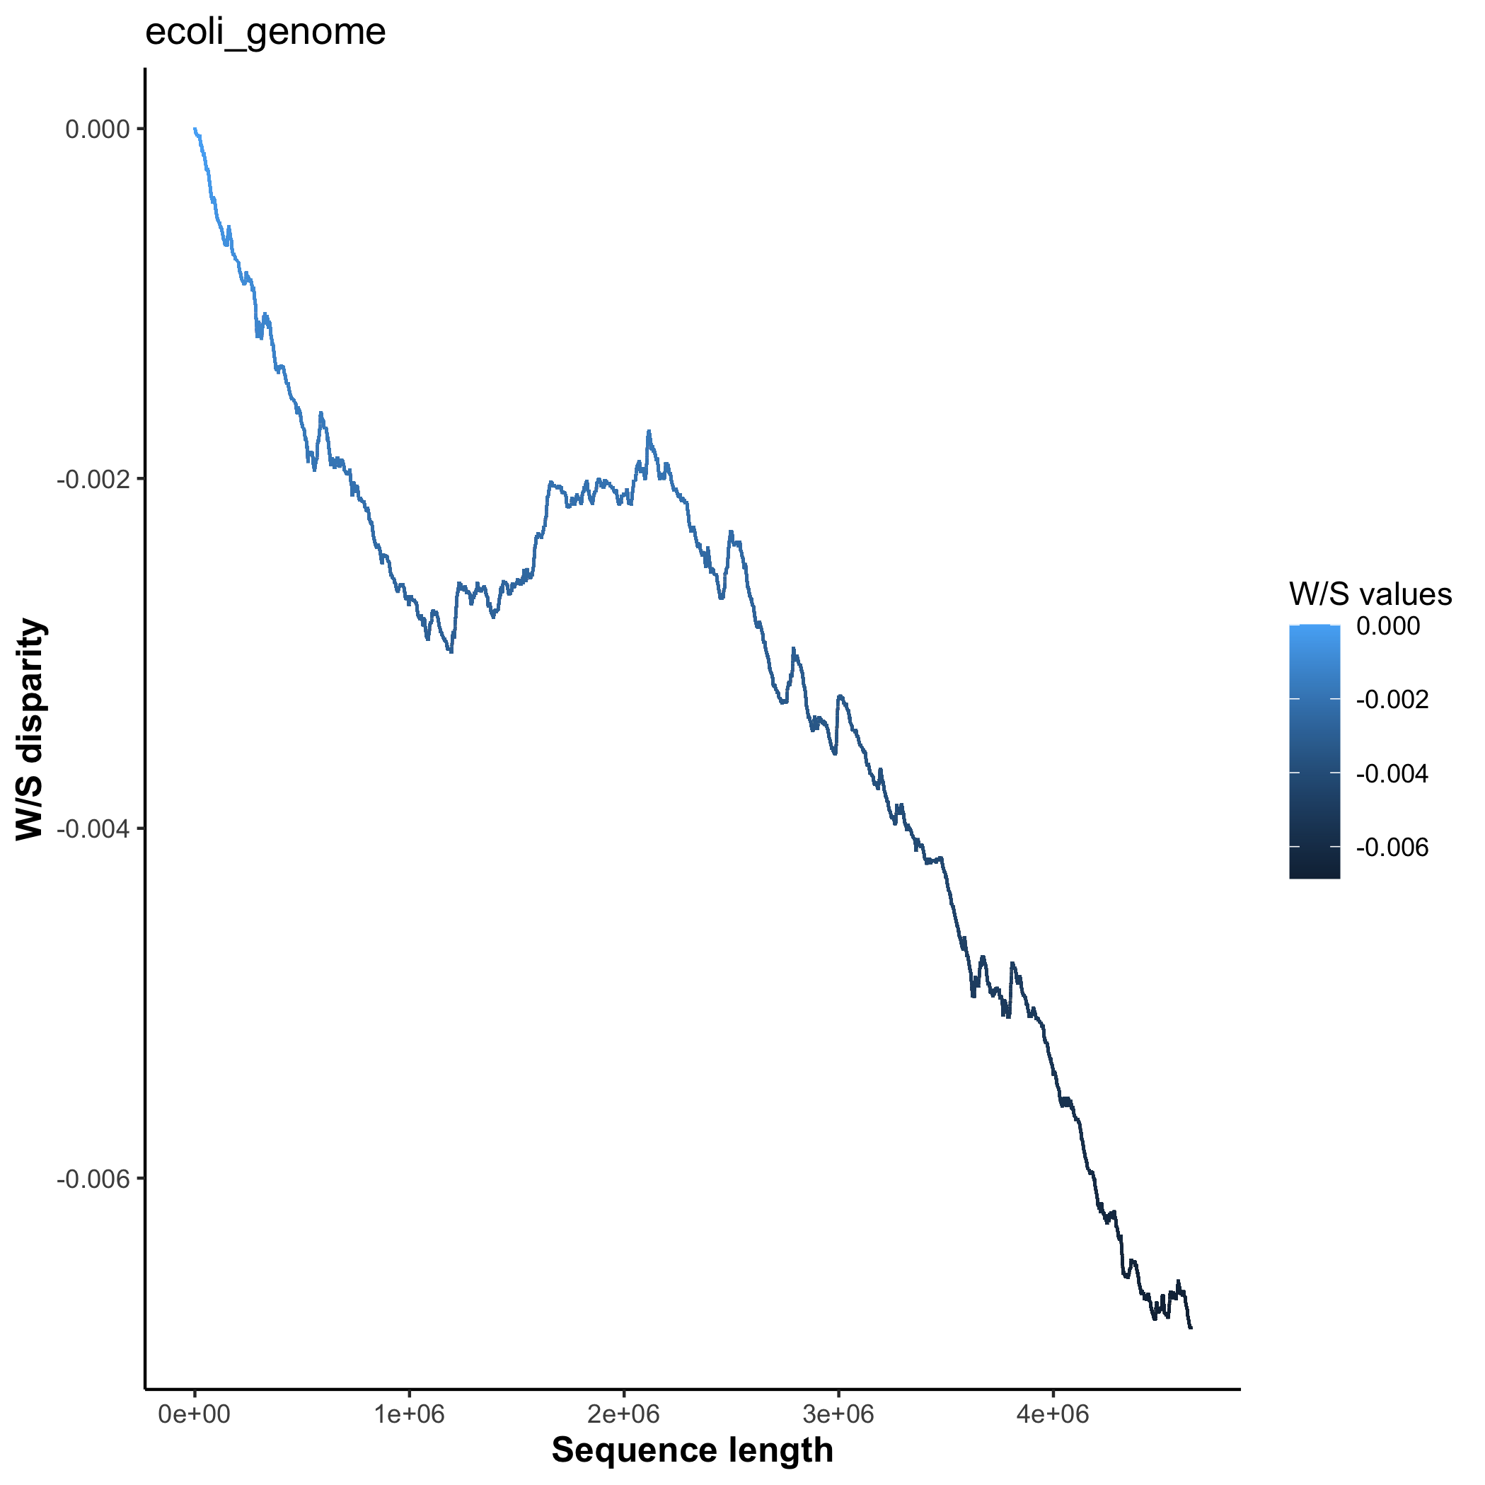
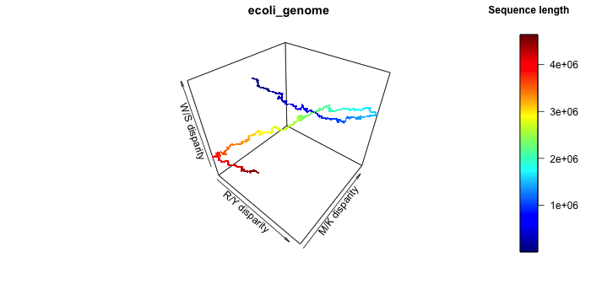
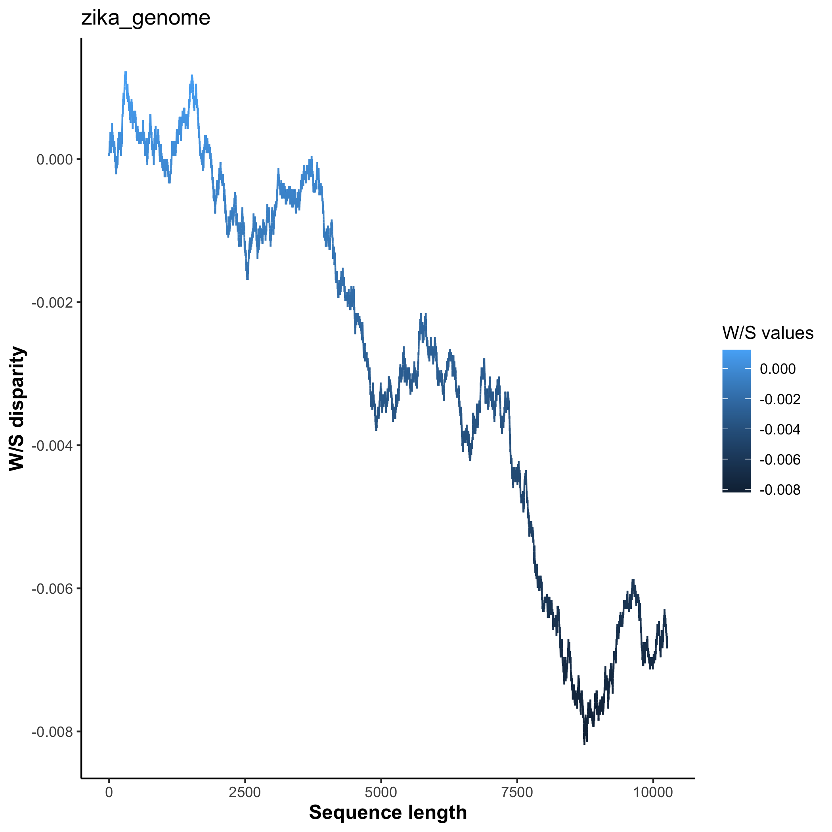
plotZcurve
Example of plots
On the top row, the generated Z-curve and W/S plots for E. coli are shown. The bottom row is displaying the results for the Zika virus genome.
In the Z-curve plot (top and bottom left), the sequence length is used as a legend, so we can follow the direction of the sequence in the plot.
In the W/S plots (top and bottom right), the lines are colored based on the W/S coordinates values along the sequence length.
While the Z-curve shows the overall trends in the three disparities, the W/S plot focuses on the AT/GC disparity, since the user may be interested in if and how the GC content changes throughout the sequence.

Slide 7
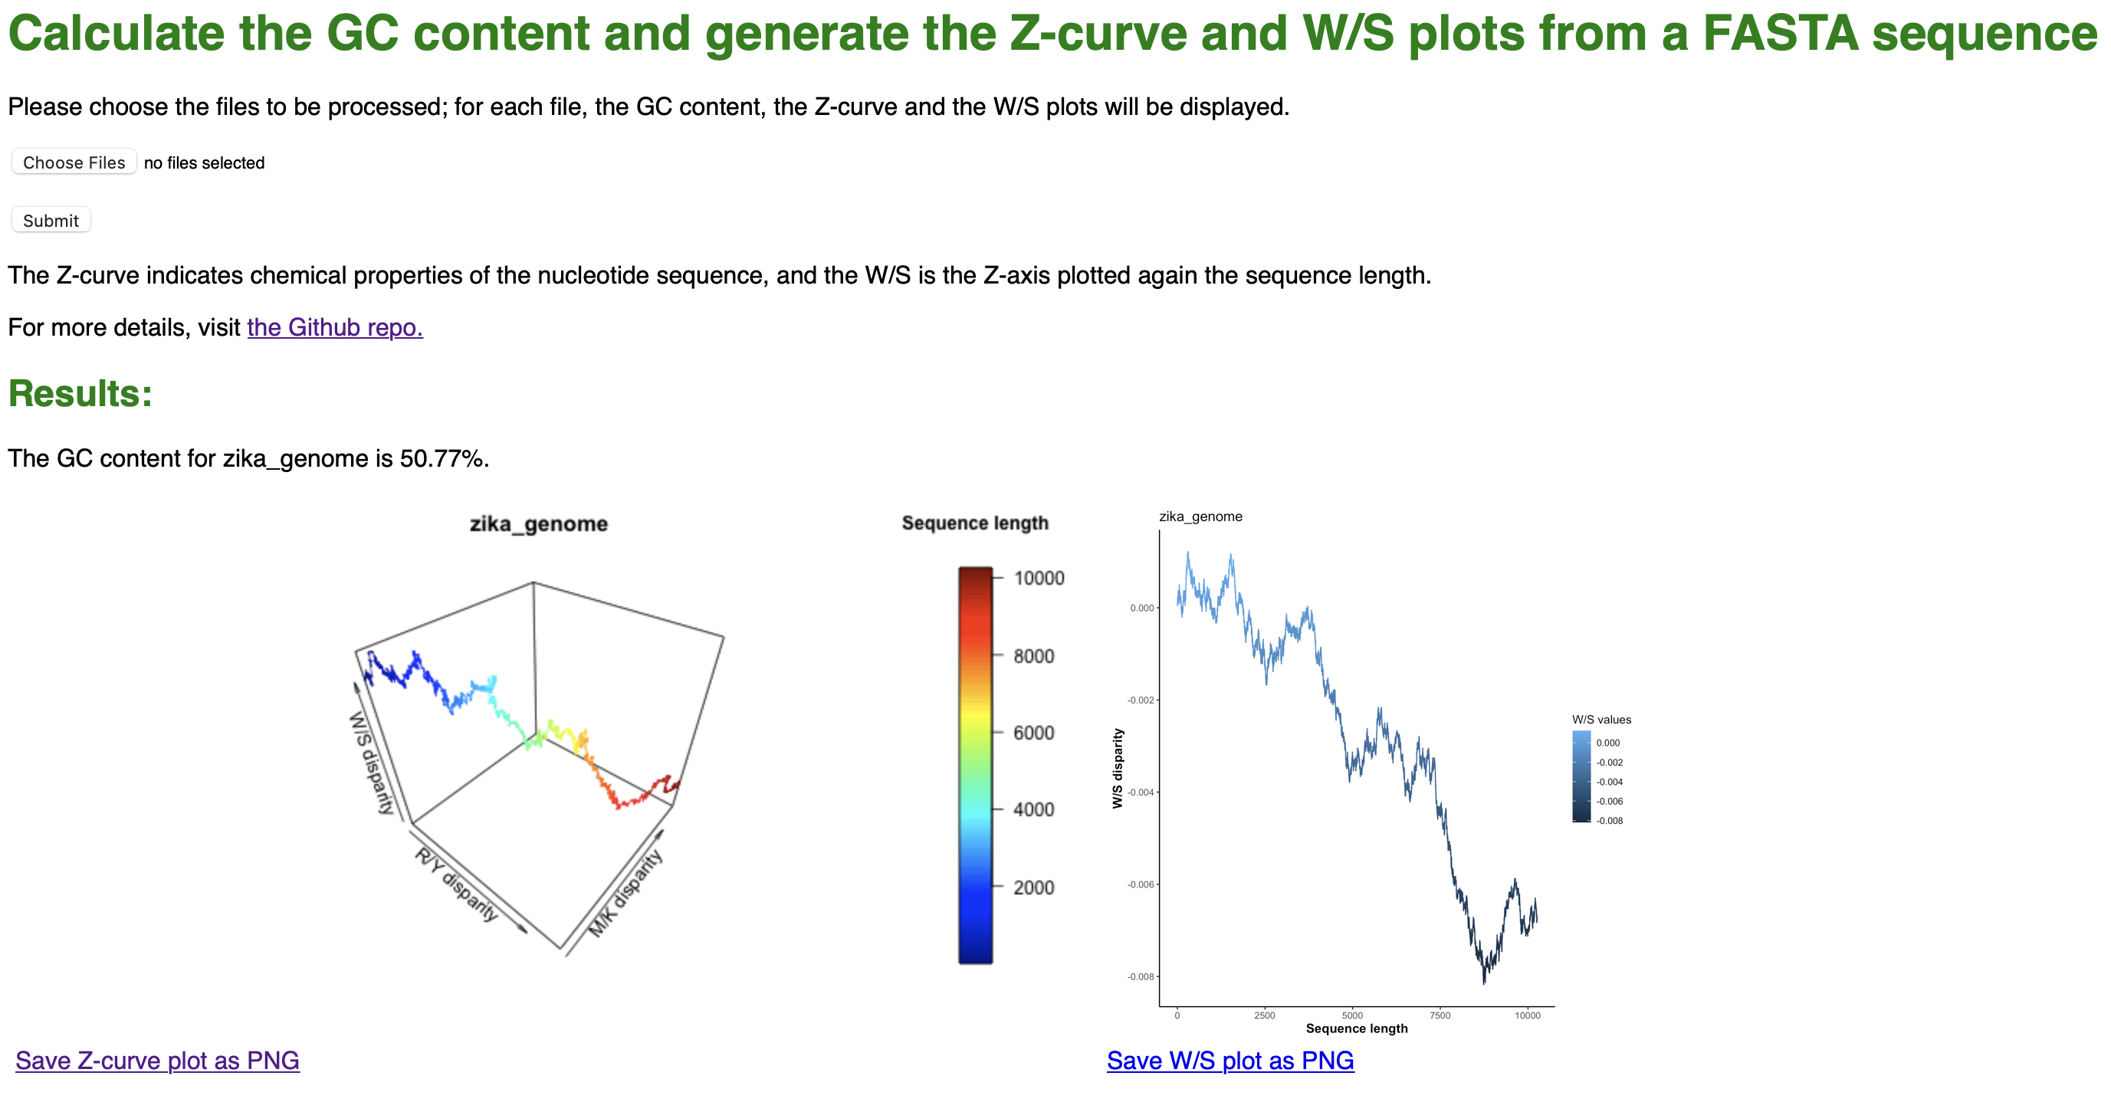
plotZcurve
Flask web interface
Runs as: flask run (in the flask_interface directory)

Slide 8
plotZcurve
Advantages
Novel software, not many options already available
Can handle multiple files simultaneously
Builds the plot based on the sequence alone -> repeatable, can be used on any sequence in FASTA format
Multiple plot extensions available
GC content saved to an output file
User-friendly version as web interface
Limitations
Slower if bigger genomes are used as
Module version is very important -> environment file is provided
A sliding window input could be added in the script -> generate ‘smoother’ plots
The Flask app is limited compared to the software, mainly for security issues of file handling
Conclusions
This novel software is a useful tool to study the chemical properties of genome (or sequences), to compare organisms and/or individuals and to get an overall idea of the genome sequence.

