Slide 1
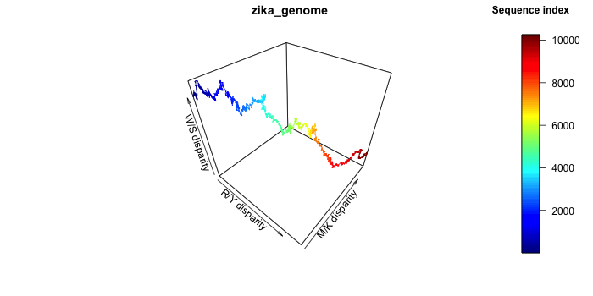
Plotting the
Z-curve
Aura Zelco, 2022/03/15
https://github.com/aurazelco/BINP29_Zcurve

Slide 2
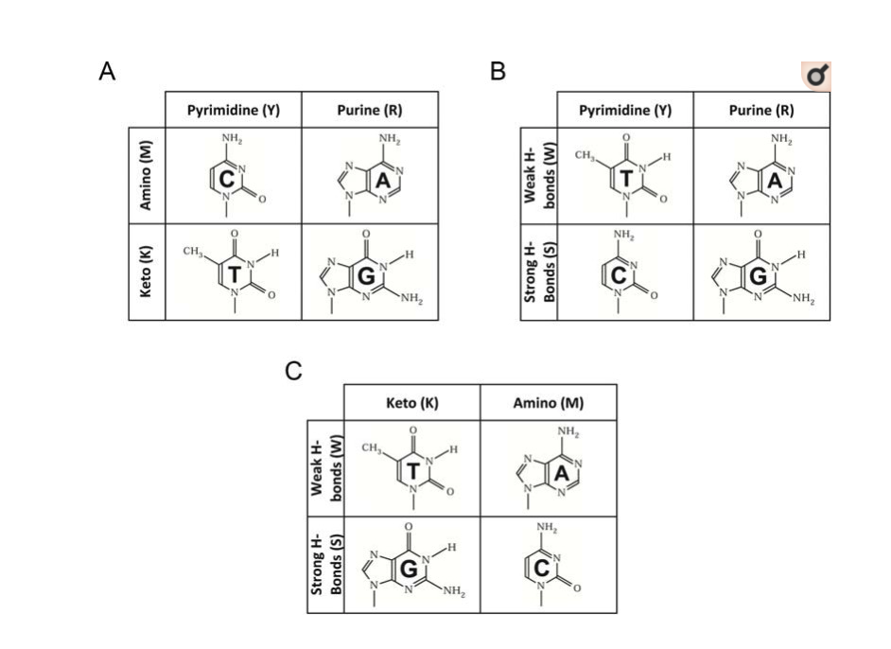
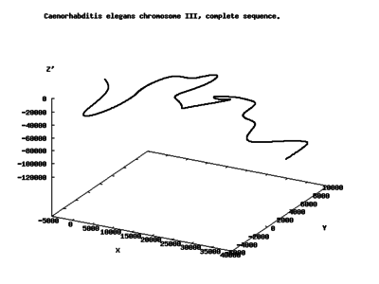
Z-curve
Background
Wikipedia
The Z-curve is a line in a 3D space, as long as the target sequence, which displays chemical properties of the sequence based on the nucleotides.
Advantages:
- highly informative
- unique to each genome
- can reveal interesting sections of the genome (e.g. horizontal gene transfer, protein-coding genes, etc)
Aim:
Create a software that plots such curve, and compare bacterial and viral sequences.
The nucleotides are divided in according to three properties¹:
puRine/pYrimide (R/Y) bases -> X
aMino/Keto (M/K) bases -> Y
3. Weak/Strong H-bonds (W/S) -> Z
1. Zhang and Zhang, Curr Genomics. 2014 Apr; 15(2): 78–94.
From paper¹

Slide 3
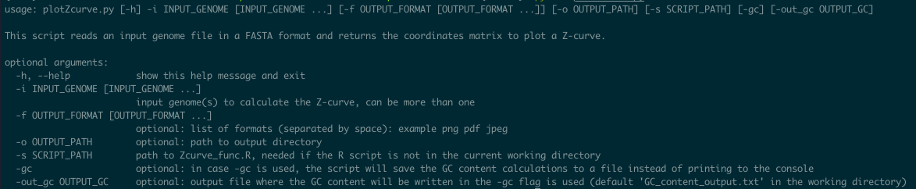
Z-curve
plotZcurve.py Python script with R custom function - pipeline
Either printed to console or to output file
Input genome file(s)
Correct format?
Extracts genome sequence
Calculates GC content
Saves plot in different formats
Uses imported R function to plot
Creates coordinates matrix

Slide 4
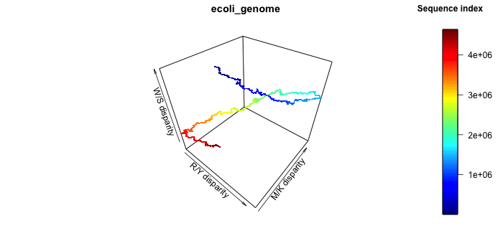
Z-curve
plotZcurve.py - plots

Slide 5

Z-curve
plotZcurve.py - example
Examples of commands:
python plotZcurve.py -i samples_data/zika_genome.fna
2. python plotZcurve.py -i samples_data/ecoli_genome.fna -gc
3. python plotZcurve.py -i samples_data/zika_genome.fna -f pdf
4. python plotZcurve.py -i samples_data/zika_genome.fna samples_data/ecoli_genome.fna -gc -out_gc results.txt

Slide 6
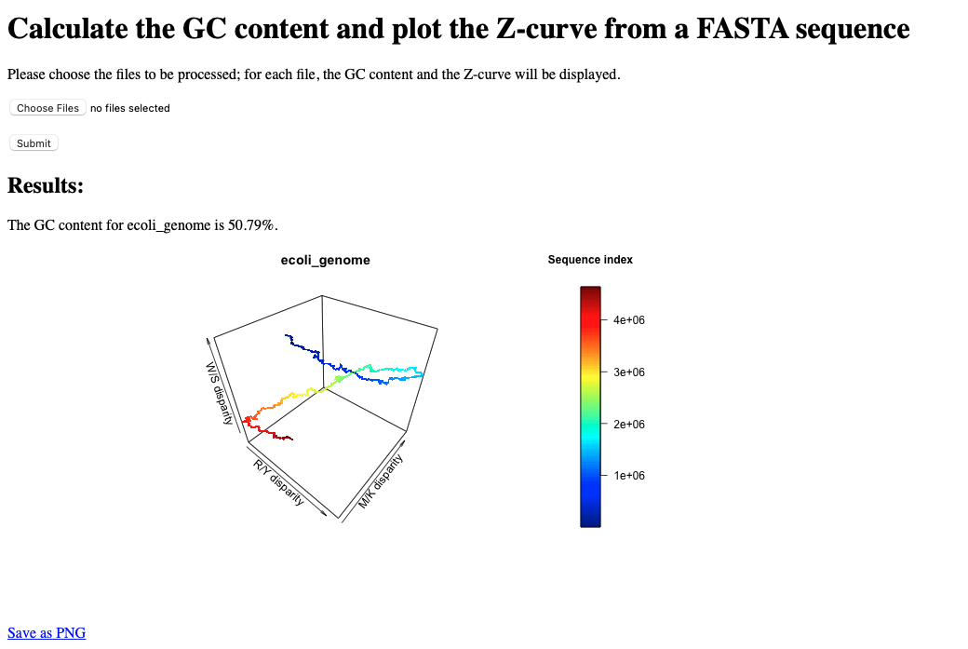
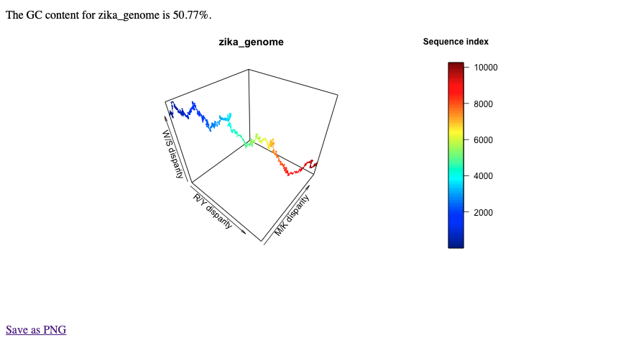
Z-curve
Flask web interface
Runs as: flask run (in the flask_interface directory)

Slide 7
Z-curve
Advantages
Novel software, not many options already available
Can handle multiple files simultaneously
Builds the plot based on the sequence alone -> repeatable, can be used on any sequence in FASTA format
Multiple plot extensions available
GC content saved to an output file
User-friendly version as web interface
Limitations
Slower if bigger genomes are used as
Module version is very important -> environment file is provided
A sliding window input could be added in the script -> generate ‘smoother’ plots
The Flask app is limited compared to the software, mainly for security issues of file handling
Conclusions
This novel software is a useful tool to study the chemical properties of genome (or sequences), to compare organisms and/or individuals and to get an overall idea of the genome sequence.

