Slide 1
Title: CMIP6 Based Climate Analysis for Three Cities: Temperature and Precipitation under SSP Scenarios.
Aurela Sakaj

Slide 2
Introduction
Goal To evaluate projected temperature and precipitation changes using CMIP6 multi-model ensemble data for three climate-critical cities, Cairo, Helsinki, and New Delhi, under historical, medium (SSP2-4.5), and high (SSP5-8.5) emission scenarios.
Key Climate Zones Studied
❄️ Cold Temperate ☀️ Hot Desert 🌧️ Subtropical
Critical Research Focus
• Arctic amplification effects • Extreme heat & aridification • Monsoon variability & flood risks

Slide 3
Cities Selected for CMIP6 Climate Analysis
Helsinki, Finland
Climate: Cold temperate (continental)
Region: Northern Europe
Relevance:
Highly sensitive to warming due to Arctic amplification
Clear signal in both temperature and snow cover trends
Cairo, Egypt
Climate: Hot desert
Region: North Africa / Middle East
Relevance:
Arid climate with low baseline precipitation
Useful for analyzing precipitation reduction and extreme heat
Well-covered in CMIP6 model grid
New Delhi, India
Climate: Subtropical (semi-arid to humid)
Region: South Asia
Relevance:
High exposure to heat stress and monsoon variability
Critical for urban climate resilience and adaptation planning

Slide 4
Climate Models and Scenarios
Models Used
MPI-ESM1-2-LR (Germany) | MIROC6 (Japan) | EC-Earth3 (Europe)
Selected from CMIP6 for consistent data availability
Represent major global modeling centers
Provide reliable outputs for temperature and precipitation
Cover all required scenarios: Historical, SSP2-4.5, SSP5-8.5
Scenarios Analyzed
Historical (Baseline climate conditions)
SSP2-4.5 – "Middle of the Road" (Moderate emissions)
SSP5-8.5 – "Fossil-Fueled Development" (High emissions)
Key Variables
tas – Surface air temperature (°C)
pr – Precipitation (mm/day)

Slide 5
Statistical Analysis and Visualization
Significance Testing
Welch’s t-tests applied to 2080–2100 data
Assesses statistical difference between SSP2-4.5 and SSP5-8.5 projections
Visualization
Time series plots per city for temperature and precipitation
Ensemble mean with ±1 standard deviation shaded
Color-coded by scenario using consistent palette
Trend Estimation
Linear regression applied to annual means
Trends reported as °C/decade (temperature) and mm/day/decade (precipitation)
Scenario Comparison (ΔT and ΔP)
Mean changes calculated between 2020–2040 and 2080–2100
Computed separately for SSP2-4.5 and SSP5-8.5

Slide 6
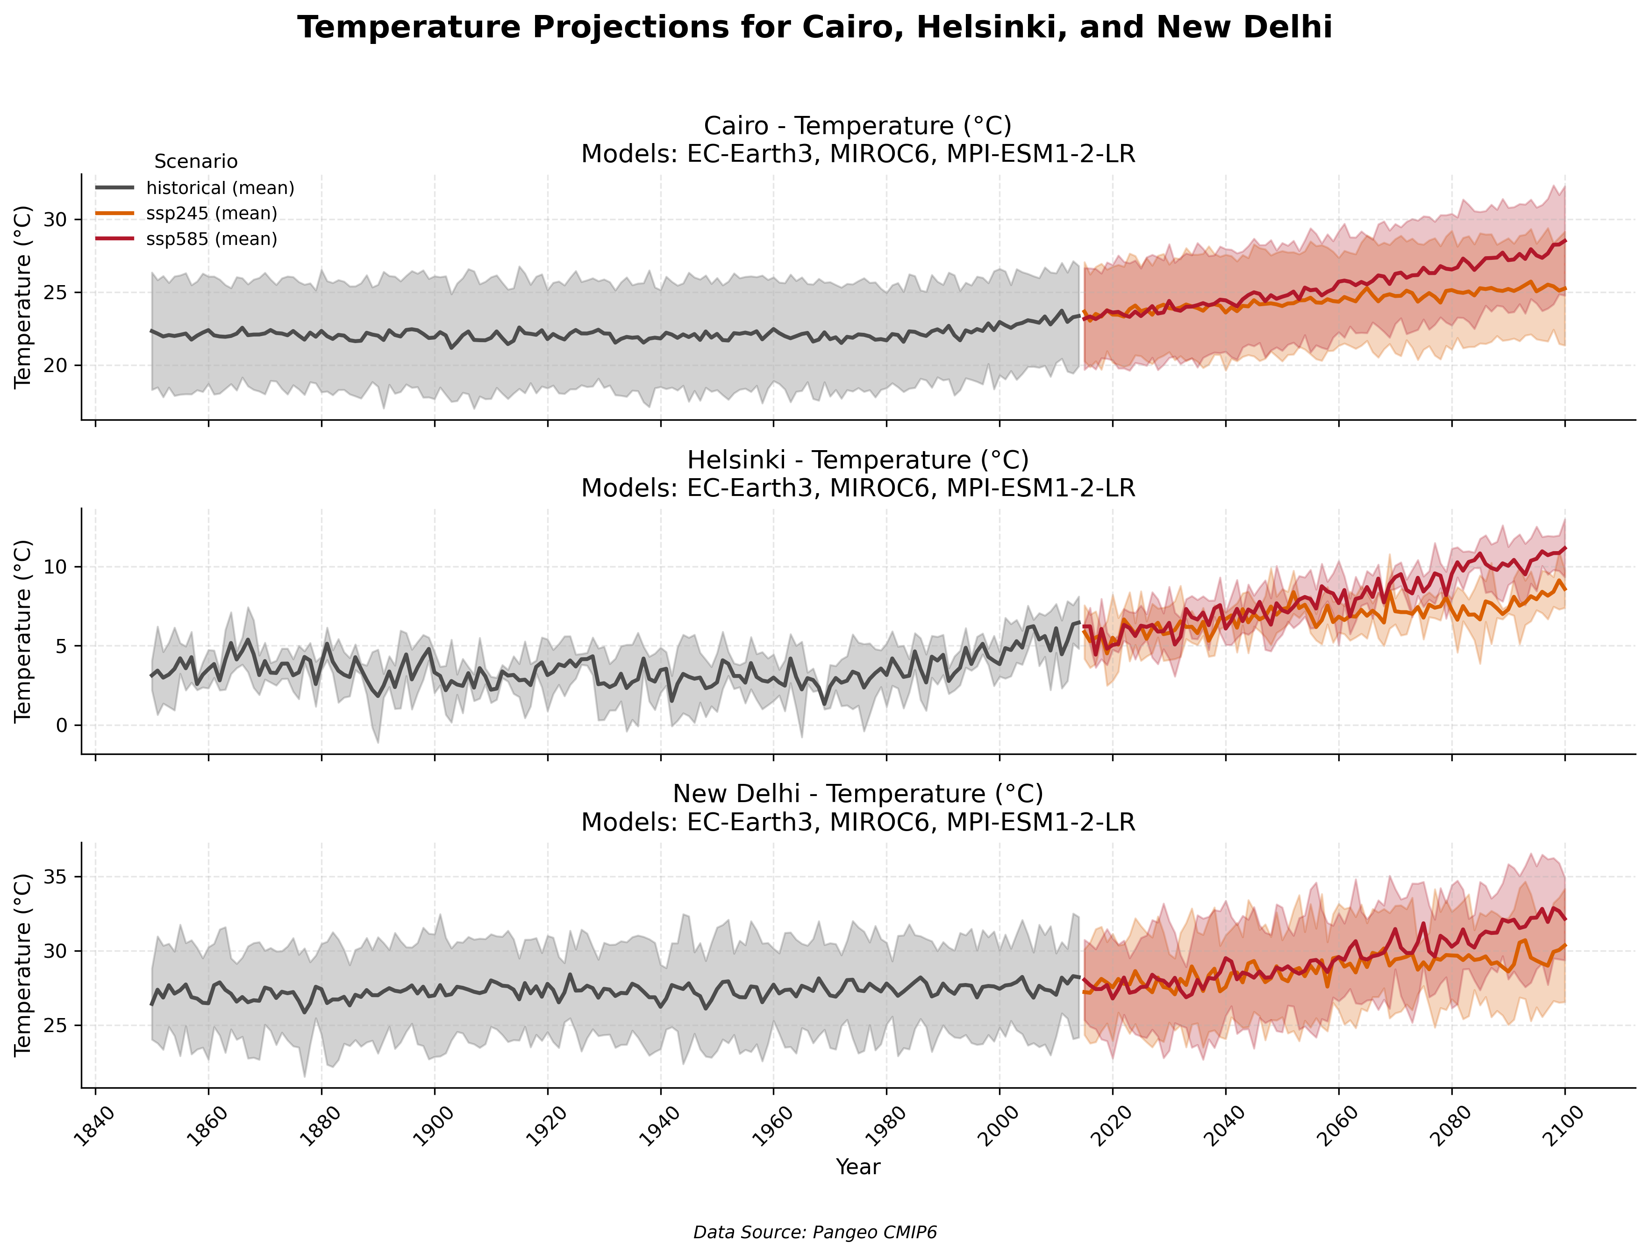

Slide 7
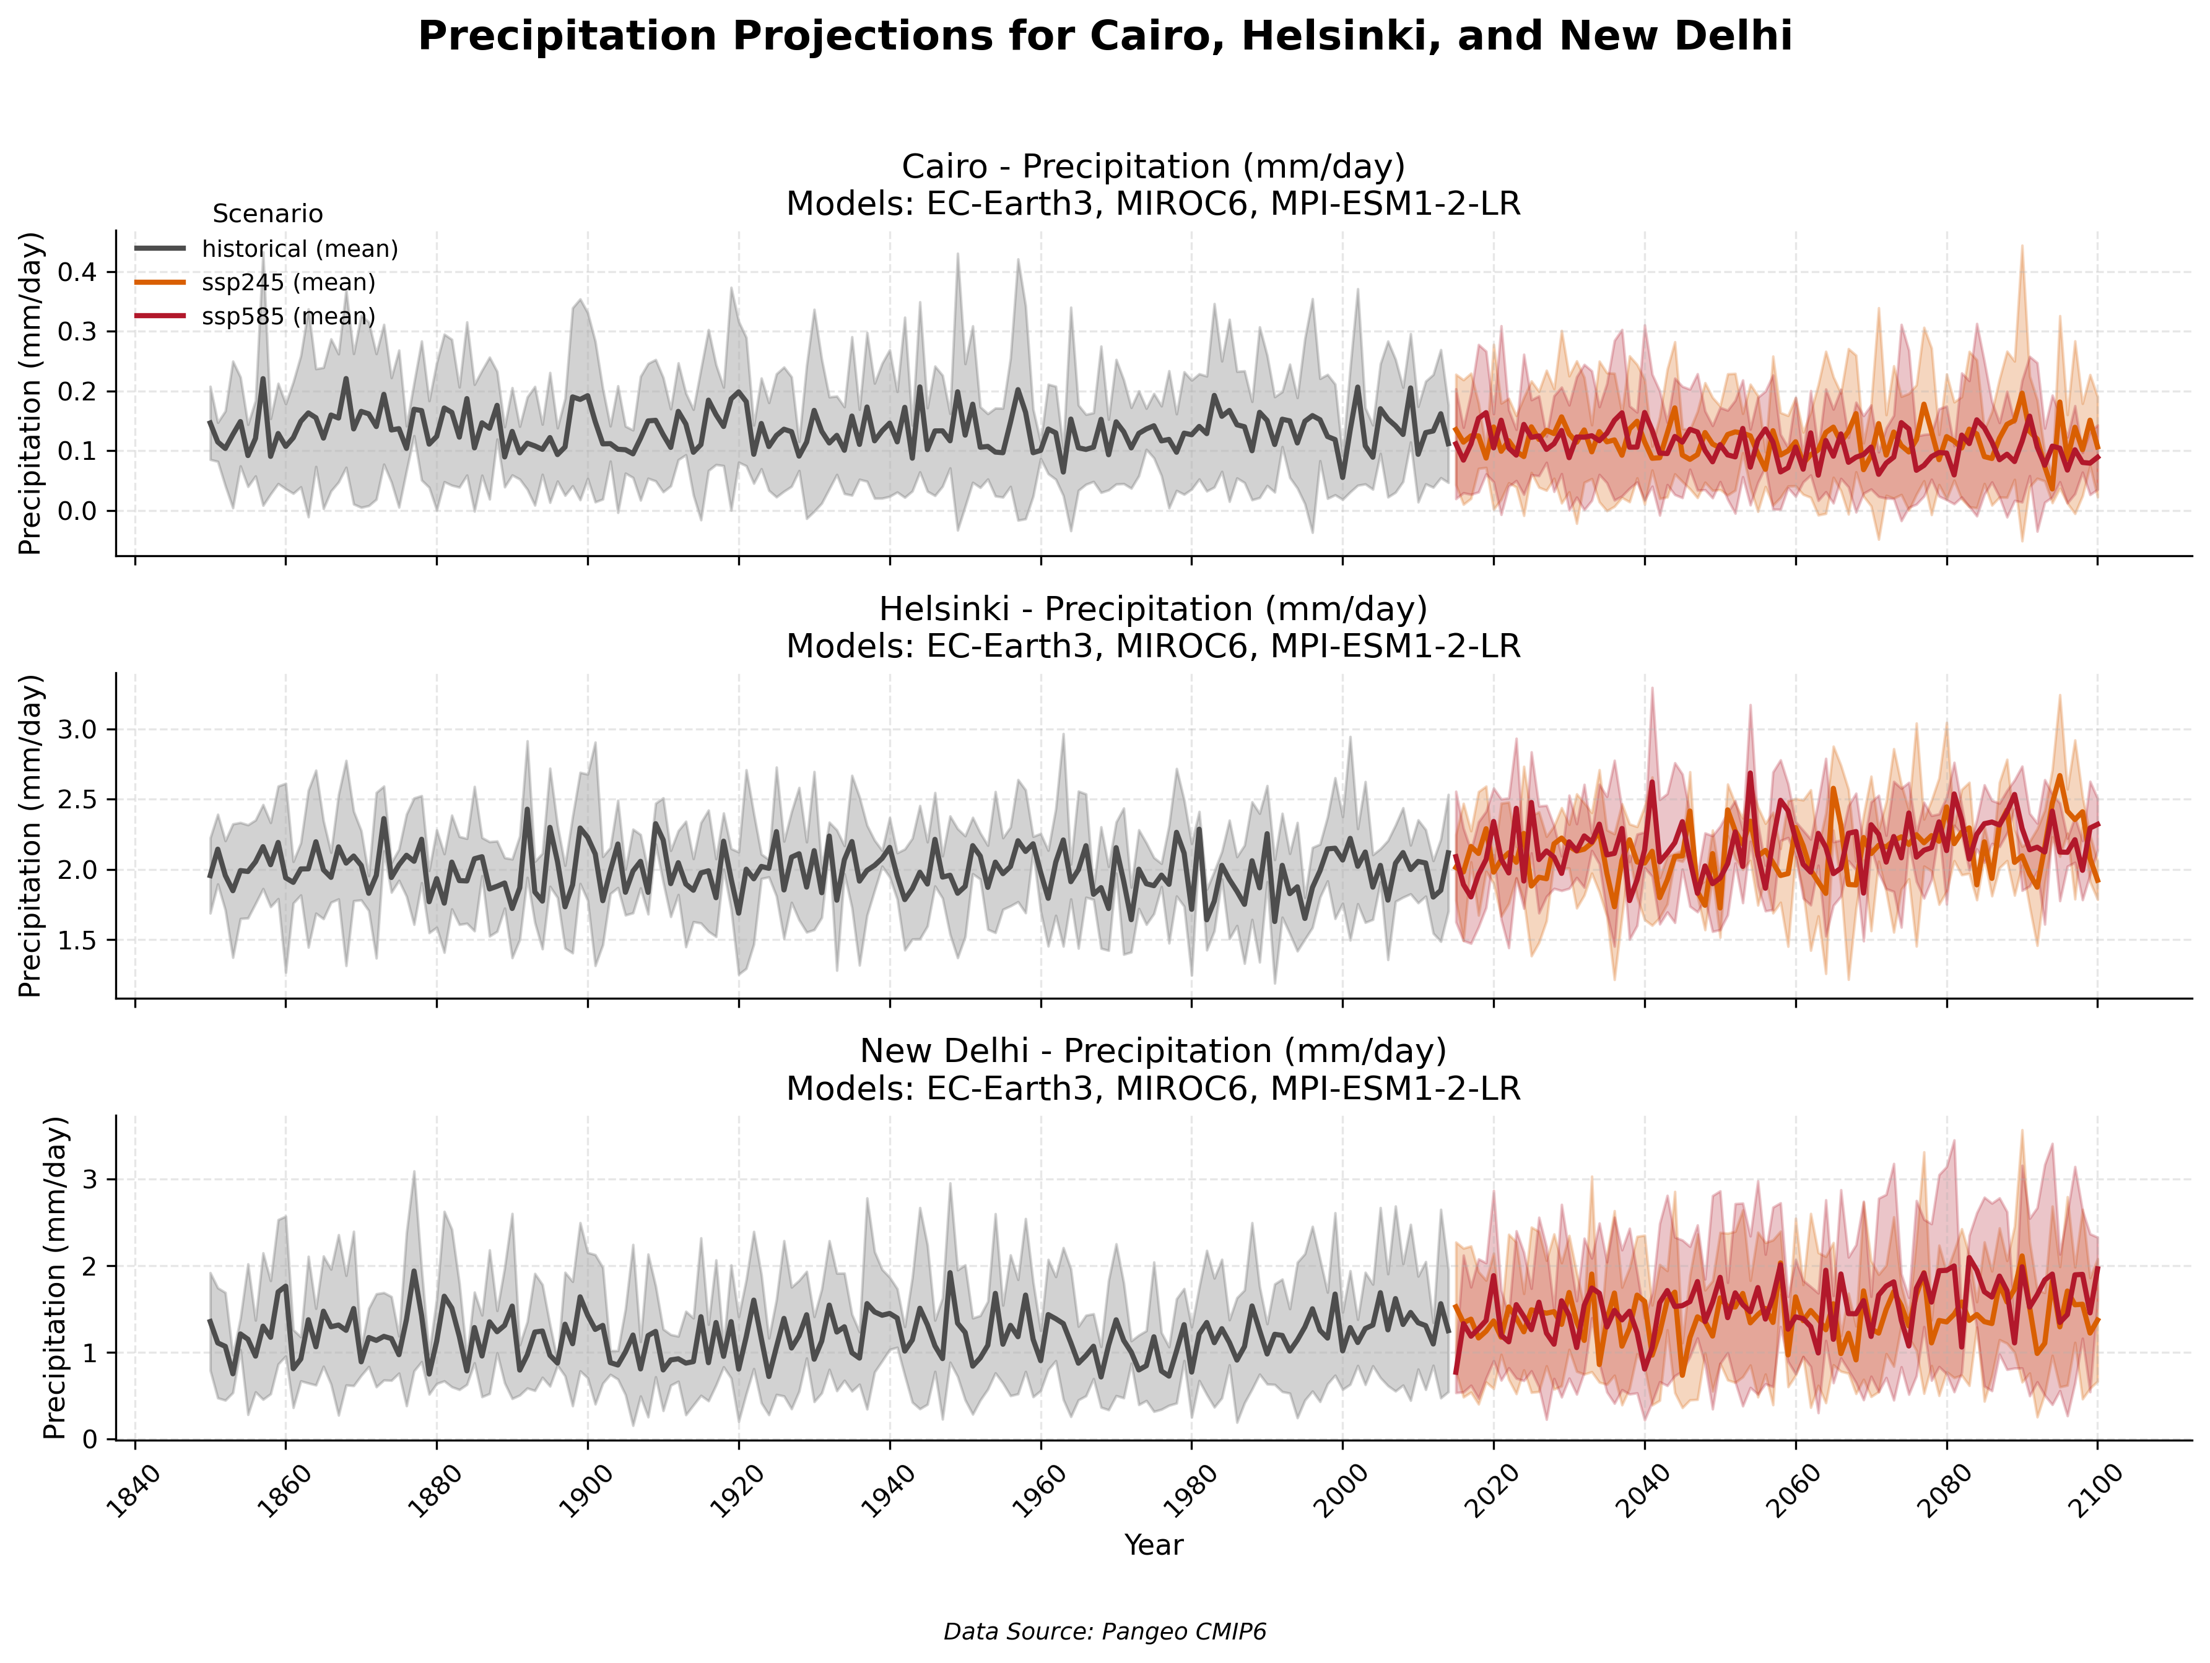

Slide 8
Projected Temperature and Precipitation Trends Results (2020–2100)
Location | SSP2-4.5 Trend (°C/decade) | SSP5-8.5 Trend (°C/decade) | ΔT SSP2-4.5 (2020–2100) | ΔT SSP5-8.5 (2020–2100) | p-value (Temp)
Cairo | 0.23 | 0.59 | +1.4°C | +3.5°C | 3.2 × 10⁻⁸
Helsinki | 0.27 | 0.67 | +1.6°C | +4.1°C | 2.1 × 10⁻⁹
New Delhi | 0.28 | 0.65 | +1.7°C | +3.8°C | 1.6 × 10⁻⁶
Location | SSP2-4.5 Trend (mm/day/decade) | SSP5-8.5 Trend (mm/day/decade) | SSP2-4.5 ΔP (%) | SSP5-8.5 ΔP (%) | p-value (Precip)
Cairo | 0.0 | -0.004 | -1% | -17% | 0.15
Helsinki | 0.025 | 0.016 | +6% | +6% | 0.39
New Delhi | 0.016 | 0.048 | +6% | +24% | 0.094

Slide 9
Key findings
️Temperature Trends
Strongest warming in Helsinki:
SSP5-8.5: +0.67°C/decade (ΔT +4.1°C by 2100)
p-value: 2.1e-9 (highly significant)
New Delhi & Cairo show rapid warming under high emissions:
SSP5-8.5 trends: 0.59–0.65°C/decade → +3.5–3.8°C by 2100
Precipitation Shifts
Severe drying in Cairo (SSP5-8.5):
17% reduction in rainfall (p=0.15, less certain)
Wettest outlook for New Delhi:
+24% rainfall by 2100 under SSP5-8.5 (p=0.094, marginal significance)
Helsinki: Consistent +6% precipitation across scenarios (p=0.39, uncertain)

Slide 10
Key findings
Critical Implications!
High-emissions scenarios (SSP5-8.5) amplify extremes:
2–3 × greater warming vs. SSP2-4.5.
Mediterranean (Cairo) faces dual risks:
Heating (+3.5°C) and drying (-17%).
South Asia (New Delhi): Warmer (+3.8°C) and wetter (+24%) → Flood risks.
Confidence Assessment
Temperature Trends
High Confidence (all p-values < 0.00001)
Helsinki most statistically significant (p=2.1e-9)
Precipitation Trends
Moderate-Low Confidence
Only New Delhi's +24% change approaches significance (p=0.094)

