Slide 1
Primality testing
Aurèle Bartolomeo

Slide 2
Summary
Fermat and Miller-Rabin algorithm
General Performances
Performance on Carmichael numbers
Accuracy vs. k (the number of rounds of testing)

Slide 3
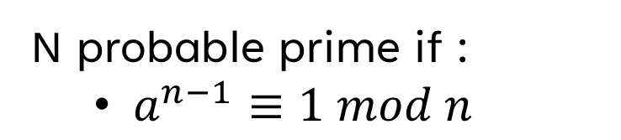
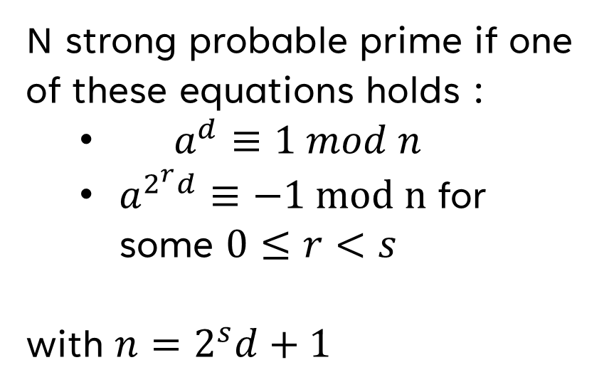
1. The algorithms
Fermat
Miller-Rabin
N strong probable prime if one of these equations holds :
$a^{d}≡1 mod n$
$a^{2^{r}d}≡−1 mod n$ for some $0≤r<s$
with $n=2^{s}d+1$
N probable prime if :
$a^{n−1}≡1 mod n$

Slide 4
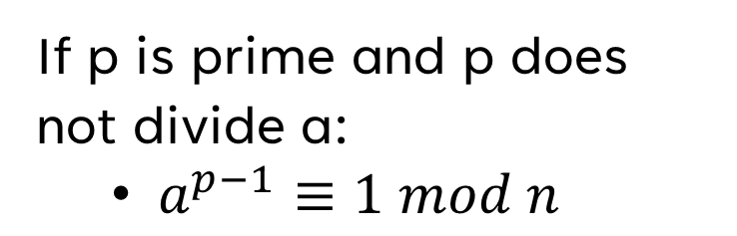
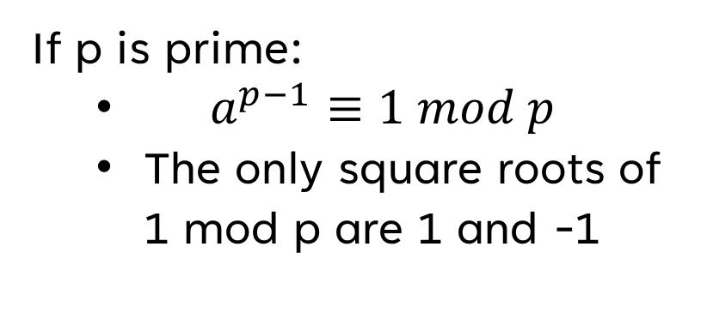
1. The algorithms
Ideas beneath the tests
Fermat
Miller-Rabin
If p is prime and p does not divide a:
$a^{p−1}≡1 mod n$
If p is prime:
$a^{p−1}≡1 mod p$
The only square roots of 1 mod p are 1 and -1

Slide 5
2. General Performances
Main Idea :
Study the impact of the method choosen and the value of k (the number of bases a we try for each number) on accuracy and time for running the algorithm. In order to calculate these values, we will check the results of the algorithms for the 8000 first numbers. (This number has been choosen because it allows us to cover the first thousand prime numbers)

Slide 6
2. General Performances
Fermat |  |  |  | Miller-Rabin
K=1 |  | K=5 |  | K=1 |  | K=5
accuracy | time | accuracy | time | accuracy | time | accuracy | time
0.995 | 2.785 | 0.999 | 4.034 | 0.997 | 1.704 | 0.999 | 1.958
Miller-Rabin algortihm seems faster in practice, although they have the same theoretical complexity upper bound.
Increasing k leads to better accuracy (less composite numbers declared probably prime)

Slide 7
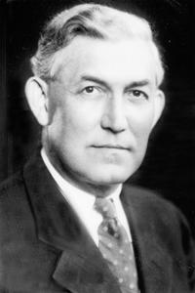
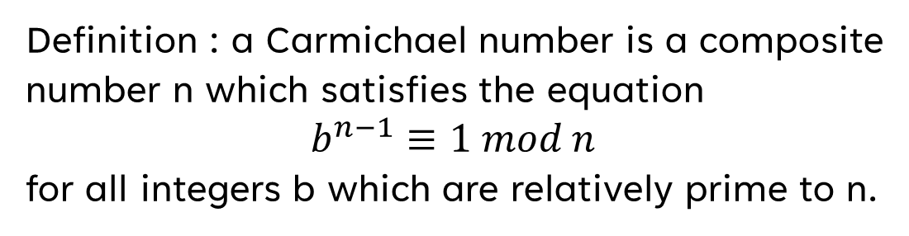
3. Performance On carmichael numbers
Definition : a Carmichael number is a composite number n which satisfies the equation
$$b^{n−1}≡1 mod n$$
for all integers b which are relatively prime to n.
We loop 100 times over the 7 first Carmichael numbers, and compare the accuracy of the Fermat and Miller-Rabin algorithms.
Robert D. Carmichael

Slide 8
3. Performance On carmichael numbers
Fermat |  | Miller-Rabin
K=1 | K=5 | K=1 | K=5
accuracy | accuracy | accuracy | accuracy
0.241 | 0.793 | 0.919 | 1.0
Conclusion : Fermat method performs very poorly while Miller-Rabin results are barely affected !

Slide 9
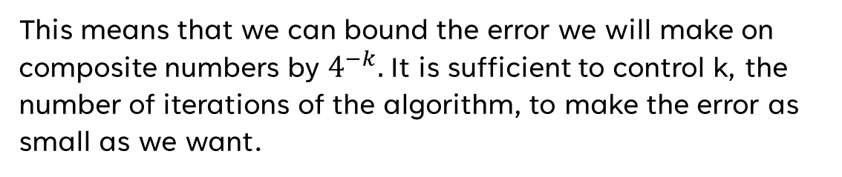
4. Accuracy vs. k
Michael Rabin proved that if a number n is composite, then at most ¼ of the bases a are strong liars for n.
This means that we can bound the error we will make on composite numbers by $4^{−k}.$It is sufficient to control k, the number of iterations of the algorithm, to make the error as small as we want.

Slide 10
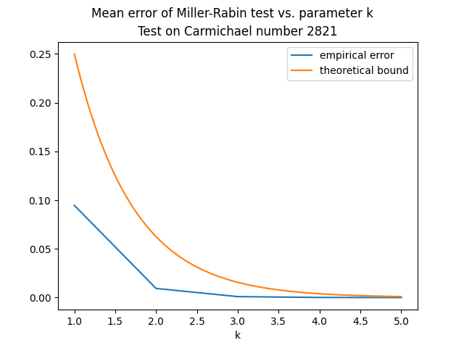
4. Accuracy vs. k
We repeat 100000 times the Miller-Rabin test on Carmichael number 2821, for k values going from 1 to 5. The empirical error is indeed below the theoretical bound. In addition, we observe that from k=3, the error is virtually 0.

Slide 11
CONCLUSION
In terms of accuracy, running time of the algorithm and performance on Carmichael Numbers, Miller-Rabin test gives by far better results. However, the advantage of Fermat test is its theoretical ease. Finally, we recommend to use always Miller-Rabin algorithm for primality testing.

Slide 12
Bonus
The biggest probable prime that we have found using the methods described in this project is 1000000007, and it is prime with probability 0.999.

Slide 13
Bibliography
https://en.wikipedia.org/wiki/Fermat_primality_test, consulted on 01/01/2022
https://en.wikipedia.org/wiki/Miller%E2%80%93Rabin_primality_test, consulted on 01/01/2022
https://primes.utm.edu/lists/small/1000.txt, consulted on 02/01/2022
https://en.wikipedia.org/wiki/Carmichael_number, consulted on 01/01/2022
Michael O Rabin, Probabilistic algorithm for testing primality, Journal of Number Theory, Volume 12, Issue 1, 1980, Pages 128-138, ISSN 0022-314X, https://doi.org/10.1016/0022-314X(80)90084-0.

Slide 14
Thank you !
Aurèle Bartolomeo
bartolomeo.1989401@student.uniroma1.it

