Slide 1
Aurelia-Slickgrid
GitHub Open Source Project
https://github.com/ghiscoding/aurelia-slickgrid
Live Demo on GitHub
https://ghiscoding.github.io/aurelia-slickgrid
Author
Ghislain B. (@ghiscoding)

Slide 2
Why create Aurelia-Slickgrid?
Our needs
We have Data Grids in all our recent projects
Our previous projects, built with AngularJS, were using UI-Grid
It must be fast with Pagination, Columns Filters, Columns Resize, Sorts, Cell Editors
It must support multiple locales (in Canada all our projects must support English & French)
It has to support external query API or services (like Odata, GraphQL or external service to interact with backend)
Other libraries
Other libraries like Ag-Grid, Kendo UI, … they’re good but their best features are not free

Slide 3
Basic Grid
Component
export class BasicGridExample {
columnDefinitions: Column[];
gridOptions: GridOption;
dataset: any[];
constructor() {
this.defineGrid();
}
definedGrid(): void {
this.columnDefinitions = [
{ id: 'title', name: 'Title', field: 'title', sortable: true },
{ id: 'duration', name: 'Duration (days)', field: 'duration', sortable: true },
{ id: '%', name: '% Complete', field: 'percentComplete', sortable: true },
{ id: 'start', name: 'Start', field: 'start' },
{ id: 'finish', name: 'Finish', field: 'finish' },
{ id: 'effort-driven', name: 'Effort Driven', field: 'effortDriven', sortable: true }
];
this.gridOptions = {
autoResize: {
containerId: 'demo-container',
sidePadding: 15
},
enableAutoResize: true,
enableSorting: true
};
this.dataset = [ /* your data */ ];
}
}
View
<div class="demo-container">
<aurelia-slickgrid grid-id="grid1"
column-definitions.bind="columnDefinitions"
grid-options.bind="gridOptions"
dataset.bind="dataset">
</aurelia-slickgrid>
</div>
Demo on next slide

Slide 4
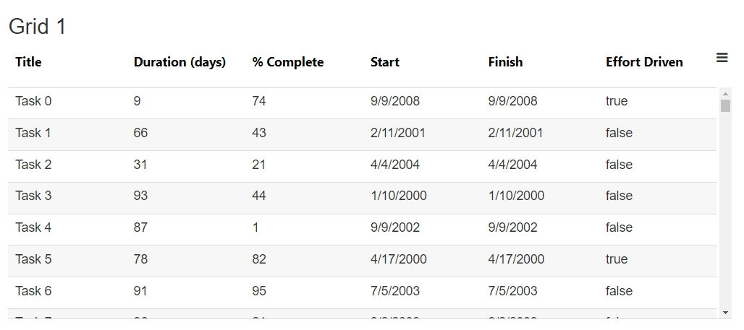
Basic Grid demo

Slide 5
GraphQL API, Grid State & Presets
export class BasicGridExample {
columnDefinitions: Column[];
gridOptions: GridOption;
dataset: any[];
constructor() {
this.defineGrid();
}
definedGrid(): void {
this.columnDefinitions = [ /*...*/ ];
this.gridOptions = {
pagination: { pageSizes: [10, 25, 50, 75, 100], pageSize: defaultPageSize, totalItems: 0 },
presets: {
filters: [
{ columnId: 'gender', searchTerms: ['male'], operator: OperatorType.equal },
{ columnId: 'name', searchTerms: ['John Doe'], operator: OperatorType.contains },
{ columnId: 'company', searchTerms: ['xyz'], operator: 'IN’ }
],
sorters: [
{ columnId: 'name', direction: 'asc' },
{ columnId: 'company', direction: SortDirection.DESC }
],
pagination: { pageNumber: 2, pageSize: 20 }
},
backendServiceApi: {
service: new GraphqlService(),
options: {
columnDefinitions: this.columnDefinitions,
datasetName: 'users’
},
preProcess: () => this.displaySpinner(true),
process: (query) => this.getCustomerApiCall(query),
postProcess: (result: GraphqlResult) => this.displaySpinner(false),
}
}
}
Auto-generate GraphQL query string
Load Presets & Grid State
Can use Grid State with Local Storage
Demo on next slide

Slide 6
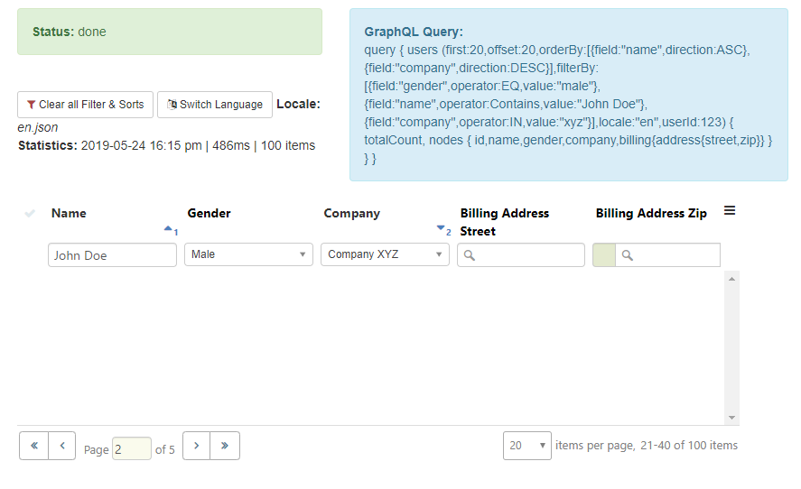
GraphQL with Presets demo * here we are only showing GraphQL query string for demo purposes

Slide 7
Global Options (Wiki)
To change default options globally (used by all grids), you can use the plugin config
export function configure(aurelia: Aurelia) config => {
aurelia.use.plugin(PLATFORM.moduleName('aurelia-slickgrid'), config => {
// change any of the default global grid options
config.options.gridMenu.iconCssClass = 'fa fa-bars’;
config.options.enableAutoResize = true;
config.options.autoResize: {
containerId: 'grid-container',
sidePadding: 15
};
config.options.enableFiltering = true;
});
});

Slide 8
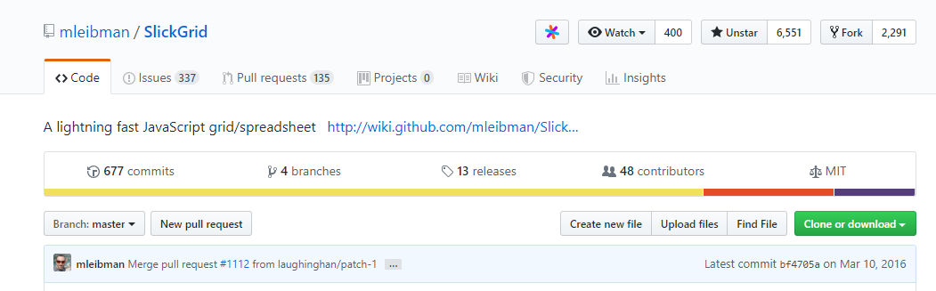
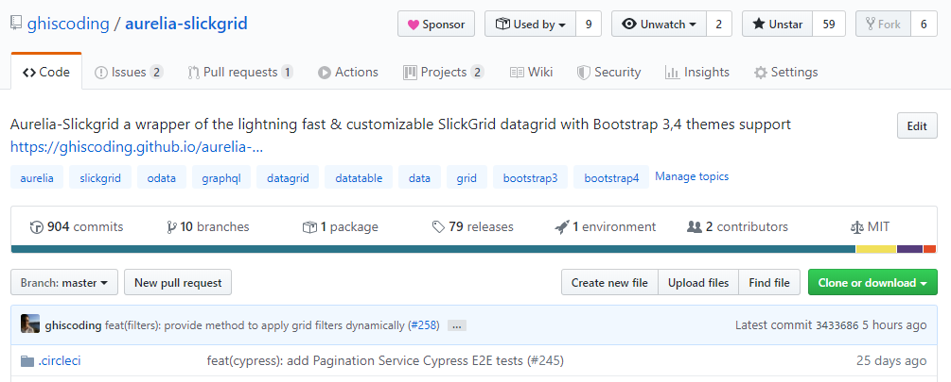
GitHub Open Source
Downloads of 9k/year, 900+ commits, 60+ stars, 75+ releases, 2200+ unit tests
One major contributor
Wrapper of SlickGrid core

Slide 9







Open Source Tools to Build & Tests
Continuous Integration with CircleCI
runs Jest unit tests & upload test coverage to CodeCov (even on PRs)
also runs Cypress E2E tests

Slide 10
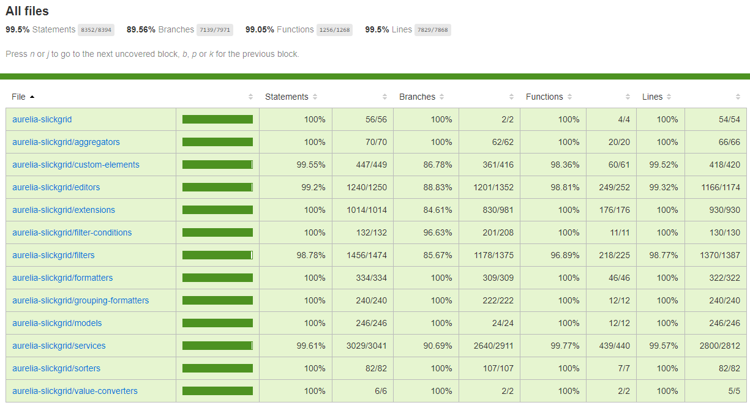

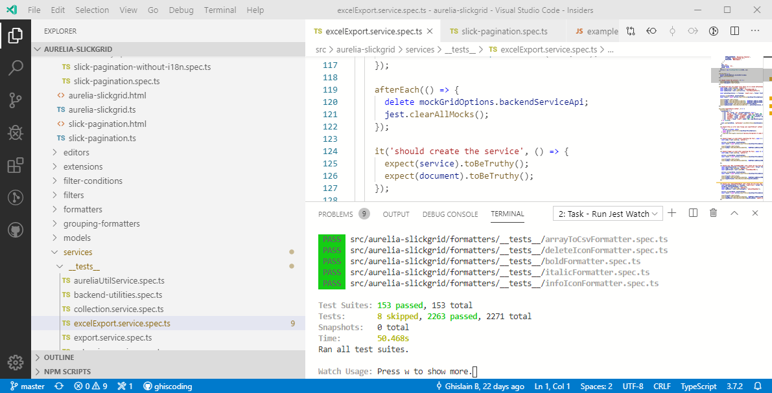

Integration & Unit Tests

Slide 11
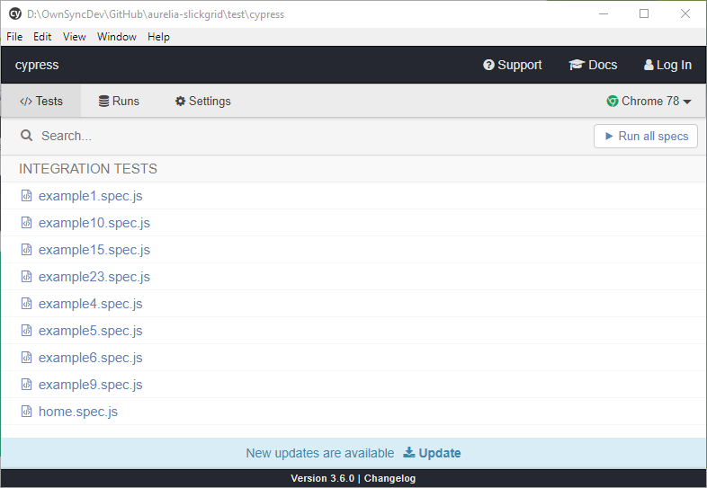
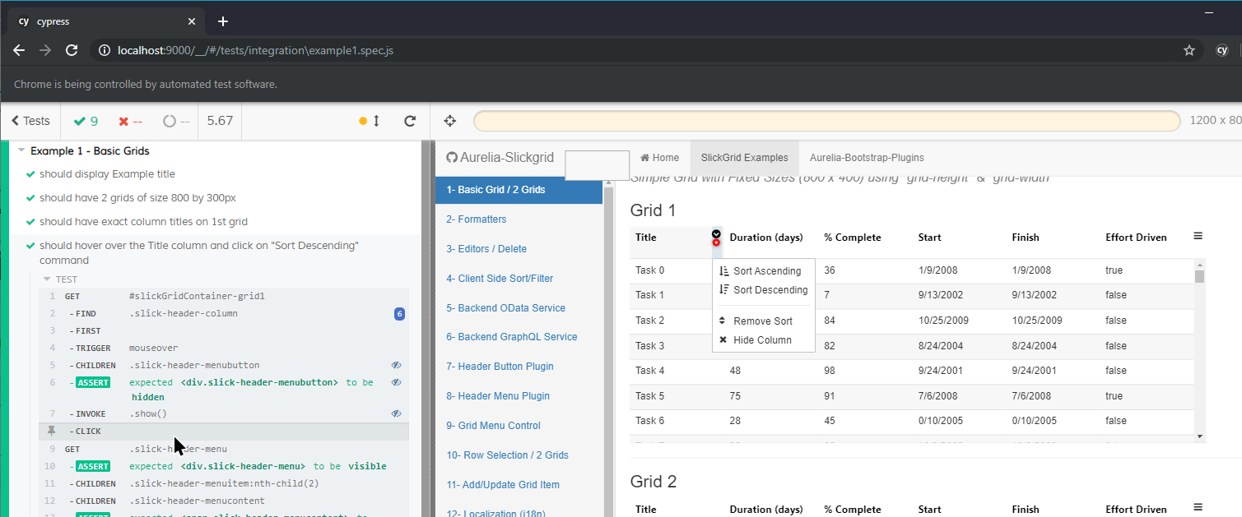
E2E Tests with

Slide 12
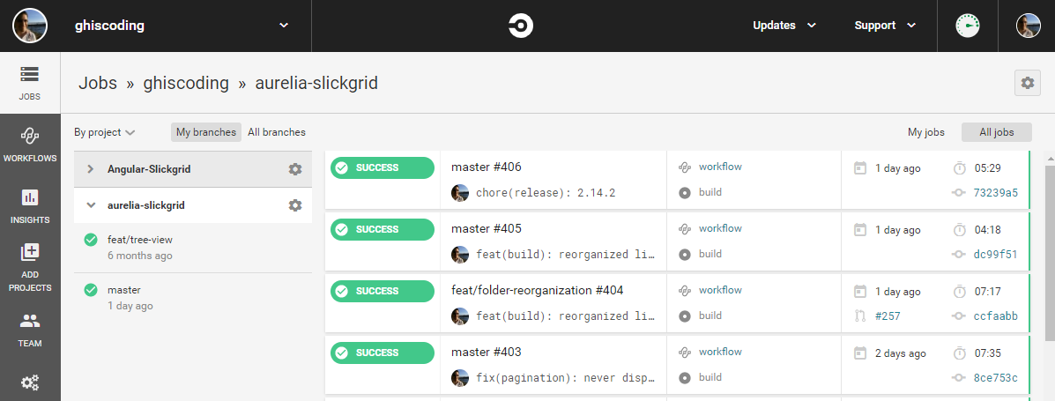
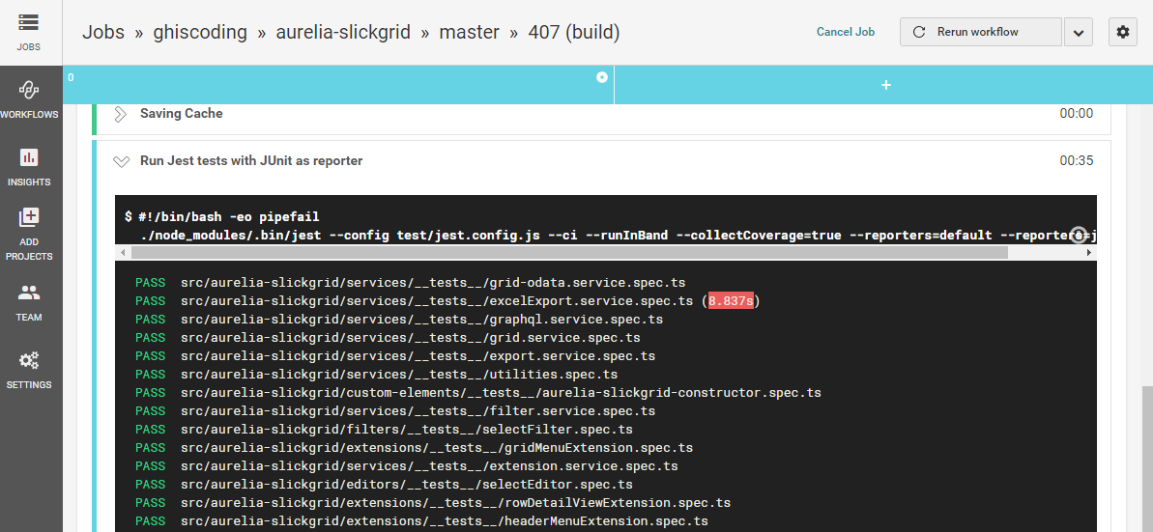
CI Builds

Slide 13
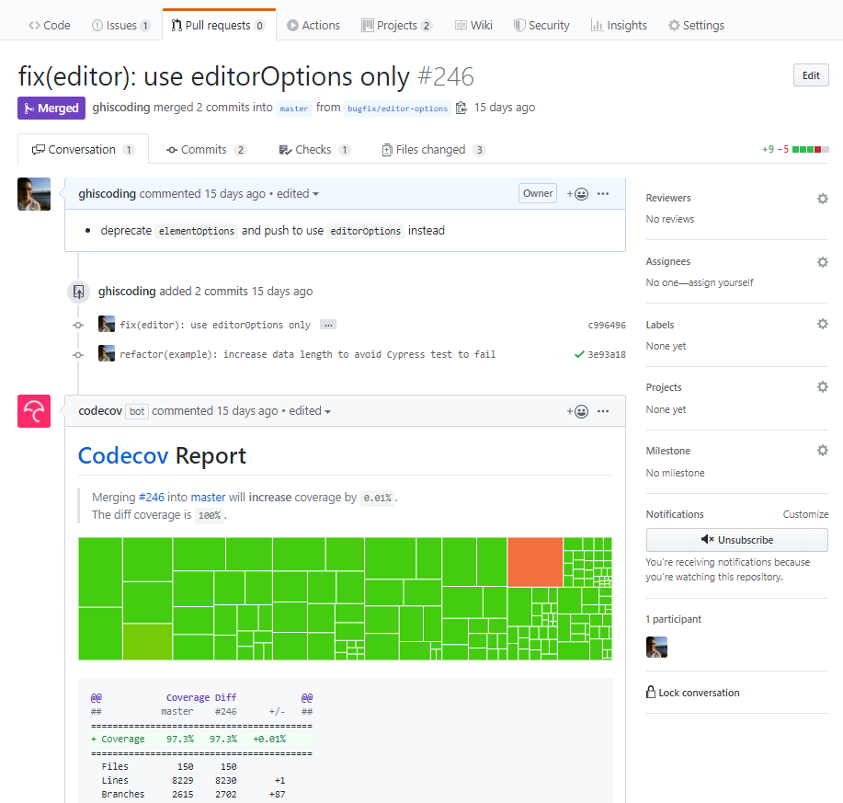

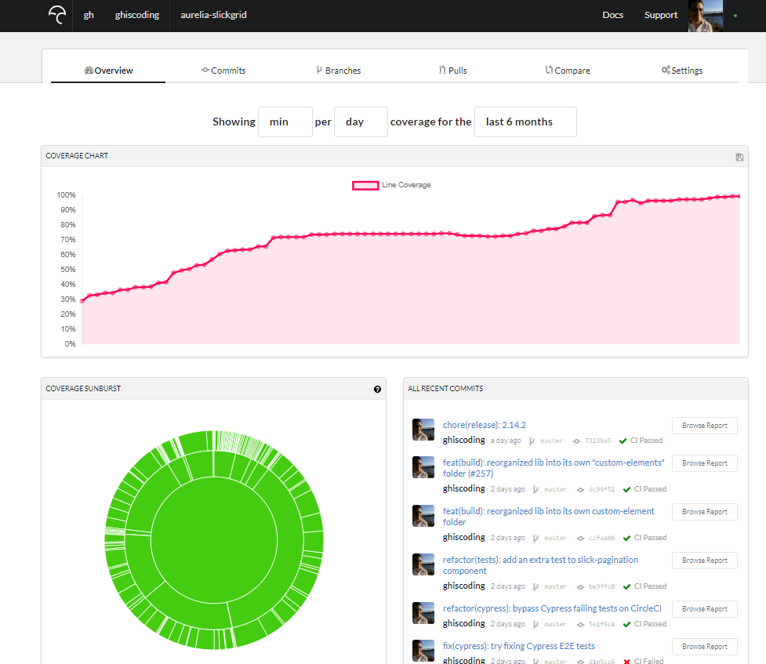

Test Code Coverage with

Slide 14
SASS Styling Bootstrap centric theme, but Material is doable
Over 300 SASS variables
/* Aurelia-Slickgrid SASS styling */
$checkbox-selector-color: darken($primary-color, 15%);
$pagination-icon-color: lighten($second-color, 15%);
$row-selected-color: #BEE2C5;
$row-highlight-background-color: darken($row-selected-color, 8%);
$row-mouse-hover-color: lighten($row-selected-color, 10%);
$multiselect-icon-color: darken($primary-color, 12%);
$multiselect-dropdown-max-width: 450px;
$multiselect-checkbox-hover-bg-color: lighten($row-mouse-hover-color, 2%);
$viewport-border-top: 2px solid #399600;
$header-row-count: 2;
$text-editor-border: rgb(212, 212, 212) 1px solid;
@import '../node_modules/aurelia-slickgrid/dist/styles/sass/slickgrid-theme-bootstrap.scss';
Demo on next slide

Slide 15
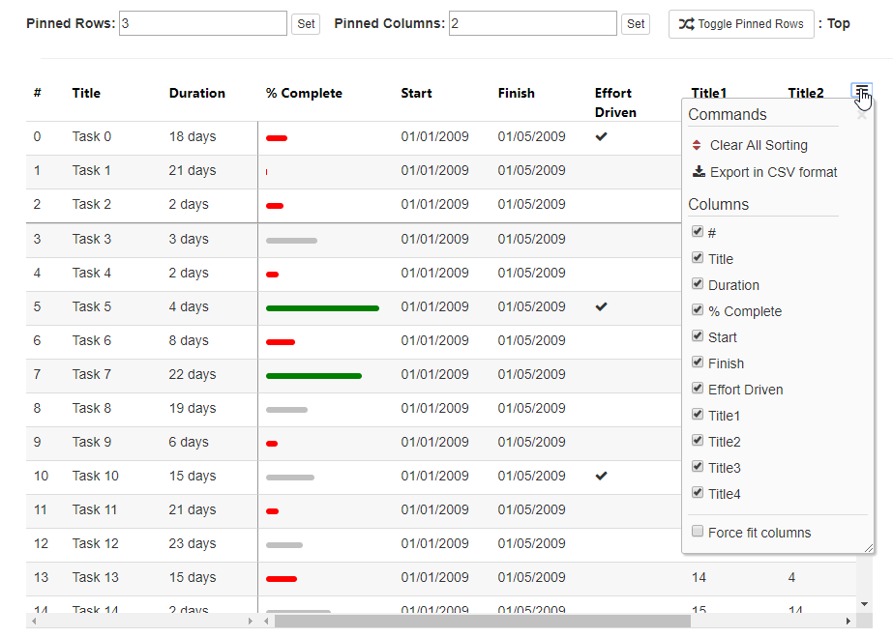
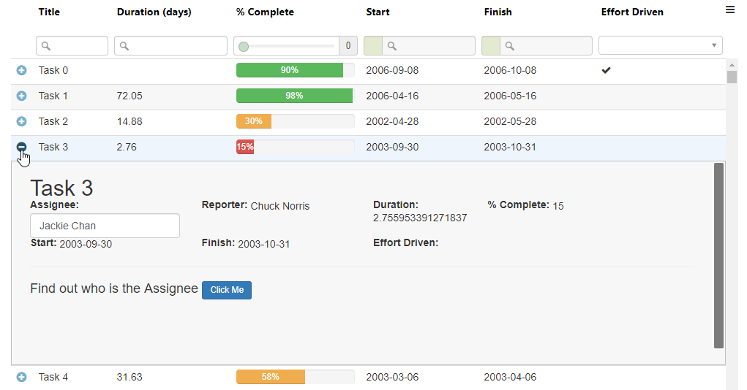
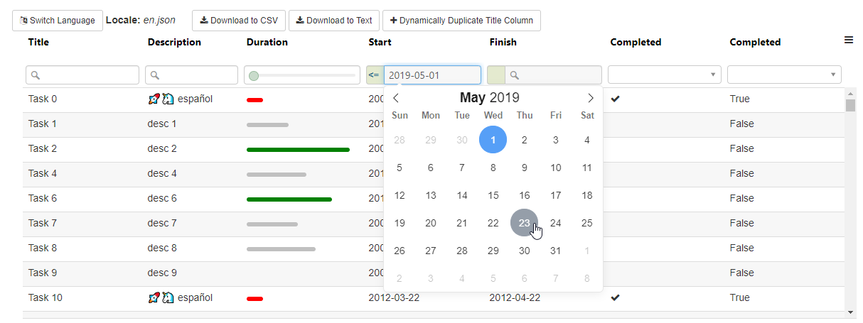
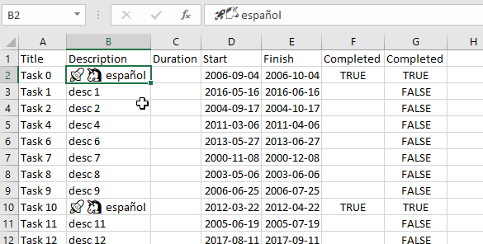
Lots of Live Demos (on GitHub)

Slide 16
Links & Wiki Documentation
Aurelia-Slickgrid Library
GitHub
NPM
Wiki (documentation)
HOW TO – Step by Step
Demos
Bootstrap 3
Bootstrap 4
Lots of Component demos
Code
Thank You!

