Slide 1

Genomics Innovation: Shifting the Paradigm
Rob Elshire
MapNet
28th October 2015

Slide 2
Innovate: to introduce something new.
Paradigm: example or pattern, archetype.

Slide 3
Rate of Change in Genomics Era
Embrace the change!

Slide 4
A new scientific truth does not triumph by convincing its opponents and making them see the light, but rather because its opponents eventually die, and a new generation grows up that is familiar with it.
--Max Planck

Slide 5
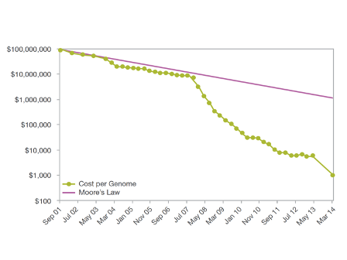
Rate of Change
Moore's law (published in 1965) is the observation that the number of transistors in a dense integrated circuit doubles approximately every two years. (Wikipedia)

Slide 6
18th Century Incentives
United States patent law is authorized by the U.S. Constitution. Article One, section 8, clause 8 states:
The Congress shall have power ... To promote the progress of science and useful arts, by securing for limited times to authors and inventors the exclusive right to their respective writings and discoveries;
In the 18th century, there was a need to move brains to the U.S. Legal mechanisms were designed to do this. See further link below.
Eben Moglen on Origins of Copyrights and Patents

Slide 7
18th Century Law in 2015
Then
Now
Steady and low rate of change
Incentivise inventors by giving them exclusive rights for 20 years.
Patents provide information for next round of inventors
Rapid increase in rate of change
Incentivise inventors by giving them exclusive rights for 20 years.
Information could be obsolete well before patent expires

Slide 8
Genomics Context
Something like GBS was the next logical thing to try.
The components of GBS were well known.
Utility of GBS will last much less than 20 years.
Therefore to maximise the utility of the method, it needs to be made freely available.

Slide 9
Collaborative Improvements
A GNU way of working

Slide 10
Software Tools
Sample Tracking
Quality control metrics
Automation
Reproducibility
Downstream analyses

Slide 11
Information
Species specific data
How many SNPs
Level of Multiplexing
Software configurations / versions
Best practices guides
Lab trouble shooting guides

Slide 12
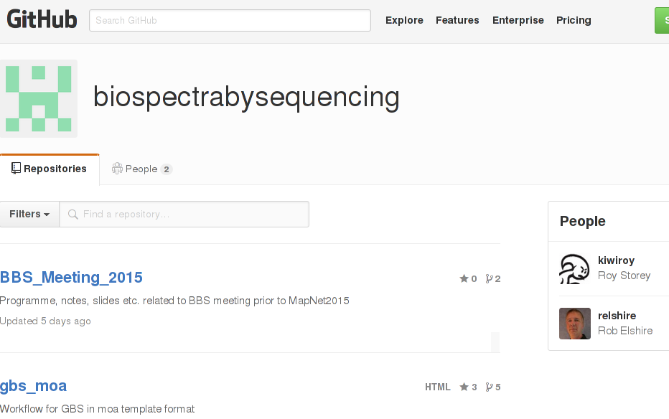
Biospectra by Sequencing

Slide 13
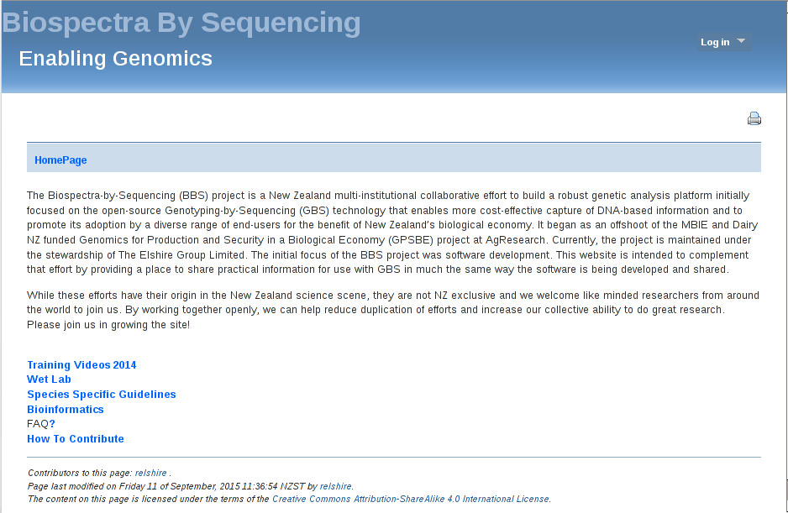
Biospectra by Sequencing

Slide 14
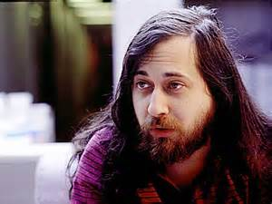

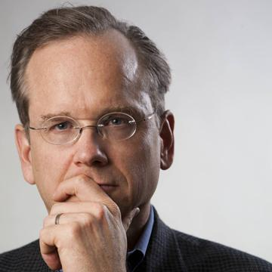

Repurposing 18th Century Law
Richard Stallman
President Free Software Foundation
Copyleft
GNU Project (1984)
Lawrence Lessig
Harvard Law Professor
Creative Commons 2001

Slide 15
Embodiment of the Method
Incremental improvement.
Free Software licenses and tools encourage improvement and sharing of improved versions.
Creative Commons licenses do similar things of non-software creative works.

Slide 16
Working Together
The tasks require multi-disciplinary teams
GitHub and Wikis provide mechanisms for giving credit as well as do the work
FLOSS and CC licensing are necessary
FLOSS and CC licensing are not sufficient

Slide 17
Not Sorted Yet
Some BBS contributors have jobs.
Employers hold copyright on the work of employees.
If employer removes the work from an integrated software program, then it falls over.
Is there a way to prevent that from happening?

Slide 18



Contributor Agreements
http://contributoragreements.org

Slide 19
Take Home
The way we work needs to keep pace with the rate of change
18th Century IP laws are not fit for purpose in the Genomic Era
Mechanisms have been developed to counter the deficiencies
We are working to get those mechanisms inside the square

Slide 20
Thanks to:
Contributors to Science that made my work possible.
My former colleagues in the Buckler Lab.
The many great scientists I’ve had the pleasure of working with.
The FLOSS Community.

Slide 21

More About BBS
http://biospectrabysequencing.org

