Slide 1
Aurelien Bouvier
PyVisage: an image analysis package

Slide 2
Outline
Overview
Installation
Code high-level architecture
Modules description
Tutorials
Useful commands
Upcoming improvements

Slide 3
Overview 1
Goal: build a modular package for Image processing/analysis intended for efficient sensor characterization
Python advantages:
Free and open source
High level
Simple and elegant object-oriented programming
Coding is fast thanks to zillions of available modules to help you perform specific tasks
In particular, powerful matrix/scientific modules available
Compact programs that are highly readable
PyVisage heavily uses the following python modules:
numpy
scipy
matplotlib

Slide 4
Overview 2
Software has been written in a modular fashion to simplify maintenance and future development
Current package size: ~2,000 lines
Package is at a reasonable development stage to permit other users to use it and develop further functionalities

Slide 5
Installation
Minimum packages needed: python2.7, numpy, matplotlib
A python environment that I like a lot is Enthought Canopy which can be downloaded from:
www.enthought.com/downloads/
comes pre-installed with all major python modules (numpy, scipy,matplotlib) + Ipython
Mercurial repository:
\\INVCA-storage\Users\abouvier\PROGRAMS\PyVisage
Run following command in main directory:
python setup.py install

Slide 6

Code architecture
DarkCurrent
PhotonTransfer
Crosstalk
ReadNoise
PlotTools
Measurement
ImageArray
Image

Slide 7
Image.py
Handles single image operations
Image arithmetic (ex: dark subtraction)
ROI
Column swapping
RTN/FPN corrections
Channel grouping
Plotting
2D image
histograms
profiles
PlotTools
Measurement
ImageArray
Image

Slide 8
ImageArray.py
Handles array of images
Group operations on all images (calling Image module)
Image averaging
Image merging
PlotTools
Measurement
ImageArray
Image

Slide 9
Measurement.py
Handles analysis of parameter scan
Batch post-processing
Calculation of response, noise vs parameter scanned
Results plotting
High level modules (ReadNoise.py, Crosstalk.py, PhotonTransfert.py) all inherit directly from this module
PlotTools
Measurement
ImageArray
Image

Slide 10
PlotTools.py
Provides plotting related functions
PlotTools
Measurement
ImageArray
Image

Slide 11
Image tutorial – dark subtraction
import Image
raw_bright = 'Q8A643w20#44R_Red//Bright_-0.8//image_0.raw'
raw_dark = 'Q8A643w20#44R_Red//Dark_-0.8//image_0.raw'
im_bright = Image.Image(raw_bright)
im_dark = Image.Image(raw_dark)
im_bright.info() # optional
# Dark subtraction
im_bright.subtract(im_dark)
im_bright.plot_image(bsave=True,filename='image_darksubtracted.png')
im_bright.plot_histogram(bsave=True,filename='hist_darksubtracted.png')

Slide 12
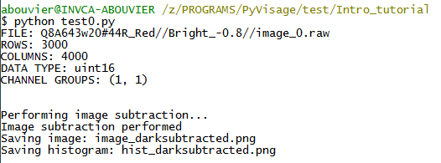
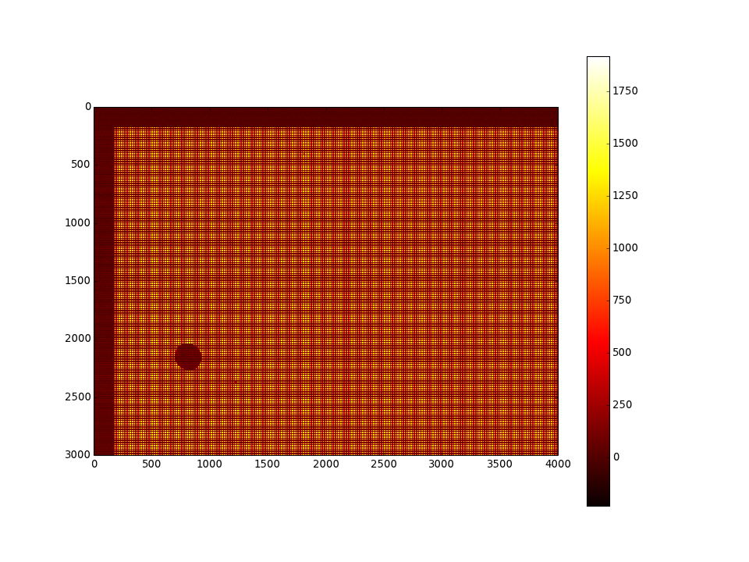
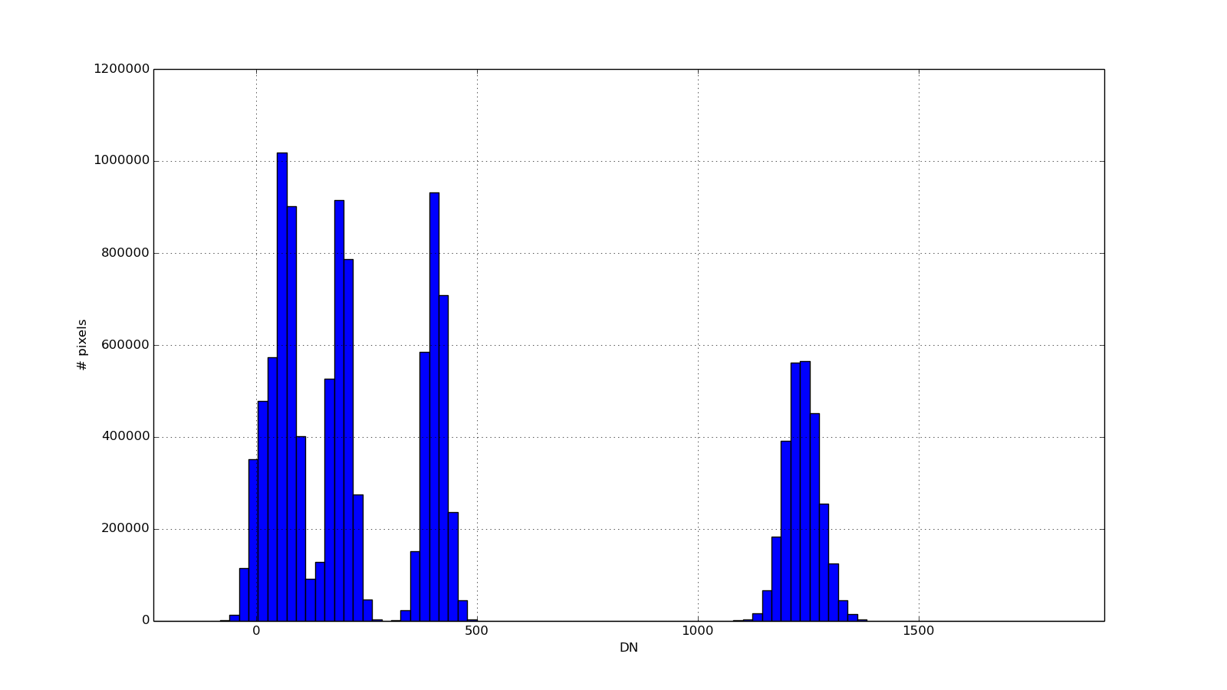
Image tutorial – dark subtraction

Slide 13
Image tutorial – ROI + channel splitting
import Image
raw_bright = 'Q8A643w20#44R_Red//Bright_-0.8//image_0.raw'
raw_dark = 'Q8A643w20#44R_Red//Dark_-0.8//image_0.raw'
im_bright = Image.Image(raw_bright)
im_dark = Image.Image(raw_dark)
# Dark subtraction
im_bright.subtract(im_dark)
# Channel grouping
im_bright.set_channel_groups((2,2))
# Set ROI in Bayer region
im_bright.set_ROI(2000,2300,1000,1300) # bayer
im_bright.plot_image(bstack=True,bsave=True,filename='image_darksubtracted_roi_channelsplit.png')
im_bright.plot_histogram(bsave=True,filename='hist_darksubtracted_roi_channelsplit.png')
print "horizontal xtalk = %.1f%%"%(Median[1]/Median[0]*100)
print "vertical xtalk = %.1f%%"%(Median[2]/Median[0]*100)

Slide 14
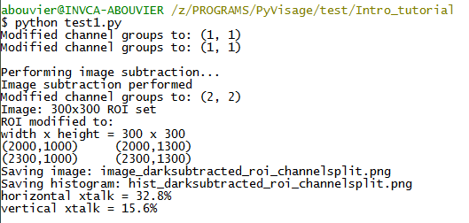
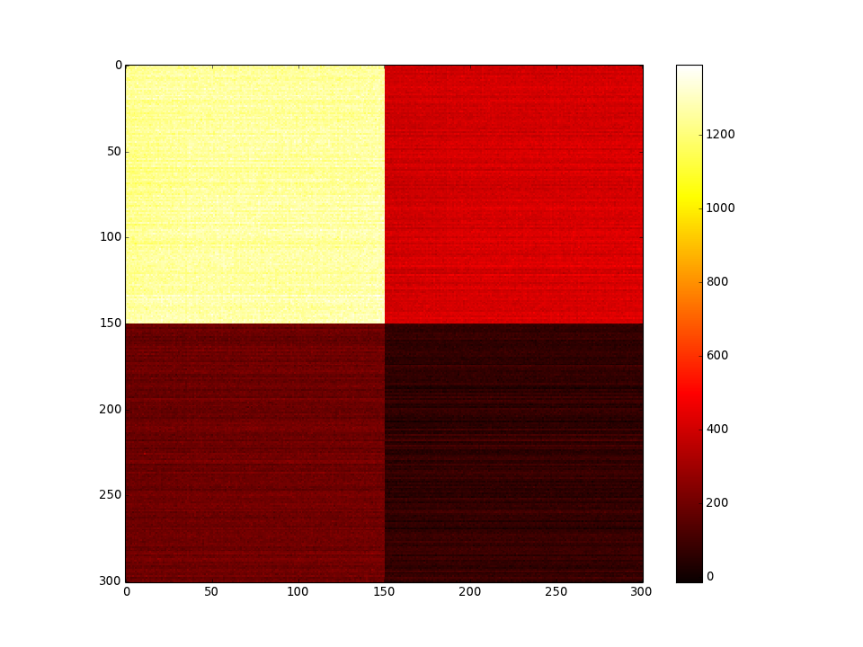
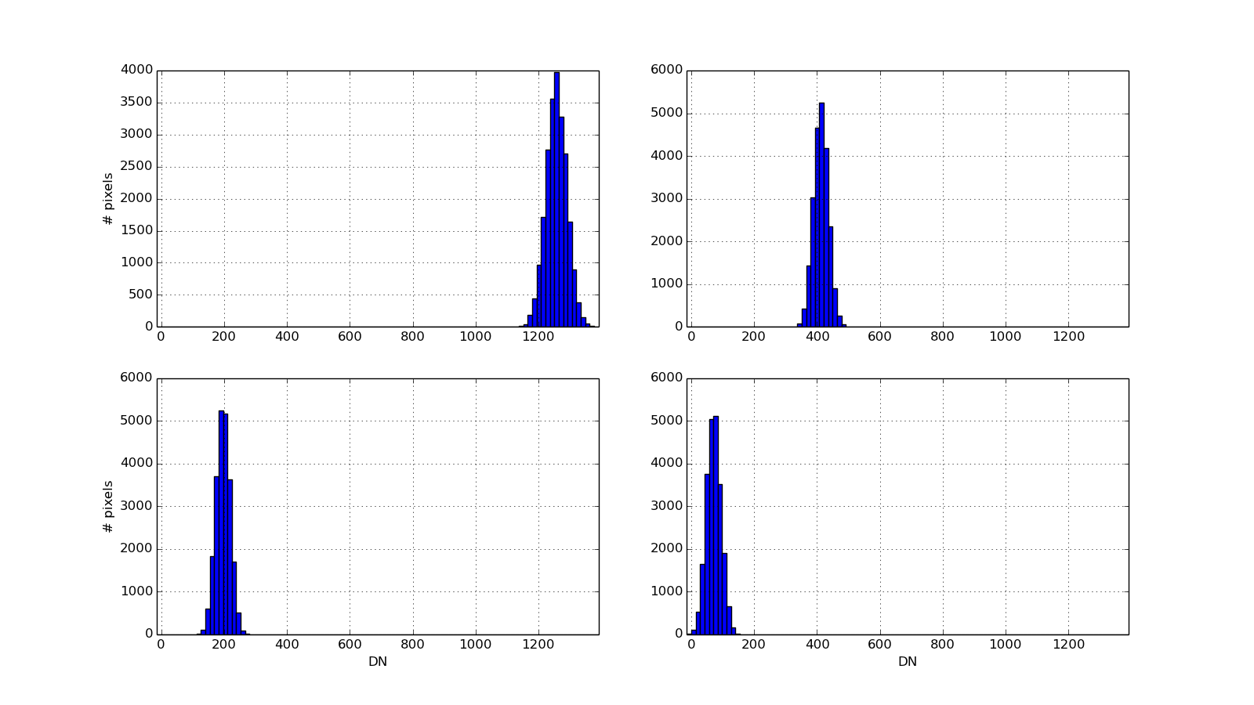
Image tutorial – ROI + channel splitting

Slide 15
Image tutorial – RTN correction
import Image
raw_bright = 'Q8A643w20#44R_Red//Bright_-0.8//image_0.raw'
raw_dark = 'Q8A643w20#44R_Red//Dark_-0.8//image_0.raw'
im_bright = Image.Image(raw_bright)
im_dark = Image.Image(raw_dark)
# Dark subtraction
im_bright.subtract(im_dark)
# 2x2 channel grouping
im_bright.set_channel_groups((2,2))
# Set ROI in Bayer region
im_bright.set_ROI(2000,2300,1000,1300) # bayer
# RTN correction
im_bright.RTN_correction() # default columns used: 4-67
im_bright.plot_image(bstack=True,bsave=True,filename='image_darksubtracted_roi_channelsplit_rtncorr.png')
im_bright.plot_histogram(bsave=True,filename='hist_darksubtracted_roi_channelsplit_rtncorr.png')

Slide 16
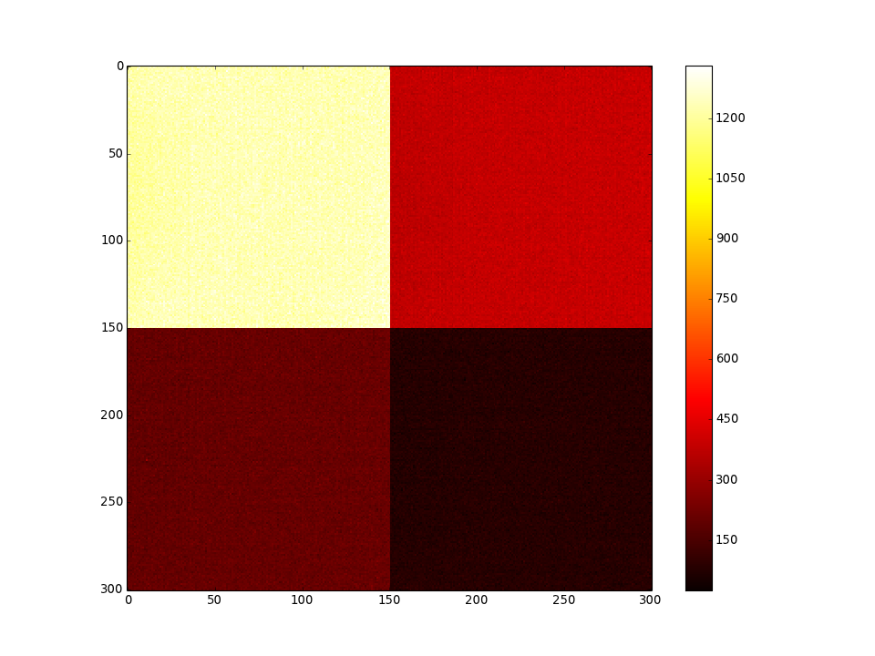
Image tutorial – RTN correction
Without RTN correction
With RTN correction
Note: RTN correction is performed on the whole image (not ROI only)

Slide 17
Useful Image.py methods (1)
info()
set_ROI(rowstart, rowstop, colstart, colstop)
set_center_ROI(roi_dim)
infoROI()
set_channel_groups(channel_groups)
get_array(i_channel_group=None, bstack=False)
get_image_channelsplit()
get_image_channel(i_channel_group)
subtract(image)
divide(image)
multiply(constant)

Slide 18
Useful Image.py methods (2)
get_median()
get_median_channel_groups():
get_rms(minval=None,maxval=None)
get_rms_channel_groups(bfit=False,nbins=100,Nsigma=3)
column_swap()
FPN_correction(bswap=True, rowstart=0, rowstop=64, target=None)
RTN_correction(bswap=True, colstart=4, colstop=67, target=None, boddeven=False, bsave=False, filename=None)
plot_histogram(channel,xmin, xmax, nbins, blog, figsize, bsave, filename, title, xlabel, ylabel):
plot_image(bstack, minval, maxval, figsize, bsave, filename, title=, bfullresolution)
plot_profile(axis=0, bsave, filename,title=, xlabel, ylabel)

Slide 19
Useful Image.py methods (3)
save2raw(filename)
save2csv(csvfilename,bverbose)

Slide 20
ImageArray tutorial
import glob
import ImageArray
file_darks = 'Intro_tutorial\\Q8A636w14#25-D_greenL\\Dark\\DarkImage_*.raw'
raw_images = glob.glob(file_darks)
im_arr = ImageArray.ImageArray(raw_images[:3])
# Average image of all images contained inside im_arr
im_avg = im_arr.average()
#im_avg.plot_image()
import Image
im_ref = Image.Image('Q8A636w14#25-D_greenL\\Dark\\DarkImage_5.raw')
# Perform batch dark subtraction
im_arr.subtract(im_ref)
#im_arr[1].plot_image()
im_arr[1].plot_histogram(xmin=-100,xmax=+100)
print im_arr.Images[1].get_rms()

Slide 21
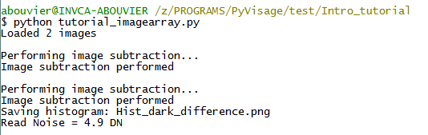
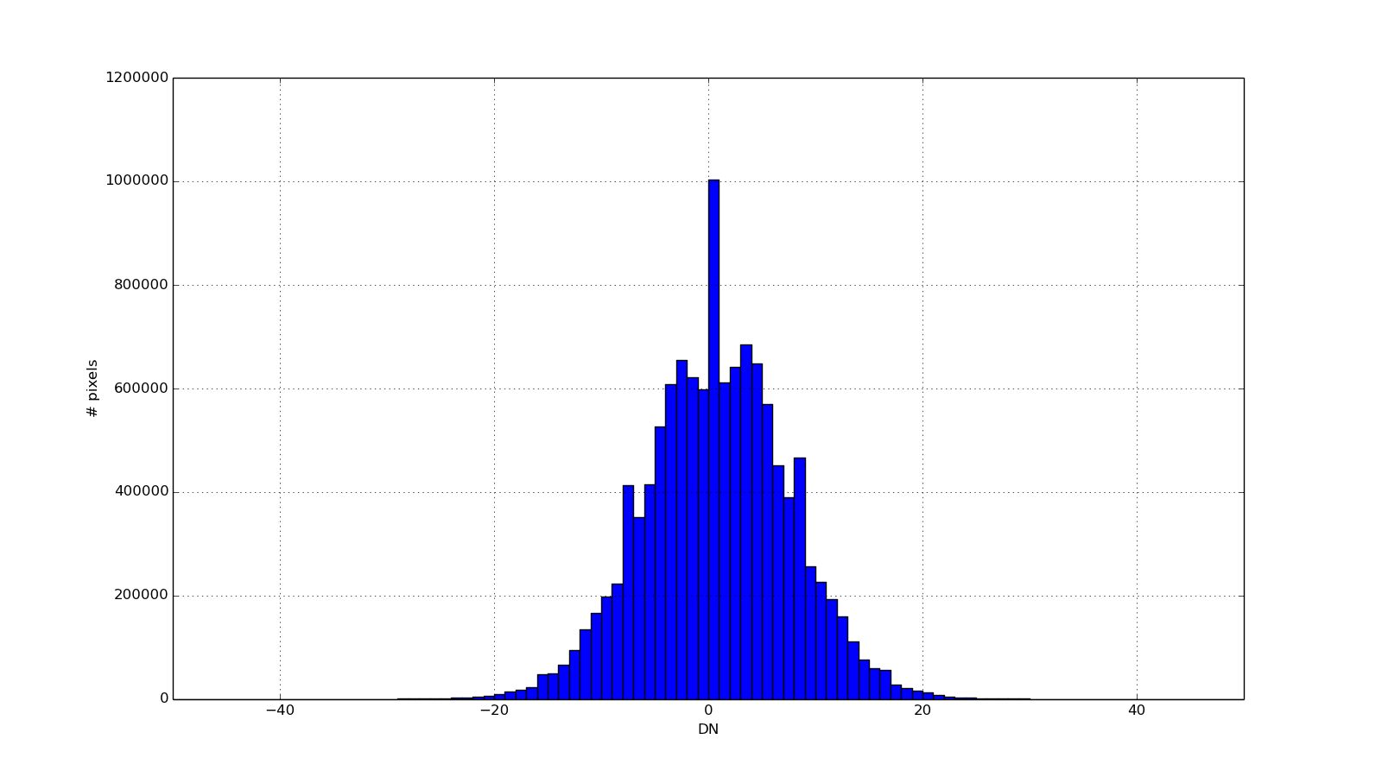
ImageArray tutorial

Slide 22
Useful ImageArray.py methods
set_ROI(rowstart, rowstop, colstart, colstop)
set_center_ROI(roi_dim)
subtract(ref_image)
average()
column_swap()
combine(shape)

Slide 23
Upcoming improvements
Revision control: Mercurial
Get more people familiar with the software and participating to its development
Expand ImageArray.py capabilities
Consolidate Measurement.py module
Improve comments inside the code for better readability
Build User Interface:
Menu driven inteface
GUI driven interface
Data acquisition:
Interface with qView3
Build data acquisition module

