Slide 1
MHW Api Project Sprint #2 Review & Retrospective
Sprint objective

Slide 2
Agenda
Introduction
Sprint #2 Objectives
Sprint #2 User Stories
Sprint#2 Demo
Sprint #2 Indicators
Sprint #2 Retrospective

Slide 3
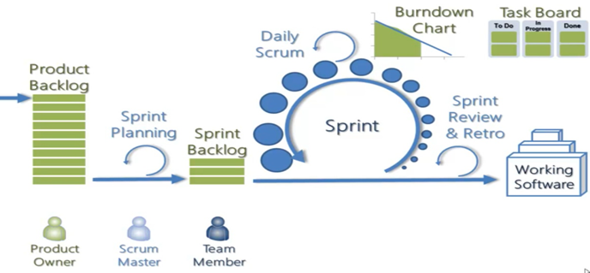
Introduction
Duration: W14-15-16 Avril 2019
Sprint duration : 8h => 1 sprint
Sprint 0
W6 2019
Sprint 1
Sprint 2
W6-7 2019
W14-15-16 2019

Slide 4




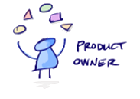
1. Introduction – Organisation
SCRUM Master :
Florian COMBAREL : Scrum Master
Stakeholders & Keys users:
Monster hunter world players
Dev Team:
Nicolas LEJEUNE
Solen PENSEL
Alex JACQUOT
Aurélien THOMAS
Jonathan FERNANDO-JOHNSON
Product Owner
Anas ABOUZAHRA

Slide 5
Agenda
Introduction
Sprint #2 Objectives
Sprint #2 User Stories
Sprint#2 Demo
Sprint #2 Indicators
Sprint #2 Retrospective

Slide 6
2. Sprint #2 Objectives
Obtenir un prototype fonctionnel avec un minimum de fonctionnalités implémentées afin d’avoir un bref aperçu de l’utilisation de l’application.
Une meilleure organisation était attendu pour ce sprint et des avancées par rapport au sprint 1.

Slide 7
Agenda
Introduction
Sprint #1 Objectives
Sprint #1 User Stories
Sprint#1 Demo
Sprint #1 Indicators
Sprint #1 Retrospective

Slide 8
3. Sprint #2 User Stories
Sprint #1 objectives
As an user I want to access a list of all the armor of the game
As an user I want to navigate in the application through an interface
As an user I want to access a list of all the skills of the game

Slide 9
Agenda
Introduction
Sprint #2 Objectives
Sprint #2 User Stories
Sprint#2 Demo
Sprint #2 Indicators
Sprint #2 Retrospective

Slide 10

4. Sprint #2 Demo

Slide 11
Agenda
Introduction
Sprint #2 Objectives
Sprint #2 User Stories
Sprint#2 Demo
Sprint #2 Indicators
Sprint #2 Retrospective

Slide 12
5. Sprint #2 Indicators

Slide 13
Agenda
Introduction
Sprint #2 Objectives
Sprint #2 User Stories
Sprint#2 Demo
Sprint #2 Indicators
Sprint #2 Retrospective

Slide 14
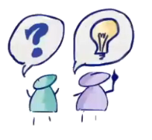



6. Sprint #2 Retrospective
Problems seen by the users
Problems seen by the PO
Problems seen by the SM
Problems seen by the Dev Team

Slide 15


