Slide 1
MHW Api Project Sprint #1 Review & Retrospective
Sprint objective

Slide 2
Agenda
Introduction
Sprint #1 Objectives
Sprint #1 User Stories
Sprint#1 Demo
Sprint #1 Indicators
Sprint #1 Retrospective

Slide 3
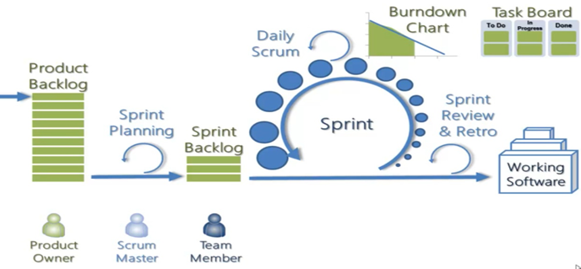
Introduction
Duration: W6-7 Février 2019
Sprint duration : 12h => 1 sprint
Sprint 0
W6 2019
Sprint 1
W6-7 2019

Slide 4




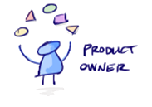
1. Introduction – Organisation
SCRUM Master :
Florian COMBAREL : Scrum Master
Stakeholders & Keys users:
Monster hunter world players
Dev Team:
Nicolas LEJEUNE
Solen PENSEL
Alex JACQUOT
Aurélien THOMAS
Jonathan FERNANDO-JOHNSON
Product Owner
Anas ABOUZAHRA

Slide 5
Agenda
Introduction
Sprint #1 Objectives
Sprint #1 User Stories
Sprint#1 Demo
Sprint #1 Indicators
Sprint #1 Retrospective

Slide 6
2. Sprint #1 Objectives
Obtenir un prototype fonctionnel avec un minimum de fonctionnalités implémentées afin d’avoir un bref aperçu de l’utilisation de l’application.

Slide 7
Agenda
Introduction
Sprint #1 Objectives
Sprint #1 User Stories
Sprint#1 Demo
Sprint #1 Indicators
Sprint #1 Retrospective

Slide 8
3. Sprint #1 User Stories
Sprint #1 objectives
As an user I want to access a list of all the armor of the game
As an user I want to navigate in the application through an interface

Slide 9
Agenda
Introduction
Sprint #1 Objectives
Sprint #1 User Stories
Sprint#1 Demo
Sprint #1 Indicators
Sprint #1 Retrospective

Slide 10

4. Sprint #1 Demo

Slide 11
Agenda
Introduction
Sprint #1 Objectives
Sprint #1 User Stories
Sprint#1 Demo
Sprint #1 Indicators
Sprint #1 Retrospective

Slide 12
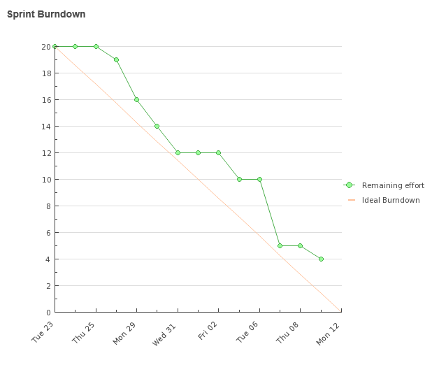
5. Sprint #1 Indicators -1-
Sprint Burndown

Slide 13
5. Sprint #1 Indicators -2-
Accuracy of estimation , Velocity , Code Quality ….

Slide 14
Agenda
Introduction
Sprint #1 Objectives
Sprint #1 User Stories
Sprint#1 Demo
Sprint #1 Indicators
Sprint #1 Retrospective

Slide 15

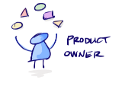


6. Sprint #1 Retrospective
Problems seen by the users
The application wasn’t running
Problems seen by the PO
Needs weren’t clear
Problems seen by the SM
Lack of understanding on the use of the DSL
Problems seen by the Dev Team
Bad organisation
Set up of the environment

Slide 16


