Slide 1

Link-State Routing
Reading: Sections 4.2 and 4.3.4
COS 461: Computer Networks
Spring 2008 (MW 1:30-2:50 in COS 105)
Jennifer Rexford
Teaching Assistants: Sunghwan Ihm and Yaping Zhu
http://www.cs.princeton.edu/courses/archive/spring08/cos461/

Slide 2
Goals of Today’s Lecture
Inside a router
  Control plane: routing protocols
  Data plane: packet forwarding
Path selection
  Minimum-hop and shortest-path routing
  Dijkstra’s algorithm
Topology change
  Using beacons to detect topology changes
  Propagating topology information
Routing protocol: Open Shortest Path First

Slide 3


What is Routing?
A famous quotation from RFC 791
  “A name indicates what we seek.
  An address indicates where it is.
  A route indicates how we get there.”
  -- Jon Postel

Slide 4
Routing vs. Forwarding
Routing: control plane
  Computing paths the packets will follow
  Routers talking amongst themselves
  Individual router creating a forwarding table
Forwarding: data plane
  Directing a data packet to an outgoing link
  Individual router using a forwarding table

Slide 5
Data and Control Planes
Processor
control plane
data plane
Switching
Fabric
Line card
Line card
Line card
Line card
Line card
Line card

Slide 6
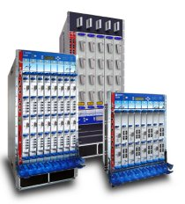
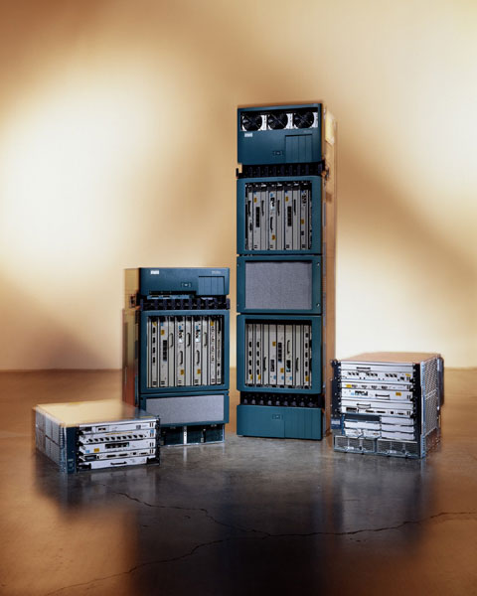
Router Physical Layout
Juniper T series
Switch
Linecards
Cisco 12000

Slide 7
Line Cards (Interface Cards, Adaptors)
Interfacing
  Physical link
  Switching fabric
Packet handling
  Packet forwarding
  Decrement time-to-live
  Buffer management
  Link scheduling
  Packet filtering
  Rate limiting
  Packet marking
  Measurement
to/from link
Receive
lookup
Transmit
to/from switch

Slide 8
Switching Fabric
Deliver packet inside the router
  From incoming interface to outgoing interface
  A small network in and of itself
Must operate very quickly
  Multiple packets going to same outgoing interface
  Switch scheduling to match inputs to outputs
Implementation techniques
  Bus, crossbar, interconnection network, …
  Running at a faster speed (e.g., 2X) than links
  Dividing variable-length packets into fixed-size cells

Slide 9
Packet Switching
“4”
Link 1, ingress
Choose
Egress
Link 1, egress
Link 2
Link 2, ingress
Choose
Egress
Link 2, egress
R1
“4”
Link 1
Link 3
Link 3, ingress
Choose
Egress
Link 3, egress
Link 4
Link 4, ingress
Choose
Egress
Link 4, egress

Slide 10
Router Processor
So-called “Loopback” interface
  IP address of the CPU on the router
Interface to network administrators
  Command-line interface for configuration
  Transmission of measurement statistics
Handling of special data packets
  Packets with IP options enabled
  Packets with expired Time-To-Live field
Control-plane software
  Implementation of the routing protocols
  Creation of forwarding table for the line cards

Slide 11
Where do Forwarding Tables Come From?
Routers have forwarding tables
  Map IP prefix to outgoing link(s)
Entries can be statically configured
  E.g., “map 12.34.158.0/24 to Serial0/0.1”
But, this doesn’t adapt
  To failures
  To new equipment
  To the need to balance load
That is where routing protocols come in

Slide 12
Computing Paths Between Routers
Routers need to know two things
  Which router to use to reach a destination prefix
  Which outgoing interface to use to reach that router
Today’s class: just how routers reach each other
  How u knows how to forward packets toward z
u
z
12.34.158.0/24
Interface along
the path to z
Router z that can
reach destination

Slide 13
Computing the Shortest Paths
(assuming you already know the topology)

Slide 14
Shortest-Path Routing
Path-selection model
  Destination-based
  Load-insensitive (e.g., static link weights)
  Minimum hop count or sum of link weights
2
3
1
1
4
2
1
5
4
3

Slide 15
Shortest-Path Problem
Given: network topology with link costs
  c(x,y): link cost from node x to node y
  Infinity if x and y are not direct neighbors
Compute: least-cost paths to all nodes
  From a given source u to all other nodes
  p(v): predecessor node along path from source to v
2
3
1
1
4
u
2
1
5
p(v)
4
3
v

Slide 16
Dijkstra’s Shortest-Path Algorithm
Iterative algorithm
  After k iterations, know least-cost path to k nodes
S: nodes whose least-cost path definitively known
  Initially, S = {u} where u is the source node
  Add one node to S in each iteration
D(v): current cost of path from source to node v
  Initially, D(v) = c(u,v) for all nodes v adjacent to u
  … and D(v) = ∞ for all other nodes v
  Continually update D(v) as shorter paths are learned

Slide 17
Dijsktra’s Algorithm
1 Initialization:
2 S = {u}
3 for all nodes v
4 if (v is adjacent to u)
5 D(v) = c(u,v)
6 else D(v) = ∞
7
8 Loop
9 find w not in S with the smallest D(w)
10 add w to S
11 update D(v) for all v adjacent to w and not in S:
12 D(v) = min{D(v), D(w) + c(w,v)}
13 until all nodes in S

Slide 18
Dijkstra’s Algorithm Example
2
2
3
1
3
1
1
1
4
4
2
1
2
1
5
5
4
3
4
3
2
2
3
1
3
1
1
1
4
4
2
1
2
1
5
5
4
3
4
3

Slide 19
Dijkstra’s Algorithm Example
2
2
3
1
3
1
1
1
4
4
2
1
2
1
5
5
4
3
4
3
2
2
3
1
3
1
1
1
4
4
2
1
2
1
5
5
4
3
4
3

Slide 20
Shortest-Path Tree
Shortest-path tree from u
Forwarding table at u
v
2
y
link
3
1
1
x
4
v
(u,v)
u
z
2
1
w
(u,w)
5
t
x
(u,w)
w
4
3
y
(u,v)
s
z
(u,v)
s
(u,w)
t
(u,w)

Slide 21
Learning the Topology
(by the routers talk amongst themselves)

Slide 22
Link-State Routing
Each router keeps track of its incident links
  Whether the link is up or down
  The cost on the link
Each router broadcasts the link state
  To give every router a complete view of the graph
Each router runs Dijkstra’s algorithm
  To compute the shortest paths
  … and construct the forwarding table
Example protocols
  Open Shortest Path First (OSPF)
  Intermediate System – Intermediate System (IS-IS)

Slide 23
Detecting Topology Changes
Beaconing
  Periodic “hello” messages in both directions
  Detect a failure after a few missed “hellos”
Performance trade-offs
  Detection speed
  Overhead on link bandwidth and CPU
  Likelihood of false detection
“hello”

Slide 24
Broadcasting the Link State
Flooding
  Node sends link-state information out its links
  And then the next node sends out all of its links
  … except the one where the information arrived
X
A
X
A
C
B
D
C
B
D
(a)
(b)
X
A
X
A
C
B
D
C
B
D
(c)
(d)

Slide 25
Broadcasting the Link State
Reliable flooding
  Ensure all nodes receive link-state information
  … and that they use the latest version
Challenges
  Packet loss
  Out-of-order arrival
Solutions
  Acknowledgments and retransmissions
  Sequence numbers
  Time-to-live for each packet

Slide 26
When to Initiate Flooding
Topology change
  Link or node failure
  Link or node recovery
Configuration change
  Link cost change
Periodically
  Refresh the link-state information
  Typically (say) 30 minutes
  Corrects for possible corruption of the data

Slide 27
When the Routers Disagree
(during transient periods)

Slide 28
Convergence
Getting consistent routing information to all nodes
  E.g., all nodes having the same link-state database
Consistent forwarding after convergence
  All nodes have the same link-state database
  All nodes forward packets on shortest paths
  The next router on the path forwards to the next hop
2
3
1
1
4
2
1
5
4
3

Slide 29

Transient Disruptions
Detection delay
  A node does not detect a failed link immediately
  … and forwards data packets into a “blackhole”
  Depends on timeout for detecting lost hellos
2
3
1
1
4
2
1
5
4
3

Slide 30
Transient Disruptions
Inconsistent link-state database
  Some routers know about failure before others
  The shortest paths are no longer consistent
  Can cause transient forwarding loops
2
2
3
1
3
1
1
1
4
4
2
1
2
1
5
4
3
4
3

Slide 31
Convergence Delay
Sources of convergence delay
  Detection latency
  Flooding of link-state information
  Shortest-path computation
  Creating the forwarding table
Performance during convergence period
  Lost packets due to blackholes and TTL expiry
  Looping packets consuming resources
  Out-of-order packets reaching the destination
Very bad for VoIP, online gaming, and video

Slide 32
Reducing Convergence Delay
Faster detection
  Smaller hello timers
  Link-layer technologies that can detect failures
Faster flooding
  Flooding immediately
  Sending link-state packets with high-priority
Faster computation
  Faster processors on the routers
  Incremental Dijkstra’s algorithm
Faster forwarding-table update
  Data structures supporting incremental updates

Slide 33
Scaling Link-State Routing
Overhead of link-state routing
  Flooding link-state packets throughout the network
  Running Dijkstra’s shortest-path algorithm
Introducing hierarchy through “areas”
Area 1
Area 2
Area 0
area
border
router
Area 3
Area 4

Slide 34
Conclusions
Routing is a distributed algorithm
  React to changes in the topology
  Compute the paths through the network
Shortest-path link state routing
  Flood link weights throughout the network
  Compute shortest paths as a sum of link weights
  Forward packets on next hop in the shortest path
Convergence process
  Changing from one topology to another
  Transient periods of inconsistency across routers

