Slide 1
Using and Building Internet Applications
Introduction

Slide 2
Overview
Growth of Computer Networking
Complexity in Networked Systems
Mastering the Complexity
Network Applications and Network Programming
Data Communications
Packet Switching & Networking Technologies
Internetworking with TCP/IP
Public/Private Internet
Networks, Interoperability and Standards
Protocol Suites and Layering Models

Slide 3
Growth of Computer Networking
Computer networking has grown explosively
Since the 1970s, computer communication has changed from a research topic to an essential part of infrastructure
Networking is used in every aspect of our lives:
  Business
  Advertising
  Production
  Shipping
  Planning
  Billing
  Accounting

Slide 4
Growth of Computer Networking
Educational institutions are using computer networks
  Provides students and teachers with access to online information
Federal, state, and local government offices use networks
Bottom line, computer networks are everywhere
The advent and utility of networking has created dramatic economic shifts
  Network has made telecommuting available to individuals
  It has changed business communication
  An entire industry emerged that develops networking technologies, products, and services
  The importance of computer networks has produced a demand in all industries for people with more networking expertise
  Companies need workers to plan, acquire, install, operate, and manage the hardware and software systems for networks

Slide 5
Complexity in Networked Systems
The networking subject seems complex, because
  Many technologies exist
  Each technology has features that distinguish it from the others
  Companies create commercial network products and services
    Often by using technologies in new unconventional ways
  Computer networks seem complex
    Technologies can be combined and interconnected in many ways

Slide 6
Complexity in Networked Systems
Computer networks can be especially confusing to a beginner because
  No single underlying theory exists that explains the relationship among all parts
  Multiple organizations have created computer networks standards
    Some standards are incompatible with others
  Various organizations have attempted to define conceptual models
  The set of technologies is diverse and changes rapidly
    Models are either so simplistic that they do not distinguish among details or so complex that they do not help simplify the subject

Slide 7
Complexity in Networked Systems
The lack of consistency in the field has produced another challenge for beginners:
  Multiple groups each attempt to create their own terminology
  Researchers cling to scientifically precise terminology
  Marketing teams often invent new terms to distinguish their products or services from others
  Technical terms are confused with the names of popular products
  Professionals sometimes use a technical term from one technology when referring to an analogous feature of another technology
  A large set of terms and acronyms that contains many synonyms
  Computer networking jargon contains terms that are often abbreviated, misused, or associated with products

Slide 8
Mastering the Complexity
To master the complexity, it is important to gain a broad background that includes five key aspects:
  Network Applications and Network Programming
  Data Communications
  Packet Switching and Networking Technologies
  Internetworking with TCP/IP
  Additional Networking Concepts and Technologies
These topics will be covered throughout the course

Slide 9
Network Applications and Network Programming
Network services are provided by an application software
  An application on one computer communicates across a network with an application program running on another computer
Network applications span a wide range, such as:
  email
  file transfer
  web browsing
  voice telephone calls (VoIP)
  distributed databases
  audio/video teleconferencing
Each application offers a specific service with its own form of user interface
  But all applications can communicate over a single, shared network

Slide 10
Network Applications and Network Programming
A unified underlying network that supports all applications makes a programmer's job much easier
  Programmer needs to learn about one interface to network and one basic set of functions to be used
  Possible to understand network applications, and even possible to write code that communicates over a network, without understanding the hardware/software technologies
  Once a programmer masters the interface, no further knowledge of networking may be needed
However, knowledge of the underlying network system allows a programmer to write better code and develop more efficient applications

Slide 11
Data Communications
Data communications refers to the study of low-level mechanisms and technologies used to send information across a physical communication medium
  Such as a wire, radio wave, or light beam
Data communications focuses on ways to use physical phenomena to transfer information
  The subject may only seem useful for engineers who design low-level transmission facilities
    However, we will see that several key concepts that arise from data communications influence the design of many protocol layers
Data communications provides a foundation of concepts
  On which the rest of networking is built

Slide 12
Packet Switching & Networking Technologies
In 1960s, the packet switching concept revolutionized data communications
Early communication networks had evolved from telegraph and telephone systems
  A physical pair of wires between two parties to form a dedicated circuit
Although mechanical connection of wires was being replaced by electronic switches, but the underlying paradigm remained the same:
  Form a circuit and then send information across the circuit
Packet switching changed networking in a fundamental way
  It provided the basis for the modern Internet
  Packet switching allows multiple users to share a network
  Packet switching divides data into small blocks, called packets
  It includes an identification of the intended recipient in each packet
  Devices throughout the network each have information about how to reach each possible destination

Slide 13
Packet Switching & Networking Technologies
Many designs for packet switching are possible
But there is a need for answers to basic questions:
  How should a destination be identified?
  How can a sender find the identification of a destination?
  How large should a packet be?
  How can a network recognize the end of one packet?
  How can a network recognize the beginning of another packet?
  If a network is shared, then how can they coordinate to insure that each receives a fair opportunity to send?
  How can packet switching be adapted to wireless networks?
  How can network technologies be designed to meet various requirements for speed, distance, and economic cost?
Many packet switching technologies have been created
  To meet various requirements for speed, distance, and economic cost

Slide 14
Internetworking with TCP/IP
In the 1970s, another revolution in computer networks arose: Internet
In 1973, Vinton Cerf and Robert Kahn observed that
  No single packet switching technology would ever satisfy all needs
    Especially because it would be possible to build low-capacity technologies for homes or offices at extremely low cost
They suggested to stop trying to find a single best solution
  Instead, explore interconnecting many packet switching technologies into a functioning whole
  They proposed a set of standards be developed for such an interconnection
  The resulting standards became known as the TCP/IP Internet Protocol Suite (usually abbreviated TCP/IP)
The success of TCP/IP lies in its tolerance of heterogeneity
TCP / IP takes a virtualization approach
  Defines a network-independent packet and a network-independent identification scheme

Slide 15
Public/Private Internet
The Internet consists of parts that are owned and operated by individuals or organizations
From ownership point of view, we can categorize networks
  Public Networks
  Private Networks
A public network is run as a service that is available to subscribers
  Any individual or corporation who pays the subscription fee can use
  A company that offers service is known as a service provider
  Public refers to the general availability of service, not to the data being transferred
A private network is controlled by one particular group
  Network use is restricted to one group
  A private network can include circuits leased from a provider

Slide 16
Networks, Interoperability and Standards
Communication always involves at least two entities
  One that sends information and another that receives it
All entities in a network must agree on how information will be represented and communicated
  Communication agreements involve many details
    The way that electrical signals are used to represent data
    Procedures used to initiate and conduct communication, and the format of messages
An important issue is interoperability
  Refers to the ability of two entities to communicate
All communicating parties agree on details and follow the same set of rules, an exact set of specifications
Communication protocol, network protocol, or simply protocol to refer to a specification for network communication
A protocol specifies the details for one aspect of communication
  Including actions to be taken when errors or unexpected situations arise

Slide 17
Protocol Suites and Layering Models
A set of protocols must be constructed
  Ensures that the resulting communication system is complete and efficient
Each protocol should handle a part of communication not handled by other protocols
How can we guarantee that protocols work well together?
  Instead of creating each protocol in isolation, protocols are designed in complete, cooperative sets called suites or families
Each protocol in a suite handles one aspect of networking
  The protocols in a suite cover all aspects of communication
  The entire suite is designed to allow the protocols to work together efficiently

Slide 18
Protocol Suites and Layering Models
The fundamental abstraction used to collect protocols into a unified whole is known as a layering model
All aspects of a communication problem can be partitioned into pieces that work together, known as a layer
Dividing protocols into layers helps both protocol designers and implementers manage the complexity
Later lectures will help us understand layering by explaining protocols in detail
For now, it is sufficient to learn the purpose of each layer and how protocols are used for communication

Slide 19
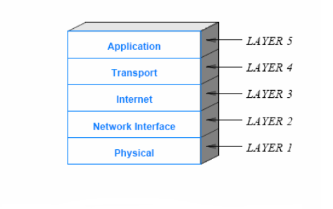
Protocol Suites and Layering Models
Layering model for TCP/IP

Slide 20
Protocol Suites and Layering Models
Physical Layer (Layer 1)
  Specify details about the underlying transmission medium and hardware
  Specifications related to electrical properties, radio frequencies, and signals belong in layer 1
Network Interface Layer (Layer 2)
  Also know as the Data Link Layer
  Specify details about communication between higher layers of protocols (implemented in SW) and the underlying network (implemented in hardware)
  specifications about
    network addresses
    maximum packet size that a network can support
    protocols used to access the underlying medium
    and hardware addressing

Slide 21
Protocol Suites and Layering Models
Internet Layer (Layer 3)
  Protocols in the Internet layer form the fundamental basis for the Internet
  Layer 3 protocols specify communication across the Internet (spanning multiple interconnected networks)
Transport Layer (Layer 4)
  Provide for communication from an application program on one computer to an application program on another
  Includes specifications on
    Controlling the maximum rate a receiver can accept data
    Mechanisms to avoid network congestion
    Techniques to insure that all data is received in the correct order

Slide 22
Protocol Suites and Layering Models
Application Layer (Layer 5)
  Specify how a pair of applications interact when they communicate
  Specify details about
    Format and the meaning of messages that applications can exchange
    Procedures to be followed
  Some examples of network applications in layer 5
    email exchange
    file transfer
    web browsing
    telephone services
    video teleconferencing

Slide 23
How Data Passes Through Layers
Protocol implementations follow the layering model
  Passes the output from a protocol in one layer to the input of a protocol in the next
To achieve efficiency
  rather than copy an entire packet
  a pair of protocols in adjacent layers pass a pointer to the packet
Each computer contains a set of layered protocols
  When an application sends data it is placed in a packet, and the packet passes down through each layer of protocols
  Once it has passed through all layers of protocols on the sending computer the packet leaves the computer and is transmitted across the physical network
  When it reaches the receiving computer the packet passes up through the layers of protocols
If the application on the receiver sends a response, the process is reversed

Slide 24
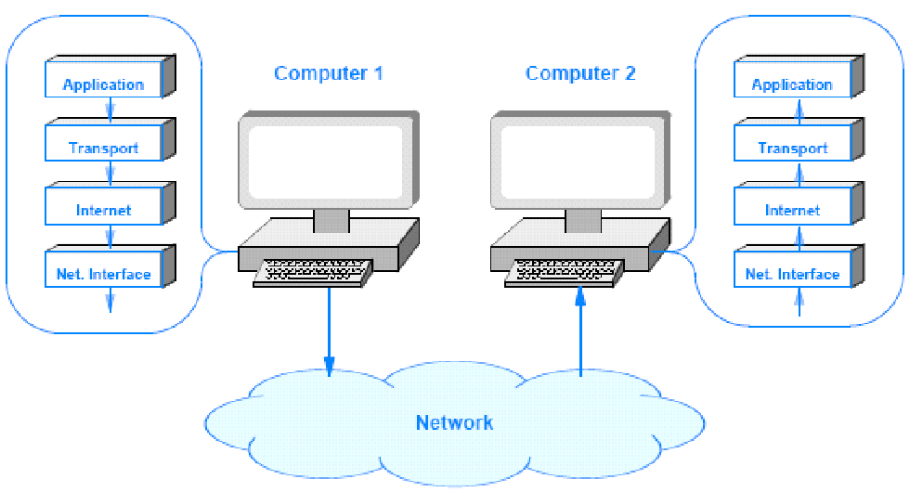
How Data Passes Through Layers

Slide 25
Headers and Layers
Each layer of protocol software performs computations that insure the messages arrive as expected
To perform such computation, protocol software on the two machines must exchange information
  Each layer on the sender prepends extra information onto the packet
  The corresponding protocol layer on the receiver removes and uses the extra information
Additional information added by a protocol is known as a header
Headers are added by protocol software on the sending computer
  That is, the Transport layer prepends a header, and then the Internet layer prepends a header, and so on
If we observe a packet traversing the network, the headers will appear in the order that Figure 1.3 illustrates
Although the figure shows headers as the same size
  In practice headers are not of uniform size and a physical layer header is optional

Slide 26
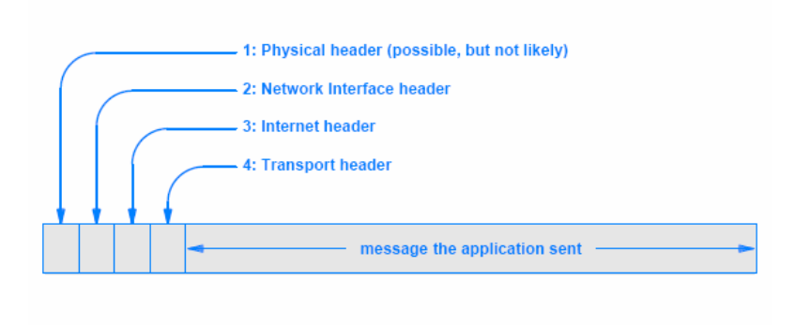
Headers and Layers
Nested protocol headers that appear on a packet as the packet travels across a network

Slide 27
ISO and the OSI Seven-Layer Reference Model
At the same time the Internet protocols were being developed, two large standards bodies jointly formed an alternative reference model
  They also created a set of internetworking protocols
These organizations are:
  International Standardization Organization (ISO)
  International Telecommunications Union,Telecommunication (ITU-T)
    The ITU was known as the Consultative Committee for International Telephone and Telegraph (CCITT)
The ISO layering model is known as the Open Systems Interconnection (OSI) Seven-Layer Reference Model

Slide 28
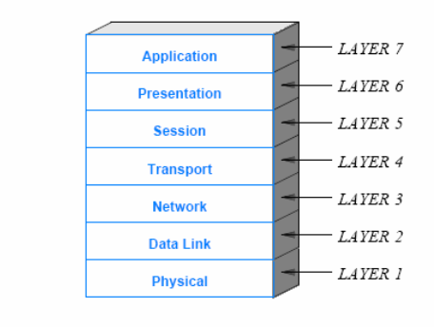
ISO and the OSI Seven-Layer Reference Model

Slide 29
Standards Overview
ISO and the ITU use a process that accommodates as many viewpoints as possible when creating a standard
  As a result, some standards can appear to have been designed by a committee making political compromises rather than by engineers and scientists
The seven-layer reference model is controversial
  It did indeed start as a political compromise
    The model and the OSI protocols were designed as competitors for the Internet protocols
ISO and the ITU are huge standards bodies that handle the world-wide telephone system and other global standards
The Internet protocols and reference model were created by a small group of about a dozen researchers
  It is easy to see why the standards organizations might be confident that they could dictate a set of protocols and everyone would switch away from protocols designed by researchers
  At one point, even the U.S. government was convinced that TCP/IP should be replaced by OSI protocols

Slide 30
Standards Overview
Eventually, it became clear that TCP/IP technology was technically superior to OSI
  Efforts to develop and deploy OSI protocols were terminated
Standards bodies were left with the seven-layer model
Advocates for the seven-layer model have tried to stretch the definitions to match TCP/IP
They argue that layer three could be considered an Internet layer and that a few support protocols might be placed into layers five and six
Perhaps the most humorous part of the story is that many engineers still refer to applications as layer 7 protocols
  Even when they know that layers five and six are unfilled and unnecessary

