Slide 1
Packet Switching and Network Technologies
The IEEE MAC Sub-Layer

Slide 2
Topics Covered
A Taxonomy of Mechanisms for Multi-Access
Static and Dynamic Channel Allocation
Channelization Protocols
Controlled Access Protocols
Random Access Protocols

Slide 3
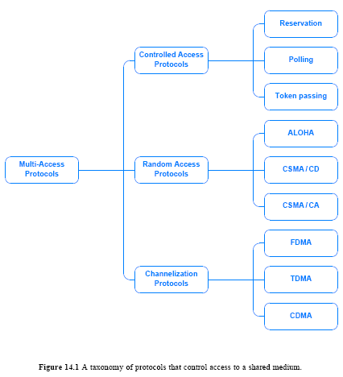
A Taxonomy of Mechanisms for Multi-Access
How do multiple, independent computers coordinate access to a shared medium?
There are three broad approaches:
  they can use a modified form of a multiplexing technique
  they can engage in a distributed algorithm for controlled access
  or they can use a random access strategy
Figure 14.1 illustrates the taxonomy
  including specific forms of each approach

Slide 4
Static and Dynamic Channel Allocation
Channelization refers to a mapping between a given communication and a channel in the underlying system
  There should be a mapping between entities and a channel is referred to as 1-to-1 and static
  Static channel allocation works well for situations where the set of communicating entities is known in advance and does not change
In many networks, however, the set of entities using the network varies over time
As an example, consider cellular telephones in a city
  users move, and they can turn a cell phone on and off at any time
  thus, the set of cell phones that are operating in the range of a given cell tower varies constantly
  A dynamic channel allocation scheme is needed; a mapping can be established when a new station appears, and the mapping can be removed when the station disappears

Slide 5
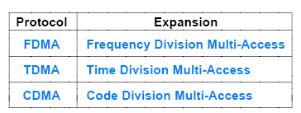
Channelization Protocols
Channelization protocols extend the multiplexing techniques covered in Chapter 11
Figure 14.2 (below) lists the main channelization techniques
These schemes have been discussed in Chapter 11 in detail
  14.4.1 FDMA
  14.4.2 TDMA
  14.4.3 CDMA

Slide 6
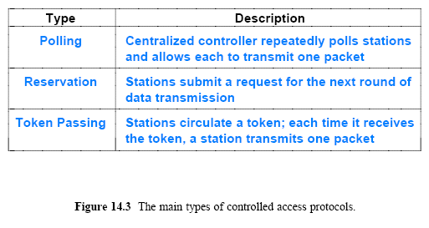
Controlled Access Protocols
Controlled access protocols provide a distributed version of statistical multiplexing
  Figure 14.3 (below) lists the three principal forms:
These will be discussed in the following sub-sections
  14.5.1 Polling
  14.5.2 Reservation
  14.5.3 Token Passing

Slide 7
Controlled Access Protocols
Polling uses a centralized controller
  which cycles through stations on the network and gives each an opportunity to transmit a packet
Algorithm 14.1 gives the steps a controller follows
The selection step is significant because it means a controller can choose which station to poll at a given time
There are two general polling policies:
  Round robin order
    Round-robin means each station has an equal opportunity to transmit packets
  Priority order
    Priority order means some stations will have more opportunity to send
    For example, priority order might be used to assign an IP telephone higher priority than a personal computer

Slide 8
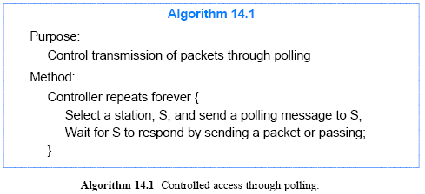
Controlled Access Protocols

Slide 9
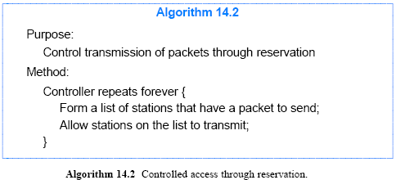
Controlled Access Protocols
Reservation
It is often used with satellite transmission
It employs a two-step process in which each round of packet transmissions is planned in advance
Typically, reservation systems have a central controller that follows Algorithm 14.2

Slide 10
Controlled Access Protocols
Reservation
In the first step
  each potential sender specifies whether they have a packet to send during the next round, and the controller transmits a list of the stations that will be transmitting
In the second step
  stations use the list to know when they should transmit
Variations exist
  where a controller uses an alternate channel to gather reservations for the next round
    while the current round of transmissions proceeds over the main channel

Slide 11
Controlled Access Protocols
Token Passing
It is most often associated with ring topologies
Although older LANs used token passing ring technology
  popularity has decreased, and few token passing networks remain
Imagine a set of computers connected in a ring
  and imagine that at any instant, exactly one of the computers has received a special control message called a token
When no station has any packets to send
  the token circulates among all stations continuously
For a ring topology, the order of circulation is defined
  if messages are sent clockwise, the next station mentioned in the algorithm refers to the next physical station in a clockwise order
When token passing is applied to other topologies (bus)
  each station is assigned a position in a logical sequence
  and the token is passed according to the assigned sequence

Slide 12
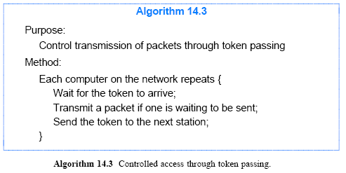
Controlled Access Protocols
Token Passing

Slide 13
Random Access Protocols
Some LANs do not employ a controlled access mechanism
  Instead, a set of computers attached to a shared medium attempt to access the medium without coordination
The term random is used because access only occurs when a given station has a packet to send
  and randomization is employed to prevent all computers on a LAN from attempting to use the medium at the same time
  the descriptions of specific methods below will clarify the use of randomization
Figure 14.4 lists the three random access methods that are discussed
  14.6.1 ALOHA
  14.6.2 CSMA/CD
  14.6.3 CSMA/CA

Slide 14
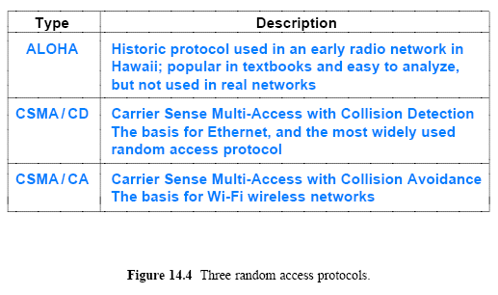
Random Access Protocols

Slide 15
Random Access Protocols
ALOHA
An early network in Hawaii, known as ALOHAnet, pioneered the concept of random access
  the network is no longer used, but the ideas have been extended
The network consisted of a single powerful transmitter in a central geographic location
  It is surrounded by a set of stations/computer
  Stations had a transmitter capable of reaching the central transmitter
    but not powerful enough to reach all the other stations
ALOHAnet used two (2) carrier frequencies for broadcasting:
  one for outbound by the central transmitter to all stations
  and another for inbound by stations to the central transmitter
Figure 14.5 illustration of outbound and inbound frequencies in ALOHAnet

Slide 16
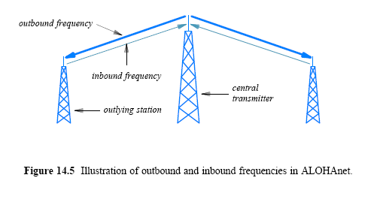
Random Access Protocols
ALOHA

Slide 17
Random Access Protocols
ALOHA
The ALOHA protocol is straightforward:
  when a station has a packet to send
    it transmits the packet on the inbound frequency
  the central transmitter repeats the transmission on the outbound frequency (which all stations can receive)
To insure that transmission is successful
  a sending station listens to the outbound channel
    if a copy of its packet arrives, the sending station moves to the next packet
    if no copy arrives, the sending station waits a short time and tries again
Why might a packet fail to arrive? Interference
  if two stations simultaneously transmit
    the signals will interfere and the two transmissions will be garbled
    called a collision, and say that the two transmitted packets collide
The protocol handles a collision
  by requiring a sender to retransmit each lost packet

Slide 18
Random Access Protocols
CSMA/CD
Researchers at Xerox PARC created a random access protocol (1973)
  In 1978, a standard (also called the DIX standard) was created
    by Digital Equipment Corporation, Intel, and Xerox
  It is widely known as Ethernet
It uses cable as a shared medium
  instead of broadcasting radio frequency transmissions through the atmosphere
Ethernet uses three (3) mechanisms to handle collisions:
  Carrier sense
  Collision detection
  Binary exponential backoff

Slide 19
Random Access Protocols
CSMA/CD
Ethernet requires each station to monitor the cable to detect whether another transmission is already in progress
  this process is known as carrier sense
  it prevents the most obvious collision problems
  and substantially improves network utilization
A collision can occur if two stations wait for a transmission to stop, find the cable idle, and both start transmitting
  A small part of the problem is that even at the speed of light, some time is required for a signal to travel down the cable
  Thus, a station at one end of the cable cannot know instantly when a station at the other end begins to transmit

Slide 20
Random Access Protocols
CSMA/CD
To handle collisions
  each station monitors the cable during transmission
If the signal on the cable differs from the signal that the station is sending
  it means that a collision has occurred
  the technique is known as collision detection
  when a collision is detected, the sending station aborts transmission
Many details complicate Ethernet transmission
  For example, following a collision, transmission does not abort until enough bits have been sent to guarantee that the collided signals reach all stations
  Furthermore, following a transmission, stations must wait for an interpacket gap (9.6 sec for a 10 Mbps Ethernet) to insure that all stations sense an idle network and have a chance to transmit

Slide 21
Random Access Protocols
CSMA/CD
Binary Exponential Backoff
  After a collision occurs
    a computer must wait for the cable to become idle again before transmitting a frame
  Randomization is used to avoid having multiple stations transmit simultaneously as soon as the cable is idle
  The standard specifies a maximum delay, d, and requires each station to choose a random delay less than d after a collision occurs
When two stations each choose a random value
  the station that chooses the smallest delay will proceed to send a packet and the network will return to normal operation
In the case where two or more computers happen to choose nearly the same amount of delay
  they will both begin to transmit at nearly the same time
  producing a second collision

Slide 22
Random Access Protocols
CSMA/CD
To avoid a sequence of collisions
  Ethernet requires each computer to double the range from which a delay is chosen after each collision
    a computer chooses a random delay between 0 - d after one collision
    a random delay between 0 - 2d after a second collision
    a random delay between 0 - 4d after a third, and so on
  After a few collisions, the range from which a random value is chosen becomes large
    Thus, some computer will choose a random delay shorter than the others, and will transmit without a collision
Doubling the range of the random delay after each collision is known as binary exponential backoff

Slide 23
Random Access Protocols
CSMA/CD
By using exponential backoff
  an Ethernet can recover quickly after a collision
  because each computer agrees to wait longer times between attempts when the cable becomes busy
Even in the unlikely event that two or more computers choose delays that are approximately equal
  exponential backoff guarantees that contention for the cable will be reduced after a few collisions
The combination of techniques described above is known by the name Carrier Sense Multi-Access with Collision Detection (CSMA/CD)
Algorithm 14.4 summarizes CSMA/CD

Slide 24
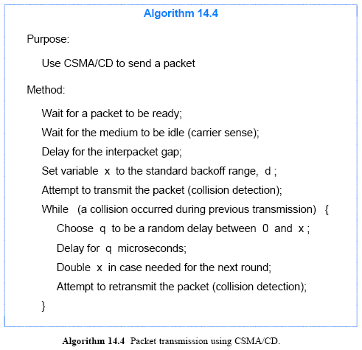
Random Access Protocols
CSMA/CD

Slide 25
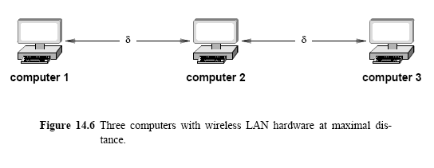
Random Access Protocols
CSMA/CA
CSMA/CD does not work as well in wireless LANs
  because a transmitter used in a wireless LAN has a limited range
A receiver that is more δ than away from the transmitter
  will not receive a signal, and will not be able to detect a carrier
Consider three computers with wireless LAN hardware positioned as Figure 14.6 (below) illustrates

Slide 26
Random Access Protocols
CSMA/CA
In Figure 14.6, computer1 can communicate with computer2, but cannot receive the signal from computer3
  Thus, if computer3 is transmitting a packet to computer2, computer1's carrier sense mechanism will not detect the transmission
  Similarly, if computer1 and computer3 simultaneously transmit, only computer2 will detect a collision
The problem is sometimes called the hidden station problem
  because some stations are not visible to others
Wireless LANs use a modified access protocol
  known as CSMA with Collision Avoidance (CSMA/CA)
The CSMA/CA triggers a brief transmission from the intended receiver before transmitting a packet

Slide 27
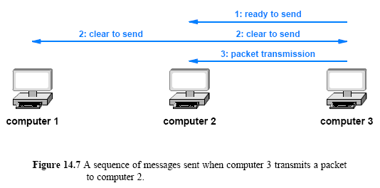
Random Access Protocols
CSMA/CA
The idea is that if both the sender and receiver transmit a message
  all computers within range of either will know a packet transmission is beginning

Slide 28
Random Access Protocols
CSMA/CA
In Figure 14.7
  computer3 sends a short message to announce that it is ready to transmit a packet to computer2
  and computer2 responds by sending a short message announcing that it is ready to receive the packet
  all computers in range of computer3 receive the initial announcement
  and all computers in the range of computer2 receive the response
  as a result, even though it cannot receive the signal or sense a carrier, computer1 knows that a packet transmission is taking place

Slide 29
Random Access Protocols
CSMA/CA
Collisions of control messages can occur when using CSMA/CA, but they can be handled easily
For example, if computer1 and computer3 each attempt to transmit a packet to computer2 at exactly the same time
  their control messages will collide
  When a collision occurs, the sending stations apply random backoff before resending the control messages.
Because control messages are much shorter than a packet, the probability of a second collision is low

