Slide 1
Packet Switching and Network Technologies
Wired LAN Technology
(Ethernet and 802.3)

Slide 2
Topics Covered
The Venerable Ethernet
Ethernet Frame Format
Ethernet Type Field and Demultiplexing
IEEE's Version of Ethernet (802.3)
LAN Connections and Network Interface Cards
Ethernet Evolution and Thicknet Wiring
Thinnet Ethernet Wiring
Twisted Pair Ethernet Wiring and Hubs
Physical and Logical Ethernet Topology
Variants of Twisted Pair Ethernet and Speeds
Twisted Pair Connectors and Cables

Slide 3
The Venerable Ethernet
Although the hardware devices, cabling, and media used with Ethernet have changed dramatically
  many of the fundamentals remain constant
One of the most interesting aspects of Ethernet evolution concerns the way newer versions of Ethernet remain backward compatible
  a new version can sense an older form and automatically adapt to accommodate the older technology

Slide 4
Ethernet Frame Format
The term frame format refers to the way a packet is organized
  including details such as the size and meaning of individual fields
The main reason that older versions of Ethernet have remained compatible with newer versions
  arises from the frame format, which has remained constant since the DIX standard was created in the 1970s

Slide 5
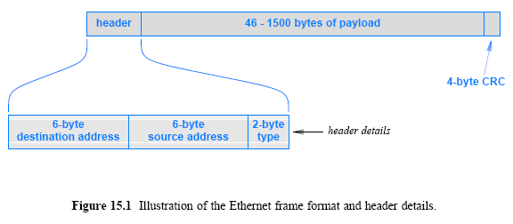
Ethernet Frame Format
Figure 15.1 (below) illustrates the basic format and the details of the frame header
As the figure shows
  an Ethernet frame consists of a fixed-length header
  a variable-length payload, and a fixed-length CRC

Slide 6
Ethernet Type Field and Demultiplexing
The type field in an Ethernet frame provides multiplexing and demultiplexing
  that allows a given computer to have multiple protocols operating simultaneously
The protocols used on the Internet send IP datagrams and ARP messages over Ethernet
  Each is assigned a unique Ethernet type (hexadecimal 0800 for IP datagrams and hexadecimal 0806 for ARP messages)
  When transmitting a datagram in an Ethernet frame, the sender assigns a type 0800
When a frame arrives at its destination
  the receiver examines the type field, and it uses the value to determine which software module should process the frame

Slide 7
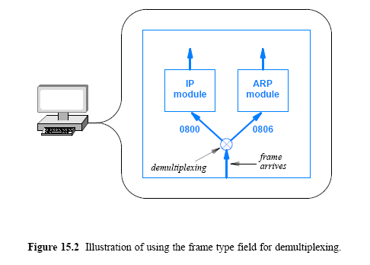
Ethernet Type Field and Demultiplexing

Slide 8
IEEE's Version of Ethernet (802.3)
IEEE developed a standard for Ethernet (1983) and attempted to redefine the Ethernet frame format
The IEEE working group that produced the standard is numbered 802.3
  professionals often refer to it as 802.3 Ethernet
The major difference between conventional Ethernet and 802.3 Ethernet arises from the interpretation of the type field
  The 802.3 standard interprets the original type field as a packet length, and adds 8-byte header that contains the packet type
  The extra header is known as a Logical Link Control / Sub-Network Attachment Point (LLC/SNAP) header; most professionals simply call it a SNAP header

Slide 9
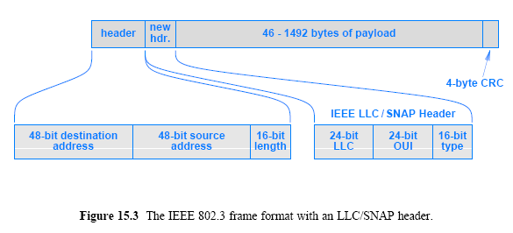
IEEE's Version of Ethernet (802.3)

Slide 10
IEEE's Version of Ethernet (802.3)
The overall frame size in 802.3 Ethernet remains the same as conventional Ethernet: 1514 bytes
  IEEE reduced the maximum payload from 1500 bytes to 1492 bytes
  SNAP header occupies the first 8 bytes of the payload
To keep the two versions of Ethernet compatible, a convention is used:
  If bytes 13-14 of a frame contain a numeric value less than 1500
    the field is interpreted as a packet length and the 802.3 standard applies
  otherwise, the field is interpreted as a type field and the original Ethernet standard applies

Slide 11
LAN Connections and Network Interface Cards
NIC appears to be an I/O device
  it is connected in the same manner as a disk or video device
A NIC handles
  address recognition
  CRC computation
  frame recognition
  sending/receiving frames
A NIC consists of a circuit board with a plug on one side.
Most computers come with a NIC already installed
The NIC is independent from the rest of the computer
  and a user can choose to replace the NIC without making other changes

Slide 12
Ethernet Evolution and Thicknet Wiring
Ethernet has undergone several major changes
  with the most significant changes in media and wiring
The original Ethernet wiring scheme was informally called thick wire Ethernet or Thicknet
  because the medium consisted of a heavy coaxial cable
  the formal term for the wiring is 10Base5
Hardware used with Thicknet was divided into two major parts
  A NIC handled the digital aspects of communication
  A separate electronic device called a transceiver connected to the Ethernet cable
    It handles carrier detection, conversion of bits into appropriate voltages for transmission, and conversion of incoming signals to bits

Slide 13
Ethernet Evolution and Thicknet Wiring
A physical cable known as an Attachment Unit Interface (AUI) connected a transceiver to a NIC in a computer
A transceiver was usually remote from a computer
For example, in an office building, transceivers might attach to an Ethernet in a hallway ceiling
Figure 15.4 illustrates how the original Thicknet wiring used an AUI cable to connect a computer to a transceiver

Slide 14
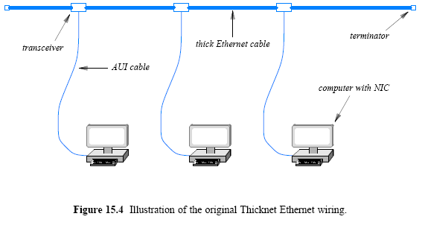
Ethernet Evolution and Thicknet Wiring

Slide 15
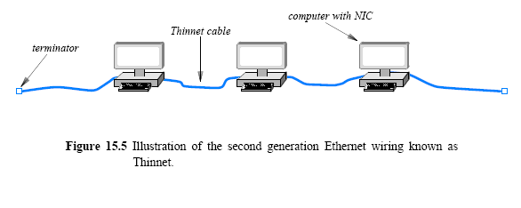
Thinnet Ethernet Wiring
A second generation of Ethernet used a thinner coaxial cable that was more flexible than Thicknet
  Formally named 10Base2 and informally known as Thinwire Ethernet or Thinnet
Thinnet integrates a transceiver directly on the NIC
  runs a coaxial cable from one computer to another

Slide 16
Thinnet Ethernet Wiring
Thinnet had advantages and disadvantages
The primary advantages
  lower overall cost and ease of installation
  No external transceivers were needed
  Thinnet cable could be installed in a convenient path
The chief disadvantage
  because the entire network was vulnerable if a user unplugged a segment of the network to relocate wires or move a computer, the entire network would stop working

Slide 17
Twisted Pair Ethernet
Wiring and Hubs
A third generation of Ethernet wiring made a dramatic shift:
  In place of coaxial cable
    it uses a central electronic device separate from the computers attached to the network
  Instead of heavy, shielded cabling
    it uses twisted pair wiring
The technology is informally known as twisted pair Ethernet, and has replaced other versions
  Thus, when someone now refers to Ethernet, they are referring to twisted pair Ethernet
The electronic device that served as the central interconnection was known as a hub
  Hubs were available in a variety of sizes, with the cost proportional to size, but recently replaced with switches

Slide 18
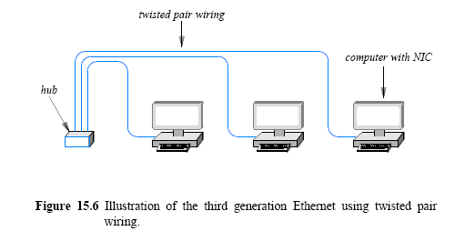
Twisted Pair Ethernet
Wiring and Hubs

Slide 19
Twisted Pair Ethernet
Wiring and Hubs
A hub emulates a physical cable
  making the entire system operate like a conventional Ethernet
A system that uses a hub in CSMA/CD receives a copy of each frame and uses the address to determine
  whether to process or ignore the frame
Twisted pair Ethernet retains the same frame format as the previous versions
In fact, software on a computer cannot distinguish between thick Ethernet, thin Ethernet, and twisted pair Ethernet
  The NIC handles the details and hides any differences

Slide 20
Physical and Logical Ethernet Topology
Twisted pair Ethernet appears to follow a star topology
  In fact, the term hub arose to clarify the concept of a central interconnection point
  However, because a hub emulates a physical cable
    the system appears to perform as if computers attach to a cable
  In fact, professionals joked that a hub really provided a bus in a box
To understand Ethernet topology
  we must distinguish between logical and physical topologies
  Logically
    twisted pair Ethernet employs a bus topology
  Physically
    twisted pair Ethernet forms a star-shaped topology

Slide 21
Variants of Twisted Pair Ethernet and Speeds
Significant improvements have been made in the quality and shielding available in twisted pair cables
  the data rate used on twisted pair Ethernet has increased
Figure 15.8 summarizes the three types of twisted pair Ethernet and the cable used with each
Higher-speed Ethernet technologies use an electronic device known as a switch rather than a hub
To remain backward compatible
  standards for the higher-speed versions specify that interfaces automatically sense the speed at which a connection can operate
  and slow down to accommodate older devices
  For example, if one plugs an Ethernet cable between an old device that uses 10BaseT and a new device that uses 1000BaseT
    the new device will autosense

Slide 22
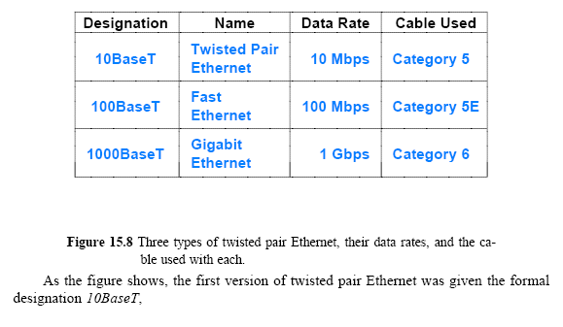
Variants of Twisted Pair Ethernet and Speeds

Slide 23
Twisted Pair Connectors and Cables
Twisted pair Ethernet uses RJ45 connectors
  which are larger versions of the RJ11 connectors used to connect telephones
What is straight and crossed Ethernet cable?
A straight cable, used between a computer and a switch
  connects each pin of the RJ45 attached to one end of the cable directly to the corresponding pin on the RJ45 at the other end
A crossed cable, which is used to connect two switches
  connects a pin on one end to a different pin on the other end
To help technicians make the correct connections
  individual wires in a Category 5 or Category 6 cable are coated with colored plastic

