Slide 1
Packet Switching and Network Technologies
Wireless Networking Technologies

Slide 2
Topics Covered
A Taxonomy of Wireless Networks
Personal Area Networks (PANs)
ISM Wireless Bands Used by LANs and PANs
Wireless LAN Technologies and Wi-Fi
Spread Spectrum Techniques
Other Wireless LAN Standards
Wireless LAN Architecture
Overlap, Association, and 802.11 Frame Format
Coordination Among Access Points
Contention and Contention-Free Access
Wireless MAN Technology and WiMax
PAN Technologies and Standards
Other Short-Distance Communication Technologies
Wireless WAN Technologies
Cell Clusters and Frequency Reuse
Generations of Cellular Technologies
VSAT Satellite Technology
GPS Satellites
Software Radio and the Future of Wireless

Slide 3
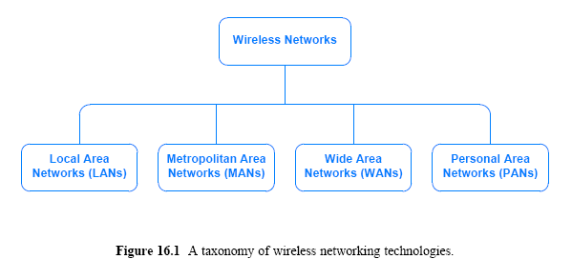
A Taxonomy of Wireless Networks
Wireless communication applies across a wide range of network types and sizes
Part of the motivation for variety
  government regulations that make specific ranges of the electromagnetic spectrum available for communication
A license is required to operate transmission equipment in some parts of the spectrum
  and other parts of the spectrum are unlicensed
Many wireless technologies have been created
  and new variants appear continually
Wireless technologies can be classified broadly according to network type

Slide 4
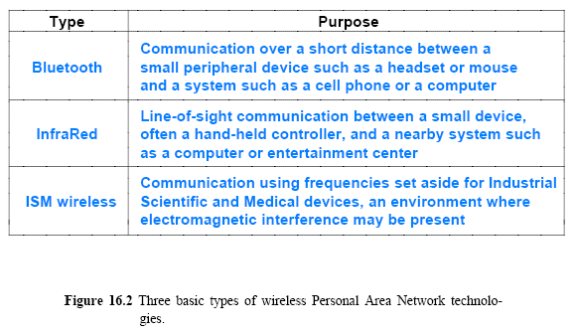
Personal Area Networks (PANs)
A PAN technology provides communication over a short distance
It is intended for use with devices that are owned and operated by a single user. For example
  between a wireless headset and a cell phone
  between a computer and a nearby wireless mouse or keyboard
PAN technologies can be grouped into three categories

Slide 5
Wireless LAN Technologies and
Wi-Fi
A variety of wireless LAN technologies exist that use
  various frequencies
  modulation techniques
  data rates
IEEE provides most of the standards
  which are categorized as IEEE 802.11
A group of vendors who build wireless equipment formed the Wi-Fi Alliance
  a non-profit organization that tests and certifies wireless equipment using the 802.11 standards
Alliance has received extensive marketing, most consumers associate wireless LANs with the term Wi-Fi
Figure 16.4 lists the key IEEE standards that fall under the Wi-Fi Alliance

Slide 6
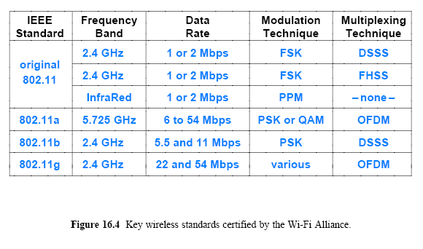
Wireless LAN Technologies and
Wi-Fi

Slide 7
Spread Spectrum Techniques
The term spread spectrum transmission uses multiple frequencies to send data
  the sender spreads data across multiple frequencies
  the receiver combines the information obtained from multiple frequencies to reproduce the original data
Spread spectrum can be used to achieve one of the following two goals:
  Increase overall performance
  Make transmission more immune to noise
The table in Figure 16.5 summarizes the three key multiplexing techniques used in Wi-Fi wireless networks
  Each technique has advantages
  Thus, when a wireless technology is defined, the designers choose an appropriate multiplexing technique

Slide 8
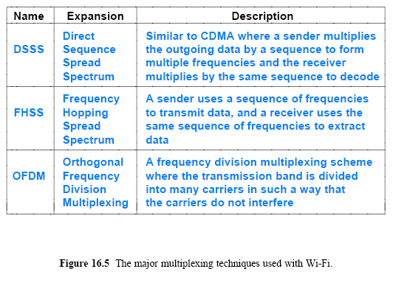
Spread Spectrum Techniques

Slide 9
Other Wireless LAN Standards
IEEE has created many wireless networking standards
  that handle various types of communication
Each standard specifies
  the frequency range
  the modulation
  the multiplexing to be used
  the data rate
Figure 16.6 lists the major standards that have been created or proposed, and gives a brief description of each
In 2007, IEEE “rolled up” many of the existing 802.11 standards into a single document known as 802.11-2007
  The document describes basics
  It has an appendix for each variant

Slide 10
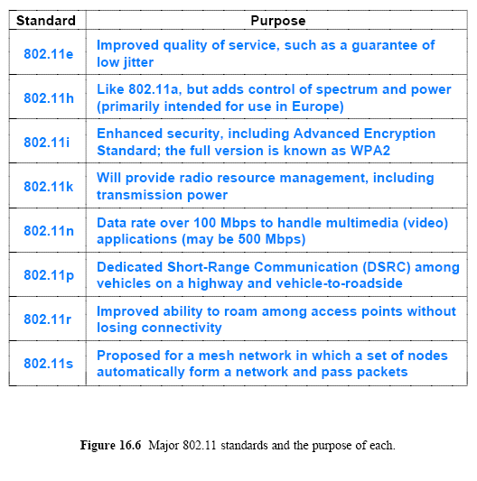
Other Wireless LAN Standards

Slide 11
Wireless LAN Architecture
The three building blocks of a wireless LAN are:
  access points (AP)
    which are informally called base stations
  an interconnection mechanism
    such as a switch or router used to connect access points
  a set of wireless hosts
    also called wireless nodes or wireless stations
In principle, two types of wireless LANs are possible:
  Ad hoc
    wireless hosts communicate amongst themselves without a base station
  Infrastructure based
    a wireless host only communicates with an access point, and the access point relays all packets
An organization might deploy AP throughout its buildings

Slide 12
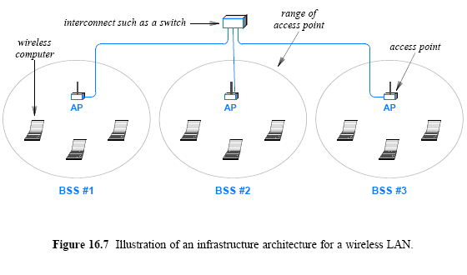
Wireless LAN Architecture
Note: The set of computers within range of a given access point is known as
a Basic Service Set (BSS)

Slide 13
Overlap, Association, and 802.11 Frame Format
Many details can complicate an infrastructure architecture
  On one hand, if a pair of APs are too far apart
    a dead zone will exist between them
    a physical location with no wireless connectivity
  On the other hand, if a pair of access points is too close together
    an overlap will exist in which a wireless host can reach both access points
Most wireless LANs connect to the Internet
  Thus, the interconnect mechanism usually has an additional wired connection to an Internet router

Slide 14
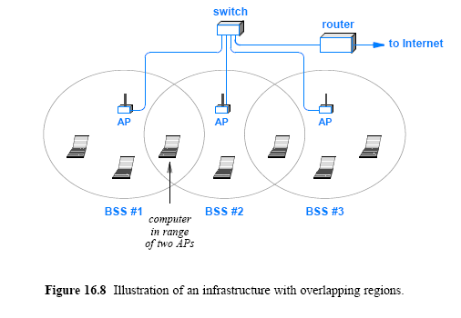
Overlap, Association, and 802.11 Frame Format

Slide 15
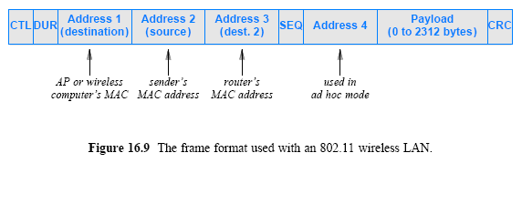
Overlap, Association, and 802.11 Frame Format
To handle overlap, 802.11 networks require a wireless host to associate with a single AP
  That is, a wireless host sends frames to a particular AP
  Then AP forwards the frames across the network
Figure 16.9 (below) illustrates the 802.11 frame format
  the figure shows that when used with an infrastructure architecture
  the frame carries the MAC address of an AP as well as the address of an Internet router

Slide 16
Coordination Among Access Points
To what extent do APs need to coordinate?
Many early AP designs were complex
The access points coordinated to provide seamless mobility similar to the cellular phone system
  That is, the APs communicated amongst themselves to insure smooth handoff as a wireless computer moved from the region to another
  Some designs measured signal strength and attempted to move a wireless node to a new AP
    when the signal received at the new AP exceeded the signal strength at the existing AP
Some vendors began to offer lower cost, less complex APs that do not coordinate
The vendors argue that signal strength does not provide a valid measure of mobility
  a mobile computer can handle changing from one AP to another
  and that the wired infrastructure connecting APs has sufficient capacity to allow more centralized coordination
A less complex AP design is appropriate in situations where an installation consists of a single AP

Slide 17
Contention and Contention-Free Access
The original 802.11 standard defined two general approaches for channel access
  Point Coordinated Function (PCF) for contention-free service
    an AP controls stations in the Basic Service Set (BSS) to insure that transmissions do not interfere with one another
    For example, an AP can assign each station a separate frequency
    In practice, PCF is never used
  Distributed Coordinated Function (DCF) for contention-based service
    arranges for each station in a BSS to run a random access protocol
Wireless networks can experience a hidden station problem
  where two stations can communicate but a third station can only receive the signal from one of them
802.11 networks use CSMA/CA
  which requires a pair to exchange Ready To Send (RTS) and Clear To Send (CTS) messages before transmitting a packet

Slide 18
Contention and Contention-Free Access
The 802.11 standard defines three timing parameters as follows:
Short Inter-Frame Space (SIFC) of 10 sec
  defines how long a receiving station waits before sending an ACK or other response
Distributed Inter-Frame Space (DIFC) of 50 sec
  defines how long a channel must be idle before a station can attempt transmission, which is equal to SIFS + two Slot Times
Slot Time of 20 sec
Figure 16.10 illustrates how the parameters are used in a packet transmission

Slide 19
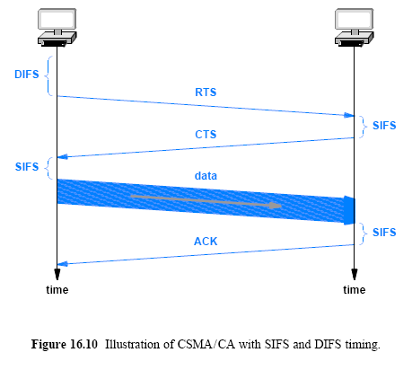
Contention and Contention-Free Access

Slide 20
Contention and Contention-Free Access
Physical separation among stations and electrical noise makes it difficult to distinguish between
  weak signals, interference, and collisions
Wi-Fi networks do not employ collision detection
  That is, the hardware does not attempt to sense interference during a transmission
  Instead, a sender waits for an acknowledgement (ACK) message
  If no ACK arrives, the sender assumes the transmission was lost
    and employs a backoff strategy similar to the strategy in wired Ethernet
In practice, 802.11 networks that have few users and do not experience electrical interference seldom need retransmission
  However, other 802.11 networks experience frequent packet loss and depend on retransmission

Slide 21
Wireless MAN Technology and WiMax
Standardized by IEEE under the category 802.16
A group of companies coined the term (WiMax)
  which is interpreted to mean World-wide Interoperability for Microwave Access
  and they formed WiMAX Forum to promote use of the technology
Two main versions of WiMAX are being developed that differ in their overall approach:
Fixed WiMAX
  refers to systems built using IEEE 802.16-2004, which is informally called 802.16d
  the technology does not provide for handoff among access points
  designed to provide connections between a service provider and a fixed location
    such as a residence or office building, rather than between a provider and a cell phone
Mobile WiMAX
  built according to standard 802.16e-2005, known also as 802.16e
  the technology offers handoff among APs
    which means a mobile WiMAX system can be used with portable devices such as laptop computers or cell phones
WiMAX offers broadband communication that can be used in a variety of ways:
  WiMAX can be used as an Internet access technology
  WiMAX can provide a general-purpose interconnection among physical sites
    especially in a city
  To be used as backhaul connection between a service provider's central network facility and remote locations
    such as cell towers

Slide 22
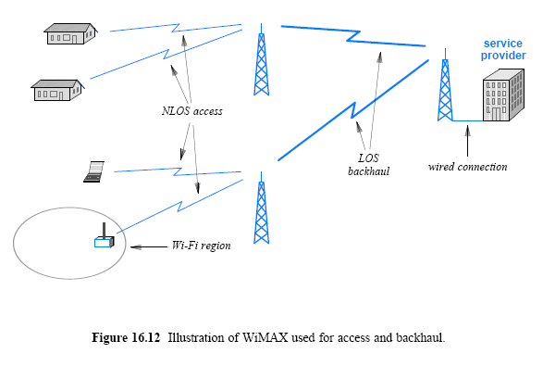
Wireless MAN Technology and WiMax

Slide 23
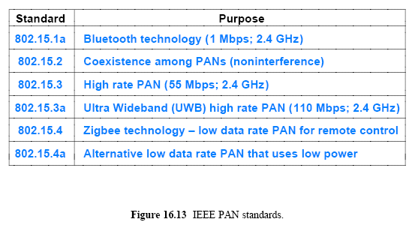
PAN Technologies and Standards
IEEE has assigned the number 802.15 to PAN standards
Several task groups and industry consortia have been formed for each of the key PAN technologies

Slide 24
PAN Technologies and Standards
Bluetooth
  The IEEE 802.15.1a standard evolved after vendors created Bluetooth technology as a short-distance wireless connection technology
The characteristics of Bluetooth technology are:
  Wireless replacement for cables (e.g., headphones or mouse)
  Uses 2.4 GHz frequency band
  Short distance (up to 5 meters, with variations that extend the range to 10 or 50 meters)
  Device is master or slave
  Master grants permission to slave
  Data rate is up to 721 Kbps

Slide 25
PAN Technologies and Standards
Ultra Wideband (UWB)
  The idea behind UWB communication is that spreading data across many frequencies
    requires less power to reach the same distance
The key characteristics of UWB are:
  Uses wide spectrum of frequencies
  Consumes very low power
  Short distance (2 to 10 meters)
  Signal permeates obstacles such as walls
  Data rate of 110 at 10 meters, and up to 500 Mbps at 2 meters
  IEEE unable to resolve disputes and form a single standard

Slide 26
PAN Technologies and Standards
Zigbee
  The Zigbee standard (802.15.4) arose from a desire to standardize wireless remote control technology
    especially for industrial equipment
  Because remote control units only send short command
    high data rates are not required
The chief characteristics of Zigbee are:
  Wireless standard for remote control, not data
  Target is industry as well as home automation
  Three frequency bands used (868 MHz, 915 MHz, and 2.4 GHz)
  Data rate of 20, 40, or 250 Kbps, depending on frequency band
  Low power consumption
  Three levels of security being defined

Slide 27
Other Short-Distance Communication Technologies
Two other wireless technologies provide communication over short distances, but they are not listed under PANs
  InfraRED technologies provide control and low-speed data communications
  RFID technologies are used with sensors

Slide 28
Other Short-Distance Communication Technologies
InfraRED
  InfraRED technology is often used in remote controls
    and may be used as a cable replacement (e.g., for a wireless mouse)
  The Infrared Data Association (IrDA) has produced a set of standards that are widely accepted
The chief characteristics of the IrDA technology are:
  Family of standards for various speeds and purposes
  Practical systems have range of one to several meters
  Directional transmission with a cone covering 30
  Data rates between 2.4 Kbps (control) and 16 Mbps (data)
  Generally low power consumption with very-low power versions
  Signal may reflect from surfaces
    but cannot penetrate solid objects

Slide 29
Other Short-Distance Communication Technologies
Radio Frequency Identification (RFID)
  RFID technology uses an interesting form of wireless communication to create a mechanism
  A small tag contains identification information
    that a receiver can “pull” from the tag
Some features of RFID:
  Over 140 RFID standards exist for a variety of applications
  Passive RFIDs draw power from the signal sent by the reader
  Active RFIDs contain a battery
    which may last up to 10 years
  Limited distance
    although active RFIDs extend farther than passive
  Can use frequencies from less than 100 MHz to 868-954 MHz
  Used for
    inventory control, sensors, passports, and other applications

Slide 30
Wireless WAN Technologies
Wireless WAN technologies can be divided into two categories:
  Cellular communication systems
  Satellite communication systems

Slide 31
Wireless WAN Technologies
Cellular systems were originally designed to provide voice services to mobile customers
  System was designed to interconnect cells to the public telephone
Currently, cellular systems are being used to provide data services and Internet connectivity
In terms of architecture
  each cell contains a tower
  a group of (usually adjacent) cells is connected to a Mobile Switching Center (MSC)
The center tracks a mobile user
  and manages handoff as the user passes from one cell to another.
Figure 16.14 illustrates how cells might be arranged along a highway

Slide 32
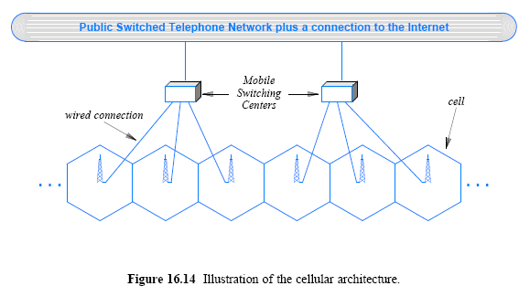
Wireless WAN Technologies

Slide 33
Wireless WAN Technologies
When moving between two cells belonging to the same MSC
  the switching center handles the change
When a user passes from one geographic region to another
  two MSCs are involved in the handoff
Perfect cellular coverage occurs if each cell is a hexagon
  because the cells can be arranged in a honeycomb
  In practice, cellular coverage is imperfect
Most cell towers use omnidirectional antennas
  that transmit in a circular pattern
  obstructions and electrical interference can attenuate a signal or cause an irregular pattern
    in some cases, cells overlap and in others, gaps exist with no coverage
Figure 16.15 illustrates ideal and realistic coverage

Slide 34
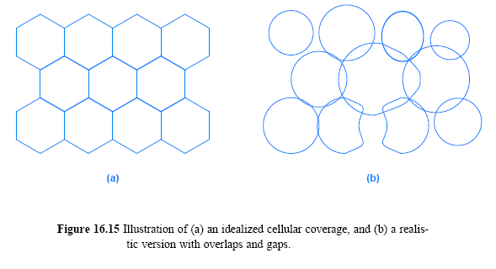
Wireless WAN Technologies

Slide 35
Wireless WAN Technologies
The variability of cell density is possible
In rural areas (expected density of cell phones is low)
  cell size is large, a single tower is adequate for a large area
In an urban setting (many cell phones in a given area)
  For example, consider a city block in a large metropolitan area
  In addition to pedestrians and people riding in vehicles, such an area can contain office or apartment buildings with many occupants
Designers break a region into many cells to handle more calls
  a practical deployment uses various size cells, with smaller cells used to cover metropolitan areas

Slide 36
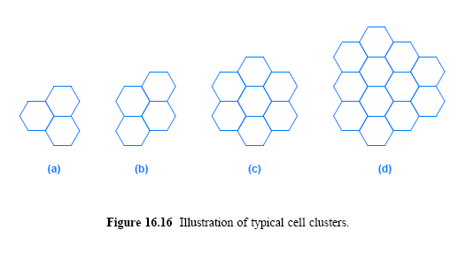
Cell Clusters and Frequency Reuse
Cellular communication follows a key principle:
  Interference can be minimized if an adjacent pair of cells do not use the same frequency
To implement the principle
  cellular planners employ a cluster approach
    in which a small pattern of cells is replicated

Slide 37
Cell Clusters and Frequency Reuse
In geometric terms, each of the shapes in the figure can be used to tile a plane
  That is, by replicating the same shape, it is possible to cover an entire area without leaving any gaps
If each cell in a given shape is assigned a unique frequency
  the repeated pattern will not assign the same frequency to any pair of adjacent cells
Figure 16.17 illustrates a replication of the 7-cell cluster
  (with a letter in each cell to denote the frequency assigned to the cell)
  each letter corresponds to a particular frequency
  and each cell within a cluster is assigned a frequency
  when the cluster pattern is replicated
    no adjacent cells share a common frequency

Slide 38
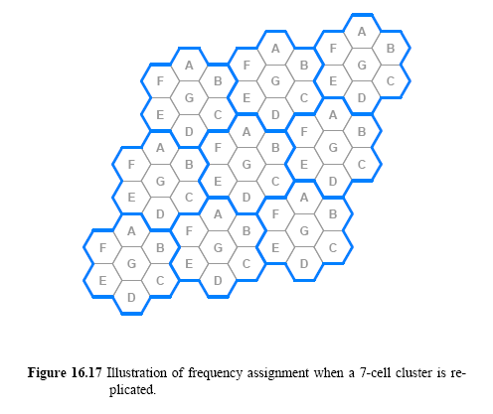
Cell Clusters and Frequency Reuse

Slide 39
Generations of Cellular Technologies
Telecommunications industry divides cellular technologies into four generations
  that are labeled 1G, 2G, 3G, and 4G
  with intermediate versions labeled 2.5G and 3.5G
1G
  Began in the late 1970s, and extended through the 1980s
  Originally called cellular mobile radio telephones
    used analog signals to carry voice
2G and 2.5G
  Began in the early 1990s and continues to be used
  The main distinction between 1G and 2G arises
    because 2G uses digital signals to carry voice
  The label 2.5G is used for systems that extend a 2G system
    to include some 3G features

Slide 40
Generations of Cellular Technologies
3G and 3.5G
  Began in the 2000s
  Focuses on the addition of higher-speed data services
  A 3G system offers download rates of 400 Kbps to 2 Mbps, and is intended to support applications such as web browsing and photo sharing
  3G allows a single telephone to roam across the world
4G
  Began around 2008
  Focuses on support for real-time multimedia
    such as a television program or high-speed video
  They include multiple connection technologies
    such as Wi-Fi and satellite
    at any time, the phone automatically chooses the best connection technology available

Slide 41
Generations of Cellular Technologies
A variety of standards have evolved
  (many attempted to choose an approach and create a standard)
  The European Conference of Postal and Telecommunications Administrators chose a TDMA technology known as Global System for Mobile Communications (GSM)
  In the United States, each carrier created a network with its own technology
  Motorola invented a TDMA system known as iDEN
  Most US and Asian carriers adopted a CDMA approach that was standardized as IS-95A
  Japan created a TDMA technology known as PDC

Slide 42
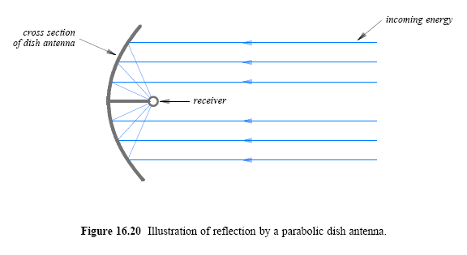
VSAT Satellite Technology
The key to satellite communication is a parabolic antenna
  It is known informally as a dish
  The parabolic shape means that electromagnetic energy arriving from a distant satellite is reflected to a single focus point
  By aiming the dish at a satellite and placing a detector at the focus point
    a designer can guarantee that a strong signal is received

Slide 43
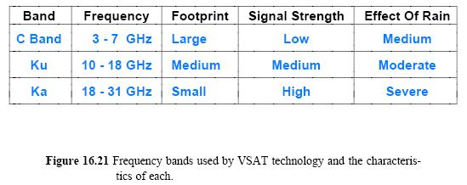
VSAT Satellite Technology
VSAT satellites use three frequency ranges that differ in
  the strength of the signal delivered
  the sensitivity to rain and other atmospheric conditions
  the area of the earth's surface covered (satellite's footprint)

Slide 44
GPS Satellites
Global Positioning System (GPS) provide accurate time and location information
  Location information is increasingly used in mobile networking, location-based services
The key features are:
  Accuracy between 2-20 meters
    (military ones have higher accuracy)
  24 total satellites orbit the earth
  Satellites arranged in six (6) orbital planes
  Provides time synchronization
    that can be used in some communications
Obtaining position information is straightforward:
  All GPS satellites orbit in well-known positions
    a receiver can determine a unique location on the earth's surface by finding the distance to three satellites

Slide 45
Software Radio and the Future of Wireless
Wireless technologies use special-purpose radio hardware
  The antenna, transmitter, and receiver in a given device are designed to operate on predetermined frequencies
    using specific forms of modulation and multiplexing
A cell phone that can use GSM, Wi-Fi, and CDMA networks
  But it must have three completely separate radio systems, and must choose among them
Traditional radios are being replaced by radios that follow a programmable paradigm
  in which features are controlled by software running on a processor

Slide 46
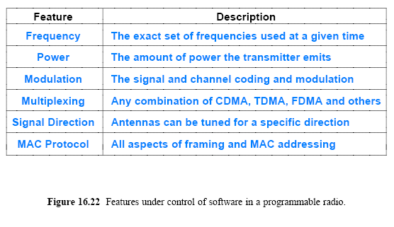
Software Radio and the Future of Wireless

Slide 47
Software Radio and the Future of Wireless
The key technologies that enable software radios are:
  Tunable analog filters and multiple antenna management
    Analog chips are currently available that provide tunable analog filters
  Digital Signal Processors (DSPs) are available to handle signal coding and modulation
  Multiple-Input Multiple-Output (MIMO) denotes a system that employs multiple antennas for both transmission and reception
  Universal Software Radio Peripheral (USRP) and GNU Radio are currently available for experimentation

