Slide 1
Packet Switching and Network Technologies
WAN Technologies and Dynamic Routing

Slide 2
Topics Covered
Large Spans and Wide Area Networks
Forming a WAN
Store and Forward Paradigm
Addressing in a WAN
Next-Hop Forwarding
Dynamic Routing Updates in a WAN
Forwarding Table Computation
Distributed Route Computation
Shortest Path Computation in a Graph
Routing Problems

Slide 3
Large Spans and Wide Area Networks
Networking technologies can be classified according to the distance spanned:
  PAN spans a region near an individual
  LAN spans a building or campus
  MAN spans a large metropolitan area
  WAN spans multiple cities or countries
Consider a company that uses a satellite bridge to connect LANs at two sites
  Should the network be classified as a WAN or as an extended LAN?

Slide 4
Large Spans and Wide Area Networks
The key issue that separates WAN technologies from LAN technologies is scalability
A WAN must be able to grow as needed to connect many sites
  spread across large geographic distances
A technology is not classified as a WAN unless it can deliver reasonable performance for a large scale network
  A WAN does not merely connect to many computers at many sites
    it must provide sufficient capacity to permit all computers to communicate
Thus, a satellite bridge that connects a pair of PCs and printers is merely an extended LAN

Slide 5
Traditional WAN Architecture
WAN designers chose to create a special-purpose hardware device that could be placed at each site
A packet switch provides
  local connections for computers at the site
  as well as connections for data circuits that lead to other sites
A packet switch consists of a small computer system
  with a processor, memory, and I / O devices used to send and receive packets
Early packet switches were constructed from conventional computers
  the packet switches used in the highest-speed WANs require special-purpose hardware

Slide 6
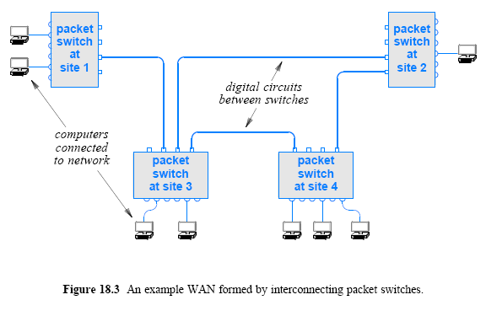
Forming a WAN

Slide 7
Store and Forward Paradigm
The goal of a WAN is to allow as many computers as possible to send packets simultaneously
The fundamental paradigm used to achieve simultaneous transmission is known as store and forward
To perform store and forward processing
  a packet switch buffers packets in memory
The store operation occurs when a packet arrives:
  I / O hardware in the switch places a copy of the packet in memory
The forward operation occurs once a packet has arrived and is waiting in memory. The processor
  examines the packet
  determines its destination
  and sends the packet over the I / O interface that leads to the destination

Slide 8
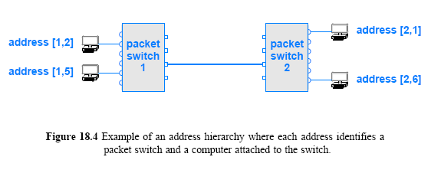
Addressing in a WAN
From the view of an attached computer
  a traditional WAN network operates similar to a LAN
  Each WAN technology defines the exact frame format a computer uses when sending and receiving data
  Each computer connected to a WAN is assigned an address
WANs addresses follow a key concept that is used in the Internet: hierarchical addressing
  Hierarchical addressing divides each address into two parts:
  (site, computer at the site)
  In practice, instead of a identifying a site, each packet switch is assigned a unique number
    first part of an address identifies a packet switch
    second part identifies a specific computer

Slide 9
Next-Hop Forwarding
What is the importance of hierarchical addressing?
When a packet arrives
  a switch must choose an outgoing path over which to forward it
If a packet is destined
  for a local computer
    the switch sends the packet directly to the computer
  Otherwise
    the packet must be forwarded over to another switch
To make the choice, a packet switch
  examines the destination address in the packet
  and extracts the packet switch number
    If the number in the destination address is identical to the packet switch's own ID the packet is intended for a computer on the local packet switch
    Otherwise, the packet is intended for a computer on another switch

Slide 10
Next-Hop Forwarding
A packet switch does not need to keep complete information about how to reach all possible computers
  nor does a switch need to compute the entire route a packet will follow
Instead, a switch bases forwarding on packet switch IDs
  which means that a switch only needs to know which outgoing link
A switch only needs to compute the next hop for a packet
The process is called next-hop forwarding
  and is analogous to the way airlines list flights
To make the computation efficient
  switches use table lookup
  that is, each packet switch contains a forwarding table
  such tables were originally called routing tables
    lists all possible packet switches and gives a next hop for each

Slide 11
Dynamic Routing Updates in a WAN
Forwarding table must guarantee the following:
Universal communication
  The forwarding table in each switch must contain a valid next-hop route for each possible destination address
Optimal routes
  In a switch, the next-hop value in the forwarding table for a given destination must point to the shortest path to the destination
Network failures further complicate forwarding
  For example, if two paths exist to a given destination and one of the paths becomes unavailable because hardware fails, forwarding should be changed to avoid the unavailable path
  A network manager cannot merely configure a forwarding table to contain static values that do not change
  Instead, software running on the packet switches continually tests for failures, and reconfigures the forwarding tables automatically

Slide 12
Dynamic Routing Updates in a WAN
We use the term routing software to describe software that automatically reconfigures forwarding tables
Route computation in a WAN is to think of a graph that models the network
  software uses the graph to compute the shortest path to all possible destinations
Each node in the graph corresponds to a packet switch in the network (individual computers are not part of the graph)
If the network contains a direct connection between a pair of packet switches
  the graph contains an edge or link between the corresponding nodes

Slide 13
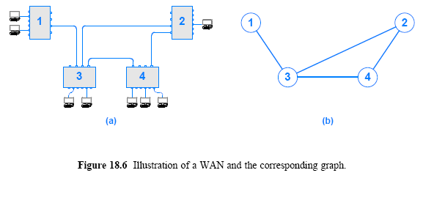
Dynamic Routing Updates in a WAN

Slide 14
Dynamic Routing Updates in a WAN
As Figure 18.6 shows, nodes in the graph are given a label that is the same as the number assigned to the corresponding packet switch
A graph representation is useful in computing next-hop forwarding
  because graph theory has been studied and efficient algorithms have been developed
  a graph abstracts away details, allowing routing software to deal with the essence of the problem
When it computes next-hop forwarding for a graph
  a routing algorithm must identify a link
Our examples will used the notation (k, j) to denote a link from node k to node j
  When a routing algorithm runs on the graph in Figure 18.6b
  The algorithm produces output as shown in Figure 18.7

Slide 15
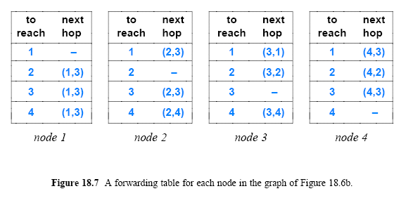
Dynamic Routing Updates in a WAN

Slide 16
Forwarding Table Computation
Basic approaches to construct forwarding tables?
Static routing
  A program computes and installs routes when a packet switch boots
  The routes do not change
Dynamic routing
  A program builds an initial forwarding table when a switch boots
  Program then alters the table as conditions in the network change
Each approach has advantages and disadvantages
  Advantages of static routing are simplicity and low overhead
  Disadvantage is inflexibility
    static routes cannot be changed when communication is disrupted
Large networks are designed with redundant connections to handle occasional hardware failures
  most WANs use a form of dynamic routing

Slide 17
Distributed Route Computation
Algorithm 18.2 shows how a forwarding table can be computed
  after information about a network is encoded in a graph
In practice, WANs need to perform distributed route computation
  Instead of a centralized program computing all shortest paths
    each packet switch must compute its own forwarding table locally
  All packet switches must participate in distributed route computation
There are two general forms:
  Link-State Routing (LSR), which uses Dijkstra's algorithm
  Distance-Vector Routing (DVR), which uses another approach

Slide 18
Distributed Route Computation
Link-State Routing (LSR)
Link-state routing or Link-status routing
  the approach also known as Shortest Path First (SPF) routing
  Dijkstra algorithm used it to characterize the way it works
    actually all routing algorithms find shortest paths
To use LSR, packet switches periodically send messages across the network that carry the status of a link
  For example, packet switches 5 and 9 measure the link between them and send a status message
    such as “the link between 5 and 9 is up”
  Each status message is broadcast to all switches
Every switch collects incoming status messages
  and uses them to build a graph of the network
Each switch then uses Algorithm 18.2 to produce a forwarding table by choosing itself as the source

Slide 19
Distributed Route Computation
Link-State Routing (LSR)
An LSR algorithm can adapt to hardware failures
If a link between packet switches fails
  the attached packet switches will detect the failure
  and broadcast a status message that specifies the link is down
All packet switches receive the broadcast
  change their copy of the graph to reflect the change in the link's status
  and re-compute shortest paths
Similarly, when a link becomes available again
  the packet switches connected to the link detect that it is working
  and start sending status messages that report its availability

Slide 20
Distributed Route Computation
Distance Vector Routing (DVR)
As with LSR, each link in the network is assigned a weight
The distance to a destination between two packet switches is defined to be the sum of weights along the path between the two
Like LSR, DVR arranges for packet switches to exchange messages periodically
In DVR, a switch sends a complete list of destinations and the current cost of reaching each
When it sends a DVR message
  a switch is sending a series of individual statements, of the form:
  “I can reach destination X, and its current distance from me is Y”

Slide 21
Distributed Route Computation
Distance Vector Routing (DVR)
DVR messages are not broadcast
  Each switch periodically sends a DVR message to its neighbors
Each message contains pairs of (destination, distance)
Each packet switch must keep a list of possible destinations
  along with the current distance to the destination and the next hop to use
  the list of destinations and the next hop for each can be found in the forwarding table
DVR software can be considered as maintaining an extension to the forwarding table
  that stores a distance for each destination

Slide 22
Distributed Route Computation
Distance Vector Routing (DVR)
When a message arrives at a switch from neighbor N
  the switch examines each item in the message
  and changes its forwarding table if the neighbor has a shorter path to some destination than the path currently being used
Example:
  if neighbor N advertises a path to destination D as having cost 5 and the current path through neighbor K has cost 100
    the current next hop for D will be replaced by N
    and the cost to reach D will be 5 plus the cost to reach N
Algorithm 18.3 specifies how routes are updated when using the distance-vector approach

Slide 23
Shortest Path Computation in a Graph
Once a graph has been created that corresponds to a network
  software uses a method known as Dijkstra's Algorithm
To find the shortest path from a source node to each of the other nodes in the graph:
  a next-hop forwarding table is constructed during the computation of shortest paths
  The algorithm must be run once for each node in the graph
  That is, to compute the forwarding table for packet switch P
    the node that corresponds to P is designated as the source node
    and the algorithm is run

Slide 24
Shortest Path Computation in a Graph
Dijkstra's algorithm is popular
  because it can be used with various definitions of shortest path
  In particular, the algorithm does not require edges in the graph to represent geographic distance. Instead, the algorithm
    allows each edge to be assigned a nonnegative value called a weight
    defines the distance between two nodes to be the sum of the weights along a path between the nodes
Figure 18.9 illustrates the concept of weights
  by showing an example graph with an integer weight assigned to each edge
  and a least-weight path between two nodes in the graph

Slide 25
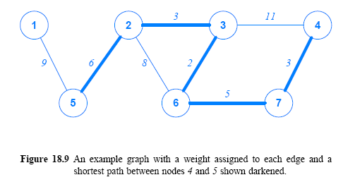
Shortest Path Computation in a Graph

Slide 26
Shortest Path Computation in a Graph
Dijkstra's algorithm maintains a set of nodes, S
  for which the minimum distance and next hop have not been computed
The set is initialized to all nodes except the source
The algorithm then iterates until set S is empty
On each iteration
  the algorithm removes a node from S that has the least distance from the source
  As it deletes node u, the algorithm examines the current distance from the source to each of the neighbors of u that remains in the set
  If a path from the source through u to the neighbor has less weight than the current path, the algorithm updates the distance to the neighbor
After all nodes have been removed from S
  the algorithm will have computed the minimum distance to each node and a correct next-hop forwarding table for all possible paths

Slide 27
Shortest Path Computation in a Graph
Dijkstra's algorithm needs 3 data structures to store:
  the current distance to each node
  the next hop for the shortest path
  and information about the remaining set of nodes
Nodes can be numbered from 1 to n as Figure 18.9
  which makes the implementation efficient
    because a node number can be used as an index into a data structure
The algorithm can use two arrays, D and R
  each indexed by the node number
  The i^{th} entry in array D stores a current value of the minimum distance from the source to node i
  The i^{th} entry in array R stores the next hop used to reach node i along the path being computed
  The set S can be maintained as a doubly linked list of node numbers
    which facilitates searching the entire set or deleting an entry

Slide 28
Shortest Path Computation in a Graph
Algorithm 18.2 uses weight (i, j) as a function
  that returns the weight of the edge from node i to node j
Function weight is assumed to return a reserved value infinity if no edge exists from node i to node j
  In practice, any value can be used to represent infinity provided the value is larger than the sum of weights along any path in the graph
  One way to generate a value infinity consists of adding one to the sum of all weights on all edges
Allowing arbitrary weights to be assigned to edges of a graph means that
  one algorithm can be used with different measures of distance
  For example, some WAN technologies measure distance by counting the number of packet switches along a path

Slide 29
Routing Problems
In theory, either LSR or DVR routing will compute shortest paths
Furthermore, each approach will eventually converge
  meaning that the forwarding tables in all packet switches agree
However, problems do occur
  For example, if LSR messages are lost, two packet switches can disagree about the shortest path
DVR problems can be more severe
  because a link failure can cause two or more packet switches to create a routing loop
    in which each packet switch thinks the next packet switch in the set is the shortest path to a particular destination
    As a result, a packet can circulate among the switches indefinitely

Slide 30
Routing Problems
One of the primary reasons DVR protocols exhibit problems comes from backwash
  (i.e., a packet switch receives information that it sent)
For example, suppose a switch tells its neighbors
  “I can reach destination D at cost 3”
  If the connection leading to destination D fails
    the switch will remove the entry for D from its forwarding table
    (or mark the entry invalid)
  But the switch has told neighbors that a route exists
Imagine that just after the link fails
  one of the neighbors sends a DVR message that specifies
  “I can reach destination D at cost 4”
Unfortunately
  the message will be believed
  and a routing loop will be created

Slide 31
Routing Problems
Most practical routing mechanisms contain constraints and heuristics to prevent problems like routing loops
For example, DVR schemes employ split horizon
  which specifies that a switch does not send information back to its origin
Furthermore, most practical routing systems introduce hysteresis
  that prevents the software from making many changes in a short time
However, in a large network where many links fail and recover frequently, routing problems can occur

Slide 32
Congestion Control Algorithms
Approaches to congestion control
Traffic-aware routing
Admission control
Traffic throttling
Load shedding

Slide 33
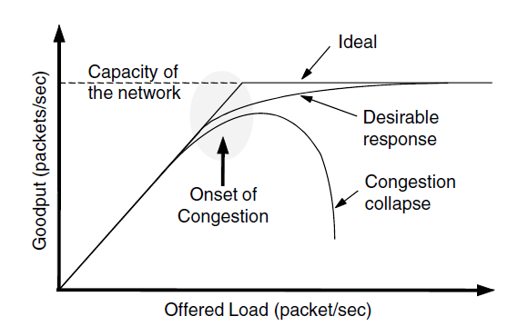
Congestion Control Algorithms
When too much traffic is offered, congestion sets in and performance degrades sharply

Slide 34
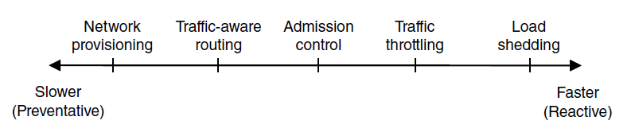
Approaches to Congestion Control
Provisioning
  Add resources
Traffic-Aware routing
  Tailor routes to specific traffic patterns
Admission Control
  Refuse new connections
Traffic Throttling
  Slow down the traffic itself (reduce the rate at which you transmit)
Load Shedding
  Discard packets

Slide 35
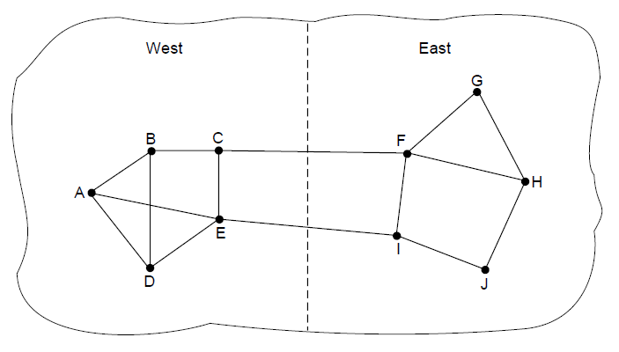
Traffic-Aware Routing

Slide 36
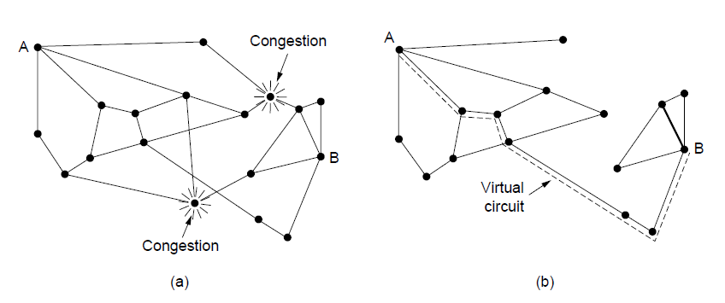
Traffic Throttling
(a) A congested network. (b) The portion of the network that is not congested. A virtual circuit from A to B is also shown.

Slide 37
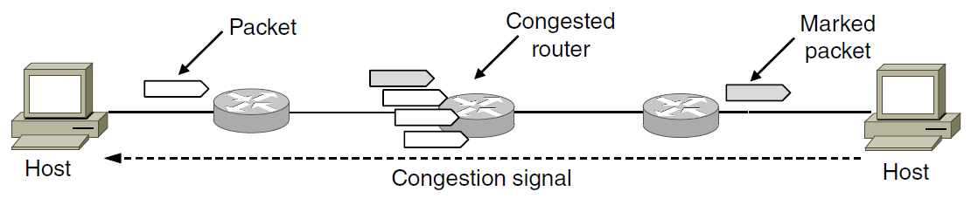
Traffic Throttling
Explicit congestion notification

Slide 38
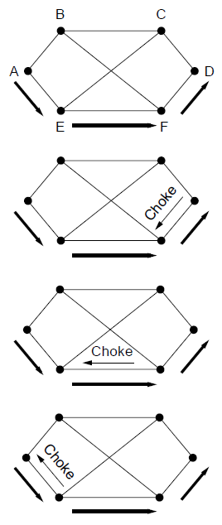
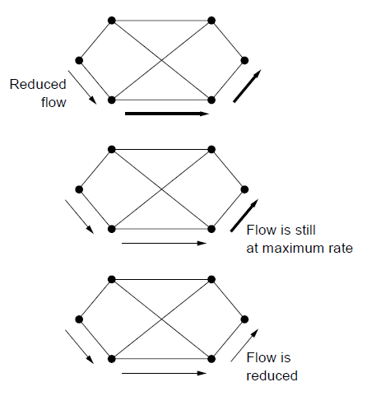
Load Shedding
A choke packet that affects only the source..

Slide 39
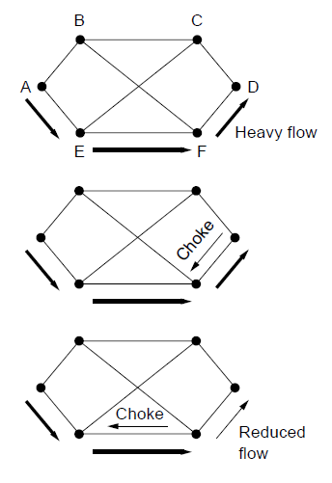
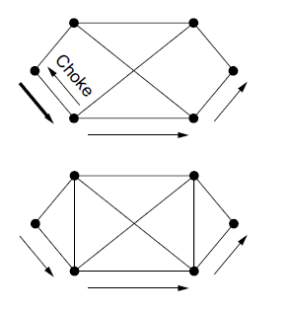
Load Shedding
A choke packet that affects each hop it passes through.

