Slide 1
Internetworking
Concepts, Architecture, and Protocols

Slide 2
Topics Covered
The Motivation for Internetworking
The Concept of Universal Service
Universal Service in a Heterogeneous World
Internetworking
Physical Network Connection with Routers
Internet Architecture
Achieving Universal Service
A Virtual Network
Protocols for Internetworking
Review of TCP/IP Layering
Host Computers, Routers, and Protocol Layers

Slide 3
The Motivation for Internetworking
Each network technology is designed to fit a specific set of constraints
  LAN technologies are designed to provide high-speed communication across short distances
  WAN technologies are designed to provide communication across large areas
No single networking technology is best for all needs!
  A large organization with diverse networking requirements needs multiple physical networks
  If the organization chooses the type of network that is best for each task, the organization will have several types of networks
    For example, a LAN technology like Ethernet might be the best solution for connecting computers at a given site
    A leased data circuit might be used to interconnect a site in one city with a site in another

Slide 4
The Concept of Universal Service
Most modern computer communication systems allow communication between any two computers
  analogous to the way a telephone system provides communication between any two telephones, known as universal service
With universal service
  a user on any computer in any organization can send messages or data to any other user

Slide 5
The Concept of Universal Service
The chief problem with multiple networks is obvious:
  A computer attached to a given network can only communicate with other computers attached to the same network
  The problem became evident in the 1970s as large organizations began to acquire multiple networks
  Each network in the organization formed an island
In many early installations
  Each computer attached to a single network
  Employees had to choose a computer appropriate for each task
  Employee was given access to multiple screens and keyboards
    the employee was forced to move from one computer to another to send a message across the appropriate network
  Users are neither satisfied nor productive when they must use a separate computer for each network

Slide 6
Universal Service in a Heterogeneous World
Does universal service mean that everyone needs to adopt a single network technology?
  or is it possible to have universal service across multiple networks that use multiple technologies?
Incompatibilities make it impossible to form a large network merely by interconnecting the wires among networks
Furthermore, extension techniques such as bridging cannot be used with heterogeneous network technologies
  each technology uses its own packet format and addressing scheme
  a frame created for one network technology cannot be transmitted on a network that uses a different technology

Slide 7
Internetworking
Despite the incompatibilities among network technologies
  researchers have devised a scheme that provides universal service among heterogeneous networks, called internetworking
The scheme uses both hardware and software
  Additional systems are used to interconnect a set of networks
  Software on the attached computers provides universal service
  The resulting system of connected physical networks is known as an internetwork or internet
An internet is not restricted in size
  internets exist that contain a few networks
  the global Internet contains tens of thousands of networks
  the number of computers attached to each network can vary
    some networks have no computers attached
    while others have hundreds

Slide 8
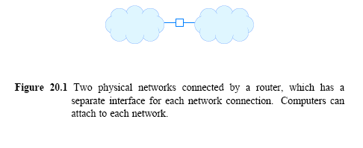
Physical Network Connection with Routers
The basic component used to connect heterogeneous networks is a router
Physically a router is
  an independent hardware system dedicated to the task of interconnecting networks
  contains a processor and memory as well as a separate I/O interface for each network to which it connects

Slide 9
Physical Network Connection with Routers
The figure uses a cloud to depict each network
Router connections are not restricted to a network technology
  Each cloud represents an arbitrary network technology
A router can connect
  two LANs
  a LAN and a WAN
  or two WANs
When a router connects two networks in the same general category
  the networks do not need to use the same technology
  for example
    a router can connect an Ethernet to a Wi-Fi network

Slide 10
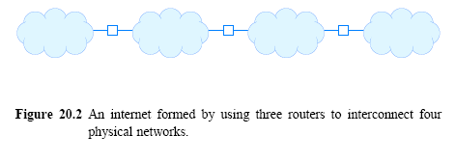
Internet Architecture
Organizations choose network technologies appropriate for each need
  and to use routers to connect all networks
Figure 20.2 (below) illustrates how three routers can be used to connect four arbitrary physical networks into an internet

Slide 11
Internet Architecture
Figure 20.2 shows each router with exactly two connections
  commercial routers can connect more than two networks
  a single router could connect all four networks in the example
An organization seldom uses a single router to connect all of its networks
There are reasons for multiple connections:
Load-balancing and speed
  the processor in a given router is insufficient to handle the traffic passing among an arbitrary number of networks
Redundancy improves internet reliability
  To avoid a single point of failure
    The protocol software continuously monitors internet connections
    It instructs routers to send traffic along alternative paths when a network or router fails

Slide 12
Internet Architecture
An organization must choose a design that meets the organization's need for
  Reliability
  Capacity
  Cost
The exact details of internet topology to be chosen often depend on the following
  bandwidth of the physical networks
  expected traffic
  organization's reliability requirements
  cost
  performance of available router hardware

Slide 13
Achieving Universal Service
Routers must agree to forward information
The task is complex because
  frame formats and addressing schemes used by the underlying networks can differ
Protocol software makes universal service possible
  Later chapters describe Internet protocol software in detail
  when written with an uppercase I, the term Internet refers to the current global Internet and the associated protocols
Internet protocols overcome differences in frame formats and physical addresses
  to make communication possible among networks that use different technologies

Slide 14
A Virtual Network
Internet provides the appearance of a single seamless communication system
  a combination of hardware and software provides the illusion of a uniform network system
Internet software hides the details of
  physical network connections
  physical addresses
  routing information
Users/application programs are not supposed to be aware of the underlying physical networks or the routers that connect
We say that an internet is a virtual network system
  because the communication system is an abstraction

Slide 15
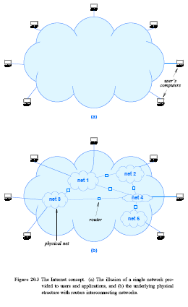
A Virtual Network
Figure 20.3 The Internet concept:
The illusion of a single network provided to users and applications
the underlying physical structure with routers interconnecting networks

Slide 16
Protocols for Internetworking
Several protocols have been proposed for use with internets
  The TCP/IP Internet Protocol suite is the most widely used one
Networking professionals simply refer to the suite as TCP/IP
  TCP and IP are acronyms for two of the most important protocols
TCP/IP was developed at the same time as the Internet
  The same researchers who proposed TCP/IP also proposed the Internet architecture described above
  Work on TCP/IP began in the 1970s
    approximately the same time that LANs were being developed
  Work continued until the early 1990s when the Internet became commercial

Slide 17
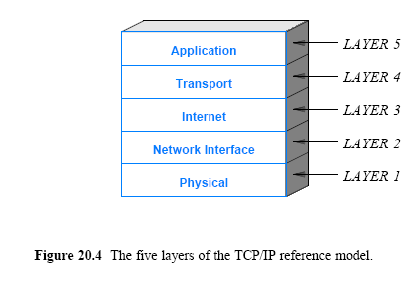
Review of TCP/IP Layering
Recall from Chapter 1 that the Internet protocols use a five-layer reference model as Figure 20.4 illustrates

Slide 18
Review of TCP/IP Layering
We have already explored three of the layers
Chapters in this part of the text consider the two remaining layers in detail:
Layer Internet
  Layer 3 (IP) specifies the format of packets sent across the Internet
  Also specifies mechanisms used to forward packets
Layer Transport
  Layer 4 (TCP) specifies the messages
  Provides procedures that are used to insure reliable transfer

Slide 19
Host Computers, Routers, and Protocol Layers
Host computer to refer to a computer that connects to the Internet and runs applications
A host can be as small as a cell phone or as large as a mainframe
  a host's CPU can be slow or fast
  the memory can be large or small
  and the network can operate at high or low speed
TCP/IP protocols make it possible for any pair of hosts to communicate
  despite hardware differences
Both hosts and routers need TCP/IP protocol software
  However, routers do not use protocols from all layers
    a router does not need layer 5 protocols
    because routers do not run conventional applications

