Slide 1
Internetworking
IP: Internet Addressing

Slide 2
Topics Covered
Addresses for the Virtual Internet
The IP Addressing Scheme
The IP Address Hierarchy
Original Classes of IP Addresses
Dotted Decimal Notation
Division of the Address Space
Authority for Addresses
Subnet and Classless Addressing
Address Masks
CIDR Notation
A CIDR Example
CIDR Host Addresses
Special IP Addresses
Summary of Special IP Addresses
Routers and the IP Addressing Principle
Multi-Homed Hosts

Slide 3
Addresses for the Virtual Internet
Addressing is a critical component of the Internet
All host computers must use a uniform addressing scheme
Each address must be unique
MAC addresses do not suffice because
  the Internet can include multiple network technologies
  and each technology defines its own MAC addresses
The advantage of IP addressing lies in uniformity:
  an arbitrary pair of application programs can communicate without knowing the type of network hardware or MAC addresses being used
IP addresses are supplied by protocol software
  They are not part of the underlying network
Many layers of protocol software use IP addresses

Slide 4
The IP Addressing Scheme
Each host is assigned a unique 32-bit number
  known as the host's IP address or Internet address
When sending a packet across the Internet, sender’s protocol software must specify
  its own 32-bit IP address (the source address)
  and the address of the intended recipient (the destination address)

Slide 5
The IP Address Hierarchy
IP address is divided into two parts:
A prefix
  identifies the physical network to which the host is attached
  Each network in the Internet is assigned a unique network number
A suffix
  identifies a specific computer (host/node) on the network
  Each computer on a given network is assigned a unique suffix
IP address scheme guarantees two properties:
  Each computer is assigned a unique address
  (i.e., a single address is never assigned to more than one computer)
  Network number (prefix) assignments must be coordinated globally
  Suffixes are assigned locally without global coordination

Slide 6
Original Classes of IP Addresses
Internet contains a few large physical networks and many small networks
  the designers chose an addressing scheme to accommodate a combination of large and small networks
The original classful IP addressing divided the IP address space into three (3) primary classes
  each class has a different size prefix and suffix
The first four bits of an IP address determined the class to which the address belonged
  It specifies how the remainder of the address was divided into prefix and suffix
Figure 21.1 illustrates the five address classes
  the leading bits used to identify each class
  and the division into prefix and suffix

Slide 7
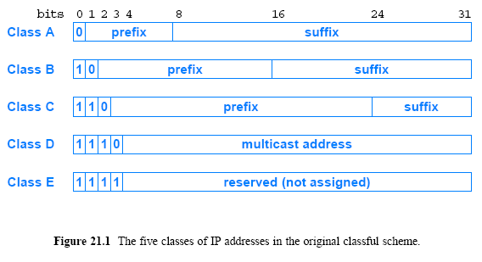
Original Classes of IP Addresses

Slide 8
Dotted Decimal Notation
A notation more convenient for humans to understand is used
Notation that has been accepted is
  express each 8-bit section of a 32-bit number as a decimal value
  use periods to separate the sections
  The scheme is known as dotted decimal notation
Figure 21.2 illustrates examples of binary numbers and the equivalent dotted decimal notation
Dotted decimal treats each octet (byte) as an unsigned binary integer
  the smallest value, 0
    occurs when all bits of an octet are zero (0)
  the largest value, 255
    occurs when all bits of an octet are one (1)
  dotted decimal addresses range
  0.0.0.0 through 255.255.255.255

Slide 9
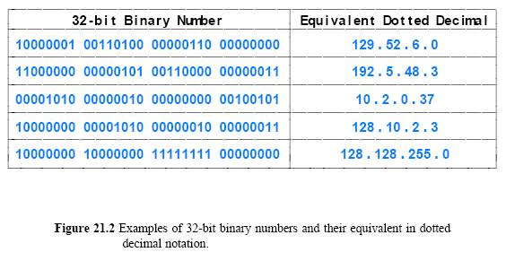
Dotted Decimal Notation

Slide 10
Division of the Address Space
The classful scheme divided the address space into unequal sizes
The designers chose an unequal division to accommodate a variety of scenarios
  For example, although it is limited to 128 networks, class A contains half of all addresses
    The motivation was to allow major ISPs to each deploy a large network that connected millions of computers
  Similarly, the motivation for class C was to allow an organization to have a few computers connected on a LAN
Figure 21.3 summarizes the maximum number of networks available in each class and the maximum number of hosts per network

Slide 11
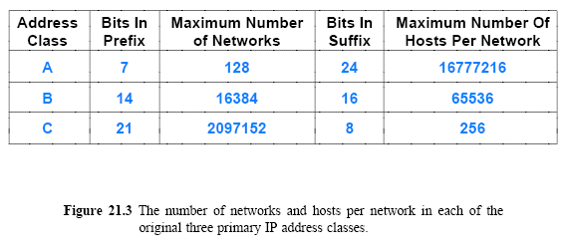
Division of the Address Space

Slide 12
Address Space Authority
Internet Corporation for Assigned Names and Numbers (ICANN) authority has been established
  to handle address assignment and adjudicate disputes
ICANN does not assign individual prefixes
  Instead, ICANN authorizes a set of registrars to do so
Registrars make blocks of addresses available to ISPs
  ISPs provide addresses to subscribers

Slide 13
Subnet and Classless Addressing
As the Internet grew
  the original classful addressing scheme became a limitation
Everyone demanded a class A or class B address
  So they would have enough addresses for future growth
    but many addresses in class A and B were unused
  Many class C addresses remained, but few wanted to use them
Two mechanisms were invented to overcome the limitation:
  Subnet addressing
  Classless addressing
The two mechanisms are closely related
  they can be considered to be part of a single abstraction:
    instead of having three distinct address classes, allow the division between prefix/suffix on an arbitrary bit boundary

Slide 14
Subnet and Classless Addressing
Subnet addressing was initially used within large organizations
Classless addressing extended the approach to all Internet
The motivation for using an arbitrary boundary?
Consider an ISP that hands out prefixes. And suppose a customer of the ISP requests a prefix for a network that contains 35 hosts
  classfull addressing requires a complete class C prefix
  only 6 bits of suffix are needed to represent all possible host values
    means 219 of the 254 possible suffixes would never be assigned
  most of the class C address space is wasted
For the above example
  classless addressing allows the ISP to assign
    a prefix that is 26 bits long
    a suffix that is 6 bits long

Slide 15
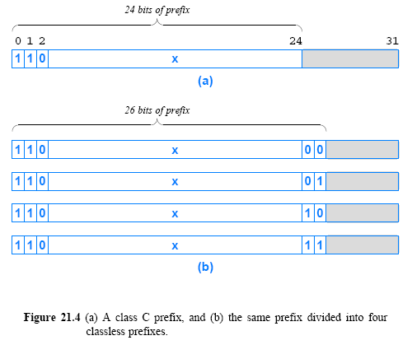
Subnet and Classless Addressing

Slide 16
Address Masks
How can an IP address be divided at an arbitrary boundary?
The classless and subnet addressing schemes require hosts and routers to store an additional piece of information:
  a value that specifies the exact boundary between the network prefix and the host suffix
To mark the boundary, IP uses a 32-bit value
  known as an address mask, also called a subnet mask
Why store the boundary size as a bit mask?
  A mask makes processing efficient
Hosts and routers need to compare the network prefix portion of the address to a value in their forwarding tables
  The bit-mask representation makes the comparison efficient

Slide 17
Address Masks
Suppose a router is given
  a destination address, D
  a network prefix represented as a 32-bit value, N
  a 32-bit address mask, M
Assume the top bits of N contain a network prefix, and the remaining bits have been set to zero
To test whether the destination lies on the specified network, the router tests the condition:
N == (D & M)
The router
  uses the mask with a “logical and (&)” operation to set the host bits of address D to zero (0)
  and then compares the result with the network prefix N

Slide 18
Address Masks
As an example:
Consider the following 32-bit network prefix:
  10000000 00001010 00000000 00000000 = 128.10.0.0
Consider a 32-bit mask:
  11111111 11111111 00000000 00000000 = 255.255.0.0
Consider a 32-bit destination address, which has a
  10000000 00001010 00000010 00000011 = 128.10.2.3
A logical and between the destination address and the address mask extracts the high-order 16-bits
  10000000 00001010 00000000 00000000 = 128.10.0.0

Slide 19
CIDR Notation
Classless Inter-Domain Routing (CIDR)
  The name is unfortunate because CIDR only specifies addressing and forwarding
  Designers wanted to make it easy for a human to specify a mask
Consider the mask needed for the example in Figure 21.4b
  It has 26 bits of 1s followed by 6 bits of 0s
  In dotted decimal, the mask is: 255.255.255.192
The general form of CIDR notation is: ddd.ddd.ddd.ddd/m
  ddd is the decimal value for an octet of the address
  m is the number of one bits in the mask
Thus, one might write the following: 192.5.48.69/26
  which specifies a mask of 26 bits

Slide 20
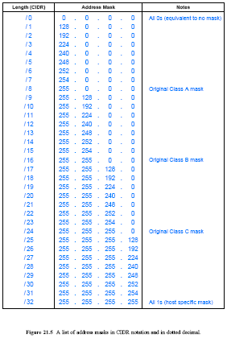
Figure 21.5
A list of address masks in CIDR notation and in dotted decimal

Slide 21
A CIDR Example
Assume an ISP has the following block 128.211.0.0/16
Suppose the ISP has 2 customers
  one customer needs 12 IP addresses and the other needs 9
The ISP can assign
  customer1 CIDR: 128.211.0.16/28
  customer2 CIDR: 128.211.0.32/28
  both customers have the same mask size (28 bits), the prefixes differ
The binary value assigned to customer1 is:
  10000000 11010011 00000000 0001 0000
The binary value assigned to customer2 is:
  10000000 11010011 00000000 0010 0000
There is no ambiguity
  Each customer has a unique prefix
  More important, the ISP retains most of the original address block
    it can then allocate to other customers

Slide 22
CIDR Host Addresses
Once an ISP assigns a customer a CIDR prefix
  the customer can assign host addresses for its network users
  suppose an organization is assigned 128.211.0.16/28
Figure 21.6 illustrates that the organization will have 4-bits to use as a host address field
  It shows the highest/lowest addresses in binary and dotted decimal
  The example avoids assigning the all 1s and all 0s host addresses
Figure 21.6 illustrates a disadvantage of classless addressing
Because the host suffix can start on an arbitrary boundary
  values are not easy to read in dotted decimal
  For example
    when combined with the network prefix, the 14 possible host suffixes result in dotted decimal values from 128.211.0.17 through 128.211.0.30

Slide 23
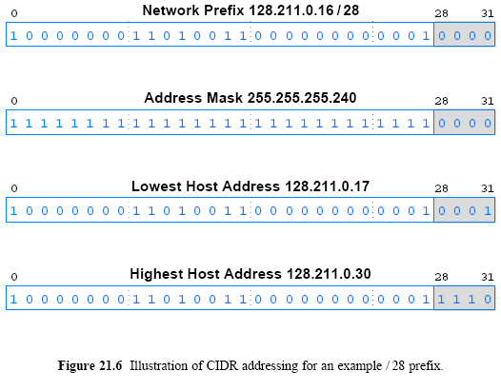
CIDR Host Addresses

Slide 24
Special IP Addresses
IP defines a set of special address forms that are reserved
  That is, special addresses are never assigned to hosts
This section describes both the syntax and semantics of each special address form
  Network Address
  Directed Broadcast Address
  Limited Broadcast Address
  This Computer Address
  Loopback Address

Slide 25
Special IP Addresses
One of the motivations for defining special address forms can be seen in Figure 21.6
It is convenient to have an address that can be used to denote the prefix assigned to a given network
IP reserves host address zero
  and uses it to denote a network
Thus, the address 128.211.0.16/28 denotes a network
  because the bits beyond the 28 are zero
A network address should never appear as the destination address in a packet
Note: Section 21.16 discusses the Berkeley broadcast address form, which is a nonstandard exception

Slide 26
Special IP Addresses
To simplify broadcasting (send to all)
  IP defines a directed broadcast address for each physical network
When a packet is sent to a network's directed broadcast
  a single copy of the packet travels across the Internet
    until it reaches the specified network
  the packet is then delivered to all hosts on the network
The directed broadcast address for a network is formed by adding a suffix that consists of all 1 bits to the network prefix
How does broadcast work?
If network hardware supports broadcast
  a directed broadcast will be delivered using the hardware broadcast capability
If a particular network does not have hardware support for broadcast
  software must send a separate copy of the packet to each host on the network

Slide 27
Special IP Addresses
Limited broadcast refers to a broadcast on a directly-connected network:
  informally, we say that the broadcast is limited to a “single wire”
Limited broadcast is used during system startup
  by a computer that does not yet know the network number
IP reserves the address consisting of 32-bits of 1s
  refer to limited broadcast
Thus, IP will broadcast any packet sent to the all-1s address across the local network

Slide 28
Special IP Addresses
A computer needs to know its IP address
  before it can send or receive Internet packets
TCP/IP contains protocols a computer can use to obtain its IP address automatically when the computer boots
  The startup protocols also use an IP to communicate
When using such startup protocols
  a computer cannot supply a correct IP source address
  To handle such cases
    IP reserves the address that consists of all 0s to mean this computer

Slide 29
Special IP Addresses
Loopback address used to test network applications
It is used for preliminary debugging after a network application has been created
A programmer must have two application programs that are intended to communicate across a network
  Each application includes the code needed to interact with TCP/IP
Instead of executing each program on a separate computer
  the programmer runs both programs on a single computer
  and instructs them to use a loopback address when communicating
When one application sends data to another
  data travels down the protocol stack to the IP software
  then forwards it back up through the protocol stack to the second program

Slide 30
Special IP Addresses
A programmer can test the program logic quickly
  without needing two computers and without sending packets across a network
IP reserves the network prefix 127/8 for use with loopback
The host address used with 127 is irrelevant
  all host addresses are treated the same
  programmers often use host number 1
  so it makes 127.0.0.1 the most popular loopback address
During loopback testing no packets ever leave a computer
  the IP software forwards packets from one application to another
The loopback address never appears in a packet traveling across a network

Slide 31
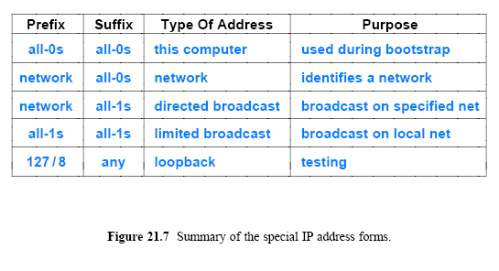
Special IP Addresses

Slide 32
Routers and the IP Addressing Principle
Each router is assigned two or more IP addresses
  one address for each network to which the router attaches
To understand why, recall two facts:
  A router has connections to multiple physical networks
  Each IP address contains a prefix that specifies a physical network
A single IP address does not suffice for a router
  because each router connects to multiple networks
  and each network has a unique prefix
The IP scheme can be explained by a principle:
  An IP address does not identify a specific computer
  each address identifies a connection between a computer and a network
  A computer with multiple network connections (e.g., a router) must be assigned one IP address for each connection

Slide 33
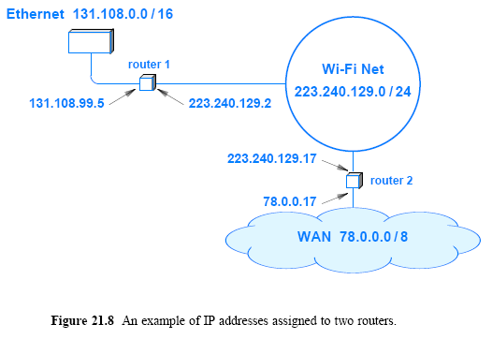
Routers and the IP Addressing Principle

Slide 34
Multi Homed Hosts
Can a host connect to multiple networks? Yes
A host computer with multiple network connections is said to be multi-homed
Multi-homing is sometimes used to increase reliability
  if one network fails, the host can still reach the Internet through the second connection
Alternatively, multi-homing is used to increase performance
  connections to multiple networks can make it possible to send traffic directly and avoid routers, which are sometimes congested
Like a router, a multi-homed host has multiple protocol addresses
  one for each network connection

Slide 35
Host Computers, Routers, and Protocol Layers
Host computer to refer to a computer that connects to the Internet and runs applications
A host can be as small as a cell phone or as large as a mainframe
  a host's CPU can be slow or fast
  the memory can be large or small
  and the network can operate at high or low speed
TCP/IP protocols make it possible for any pair of hosts to communicate
  despite hardware differences
Both hosts and routers need TCP/IP protocol software
  However, routers do not use protocols from all layers
    a router does not need layer 5 protocols
    because routers do not run conventional applications

